Slide 1
14
My bedroom
Lesson 1 – Part 1,2,3

Slide 2
①
Warm-up and review
②
Look, listen and repeat.
③
Listen, point and say.
④
Let’s talk.
⑤
Fun corner and wrap-up

Slide 3
Lesson 1
Period 1
①
Warm-up and review

Slide 4
Game: What room is this?
Look and guess
Notes:
Open the coloured squares and guess the room behind.

Slide 5
living room
SHOW

Slide 6
bathroom
SHOW

Slide 7
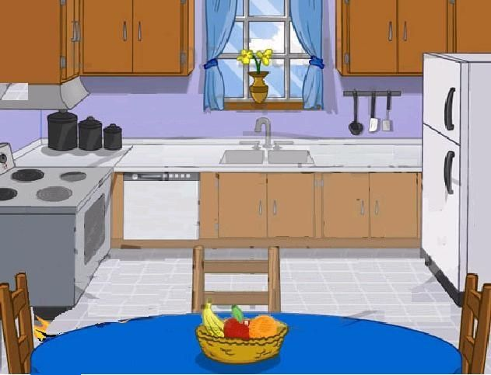
kitchen
SHOW

Slide 8
bedroom
SHOW

Slide 9
Lesson 1
Period 1
②
Look, listen and repeat.

Slide 11
Lesson 1
Period 1
③
Listen, point and say.

Slide 12
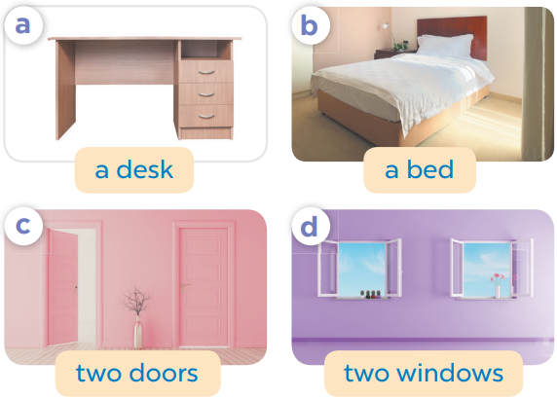
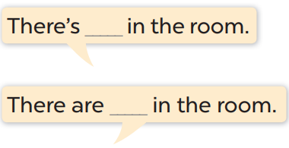

Slide 13
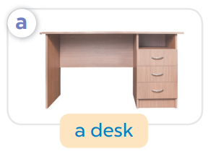
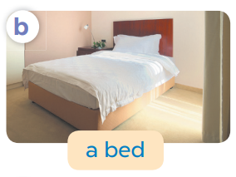
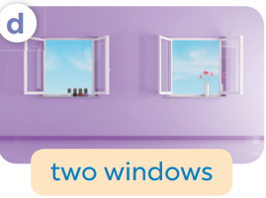
Game: What’s missing?
Notes:
Game: What’s missing?
T divides the class into 2 teams: BOYS and GIRLS.
T shows 4 pictures on the board. Take out 1, then 2 pictures then ask pupils to find out what is/ are missing.
Members of each team try to say out loud the missing room as fast as possible.

Slide 14
What’s missing?

Slide 15
What’s missing?

Slide 16
What’s missing?

Slide 17
What’s missing?

Slide 18
What’s missing?
What’s missing?

Slide 19
What’s missing?
What’s missing?

Slide 20
What’s missing?
What’s missing?

Slide 21
What’s missing?
What’s missing?

Slide 22
What’s missing?
What’s missing?

Slide 23
What’s missing?
What’s missing?

Slide 24
Lesson 1
Period 1
④
Let’s talk.

Slide 25
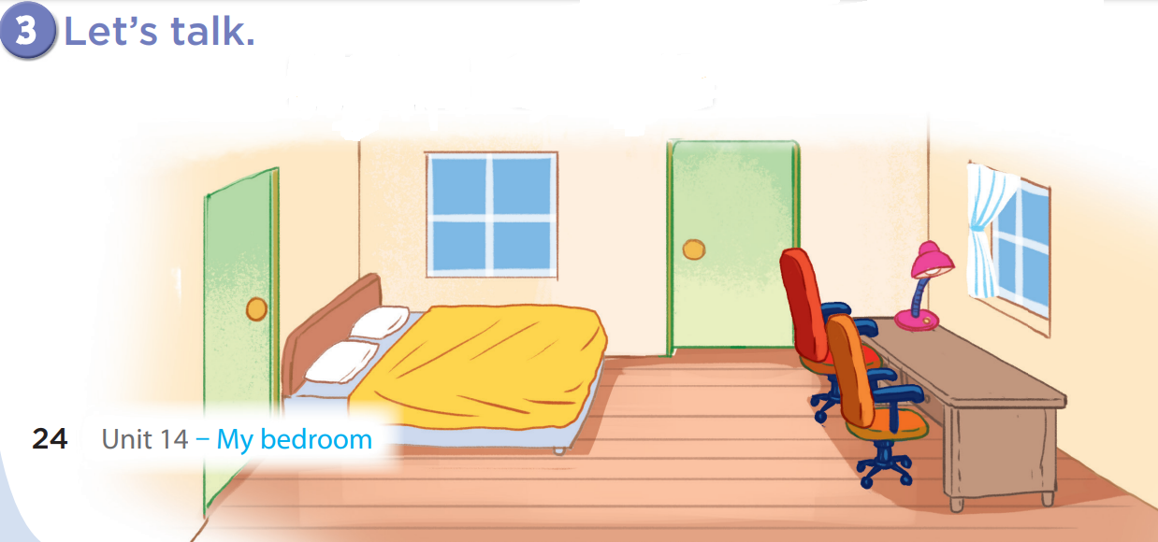
There are
two windows.
There is a bed.

Slide 26
There are
two doors.
There is a desk.

Slide 27
There are
two chairs.
There is a lamp.

