Slide 1
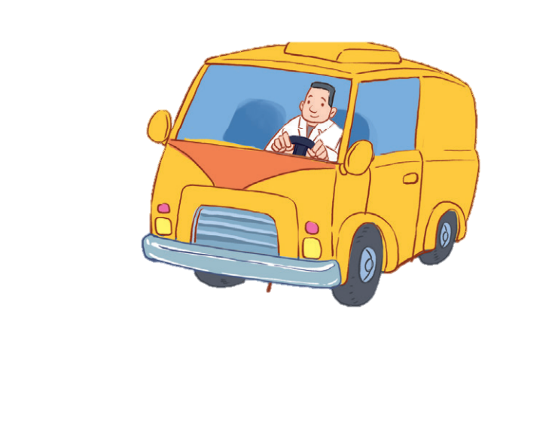
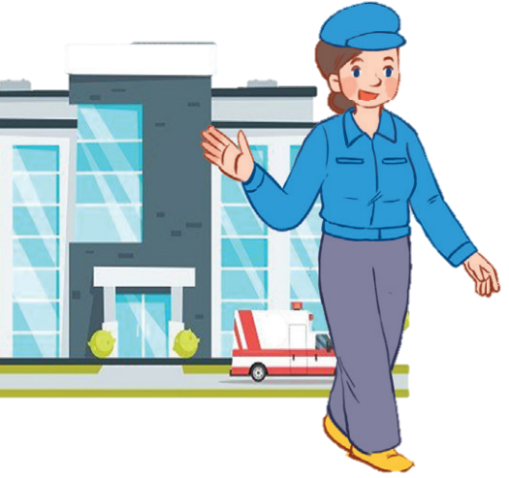
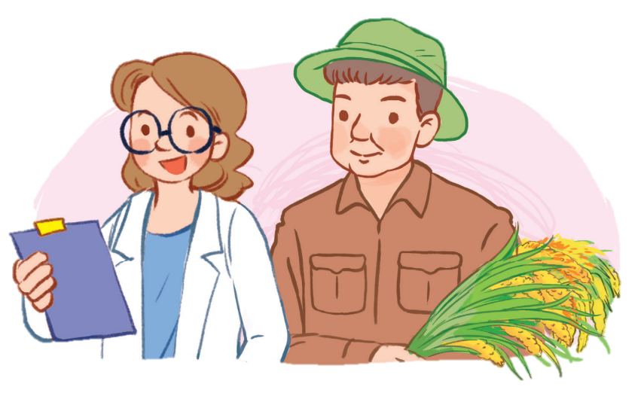
12
LESSON 3 – Part 1,2,3

Slide 2
Contents
Warm-up and review
Listen and repeat.
Listen and circle.
Let’s chant.
1
2
3
4
5
Fun corner and wrap-up

Slide 3
1
Warm-up and review

Slide 4
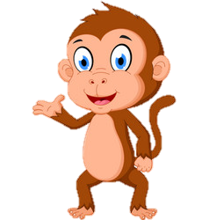
Picking coconut
Notes:
Step 1: Divide the class into 4 teams.
Step 2: Invite one pupil from each team to the front, listen to the recording and choose the right answer.
Step 3: Encourage pupils to join in the game.
Step 4: Give points to pupils.

Slide 5
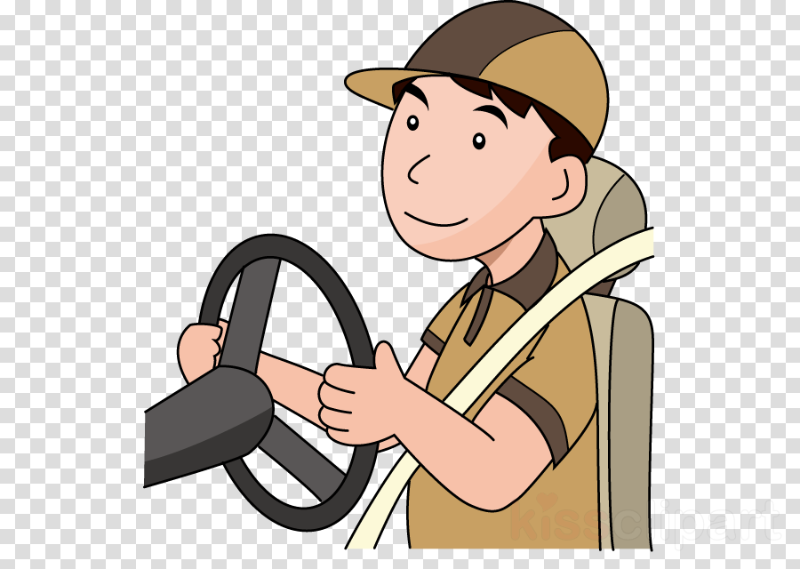
Look and click on the right coconut!
farmer
driver
doctor
We did it!
driver

Slide 6
Look and click on the right coconut!
nurse
worker
driver
We did it!
nurse

Slide 7
Look and click on the right coconut!
teacher
doctor
cook
We did it!
cook

Slide 8
Look and click on the right coconut!
singer
teacher
doctor
We did it!
teacher

Slide 9
Look and click on the right coconut!
nurse
farmer
teacher
We did it!
farmer

Slide 10
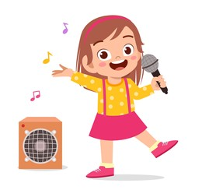
Look and click on the right coconut!
worker
doctor
singer
We did it!
singer

Slide 11
Look and click on the right coconut!
worker
cook
driver
We did it!
worker

Slide 12
Look and click on the right coconut!
singer
doctor
worker
We did it!
doctor

Slide 13
2
Listen and repeat.

Slide 15
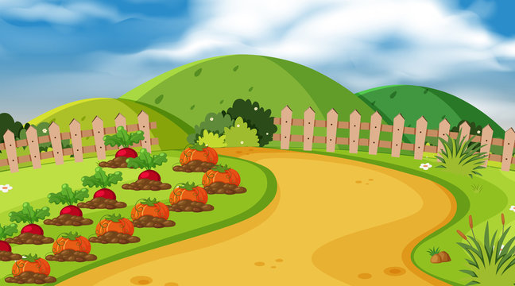
Listen and choose.
mother
or
er
doctor
Notes:
Game: Listen and choose.
Divide the class into 2 groups. Let the pupils listen to the recording, then choose the correct word.

Slide 16
Listen and choose.
or
mother
doctor
ch

Slide 17
Listen and choose.
th
or
mother
doctor

Slide 18
Listen and choose.
er
m
doctor
mother

Slide 19
3
Listen and circle.

Slide 22
4
Let’s chant.

Slide 23
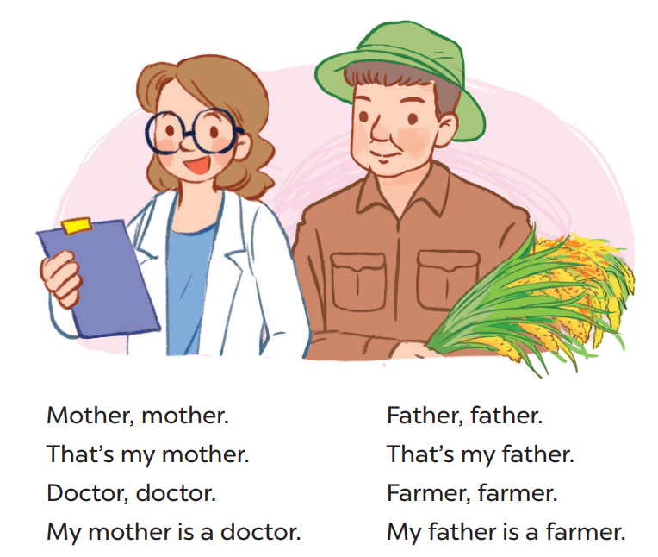

Slide 24
5
Fun corner and wrap-up

Slide 25
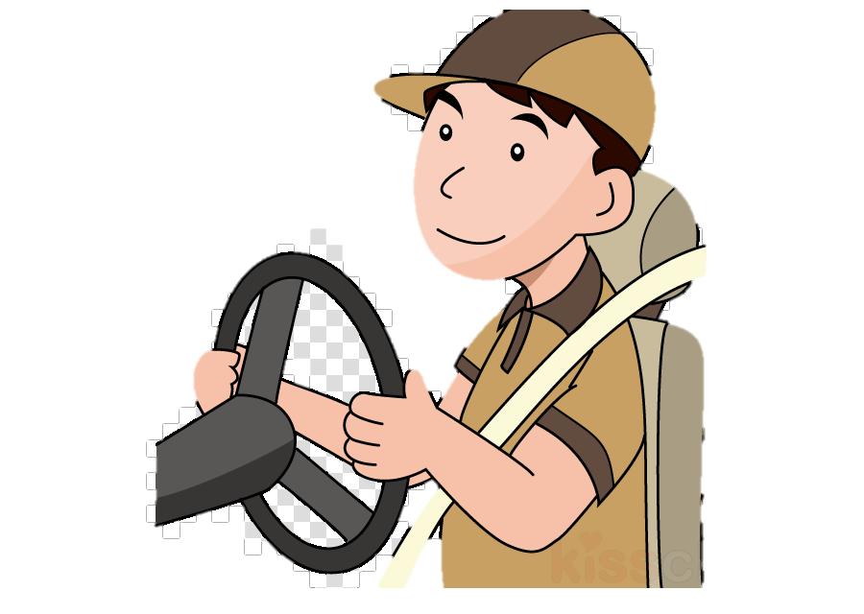
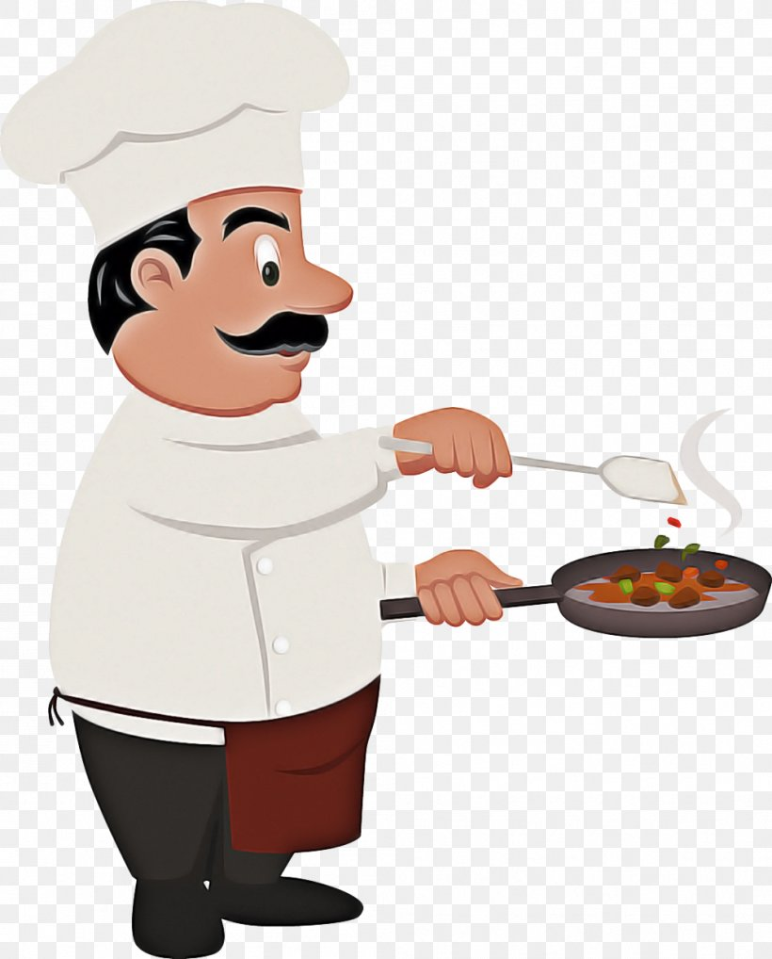
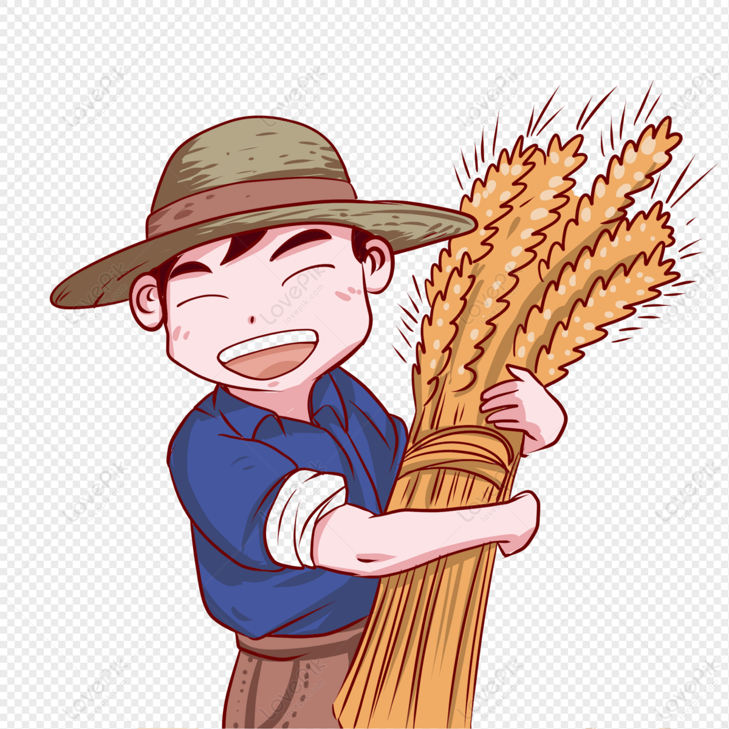
Game time: Guessing
1
2
3
4
5
6
7
8
points
Notes:
Step 1: Divide the class into 4 teams.
Step 2: Look at the cards (1-8), there are pictures behind them. Let pupils guess the jobs in the pictures. (Spin the lucky wheel to get points.)
Step 3: Encourage pupils to take part in the game and practice speaking English.
Step 4: Give points to pupils.

Slide 26
LUCKY WHEEL
5
20
15
10
Team 1
SPIN
Team 2
5
15
Team 3
20
10
Team 4
Pictures
Next activity

