Slide 1
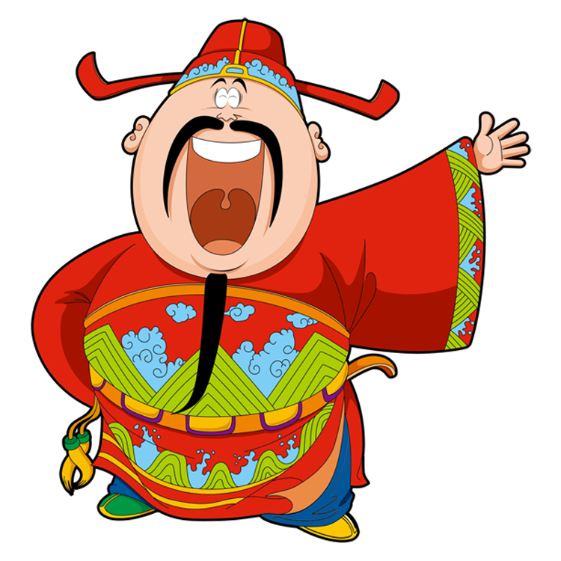
Lucky Money

Slide 2
2
6
3
7
1
5
10
8
4
9

Slide 3
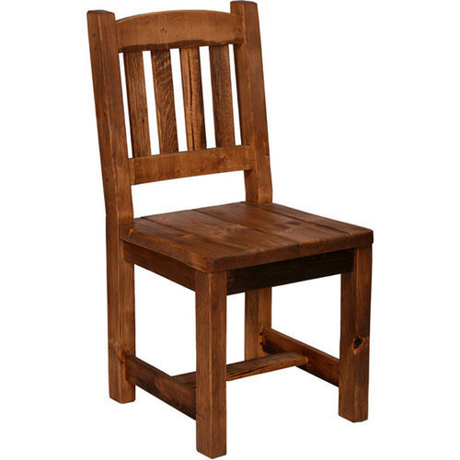
Where’s the chair?
A.
It’s here.
It’s there.
B.

Slide 4
Where’s the table?
A.
It’s here.
It’s there.
B.

Slide 5
Where’s the ball?
A.
It’s there.
It’s here.
B.

Slide 6
Where’s the coat?
A.
It’s here.
It’s there.
B.

Slide 7
Where’s the bed?
A.
Where it the bed?.
Where is the bed?
B.

Slide 8
Lucky Money
You’re lucky!

Slide 9
Lucky Money
You’re lucky!

Slide 10
Lucky Money
You’re lucky!

Slide 11
It’s here.
It is here.
A.
It are there.
B.

Slide 12
It’s there.
It is here.
A.
It is there.
B.

Slide 13
Thank you
and
Happy New Year

