Slide 1

Unit 10
Our school trip
Lesson 1 - Period 2

Slide 2
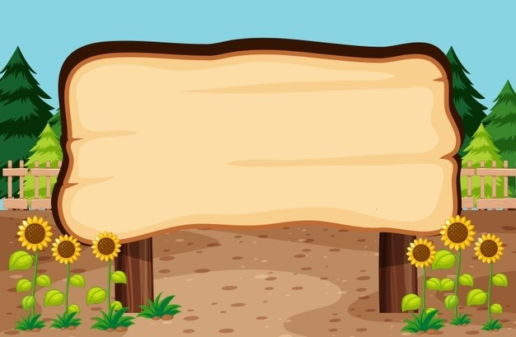

01
Warm-up and Review

Slide 3


MATCHING
GAME

Slide 4
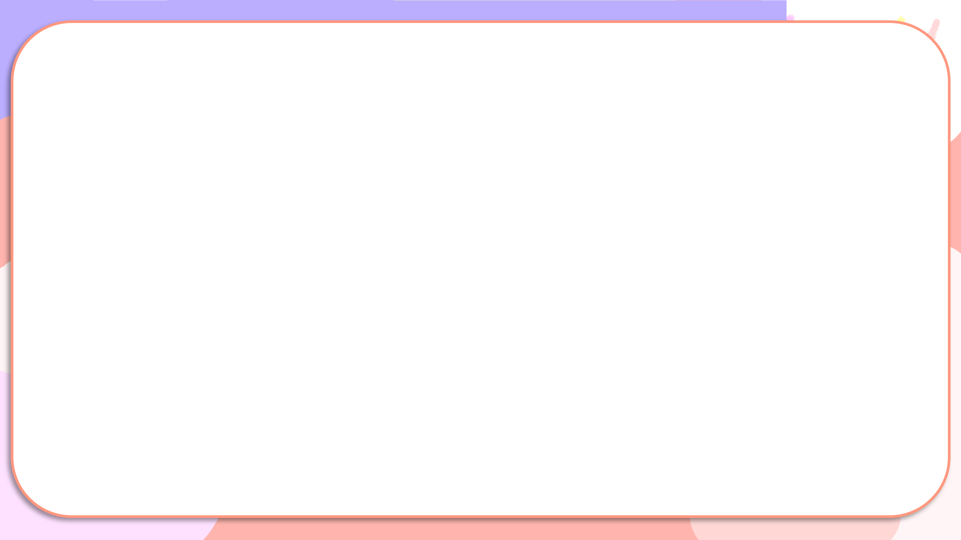


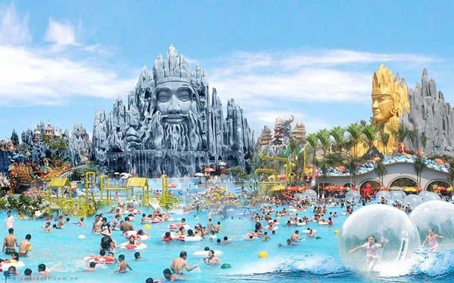
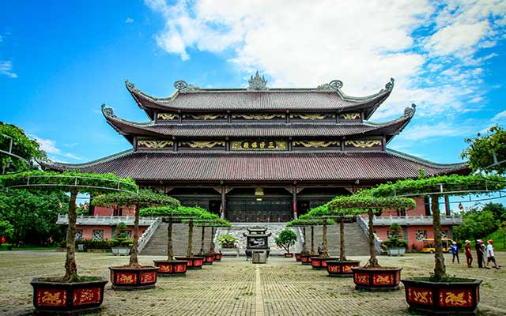
Matching
1
2
3
4
a
b
c
d
Hoan Kiem Lake
Ba Na Hills
Bai Dinh Pagoda
Suoi Tien Theme Park

Slide 5
02
Activity 1.
Listen and tick or cross

Slide 6
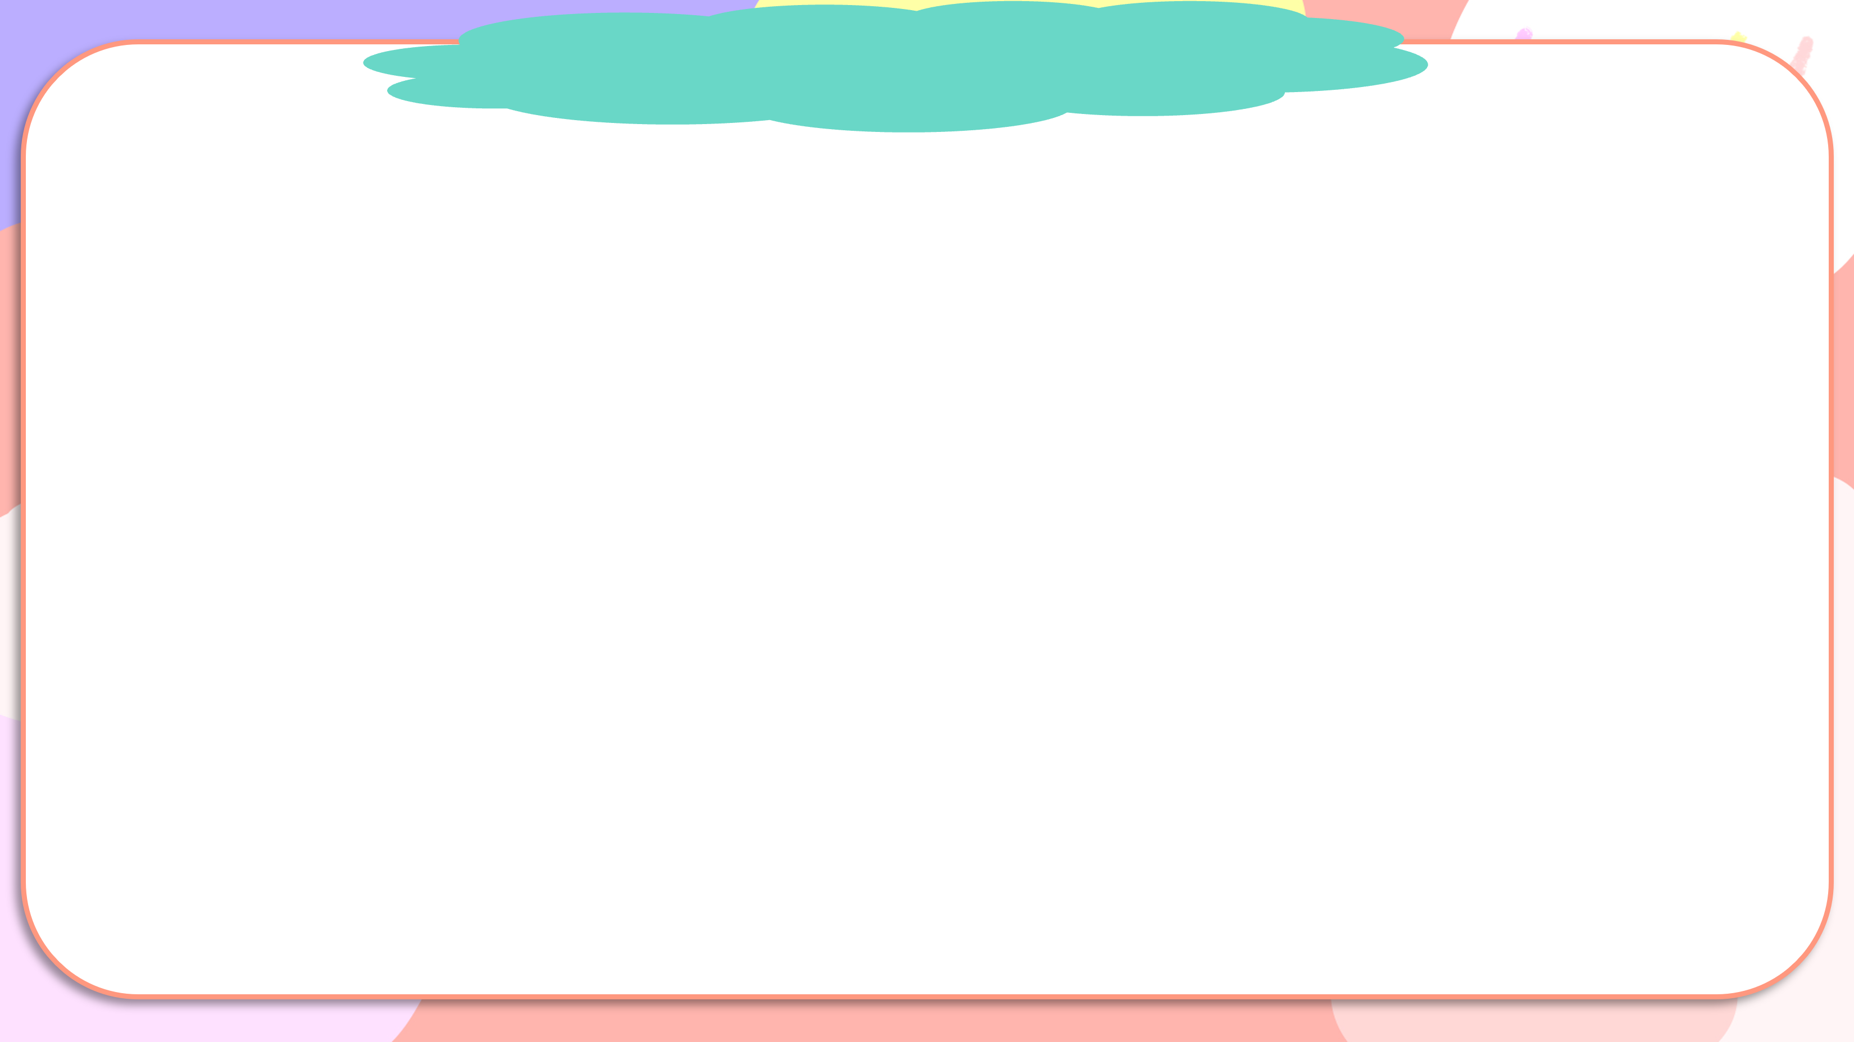
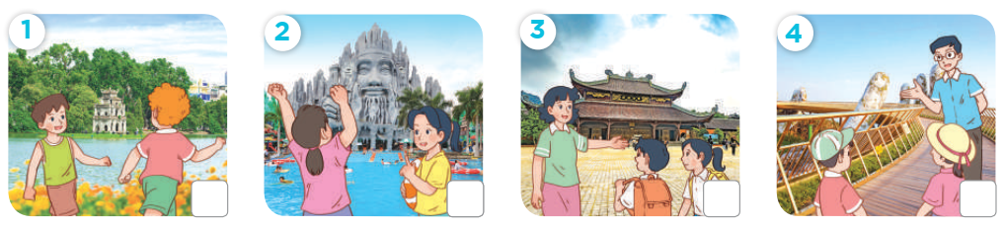
Listen and tick or cross

Slide 7

Listen and tick or cross
✓

Slide 8
Listen and tick or cross
✗

Slide 9
Listen and tick or cross
✓

Slide 10
Listen and tick or cross
✗

Slide 11
Listen and tick or cross
✓
✗
✓
✗

Slide 12
03
Activity 2.Read and circle

Slide 13
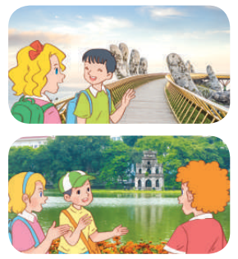
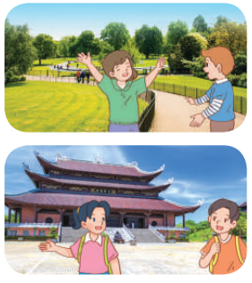
Read and circle

Slide 14
Read and complete.
1. A: Did they go to Ba Na Hills last weekend?
B: Yes, they did. / No, they didn’t. It was beautiful!

Slide 15
Read and complete.
2. A: Did your class go to Ho Tay Water Park?
B: No, we don’t / didn’t. We went to Hoan Kiem Lake / Thu Le Zoo.

Slide 16
Read and complete.
3. A: Did they go to Hyde Park on the school trip last summer?
B: Yes, they did / do. It was great!

Slide 17
Read and complete.
4. A: Did / Do they go to the Opera House on the school trip last year?
B: No, they didn’t. They went to Bai Dinh Pagoda / Ba Na Hills.

Slide 18
04
Activity 3.
Listen, complete and sing

Slide 19
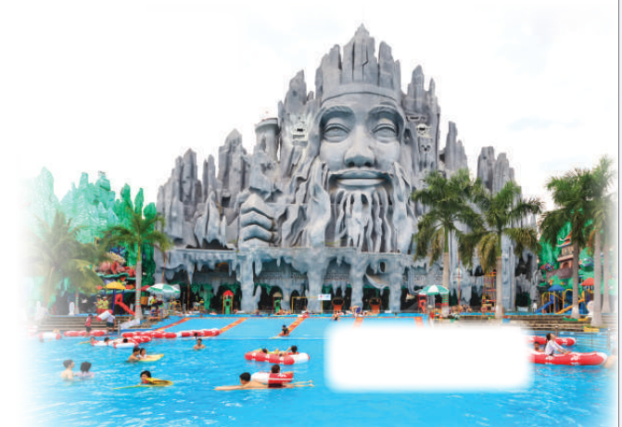
Listen, complete and sing
Did they go to Suoi Tien Theme Park?
Did they go to Suoi Tien Theme Park? Yes, they did. Yes, they did. Did they (1) ________ a film there? No, they didn’t. No, they didn’t. Did they swim in the (2) __________________ ? Yes, they did. Yes, they did. Did they play (3) _________________ there? No, they didn’t. No, they didn’t.
watch
swimming pool
badminton

Slide 20
05
Fun corner and Wrap-up

Slide 21



Flower picking
Game

Slide 22






Team 1
Team 2
Notes:
Click lần 1 vào bông hoa để tới bức tranh tương ứng. Bông hoa được chọn sẽ biến mất.
Click vào tên đội để tính điểm. Mỗi lần click một bông hoa xuất hiện để tính điểm
Click vào mũi tên đến màn hình tuyên dương

Slide 23

Did you_____?
____.
Back
Notes:
Click vào mũi tên để quay về

Slide 24
Did you_____?
____.
Back
Notes:
Click vào mũi tên để quay về

Slide 25
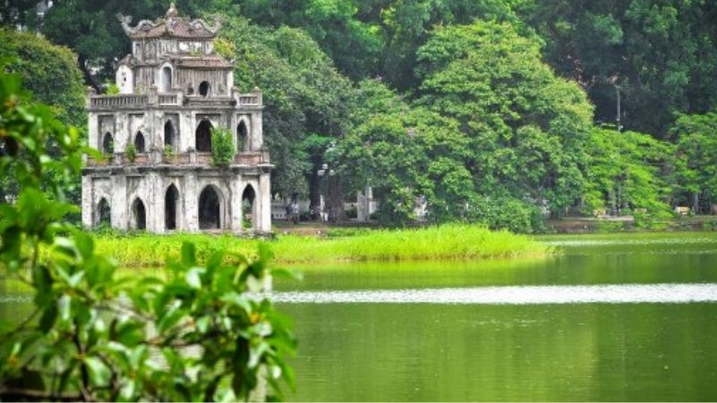
Did you_____?
____.
Back
Notes:
Click vào mũi tên để quay về

Slide 26
Did you_____?
____.
Back
Notes:
Click vào mũi tên để quay về

