Slide 1

Unit 10
Our school trip
Lesson 2 - Period 4

Slide 2


01
Warm-up and Review

Slide 3



What did they do there?
They ____.

Slide 4


Run and write
Game
?

Slide 5
02
Activity 1. Listen and tick

Slide 6

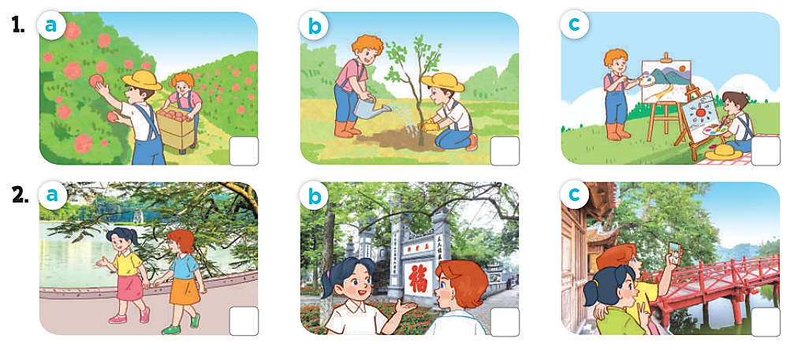
Listen and tick

Slide 7
Listen and tick
✓

Slide 8
Listen and tick
✓

Slide 9
Listen and tick
✓
✓

Slide 10
03
Activity 2.
Read and complete

Slide 11
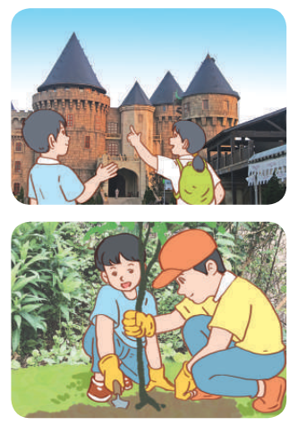
Read and complete.

Slide 12
Read and complete.
1. A: Did they ______ to Ba Na Hills last September?
B: Yes_______.
A: What did they do there?
B: They ______ the old _______ .
go
they did
visited
buidings

Slide 13
Read and complete.
2. A: ___ go to a pagoda last November?
B: No, we didn’t. We _____ to a farm.
A: What _____ you do there?
B: We___________ .
Did
went
did
planted trees

Slide 14
Read and complete.
go
1. A: Did they ______ to Ba Na Hills last September?
B: Yes_______.
A: What did they do there?
B: They ______ the old _______ .
2. A: ___ go to a pagoda last November?
B: No, we didn’t. We _____ to a farm.
A: What _____ you do there?
B: We___________ .
they did
visited
buidings
Did
went
did
planted trees

Slide 15
04
Activity 3. Let’s play

Slide 16
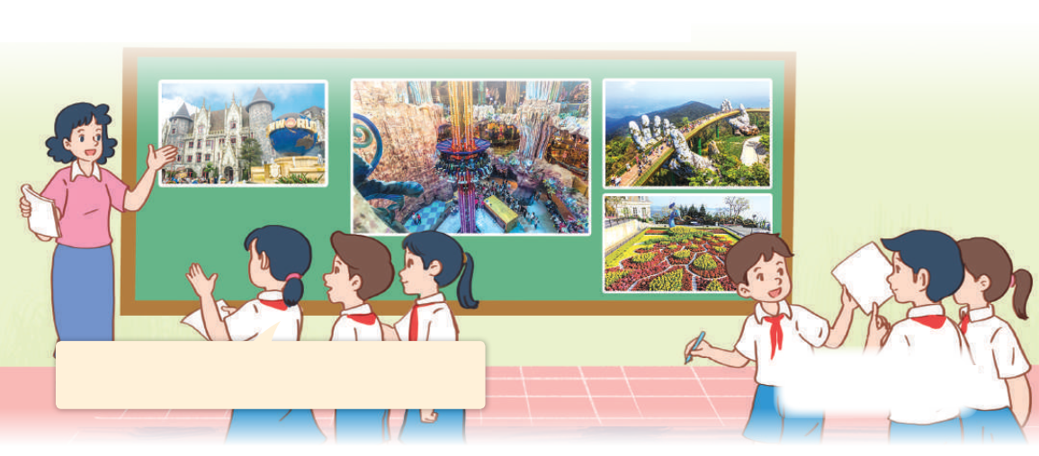
Let’s play
What did they do there?
Last weekend, they went to Ba Na Hills. They visited the famous buildings there.

Slide 17


GUESSING
GAME

Slide 18


Last weekend, they went to Ba Na Hills.
They visited the famous buildings there.

Slide 19





Slide 20
05
Fun corner and Wrap-up

Slide 21


Throw the dice
Game

Slide 22

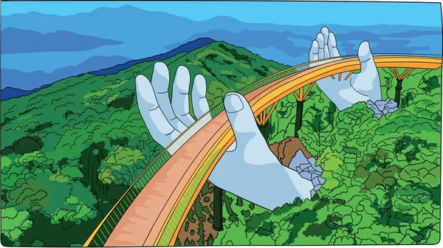
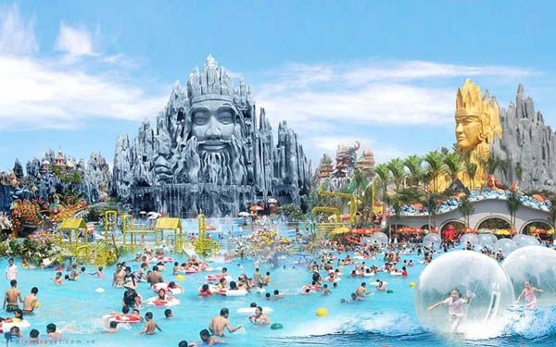
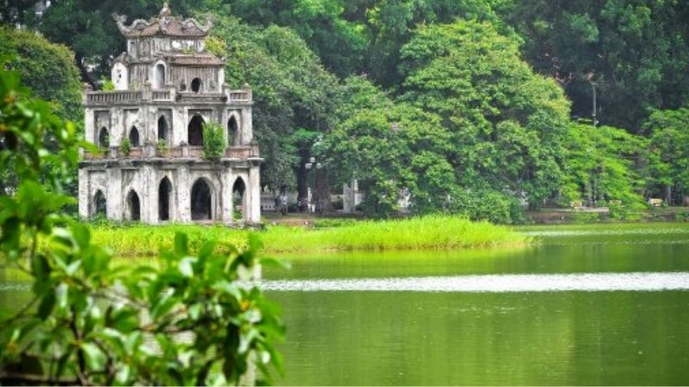
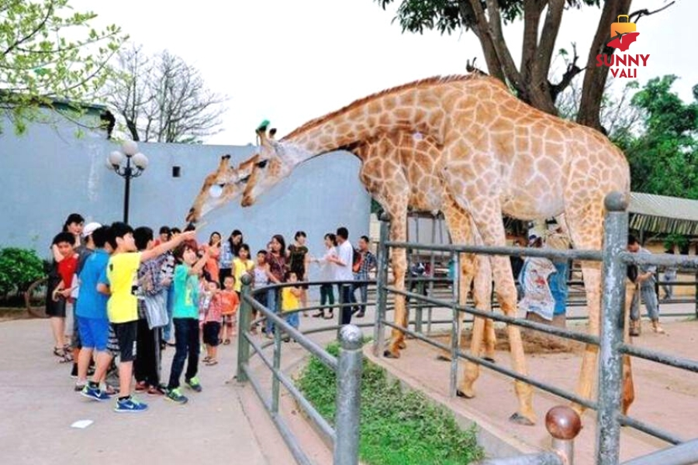
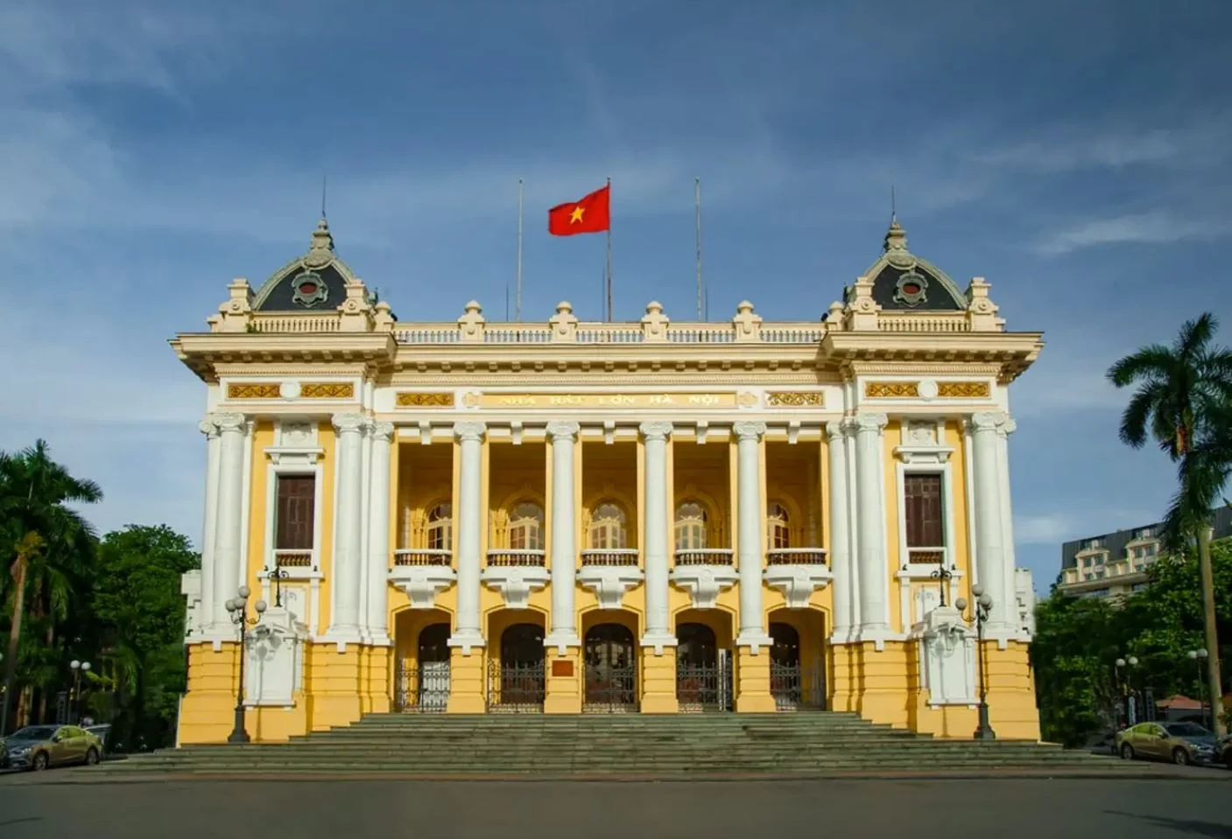
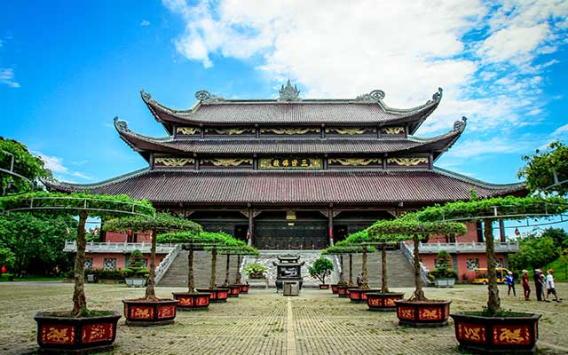

Throw the dice
Game
1
2
3
4
5
6
Notes:
Click vào tranh để làm tranh biến mất

Slide 23


Very Good!

