Slide 1
Unit 10 Our school trip
Lesson 3 - Period 5

Slide 2
01
Warm-up and Review

Slide 4
02
Activity 1. Listen and repeat

Slide 5
Listen and repeat.
'
'
No vember
We went to Sa Pa last No vember.

Slide 6
Listen and repeat.
'
'
De cember
They visited Da Lat last De cember.

Slide 7
Listen and repeat.
'
'
No vember
We went to Sa Pa last No vember.
'
'
De cember
They visited Da Lat last De cember.

Slide 8
03
Activity 2.
Circle, listen and check

Slide 9
Circle, listen and check.
1.
a. September
b. yesterday
c. Saturday
2.
a. October
b. Saturday
c. December
3.
a. banana
b. bakery
c. badminton

Slide 10
Circle, listen and check.
1.
a. September
b. yesterday
c. Saturday

Slide 11
Circle, listen and check.
2.
a. October
b. Saturday
c. December

Slide 12
Circle, listen and check.
3.
a. banana
b. bakery
c. badminton

Slide 13
'
Sep tember
'
Saturday
ba nana
'

Slide 14
04
Activity 3. Let’s chant

Slide 15
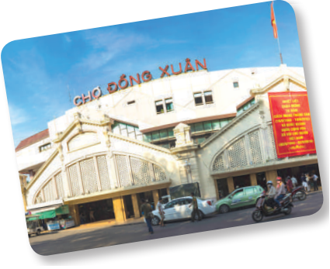
Let’s chant.
November, December.
November, December.
Where did you go last November?
We went to Ben Thanh Market last November.
November, December.
November, December.
Where did they go last December?
They went to Dong Xuan Market last December.

Slide 16
Let’s chant.
November, December.
November, December.
Where did you go last November?
We went to Ben Thanh Market last November.
November, December.
November, December.
Where did they go last December?
They went to Dong Xuan Market last December.

Slide 17
Let’s chant.
September, October.
September, October.
Where did you go last September?
We went to Ben Thanh Market last October.
September, October.
September, October.
Where did they go last October?
They went to Dong Xuan Market last September.

Slide 18
05
Fun corner and Wrap-up

Slide 19
Musical cards

Slide 20
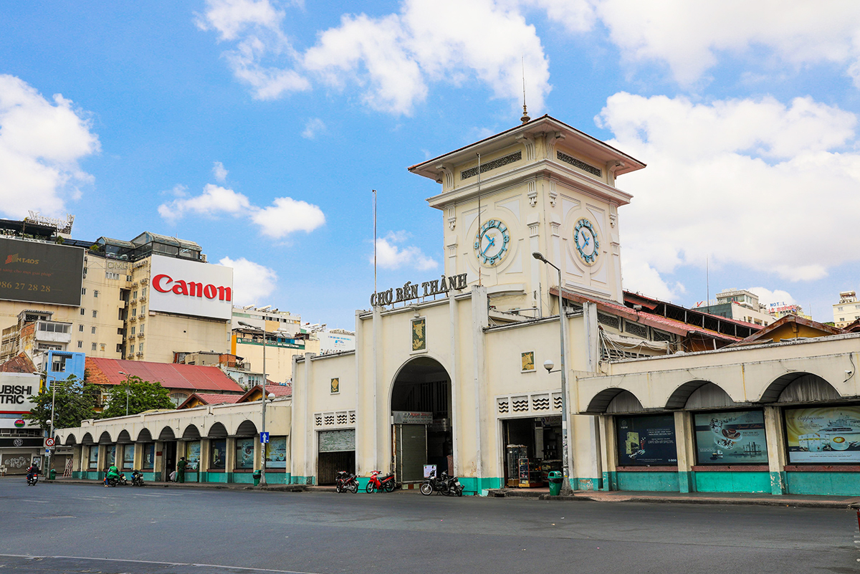
E.g
Where did you go last November?
I went to Ben Thanh Market last November.
Notes:
e.g

Slide 21
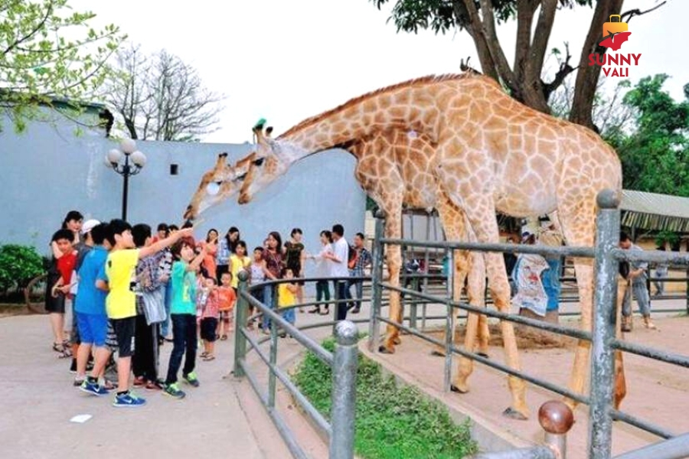
Where did you ______?
I went t __________.
Notes:
Nháy choột lần 1 bật nhạc, nháy chuột lần 2 nhạc tắt hình ảnh xuất hiện, HS hỏi đáp về hình ảnh.

Slide 22
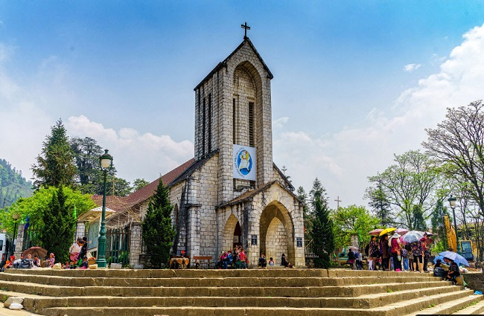
Where did you ______?
I went t __________.
Notes:
Nháy choột lần 1 bật nhạc, nháy chuột lần 2 nhạc tắt hình ảnh xuất hiện, HS hỏi đáp về hình ảnh.

Slide 23
Where did you ______?
I went t __________.
Notes:
Nháy choột lần 1 bật nhạc, nháy chuột lần 2 nhạc tắt hình ảnh xuất hiện, HS hỏi đáp về hình ảnh.

Slide 24
Where did you ______?
I went t __________.
Notes:
Nháy choột lần 1 bật nhạc, nháy chuột lần 2 nhạc tắt hình ảnh xuất hiện, HS hỏi đáp về hình ảnh.

Slide 25
Very Good!

