Slide 1
Unit 11: FAMILY TIME
Lesson 2 - Period 3

Slide 2
01
Warm-up and Review.

Slide 3
02
Activity 1
Look, listen and repeat.

Slide 4
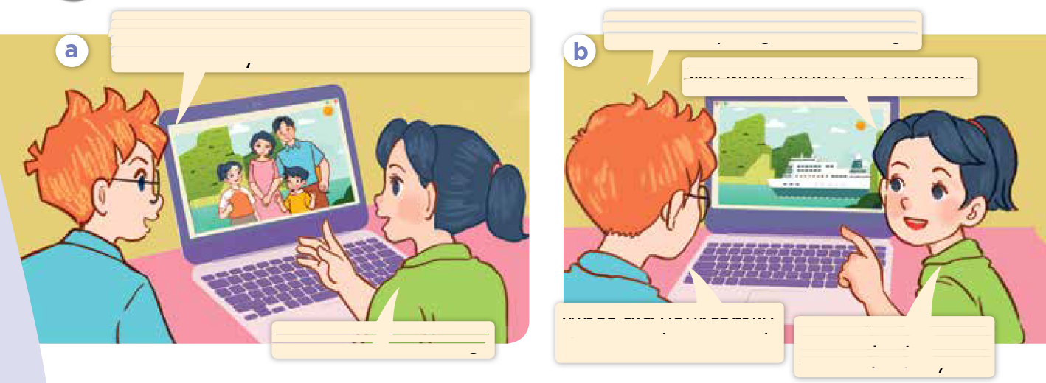
Look and say.
Notes:
Step 1: Have pupils look at Pictures a and b and identify the place, characters and their activities in the pictures.

Slide 5
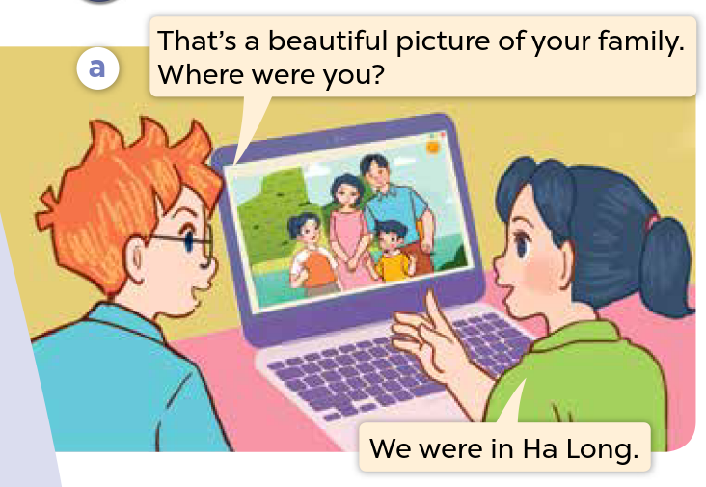
Look, listen and repeat.
Notes:
Step 2: Ask pupils to look at Picture a. Play the recording for them to listen. Play the recording again, sentence by sentence, for pupils to listen and repeat. Follow the same procedure with Picture b. Correct their pronunciation where necessary.

Slide 6
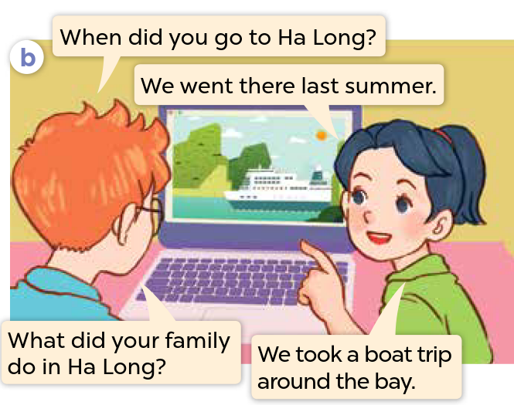
Look, listen and repeat.
Notes:
Step 2: Ask pupils to look at Picture a. Play the recording for them to listen. Play the recording again, sentence by sentence, for pupils to listen and repeat. Follow the same procedure with Picture b. Correct their pronunciation where necessary.

Slide 7
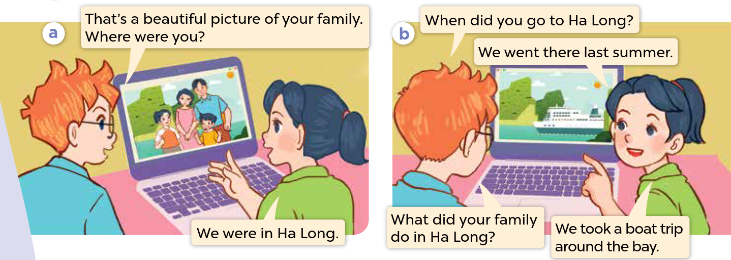
Look, listen and repeat.
Notes:
Step 3: Play the recording again for pupils to listen and repeat in chorus, sentence by sentence.
Step 4: Invite a few pairs to the front of the classroom to listen and repeat the sentences in the recording.

Slide 8
03
Activity 2
Listen, point and say.

