Slide 1
Review 2
Period 1

Slide 2
GAME
Hot-air balloon
START
1
2
3
4
5
6
7

Slide 3
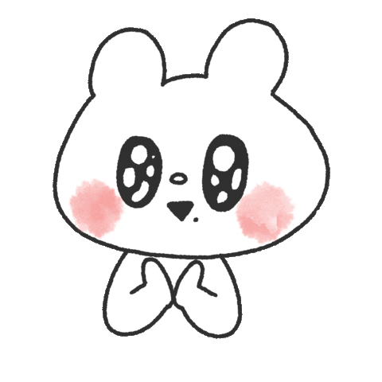
Question 1
It’s a day of the week.
A. May
B. Monday
C. Summer
1
2
3
4
5
6
7
START

Slide 4
Question 2
It’s a month of the year.
A. September
B. Winter
C. Thursday
2
1
3
4
5
6
7
START

Slide 5
02
Activity 1
Listen and tick.

Slide 6
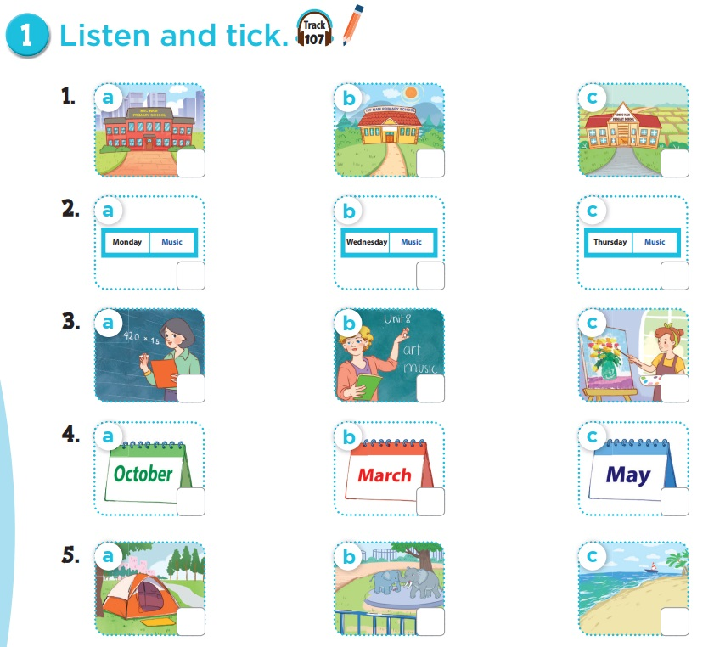

Slide 7
03
Activity 2
Ask and answer.

Slide 8
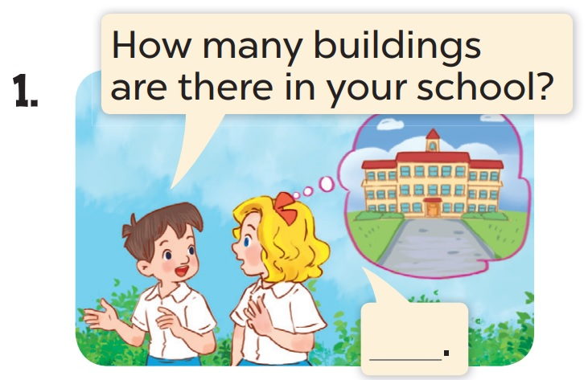
There is one.

Slide 9
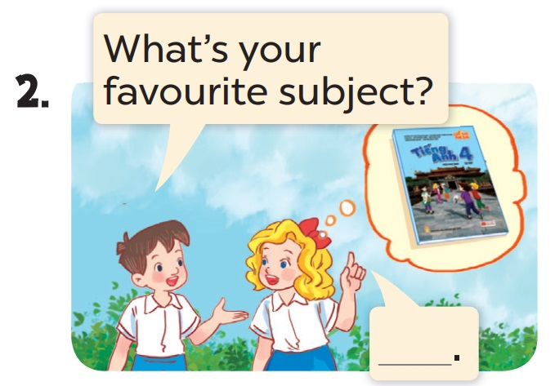
It’s English.

Slide 10
04
Game Mystery box

Slide 11
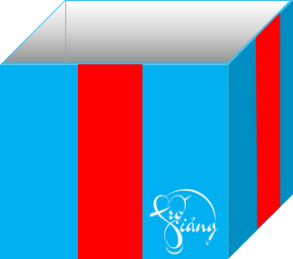
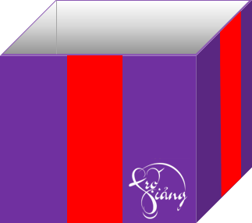
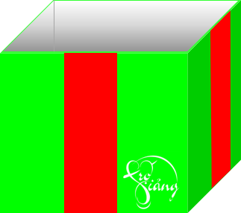

Slide 12
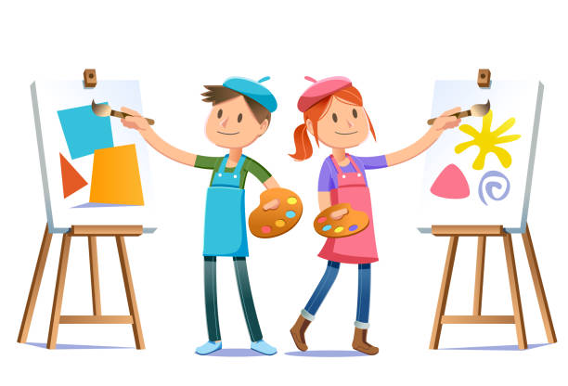
Do you have art on Tuesdays?
50 POINTS
Yes, I do. / No, I don’t.

Slide 13
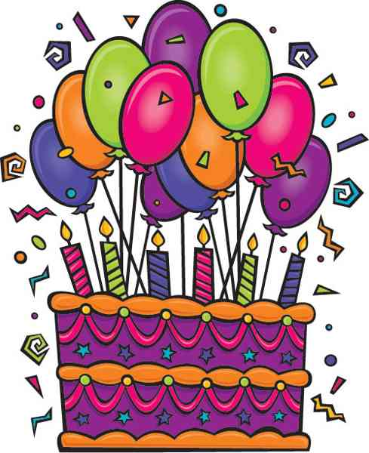
When’s your birthday?
50 POINTS
It’s in ________.

