Slide 3
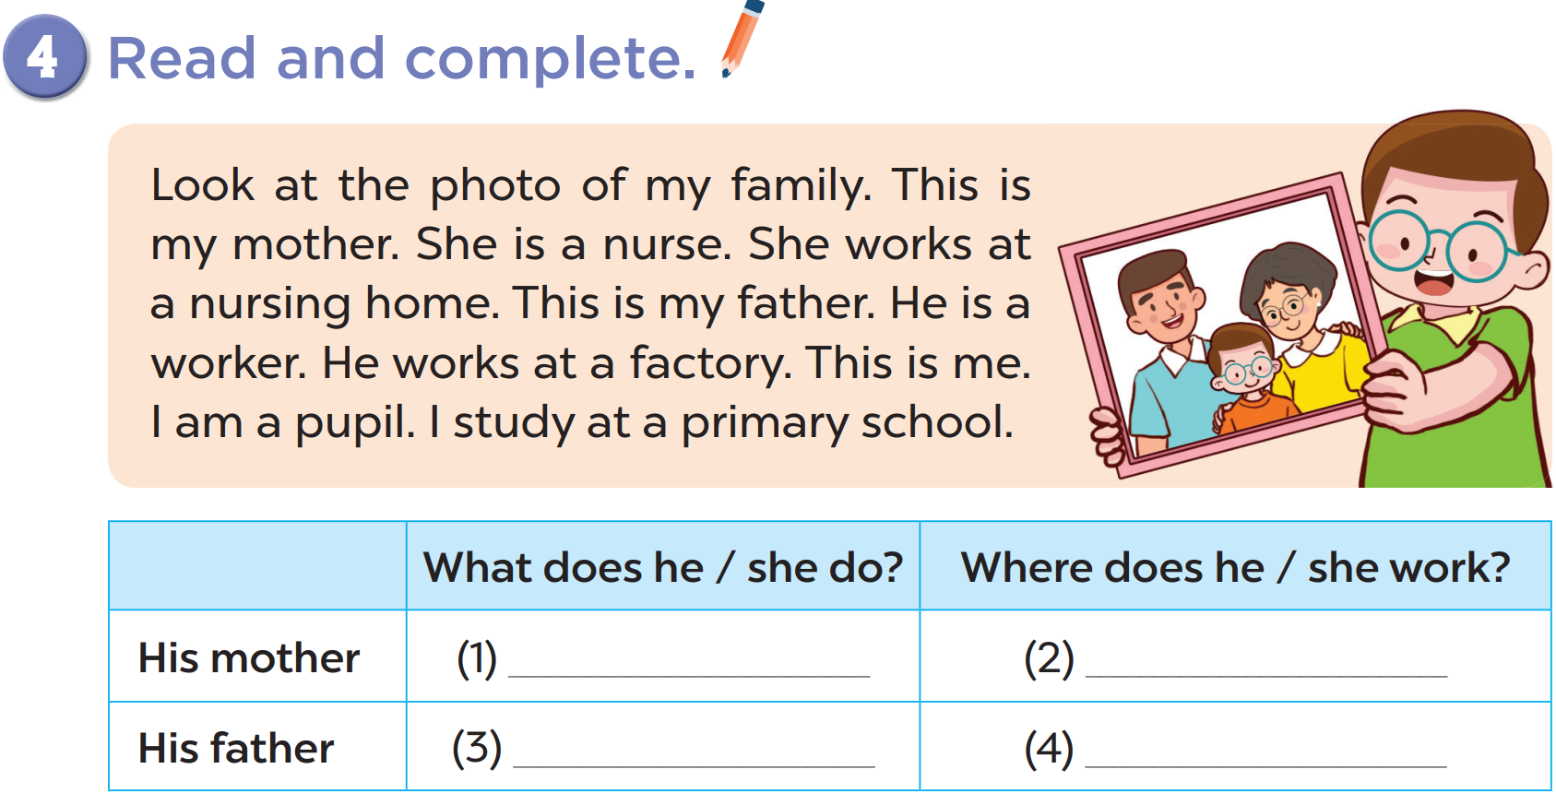
Notes:
chant several times, change the lyrics

Slide 4
a nurse
at a nursing home
a worker
at a factory
Notes:
chant several times, change the lyrics

Slide 6
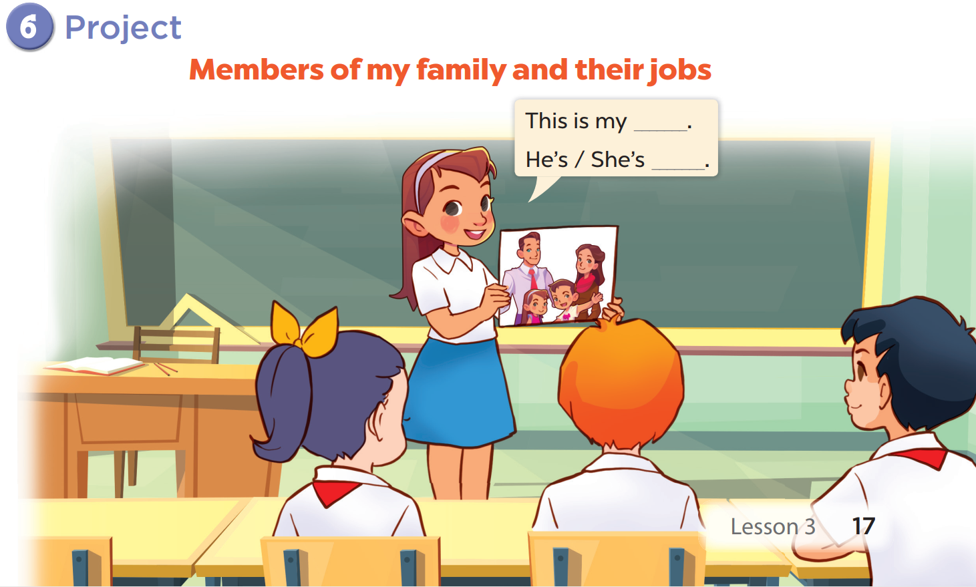

Slide 7
Scrambled Jobs game

Slide 8
eifcof rrkoew
eacoiplmn
office worker
policeman
rrmaef
taorc
farmer
actor

