Slide 1

Welcome to our class!
Teacher: Mrs Hương Giang

Slide 2
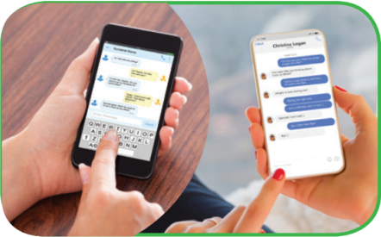
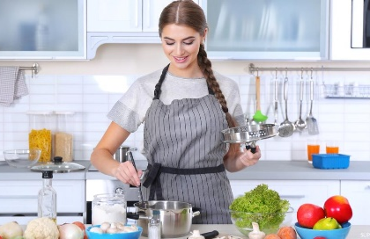
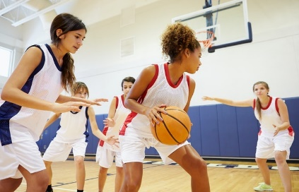
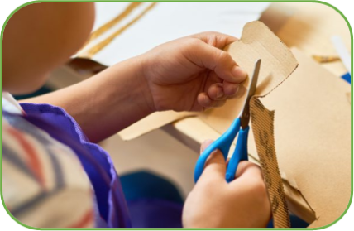
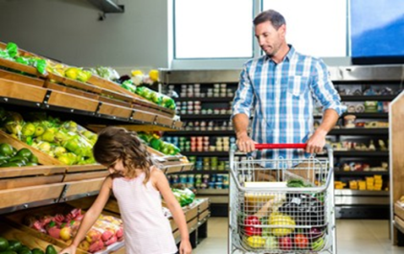


WARM-UP
PELMANISM
1
2
3
4
5
6
7
8
9
10
11
12
cooking
doing DIY
surfing the net
going shopping
playing sport
messaging friends

Slide 3
WARM-UP
PELMANISM
messaging friends
cooking
playing sport
doing DIY
going shopping
surfing the net
I am interested in cooking.
How about you? Do you like cooking?

Slide 4
CHAIN GAME
Example: I’m interested in doing DIY.
I’m crazy about ______. I’m keen on ______. I’m fond of ______.
I’m not interested in ______.
I’m not into ______.

Slide 5

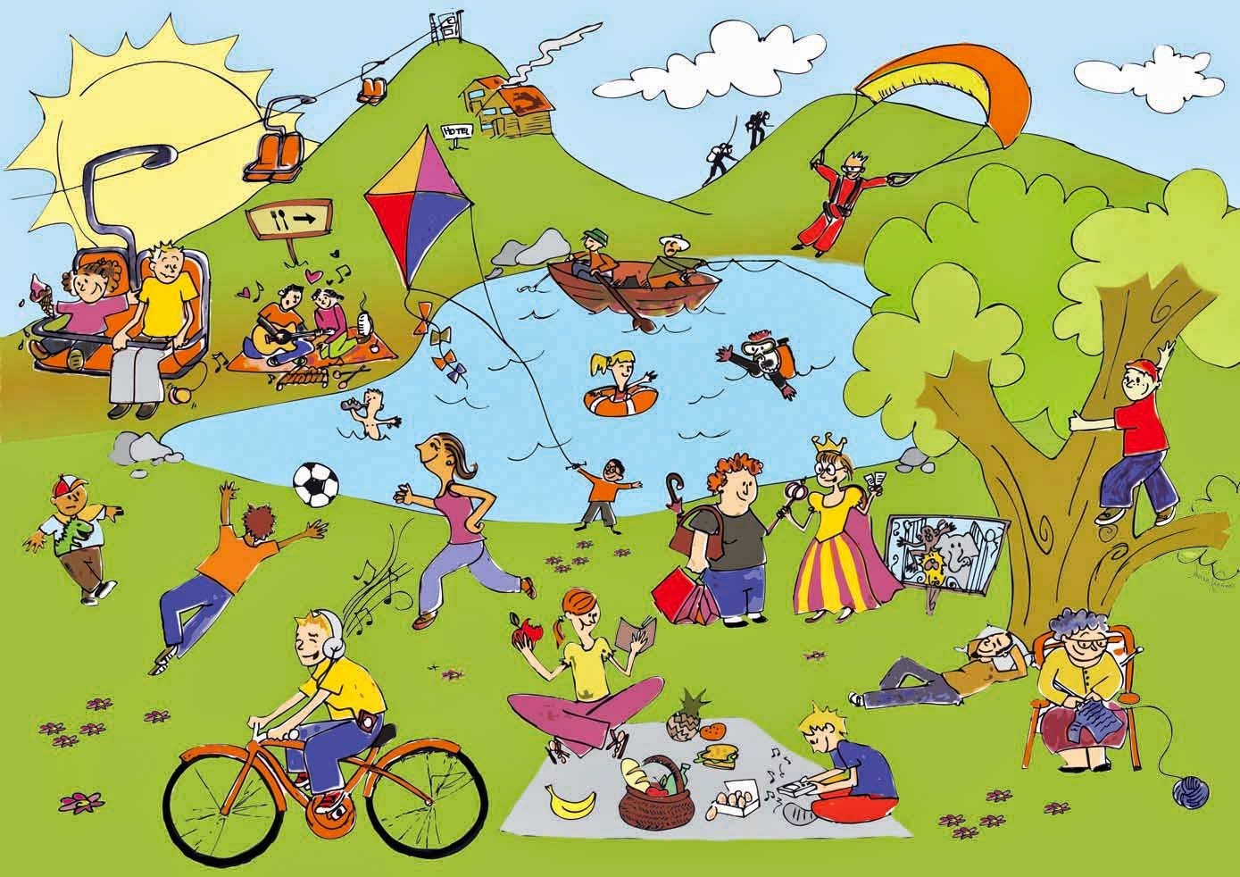
Unit
1
LEISURE TIME
LESSON 3: A CLOSER LOOK 2
1

Slide 6
Unit 1:
Leisure Time
Lesson 3: A Closer Look 2

Slide 7

love
prefer
like
enjoy
fancy
Verbs of liking
Verbs of liking are used to express positive attitudes towards people or things.

Slide 8

Verbs of disliking
detest
hate
dislike
Verbs of disliking are used to express negative attitudes towards people or things.

Slide 9

Some verbs of liking and disliking can be followed by gerunds only.
Example: They dislike surfing the net.
Some are followed by both gerunds and
to-infinitives.
Example: I love going / to go to the cinema.

Slide 10
* Verbs of liking
Adore ( yêu thích)
Love
Like, enjoy, fancy ( thích)
Don’t mind ( không phiền)
Hate (ghét)
Detest ( căm ghét)
Degree
+ Gerund
(V- ing)

Slide 11
Love
Prefer(thích hơn) + V- ing / to Verb
Like
Hate

Slide 12
1. Work in pairs. Put the verbs in the appropriate column.
love like detest fancy
dislike enjoy hate prefer
V + gerunds | V + gerunds and to-infinitives
love
detest
fancy
like
hate
prefer
dislike
enjoy

Slide 13
2. Choose the correct answer A, B, or C
1. I love ______, so in my leisure time, I go to some villages near Ha Noi to relax and enjoy the outdoors.
A. travelling B. travelled C. a travel
2. Tom enjoys ______ puzzles, especially Sudoku. A. doing B. do C. to do
3. When do you like ______ TV? A. watched B. watch C. to watch
4. Do you fancy ______ to the cinema this weekend?
A. go B. going C. to go
5. I detest ______. I think it’s cruel to harm animals. A. hunting B. to hunt C. hunt

Slide 14








MARIO’S ADVENTURE

Slide 15


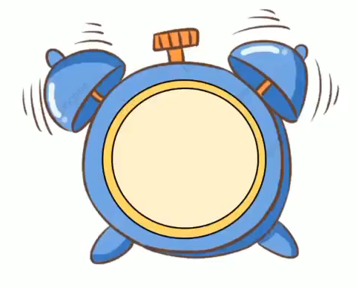
1. I love ______, so in my leisure time, I go to some villages near Ha Noi to relax and enjoy the outdoors.
A. travelling
B. travelled
C. a travel

Slide 16

2. Tom enjoys ______ puzzles, especially Sudoku.
A. doing
B. do
C. to do

Slide 17

3. When do you like ______ TV?
A. watched
B. watch
C. to watch

Slide 18
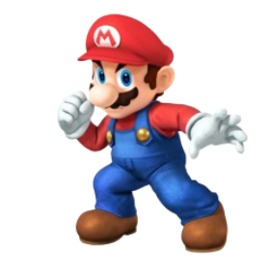
4. Do you fancy ______ to the cinema this weekend?
A. go
B. going
C. to go

Slide 19
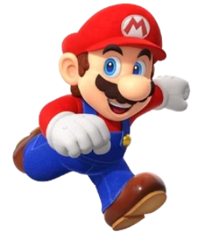
5. I detest ______. I think it’s cruel to harm animals.
A. hunting
B. to hunt
C. hunt

Slide 20

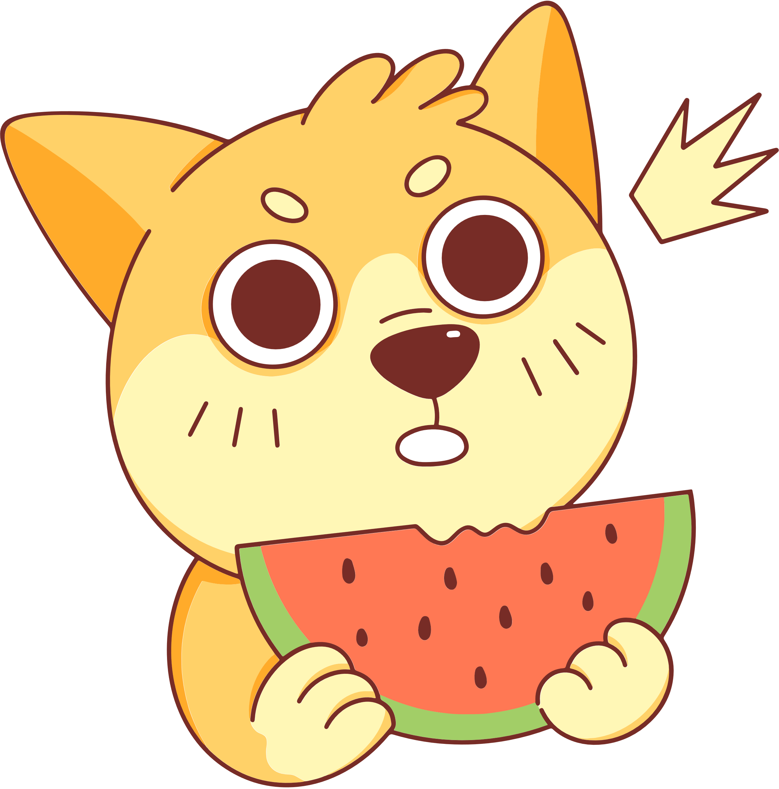
Look at the answer again.
1. I love ______, so in my leisure time, I go to some villages near Ha Noi to relax and enjoy the outdoors.
A. travelling B. travelled C. a travel
2. Tom enjoys ______ puzzles, especially Sudoku. A. doing B. do C. to do
3. When do you like ______ TV? A. watched B. watch C. to watch
4. Do you fancy ______ to the cinema this weekend?
A. go B. going C. to go
5. I detest ______. I think it’s cruel to harm animals. A. hunting B. to hunt C. hunt

Slide 21
3. Look at the pictures and complete the sentences, using the verbs in brackets in their suitable form.
1. Mark ___________________. (like)
2. The girls _______________. (enjoy)
3. My cousin _____________. (dislike)
4. My father________________. (hate)
5. Tom and his sister _______. (prefer)

Slide 22

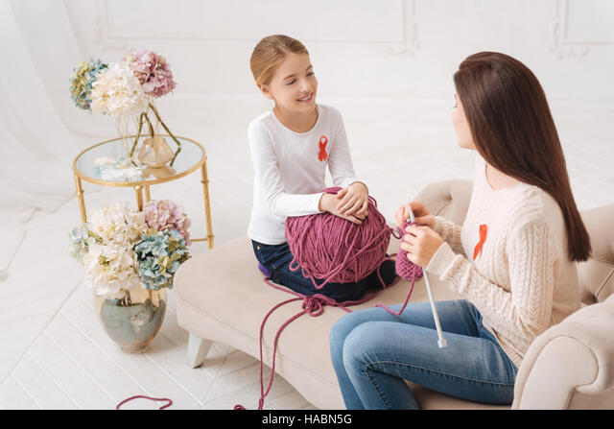
3. Look at the pictures and complete the sentences, using the verbs in brackets in their suitable form.
1. Mark ___________________________. (like)
likes surfing / to surf the Internet
2. The girls ____________. (enjoy)
enjoy knitting

Slide 23
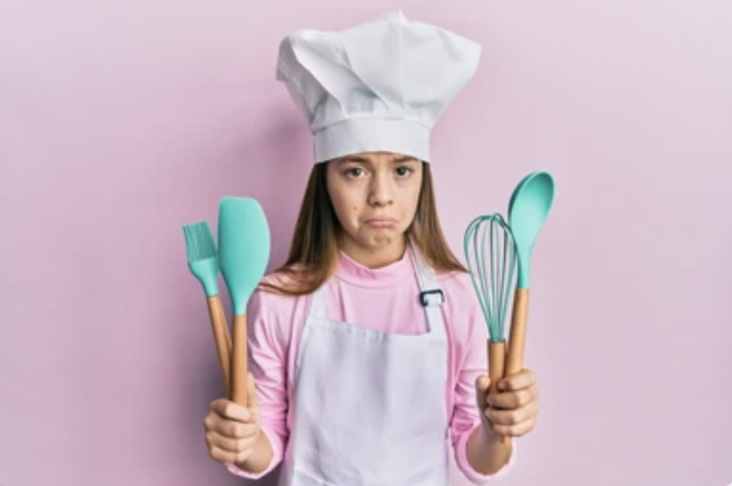
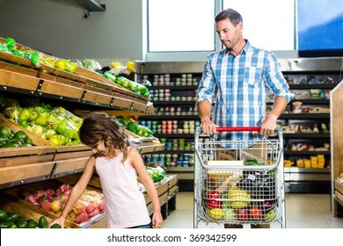
3. Look at the pictures and complete the sentences, using the verbs in brackets in their suitable form.
3. My cousin ______________. (dislike)
dislikes cooking
4. My father _______________________________. (hate)
hates going /
to go shopping

Slide 24
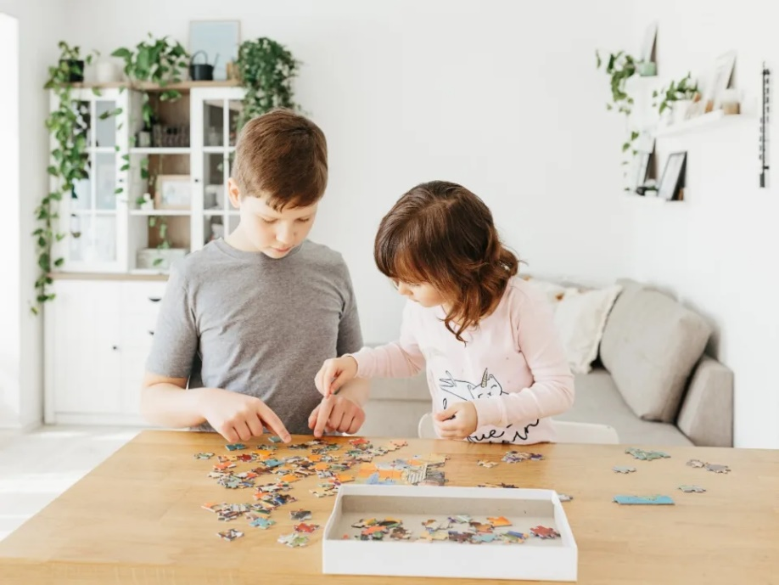
3. Look at the pictures and complete the sentences, using the verbs in brackets in their suitable form.
5. Tom and his sister __________________________. (prefer)
prefer doing /
to do puzzles

Slide 25
About you

Slide 26


4
Complete the sentences about yourself.
All about me
I like ______. I prefer ______. I love ______. | I dislike ______. I hate ______. I detest ______.

Slide 27
4
Complete the sentences about yourself.
I like messaging friends. | I dislike doing puzzles.
I prefer cooking. | I hate knitting.
I love singing. | I detest cleaning the floor.

Slide 28

* PRODUCTION
5
Likes and dislikes mimes
Work in groups. One mimes a leisure activity he / she likes or dislikes.
The others guess the activity by asking yes / no questions using the verbs they have learnt.
Example:
A: Do you like surfing the net? B: No, I don’t. C: Do you love messaging your friends?
B: Yes, I do.

Slide 29
* PRODUCTION
Find someone who…
Go around the classroom and find:
Find someone who… | Name
likes playing computer games.
enjoys knitting.
detests cooking.
fancies going shopping.
loves doing puzzles.
hates hunting.
dislikes watching TV.
prefers going to the cinema.

Slide 30
* Complete the sentences:
I like ___________ oranges.
My sister enjoys __________ meals.
They prefer _________ English.
Hoa dislikes _________ books.
We hate _________up early.
My sister is fond of _________ to English music.
Game

Slide 31
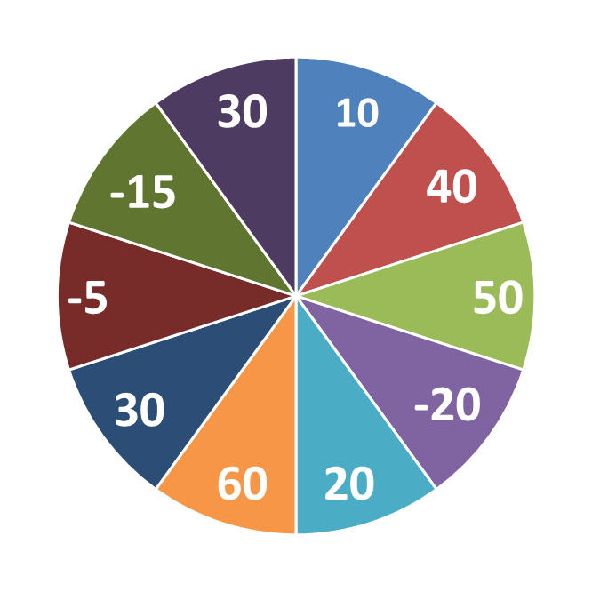
THE BIG WHEEL GAME
QUESTIONS
1
4
2
5
3
6

Slide 32
* Complete the sentences:
I like ___________ oranges.
eating

Slide 33
* Complete the sentences:
2. My sister enjoys __________ meals.
cooking

Slide 34
* Complete the sentences:
3. They prefer _________ English.
learning

Slide 35
* Complete the sentences:
4. Hoa dislikes _________ books.
reading

Slide 36
* Complete the sentences:
5. We hate _________up early.
to get

Slide 37
* Complete the sentences:
I like ___________ oranges.
My sister enjoys __________ meals.
They prefer _________ English.
Hoa dislikes _________ books.
We hate _________up early.
My sister is fond of _________ to English music.
eating
cooking
learning
reading
to get
listening

Slide 38

CONSOLIDATION
What have we learnt in this lesson?
How to use verbs of liking and disliking

Slide 39

CONSOLIDATION
2
Homework
- Do exercises in the workbook.
- Prepare lesson 4: COMMUNICATION

Slide 40


Slide 41
Homework
Review the grammar point
Make 5 sentences with verbs of liking/ disliking
Prepare: Lesson: Communication

Slide 42
THANK YOU!

Slide 43

Let’s sing!

