Slide 1
UNIT 9
Festivals around the world
Lesson 2: A closer look 1

Slide 2
Objectives
At the end of this lesson, students will be able to:
use the lexical items related to the topic festivals around the world.
pronounce and distinguish stress in
two-syllable words.
Notes:
-
-
- Pronounce and distinguish stress in two-syllable words.

Slide 3
01
Vocabulary

Slide 4
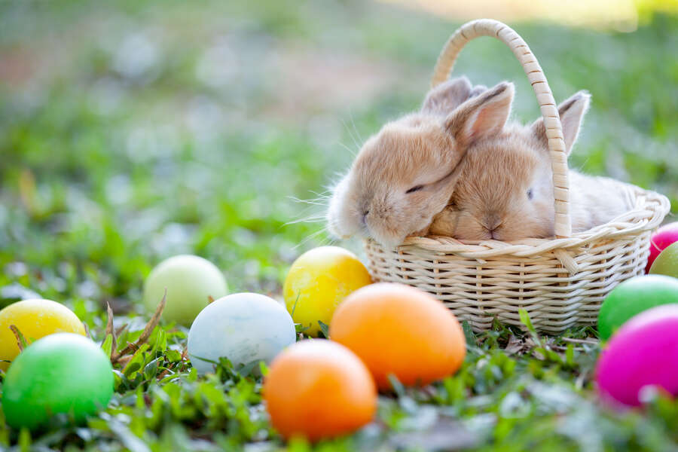
Check your answer
Easter
/ˈiːstə(r)/

Slide 5
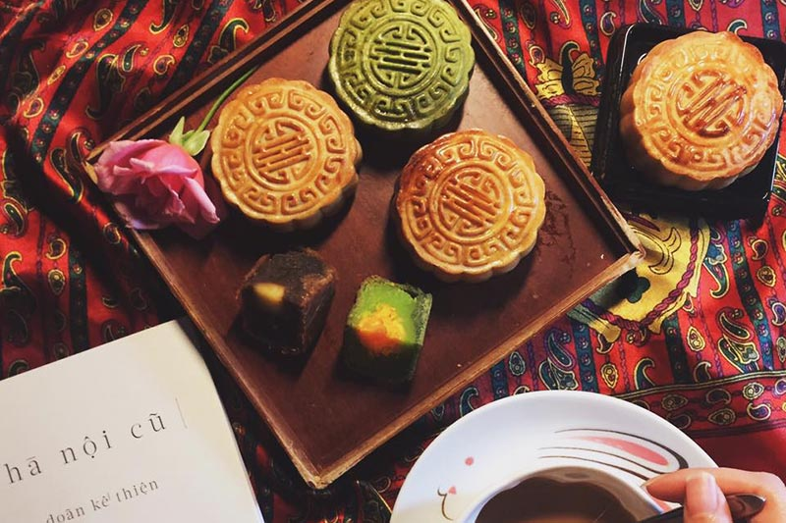
Check your answer
Mid-autumn
festival
/mɪd- ˈɔːtəm ˈfestɪvl/

Slide 6
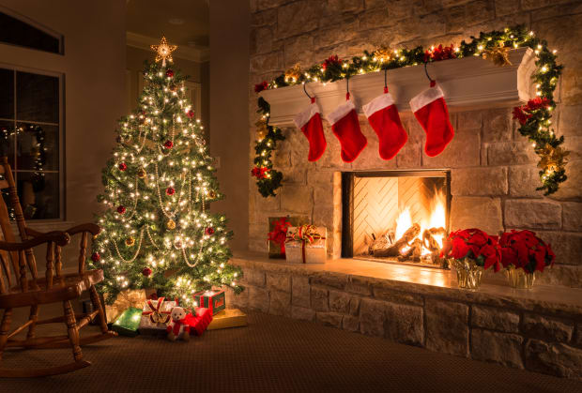
Check your answer
Christmas
/ˈkrɪsməs/

Slide 7
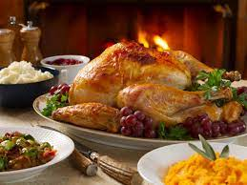
Check your answer
Thanksgiving
/ˌθæŋksˈɡɪvɪŋ/

Slide 8
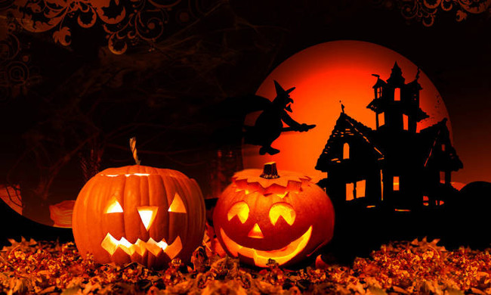
Check your answer
Halloween
/ˌhæləʊˈiːn/

Slide 9
Check your answer
Cannes film festival
/kæns fɪlm ˈfestɪvl/

Slide 10
PRESENTATION
Form | Pronunciation | Meaning
1. Cannes Film Festival | /kæn fɪlm fes.tɪ.vl/ | Liên hoan phim Cannes
2. Thanksgiving (n) | /ˌθæŋksˈɡɪv.ɪŋ/ | Lễ Tạ ơn
3. Easter (n) | /ˈiː.stər/ | Lễ Phục sinh
4. carve (v) | /kɑːv/ | chạm, khắc
5. perform (v) | /pəˈfɔːm/ | biểu diễn

Slide 11
VOCABULARY
1
Write under each picture a festival name from the box.
Cannes Film Festival Mid-Autumn Festival Thanksgiving Christmas Halloween Easter
1. ___________
2. ___________
3. ___________
Halloween
Christmas
Mid-Autumn Festival
4. ___________
5. _________________
6. ___________
Cannes Film Festival
Easter
Thanksgiving

Slide 12
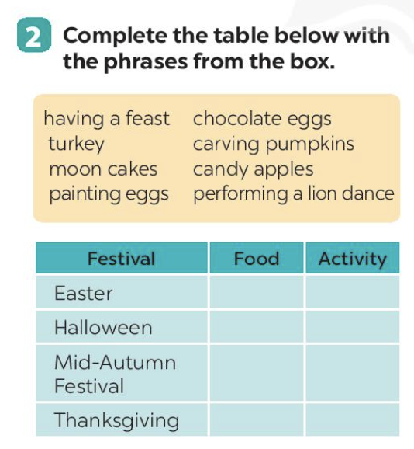
Ex 2 (pg.94) Complete the table below with the phrases from the box.
having a feast | chocolate eggs | turkey | carving pumpkins
mooncakes | candy apples | painting eggs | performing a lion dance
Festival | Food | Activity
1. Easter
2. Halloween
3. Mid-Autumn Festival
4. Thanksgiving
chocolate eggs
painting eggs
candy apples
carving pumpkins
performing
a lion dance
moon cakes
turkey
having a feast

Slide 13
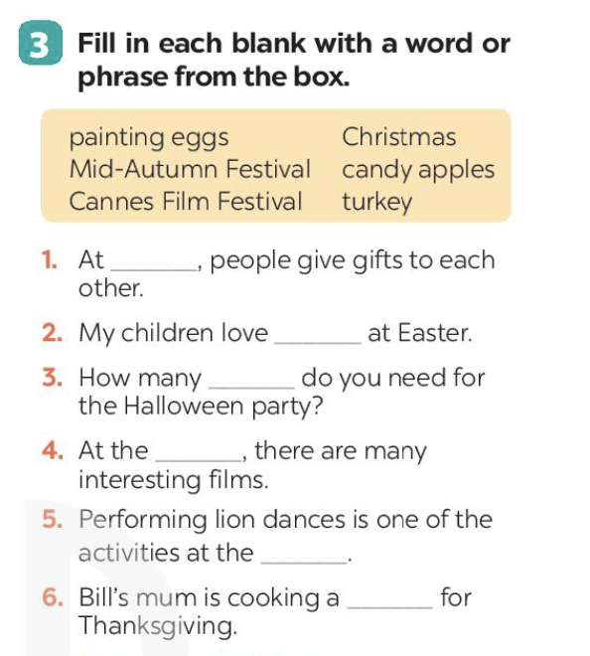
Ex 3 (pg.94) Fill in each blank with a word or frase from the box.
painting eggs | Christmas | Mid-autumn festival
candy apples | Cannes film festival | turkey
1. At _________, people give gifts to each other.
2. My children love _________ at Easter.
3. How many _________do you need for the Halloween party?
4. At the _________, there are many interesting films.
5. Performing lion dances is one of the activities at the_________.
6. Bill's mum is cooking a _________ for Thanksgiving.

Slide 14
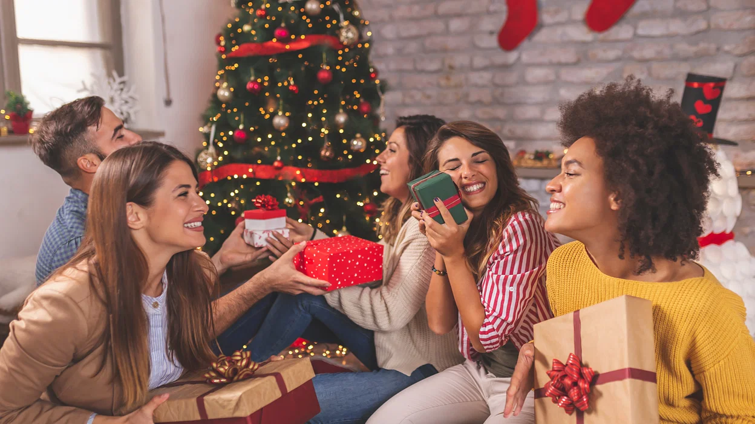
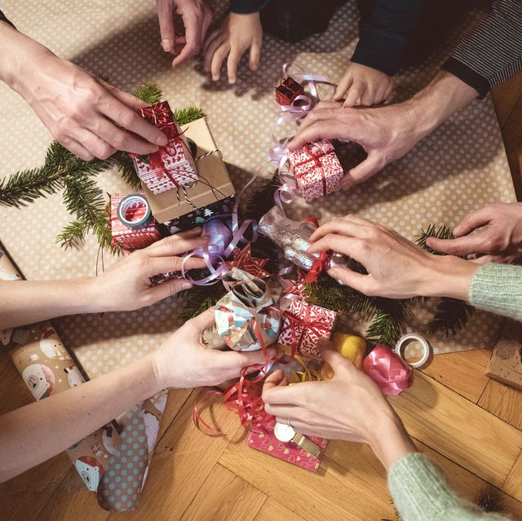
Ex 3 (pg.94) Fill in each blank with a word or frase from the box.
painting eggs | Christmas | Mid-autumn festival
candy apples | Cannes film festival | turkey
Christmas
1. At _______________, people give gifts to each other.

Slide 15
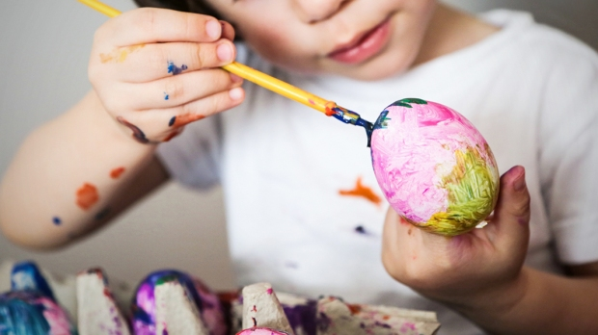
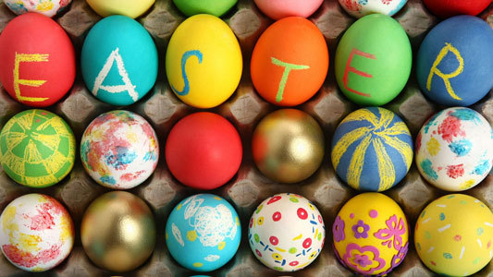
Ex 3 (pg.94) Fill in each blank with a word or frase from the box.
painting eggs | Christmas | Mid-autumn festival
candy apples | Cannes film festival | turkey
painting eggs
2. My children love ______________ at Easter.

Slide 16
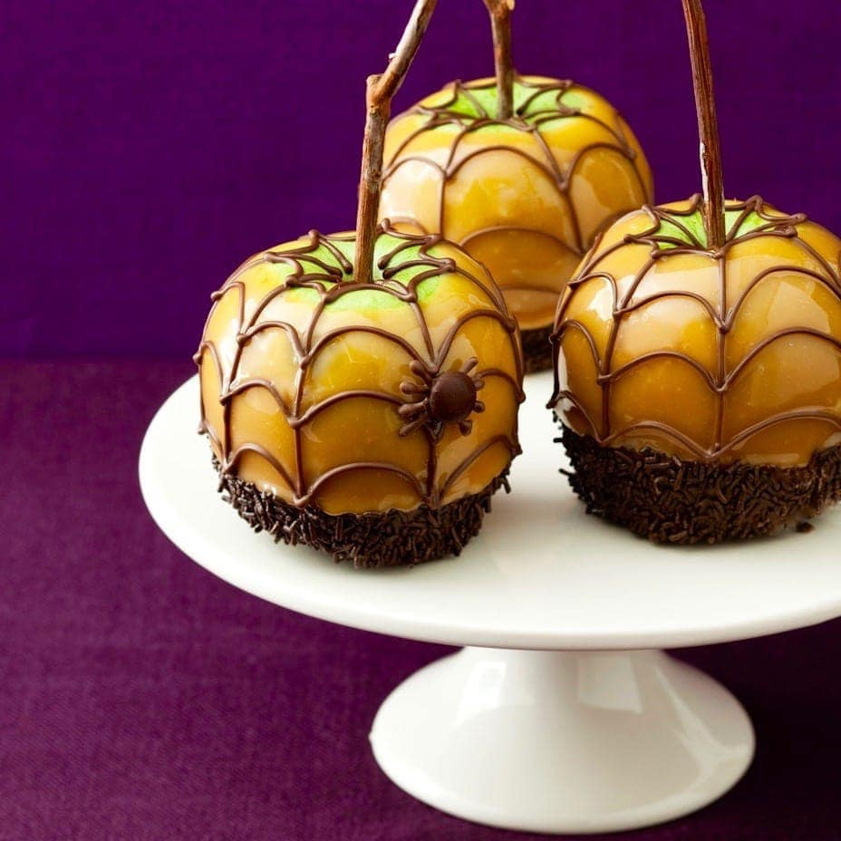
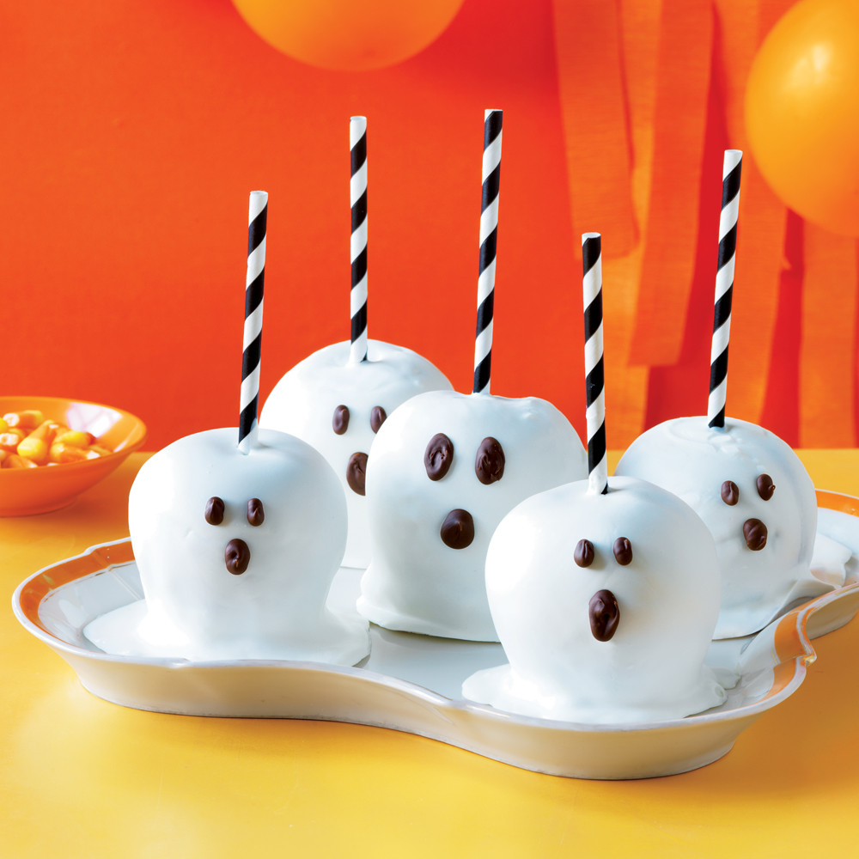
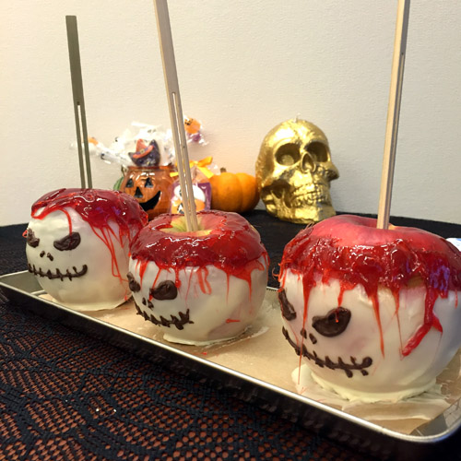
Ex 3 (pg.94) Fill in each blank with a word or frase from the box.
painting eggs | Christmas | Mid-autumn festival
candy apples | Cannes film festival | turkey
3. How many ________________do you need for the Halloween party?
candy apples

Slide 17
Ex 3 (pg.94) Fill in each blank with a word or frase from the box.
painting eggs | Christmas | Mid-autumn festival
candy apples | Cannes film festival | turkey
4. At the ______________, there are many interesting films.
Cannes film festival

Slide 18
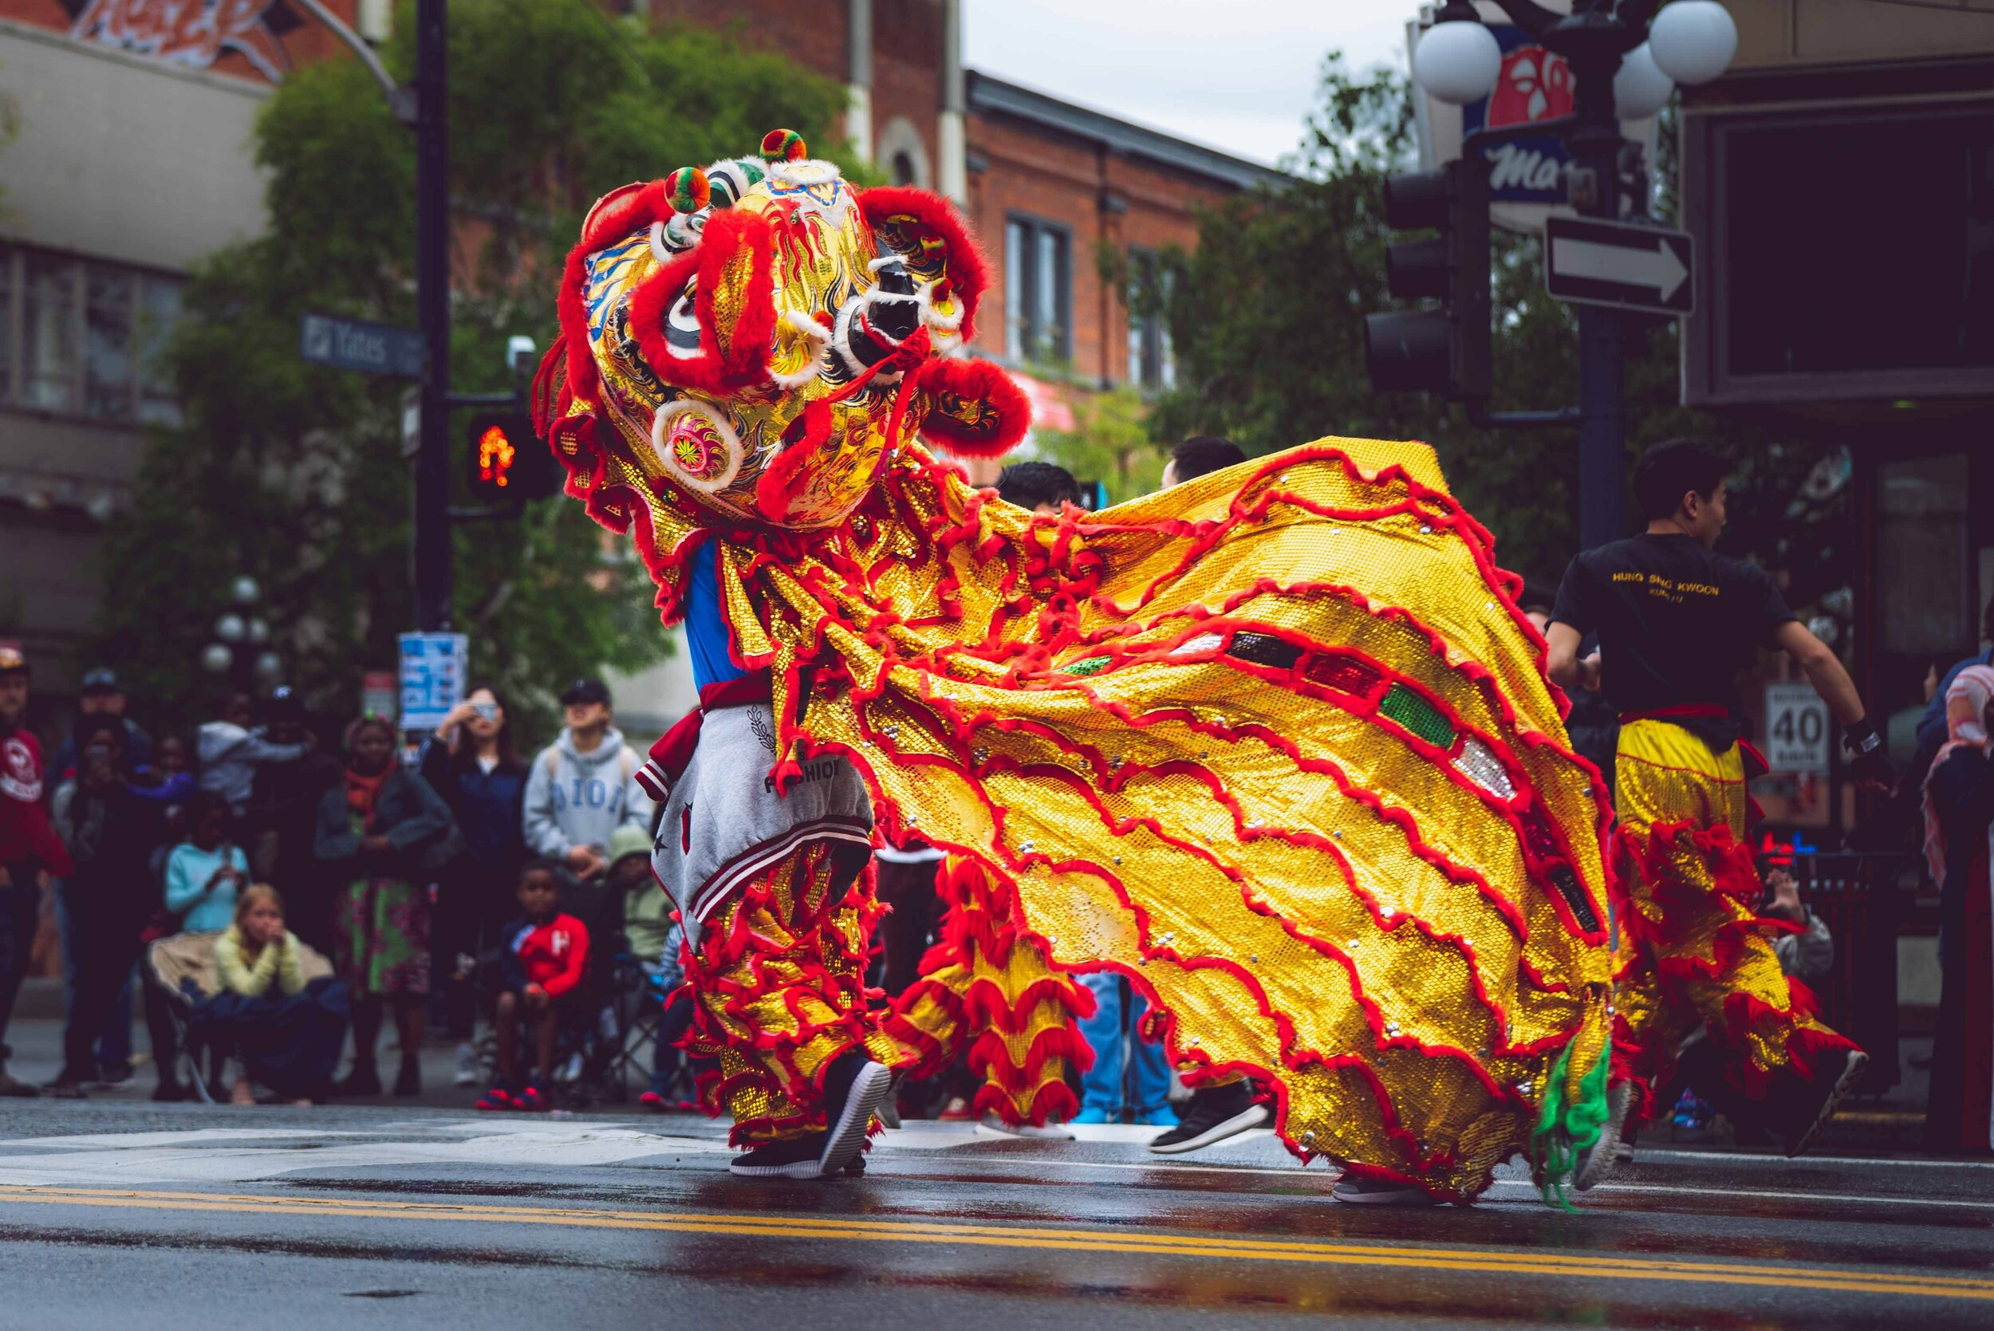
Ex 3 (pg.94) Fill in each blank with a word or frase from the box.
painting eggs | Christmas | Mid-autumn festival
candy apples | Cannes film festival | turkey
5. Performing lion dances is one of the activities at the _____________________.
Mid-autumn festival

Slide 19
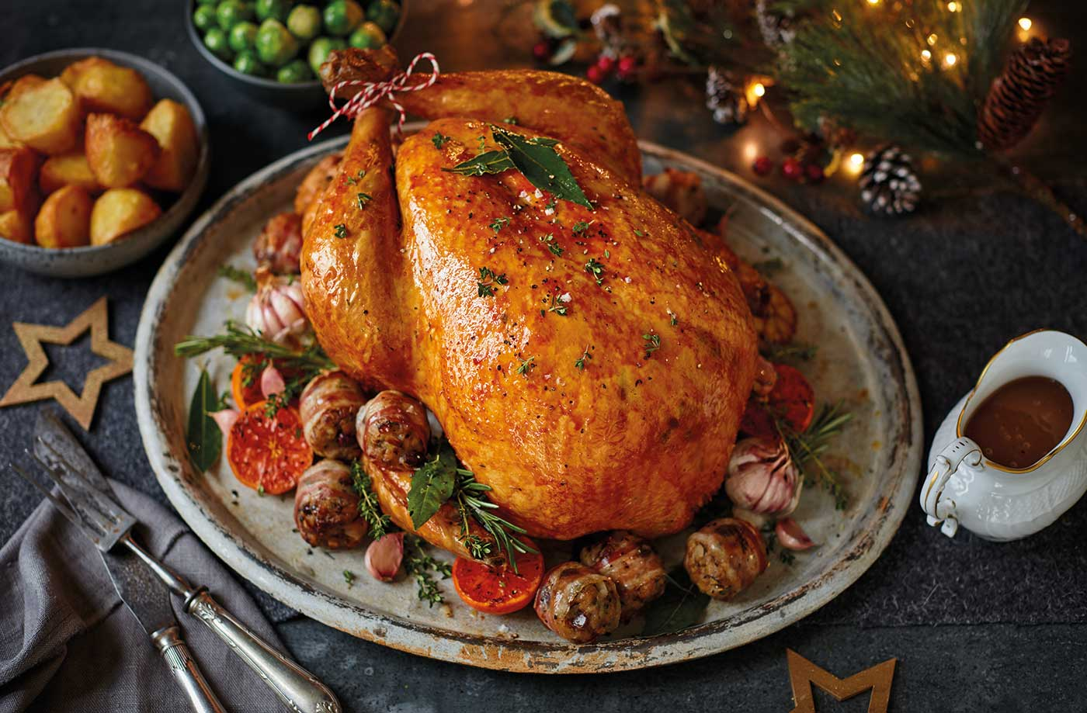
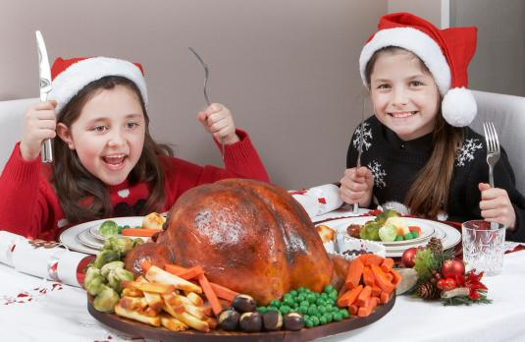
Ex 3 (pg.94) Fill in each blank with a word or frase from the box.
painting eggs | Christmas | Mid-autumn festival
candy apples | Cannes film festival | turkey
turkey
6. Bill's mum is cooking a _________ for Thanksgiving.

Slide 20
02
Pronunciation

Slide 21
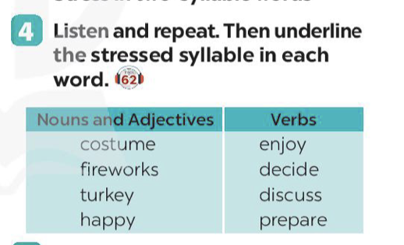
Ex 4 (pg.94) Listen and repeat.
Nouns and Adjectives | Verbs
costume | enjoy
fireworks | decide
turkey | discuss
happy | prepare

Slide 22
Ex 4 (pg.94) Underline the stressed syllable in each word.
Nouns and Adjectives | Verbs
costume | enjoy
fireworks | decide
turkey | discuss
happy | prepare

Slide 23
Stress in two-syllable words
are usually stressed on
the first syllable
Nouns and adjectives
Except for:
advice machine
mistake hotel
alone amazed
/ədˈvaɪs/
/məˈʃiːn/
/mɪˈsteɪk/
/həʊˈtel/
/əˈləʊn/
/əˈmeɪzd/

Slide 24
Stress in two-syllable words
Verbs
are usually stressed on the second syllable
Except for:
offer happen
listen visit
travel manage
/ˈɒfə/
/ˈhæpən /
/ ˈlɪsən/
/ ˈvɪzɪt/
/ˈtrævəl /
/ˈmænɪdʒ /

Slide 25
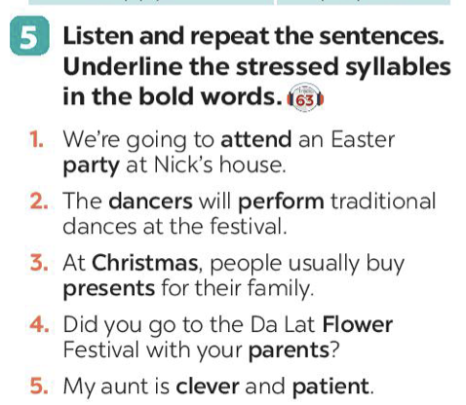
Ex 5 (pg.94) Listen and repeat the sentences. Underline the stressed syllables in the bold words.
1. We’re going to attend an Easter party at Nick’s house.
2. The dancers will perform traditional dances at the festival.
3. At Christmas, people usually buy presents for their family.
4. Did you go to the Da Lat Flower Festival with your parents?
5. My aunt is clever and patient.
/əˈtend/
/ˈpɑːti/
/ˈdɑːnsə/
/ pəˈfɔːm/
/ˈkrɪsməs /
/ˈprezənt /
/ˈflaʊə/
/ˈpeərənt /
/ˈklevə /
/ˈpeɪʃənt /

Slide 26
RECAP
1
Odd one out
A. chocolalate eggs B. moon cakes
C. carving pumpkins D. turkey
2
Fill in the blanks
Nouns and adjectives are usually stressed on the ________ syllable and verbs are stressed on the ________ syllable.
first
second

Slide 27
Photo flash
remember and write
all the festivals

Slide 28
Show all
Fast
Medium
Slow
Hide all
Notes:
Right-click on an image and select change picture.
Select your picture. Click on insert.
Start your presentation.
Click on Fast, Medium or Slow to show the series of images.
Click Show All to see all the images.
Click Hide All to hide all the images.

Slide 29
FESTA JUNINA: PACOTE DE ÍCONES

Slide 30
RECURSOS ALTERNATIVOS
Aqui está uma variedade de recursos alternativos que combinam com o estilo deste modelo:
VETORES:
Hand drawn sao joao instagram posts collection
Hand drawn sao joao illustration

