Slide 1
Unit 6: Vietnamese lifestyle: then and now
LESSON 6: SKILLS 2

Slide 2
OBJECTIVES
By the end of the lesson, students will be able to:
Listen for general and specific information to talk about changes in family life
Write about the changes in one’s family.

Slide 3
LISTENING
01.

Slide 4
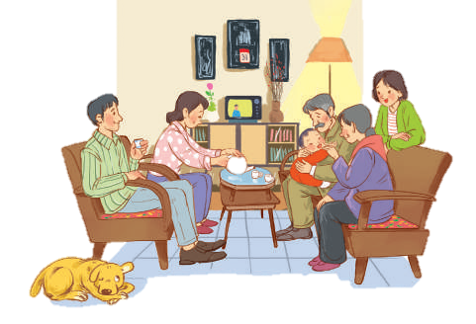
Ex1: You are going to listen to a talk about family life. Work in pairs. Choose the aspect(s) that you think will be mentioned in the talk.
a. Family types
b. Parents’ working places
c. Family holidays
d. Birthday parties
e. Parents-children relations

Slide 5
Ex2: Listen to the talk and tick (√) the correct column.
FACTS | THE PAST | THE PRESENT
1. Popularity of extended families
2. More holidays away from home
3. More time spent doing things together
4. More sources to learn from
5. More democratic parent-children relationships

Slide 6
Ex2: Listen to the talk and tick (√) the correct column.
FACTS | THE PAST | THE PRESENT
1. Popularity of extended families
2. More holidays away from home
3. More time spent doing things together
✓
✓
✓
1. In the past, there were usually three generations living together in a household.
2. Now, more families go out, visit places, play, and eat. Overall, holidays have become more relaxing and less tiring.
3. Lastly, families in the past spent more time talking and doing things together.

Slide 7
Ex2: Listen to the talk and tick (√) the correct column.
FACTS | THE PAST | THE PRESENT
4. More sources to learn from
5. More democratic parent-children relationships
✓
✓
4. Today’s children have more opportunities to learn from other sources.
5. Today’s children have more opportunities to learn from other sources. […] The relation between parents and children is more democratic.

Slide 8
Ex3: Listen again and fill in the blank with one word or number.
The speaker mentions ______ types of families.
In an extended family, there is / are _________ generation(s) living together.
The speaker describes Vietnamese people as ______.
Children in the past usually came to their ___________ to share their experiences.
Today’s children want their parents to respect their independence and _______________.

Slide 9
Ex3: Listen again and fill in the blank with one word or number.
Firstly, nuclear families have replaced extended ones.
In the past, there were usually three generations living together in a household.
Vietnamese people are traditionally family – oriented.
The speaker mentions ______ types of families.
In an extended family, there is / are _________ generation(s) living together.
The speaker describes Vietnamese people as ________________.
two
three
family – oriented.

Slide 10
Ex3: Listen again and fill in the blank with one word or number.
4. Families in the past spent more time talking and doing things together. Children came to their elders to share their experiences and look for answers to their questions.
5. Parents have leaned to respect their children’s independence and privacy.
4. Children in the past usually came to their ___________ to share their experiences.
5. Today’s children want their parents to respect their independence and _______________.
elders
privacy

Slide 11
Audio script:
Family life has changed a lot over the past 50 years.
Firstly, nuclear families have replaced extended ones. In the past, there were usually three generations living together in a household. Now, there are often two generations only: parents and children.
Secondly, Vietnamese people are traditionally family – oriented. Holidays in the past mostly meant gathering, cooking, and eating. Now, more families go out, visit places, play, and eat. Overall, holidays have become more relaxing and less tiring.
Lastly, families in the past spent more time talking and doing things together. Children came to their elders to share their experiences and look for answers to their questions. Today’s children have more opportunities to learn from other sources. They do not depend all on their elders. While they listen to their parents, they want their parents to listen to them, too. The relation between parents and children is more democratic. Parents have leaned to respect their children’s independence and privacy.

Slide 12
02.
WRITING

Slide 13
Ex4: Read the list and tick (√) the thing(s) that has/have changed in your family in the past five years. Make notes of those which have changed.
LIST |  | CHANGE
 | 1. Family type / members | Still nuclear. One more member: my brother
 | 2. Home facilities
 | 3. Ways of spending free time
 | 4. Relationships among members
✓
better, air conditioner, washing machines,…
eat out, go on holiday, do chores.
respect each other

Slide 14
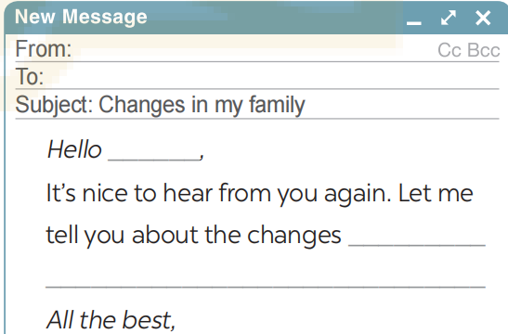
Ex5: Write an email (100 - 120 words) to your penfriend about the changes in your family. Use the ideas in 4
- Use the ideas in Activity 4 for your writing.

Slide 15
Ex5: Write an email (100 - 120 words) to your penfriend about the changes in your family. Use the ideas in 4
Suggestions for writing emails:
How have the relationships between family members changed in the past five years?
Has anyone in the family changed jobs or received a promotion?
Has anyone in the family started or completed any educational programs?
Have any family members developed new hobbies or interests?
How have these new interests affected family time and activities?
Has the family's involvement in the community or social activities changed?
Have there been any new friendships or connections made?

Slide 16
Ex5: Write an email (100 - 120 words) to your penfriend about the changes in your family. Use the ideas in 4
From: Hoa
To: Tom
Subject: Changes in my family
Hello Tom,
It’s nice to hear from you again. Let me tell you about the changes in my family over the past five years. It’s still a nuclear family with two generations. But our living conditions are much better. Two years ago, my father found another job and he earns more money now. We now have an air conditioner and a washing machine. We also spend our free time differently, often eating out or going on holidays together. My father also spends more time with my brother and me. He teaches us how to do the chores that adult men should be able to do. We act more like friends. My parents respect our independence and privacy. It’s good news, isn’t it?
All the best,
Hoa

Slide 17
SWAP AND CHECK
Check for spelling
Do the words spell correctly?
Check for ideas
Does your friend write about the changes in your family?
Check for comprehension
Does the writing make sense?
Check for grammar
Does the writing use the correct tenses and structures?

Slide 18
EXTRA ACTIVITY
Write your opinion about the role of children nowadays in the family based on the following suggestions:
The number of children in a household.
The amount of housework they share with their parents.
The amount of time they spend on family activities.
How much they are obedient to/ independent of their parents.
If they are obliged to take care of their parents when their parents get old.

Slide 19
EXTRA ACTIVITY
SUGGEST ANSWER:
Nowadays families tend to have fewer children than in the past: just one or two per family. Therefore, parents have more time to take care of their children, resulting in their children doing less housework and having fewer responsibilities in the family. Most parents encourage their children to spend more time on their studies, so they may have less time with families. The internet is also a factor to distract children from engaging with family activities. Children become more independent. However, when their parents get old, most children are willing to take care of them.

Slide 20
SWAP AND CHECK
Check for spelling
Do the words spell correctly?
Check for ideas
Does your friend write about the role of children nowadays in the family based on the following suggestions?
Check for comprehension
Does the writing make sense?
Check for grammar
Does the writing use the correct tenses and structures?

Slide 21
WRAP – UP
What have we learnt in this lesson?
Listen for general and specific information to talk about changes in family life
Write about the changes in one’s family.

Slide 22
THANK YOU!

