Slide 1
Da Phuc primary school
Welcome to my class
Teacher: Do Tra Giang
Class: 4A3

Slide 4
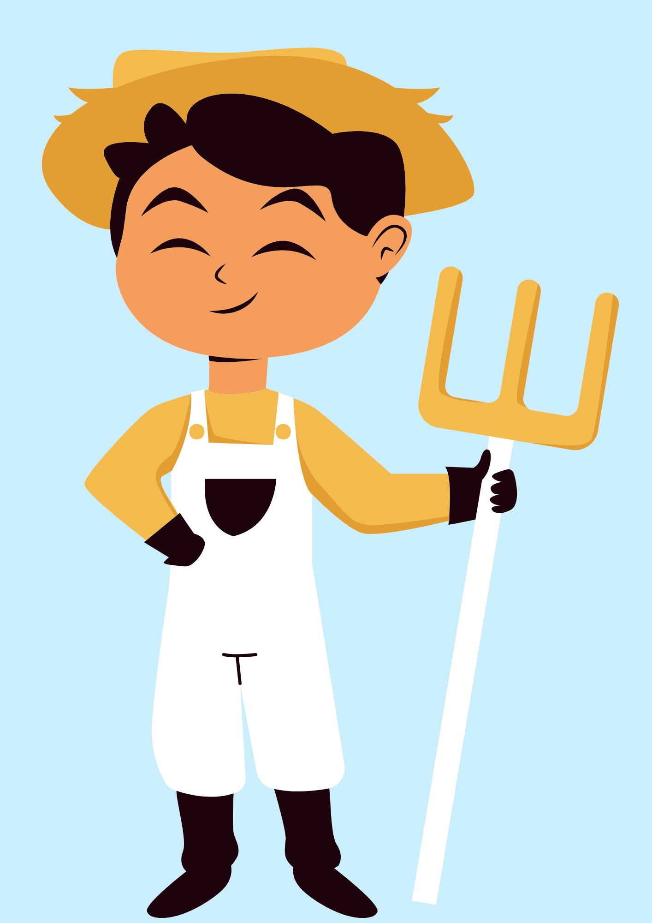
GUESS THE JOB!
a farmer

Slide 5
GUESS THE JOB!
an office worker

Slide 6
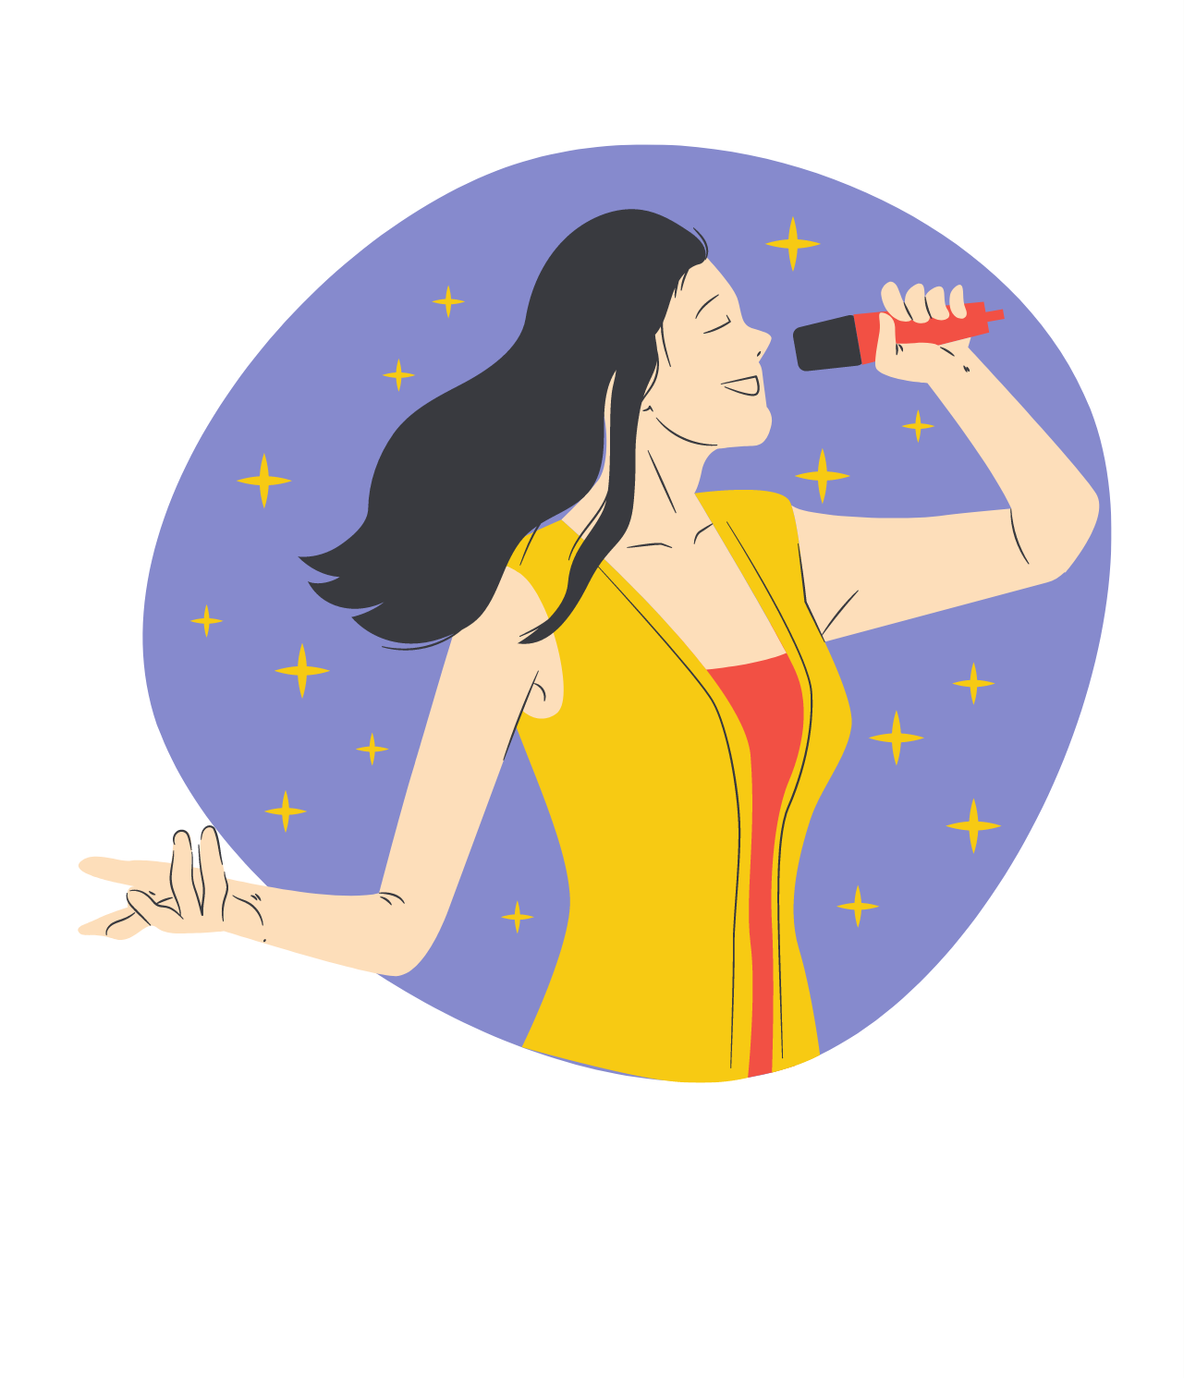
GUESS THE JOB!
a singer

Slide 7
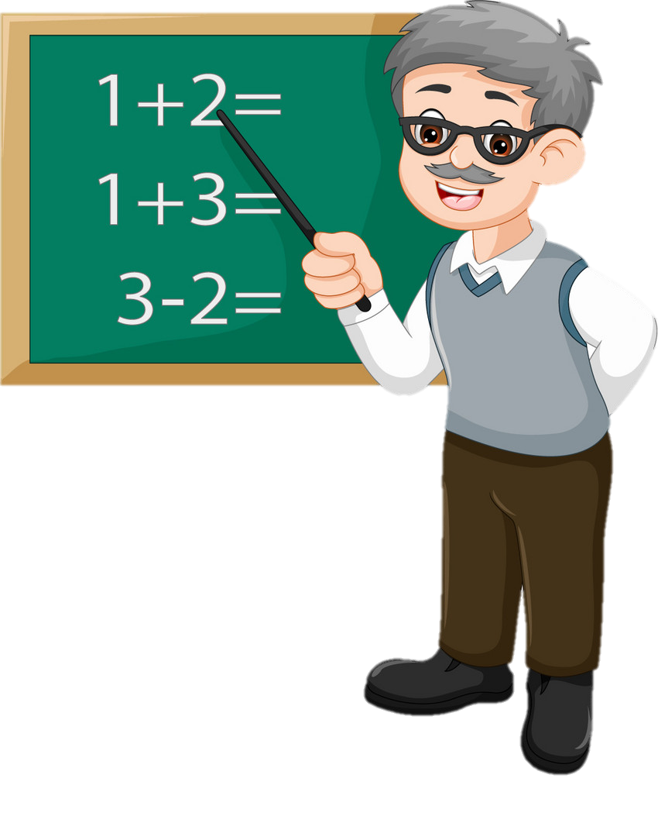
GUESS THE JOB!
a teacher

Slide 8
GUESS THE JOB!
a nurse

Slide 15
Write your own chant about your family!
My father is... He works...
My mother is... She works...

