Slide 2
13
MY house
LESSON 1 - PERIOD 1

Slide 3
TABLE OF CONTENTS
Warm-up and review
Look, listen and repeat.
01.
02.
03.
04.
Let’s talk.
Listen, point and say.
05.
Fun corner and wrap-up

Slide 4
1
Warm-up and review

Slide 5
Watch a video
Notes:
https://www.youtube.com/watch?v=nfBsIA5Lr0U

Slide 6
house

Slide 7
living room

Slide 8
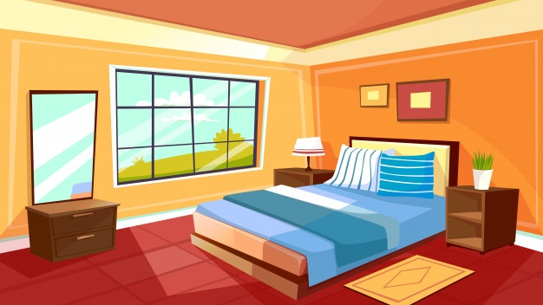
bedroom

Slide 9
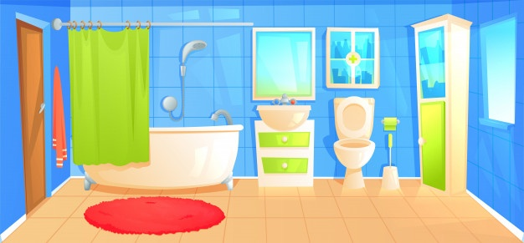
bathroom

Slide 10
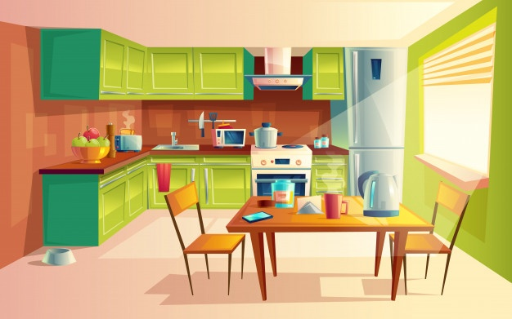
kitchen

Slide 11
Who is faster?

Slide 12
2
Look, listen and repeat. .

Slide 13
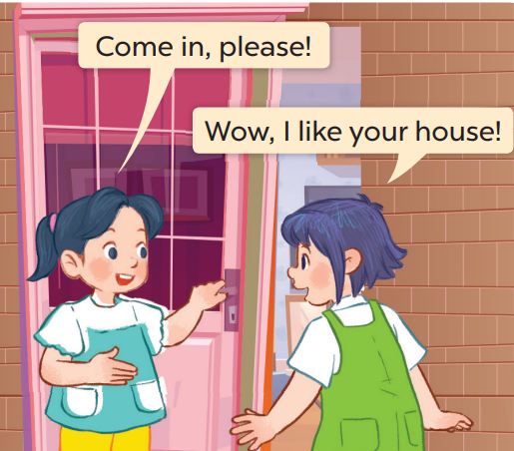
Who are they?
Where are they?

Slide 14
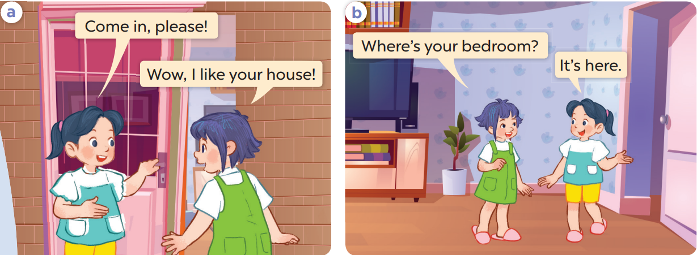
Work in pairs and repeat.

Slide 15
3
Listen, point and say..

Slide 16
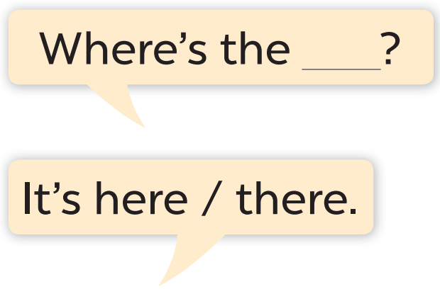
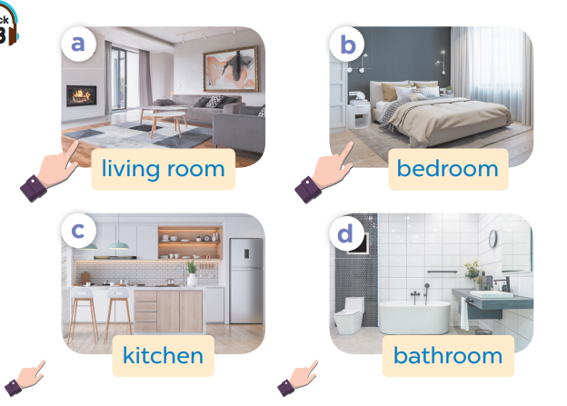

Slide 17
Work in pairs. Ask and answer.

Slide 18
Work in pairs.
Ask and answer.

Slide 19
4
Let’s talk.

Slide 20
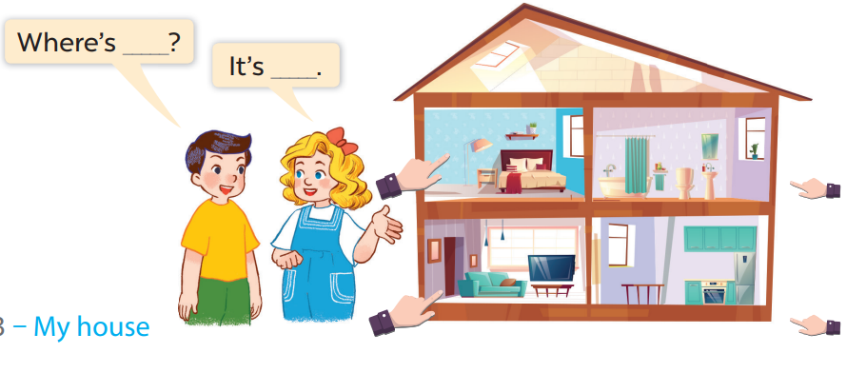
Work in pairs.
Ask and answer.

Slide 21
5
Fun corner and wrap-up

Slide 22
Play
What’s behind the square?

Slide 23
1
2
3
4
5
6
7
8
Next
tekhnologic

Slide 24
Where
………is the living room?
BACK
How
What

Slide 25
living room
Where is the………..?
BACK
kitchen
bathroom

Slide 26
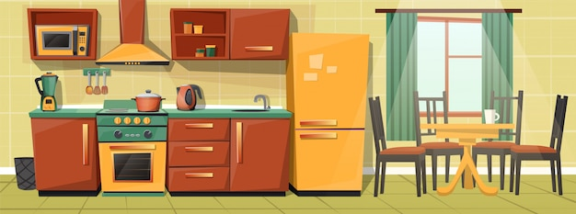
Where is the kitchen?
BACK
It’s there.
It’s here.

Slide 27
Where is the living room?
BACK
It’s there.
It’s here.

Slide 28
living room
Where is the………..?
BACK
kitchen
bathroom

Slide 29
living room
Where is the………..?
BACK
bathroom
bedroom

Slide 30
Where is the kitchen?
BACK
It’s there.
It’s here.

Slide 31
Where is the house?
BACK
It’s there.
It’s here.

Slide 32
Website: sachmem.vn
Fanpage: www.facebook.com/sachmem.vn

