Slide 1



13
Our house
LESSON 3 PERIOD 6

Slide 2
TABLE OF CONTENTS
Activity 4
Review and warm up
01.
02.
Activity 5
Activity 6
03.
04.
Listen and circle
Game
Look, complete and read
Let’s sing
Fun corner
Extra stuff
05.
06.
Game
Links

Slide 3
01.
Warm up
& review

Slide 4










TEAM 1
TEAM 2
TEAM 3

Slide 5




= 10 points
= - 20 points
= 50 points

Slide 6
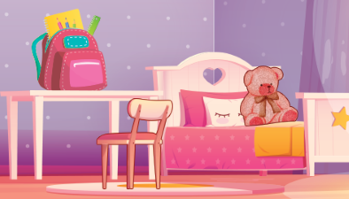
Where is the teddy bear?
It’s on the bed.

Slide 7
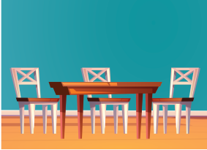
Where are the chairs?
They’re next to the table.

Slide 8
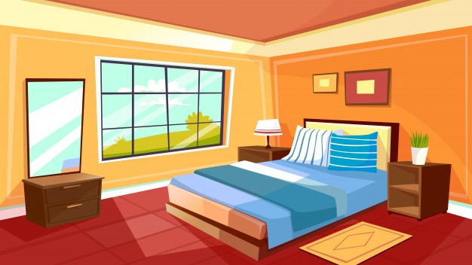
Where is the bed?
It’s in the bedroom.

Slide 9

Where is the bedroom?
It’s here!

Slide 10
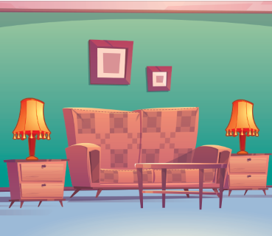
Where is the sofa?
It’s between the lamps.

Slide 11
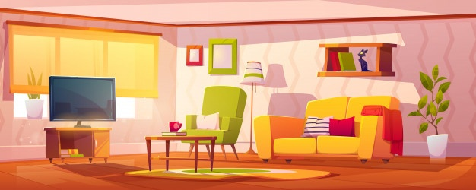
Where is the T.V?
It’s in the living room.

Slide 12
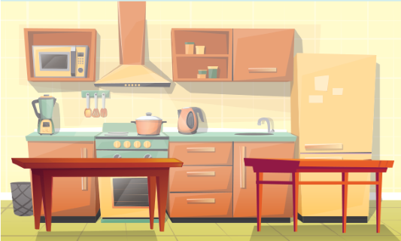
Where are the tables?
They are in the kitchen.

Slide 13
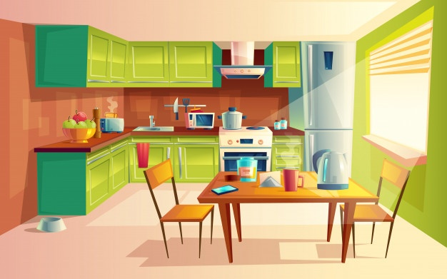
Where is the kitchen?
It’s there!

Slide 14
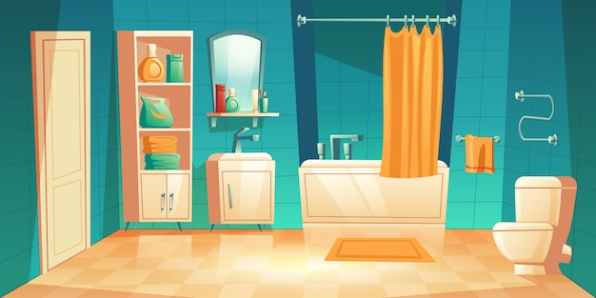
Where is the bathroom?
It’s here!

Slide 15
02.
Activity 4
Read and complete

Slide 16
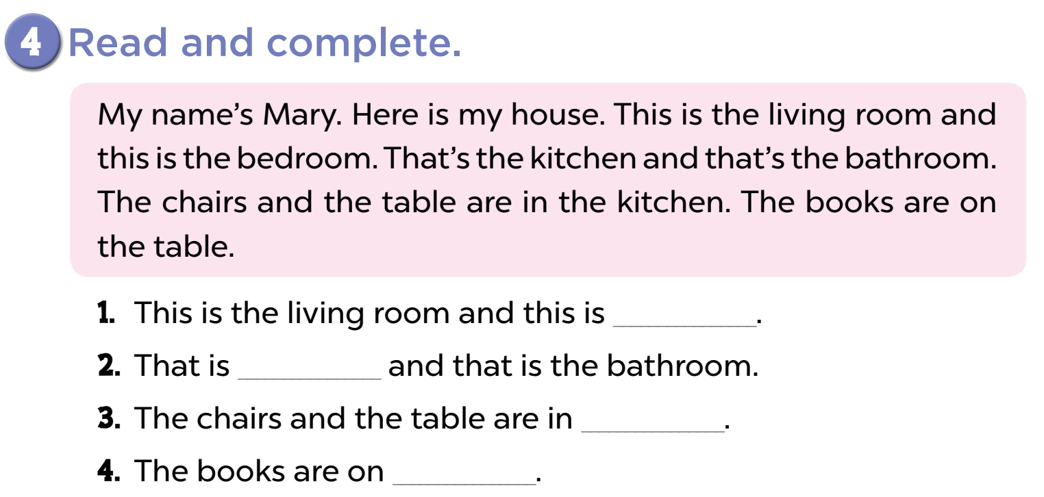

Slide 17
the bedroom
the kitchen
the kitchen
the table

Slide 18
03.
Activity 5
Let’s write

Slide 19
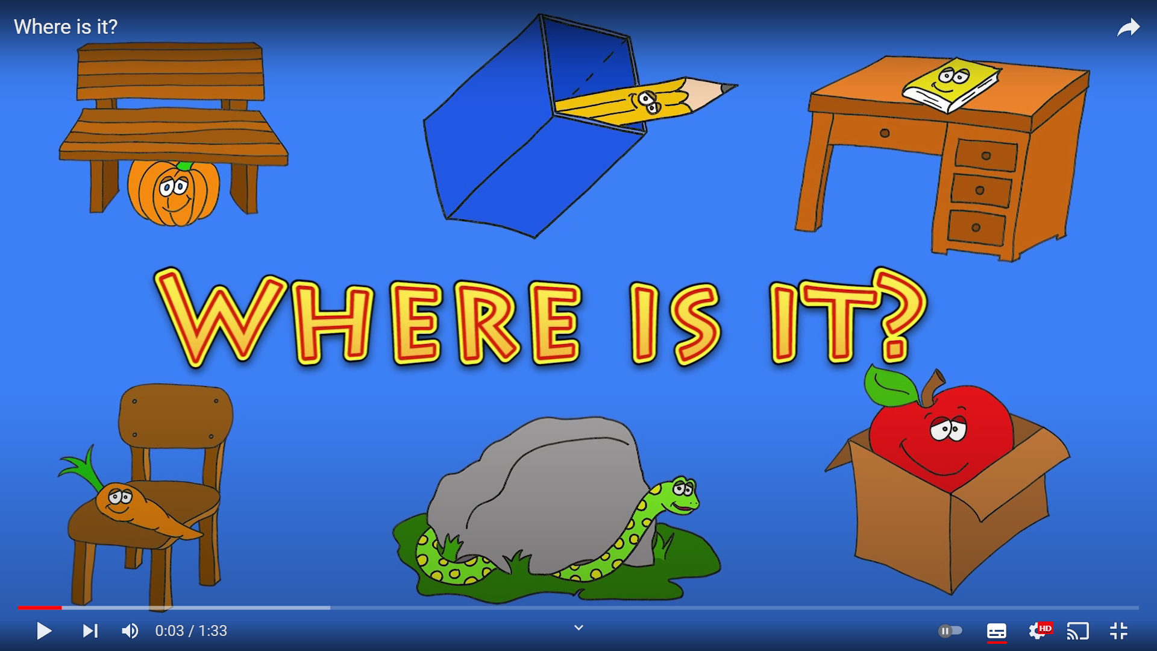
Notes:
https://www.youtube.com/watch?v=8F0NYBBKczM

Slide 20
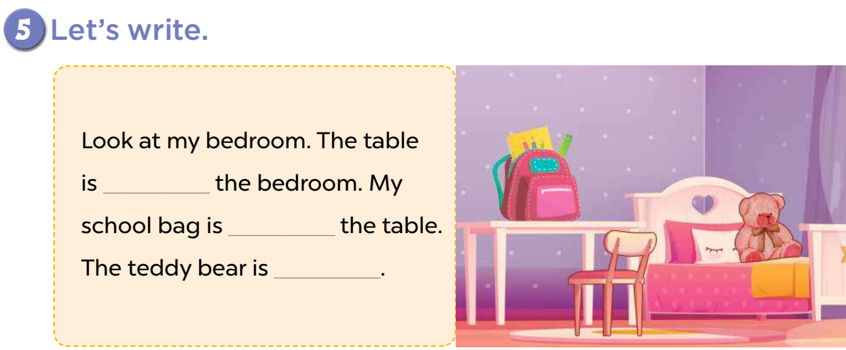
next to
on
in the bed.

Slide 21
04.
Activity 6
Project

Slide 22
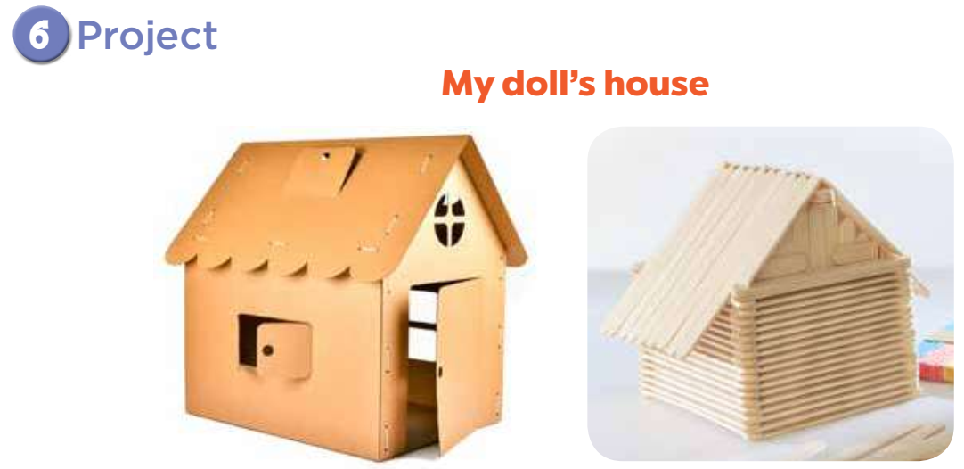

Slide 23
05
Fun corner
Let’s have some fun!

Slide 24


Slide 25
06.
Extra stuffs

