Slide 1



Slide 2
Alphabet Race Game
Apple/ | Ink | Quiz
B | J | R
C | K | S
D | L | Twelve
E | M | U
F | N | V
Goat | O | W
H | P | Y
Notes:
Alphabet Race Game:
-Teacher writes the letters from A to Y in columns down the board.
-Divide the class into 2 teams standing in 2 lines.
-2 different colored markers or piece of chalk for each team.
-Students race to write only one word next to each letter.
-Teacher checks and corrects answers on the board.

Slide 3


Slide 4

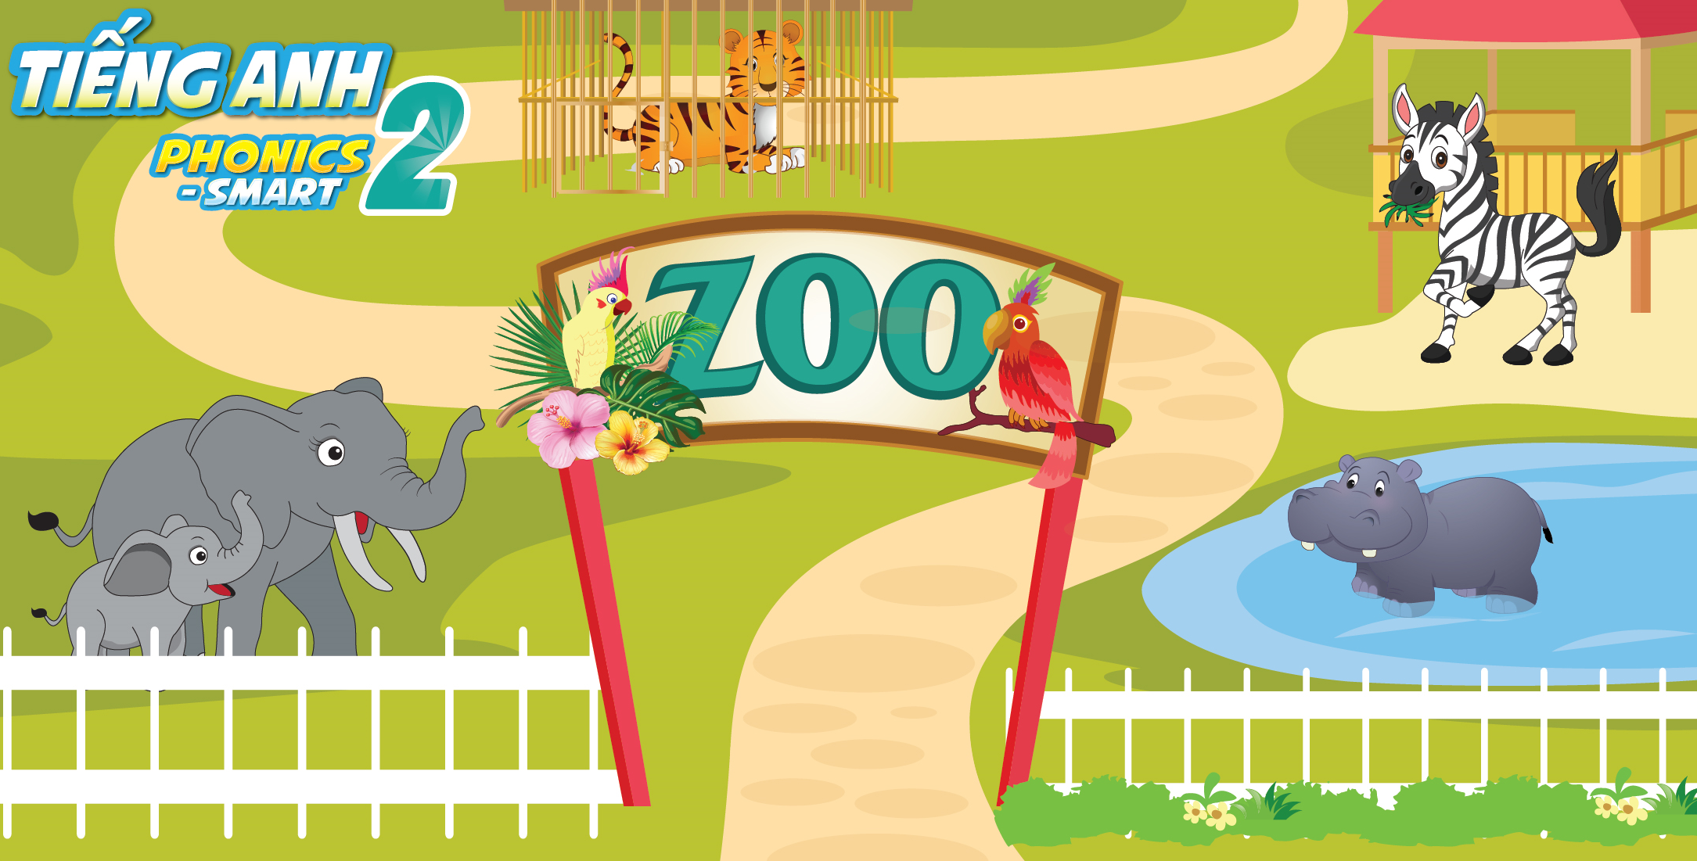
Unit 13:
Lesson 1 - Zz

Slide 5


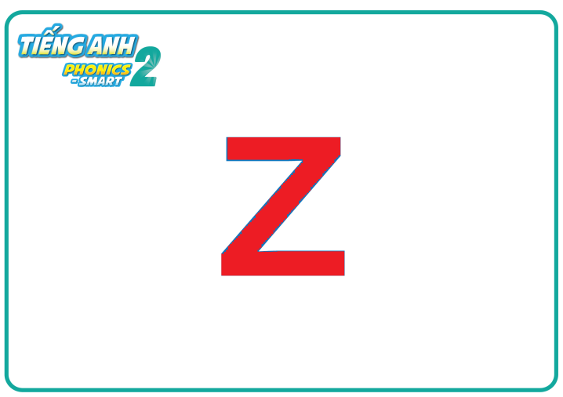
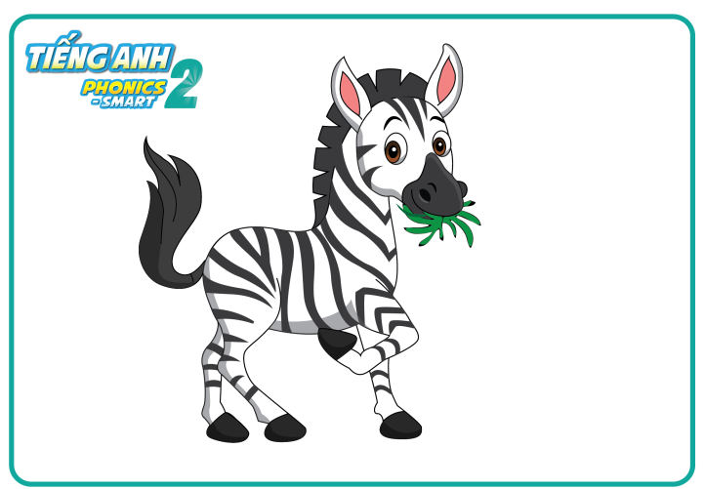
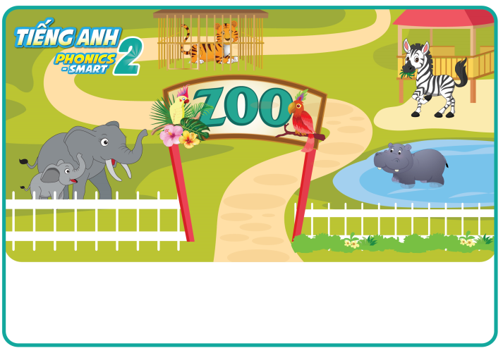
Unit 13:
Lesson 1:
Zz
1. Look, listen and repeat.
zebra
zoo

Slide 6
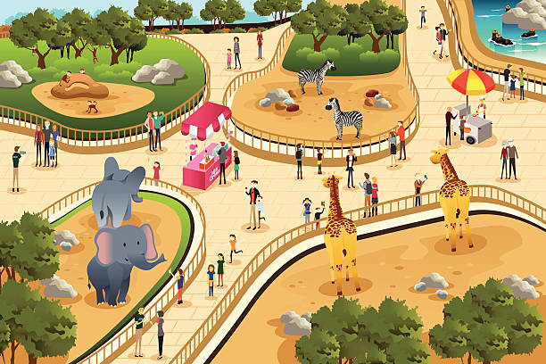
Where are the animals?
In the zoo
Notes:
Teacher asks and students answer

Slide 7
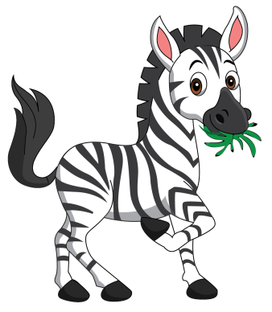

Find and point.
zebra
elephant
Notes:
Find and point game
-Teacher shows the picture and asks: What animal is it?
-Students answer and go to the board point out the animal.

Slide 8
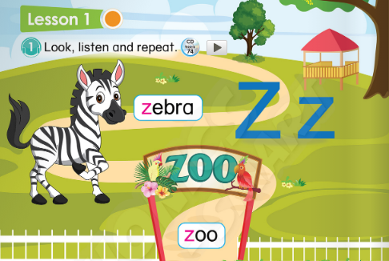
Unit 13:
Lesson 1:
Zz
1. Look, listen and repeat.

Slide 9







Unit 13:
Lesson 1:
Zz
2. Let’s chant.

Slide 10

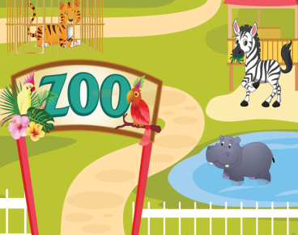

Unit 13:
Lesson 1:
Zz
1. Look, listen and repeat.
2. Let’s chant.
Z
z

