Slide 1



Slide 2
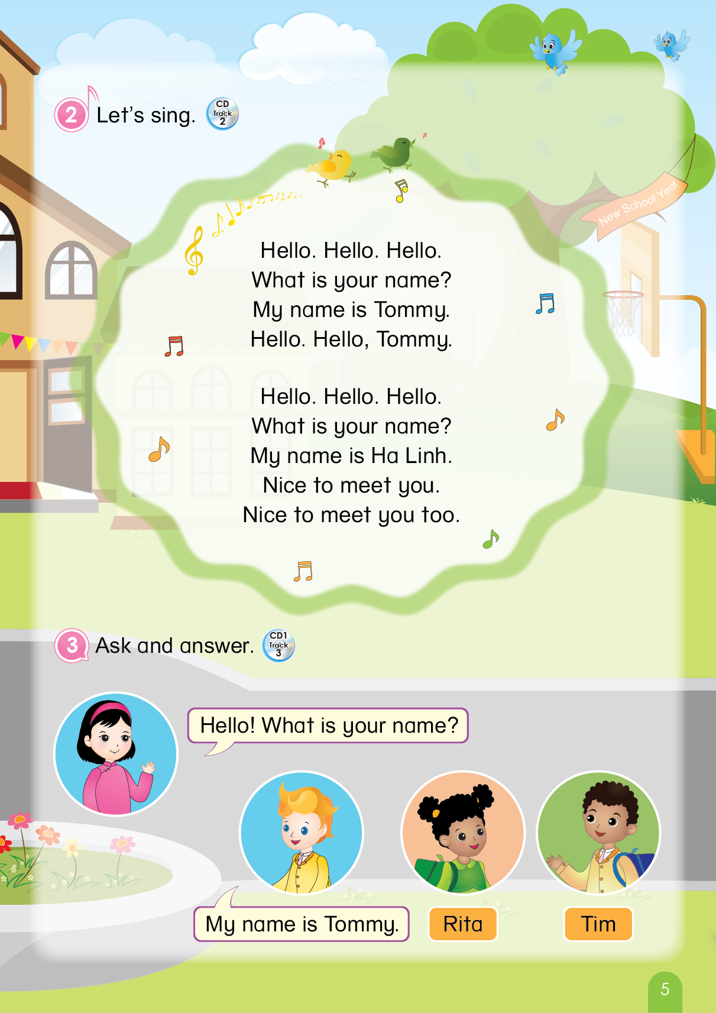

Notes:
T says “ Hello, everyone. How are you? How’s the weather? Is it sunny? Great! Now, let’s sing a song with me.”
Warm up: Sing “Hello song” – “Excellent! You sing very well.”
Divide class into 2 groups (optional) – “Today, we will have 2 groups – Group 1 and Group 2. You are Group 1, you are Group 2.”

Slide 3


Unit 5
Lesson 1
Notes:
T uses body language to describe 4 letters (A, B, C, D) and asks “What is the letter?”
T says “Today, we will learn the next letter. Can you guess what it is?”
T uses body language to describe the letter E.
Now, let’s look and listen.”

Slide 4

Unit 5:
Lesson 1:
E e
1. Look, listen and repeat.
Ee
Notes:
Introduce picture – “Now, look and listen.”
Ask sts to listen 1 times
T says “Yes, today we will learn Unit 5 – Lesson 1 – Letter E”
Ask sts to listen again 2 times – “Now, listen 2 times.”
Ask sts to listen and repeat (class, group, individual) - “Listen and repeat. Class! Group 1, please! Group 2, please! You, you and you!
T can use body language to describe the letter E. - “Look at me and listen. E! Class, what is it? Good!”
T can use body language to check sts’ understanding - “Look and tell me what it is”

Slide 5
Unit 5:
Lesson 1:
E e
1. Look, listen and repeat.
e
Notes:
Introduce picture “ Class, what is the sound of E? OK! Now, listen 3 times”
Ask sts to listen 3 times
Ask sts to listen and repeat (class, group, individual) - “Listen and repeat. Class! Group 1, please! Group 2, please! You, you and you!
T can use body language to describe the sound of E. - “Look at me and listen. e! Class, what is the sound of E? Good!”
T can use body language to check sts’ understanding - “Look and tell me what it is”

Slide 6

Unit 5:
Lesson 1:
E e
1. Look, listen and repeat.
egg
Notes:
Introduce picture “Class, what is it? OK! Now, listen 3 times”
Ask sts to listen 3 times
Ask sts to listen and repeat (class, group, individual) - “Listen and repeat. Class! Group 1, please! Group 2, please! You, you and you!
T can use body language to describe the word. - “Look at me and listen. Egg! Class, what is it? Good!”
Click to make the word “egg” disappear – Ask “What is it?”
T can use body language to check sts’ understanding - “Look and tell me what it is.”

Slide 7

Unit 5:
Lesson 1:
E e
1. Look, listen and repeat.
elephant
Notes:
Introduce picture “Class, what is it? OK! Now, listen 3 times”
Ask sts to listen 3 times
Ask sts to listen and repeat (class, group, individual) - “Listen and repeat. Class! Group 1, please! Group 2, please! You, you and you!
T can use body language to describe the word. - “Look at me and listen. Elephant! Class, what is it? Good!”
Click to make the word “egg” disappear – Ask “What is it?”
T can use body language to check sts’ understanding - “Look and tell me what it is.”

Slide 8




Unit 5:
Lesson 1:
E e
1. Look, listen and repeat.
Game
Guessing game
Notes:
Guessing game
T says “Let’s play with these magic numbers.”
Work in groups
Each group chooses 1 number – “Group 1/Group 2, what number do you like?”
T clicks on the number, shows the picture and asks “What is it?”
With a correct answer, each group will have 1 flower.

Slide 9
Unit 5:
Lesson 1:
E e
Game
Guessing game
e
Notes:
Click quickly to appear and disappear the picture
Ask “What is it?”
Click again to appear and check the answer. – “Correct! One flower for you group.”

Slide 10

Unit 5:
Lesson 1:
E e
Game
Guessing game
Notes:
Click quickly to appear and disappear the picture
Ask “What is it?”
Click again to appear and check the answer. – “Yes! One flower for you group.”

Slide 11

Unit 5:
Lesson 1:
E e
Game
Guessing game
Notes:
Click quickly to appear and disappear the picture
Ask “What is it?”
Click again to appear and check the answer. – “Right! One flower for you group.”

Slide 12
Unit 5:
Lesson 1:
E e
Game
Guessing game
Ee
Notes:
Click quickly to appear and disappear the picture
Ask “What is it?”
Click again to appear and check the answer. – “Good! One flower for you group.”

Slide 13

Notes:
“Well done. Now, let’s move to next part.”

Slide 14
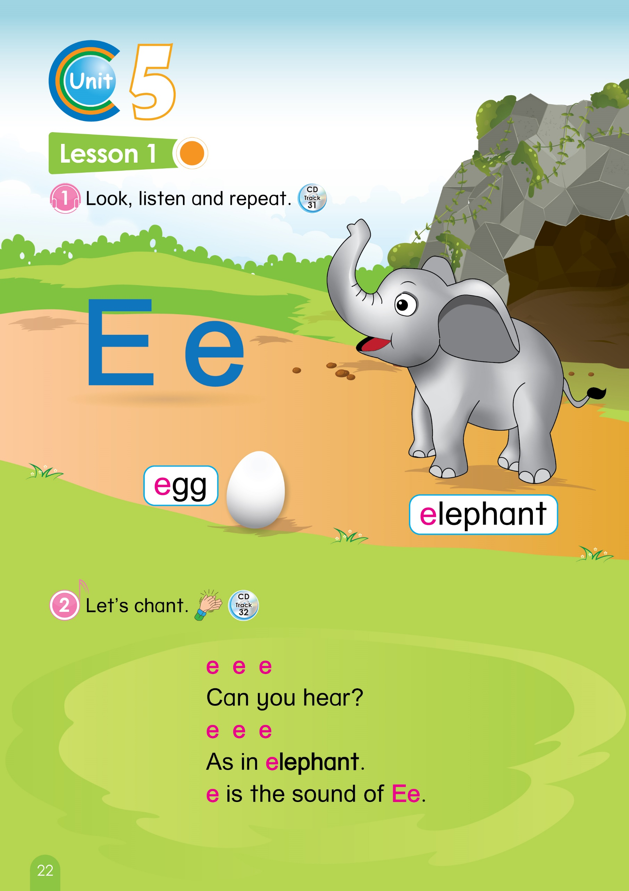
Page 22
Notes:
Book using – Look, point and say
1. T says “Class, open your book page 22. Let’s look, point and tell me what it is.”
2. T points at the picture and asks “What is it?”
3. T gives 1 flower to each group -“Great! One flower for each group.”

Slide 15

Unit 5:
Lesson 1:
E e
1. Look, listen and repeat.
2. Let’s chant.
Page 22
Notes:
T says “Let’s chant with me”
Ask sts to listen 2 times – “Listen 2 times.”
Ask sts to listen and repeat sentence by sentence – “Listen and repeat.”
Ask sts to chant (class, group) – “Class, let’s chant”

Slide 16



Unit 5:
Lesson 1:
E e
1. Look, listen and repeat.
2. Let’s chant.
…
Notes:
T shows the picture – “Now, look at the picture and chant. For example, if you see the egg, you will chant ‘as in egg’. OK! Now, let’s go.”
Sts chant based on the picture.
Elephant: “e e e / Can you hear? / e e e / As in elephant / e is the sound of Ee”
Egg: “ e e e / Can you hear? / e e e / As in egg / e is the sound of Ee”
T gives one flower to each group – “Well done. One flower for each group.”

Slide 17



Unit 5:
Lesson 1:
E e
1. Look, listen and repeat.
2. Let’s chant.
e
Ee
Notes:
Sum up – Ask “Look at these pictures again, what is it? Good!”
Count the flowers of each groups – “Let’s count your flowers.”
Group having more flowers will be the winner. – “So the winner is group …. Group …, you also good, too.”
Say goodbye “ Now, let’s say ‘Goodbye egg, Goodbye elephant.’. Now, Goodbye class.”

