Slide 2







Unit 14
AT HOME
Lesson 3

Slide 3










Table of contents
  Warm-up and review.
  Listen and repeat.
  Let’s talk.
  Let’s sing.
  Fun corner and wrap-up.

Slide 4







Warm-up and Review.

Slide 5




Let’s Play
This or That

Slide 6




sixteen
that
16
19
or
✓
✗
this
Notes:
Click the numbers to choose

Slide 7



twenty
that
13
20
or
✗
✓
this
Notes:
Click the numbers to choose

Slide 8



eighteen
that
15
18
or
✗
✓
this
Notes:
Click the numbers to choose

Slide 9



seventeen
that
17
14
or
✓
✗
this
Notes:
Click the numbers to choose

Slide 10



nineteen
that
20
19
or
✗
✓
this
Notes:
Click the numbers to choose

Slide 11

Thanks for playing!

Slide 12
Listen and repeat.

Slide 13

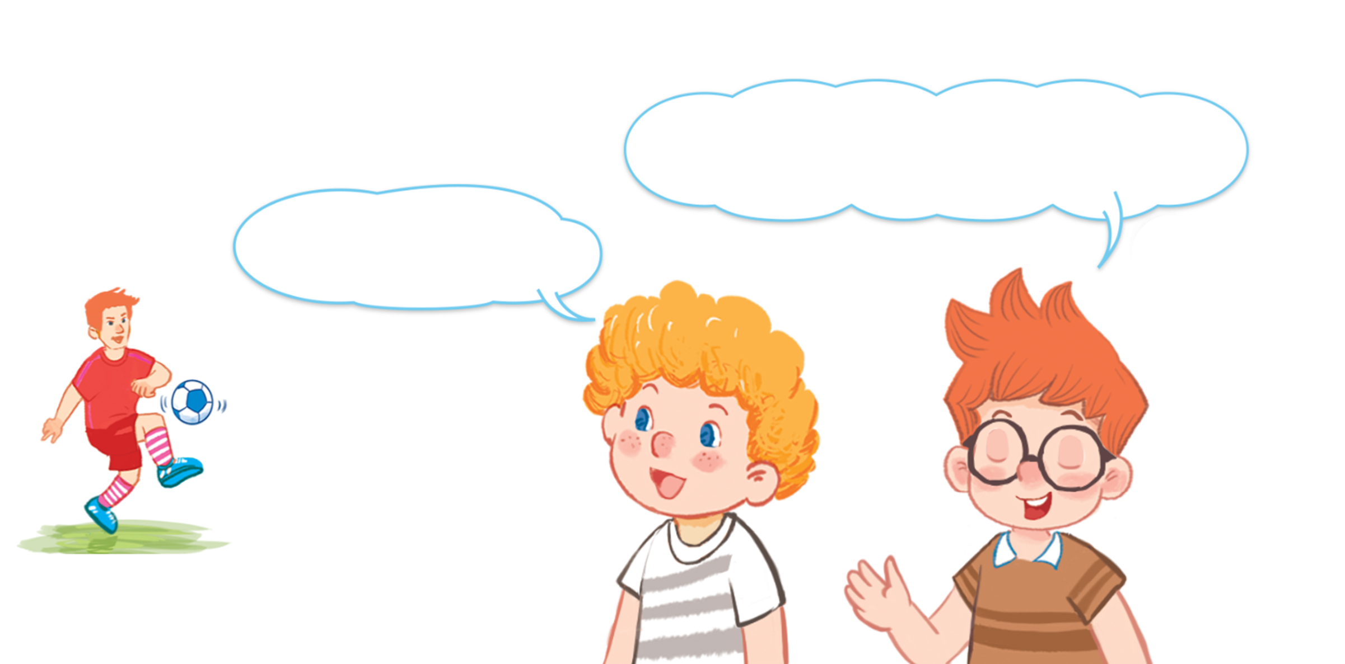
Look and say.

Slide 14

6. Listen and repeat.
How old is your brother?
How old is your brother?
How old is your brother?
How old is your brother?
He’s nineteen.
He’s nineteen.
He’s nineteen.
He’s nineteen.

Slide 15
Let’s talk.

Slide 16


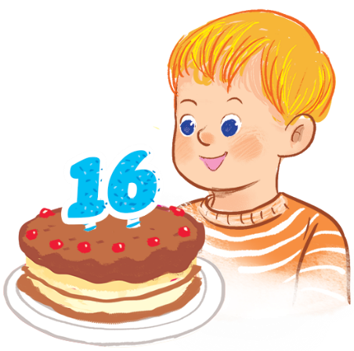
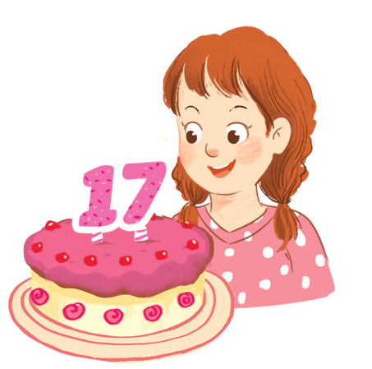
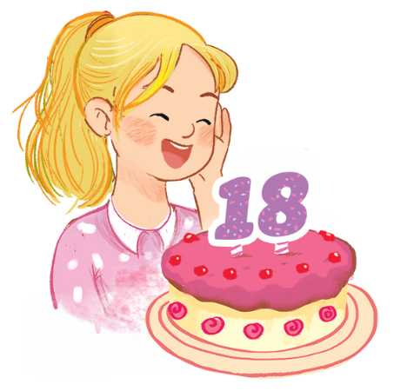
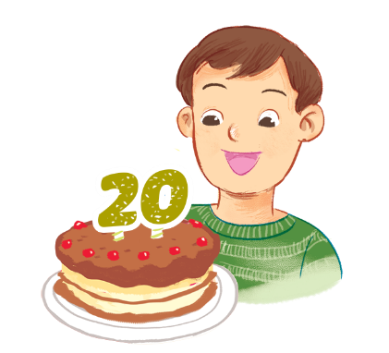
Look and say.
How old ______?
______.
a
b
c
d

Slide 17
7. Let’s talk.
How old ______?
______.
a
b
c
d

Slide 18
Work in pairs
How old ______?
______.
a
b
c
d

Slide 19
Let’s sing.

Slide 20
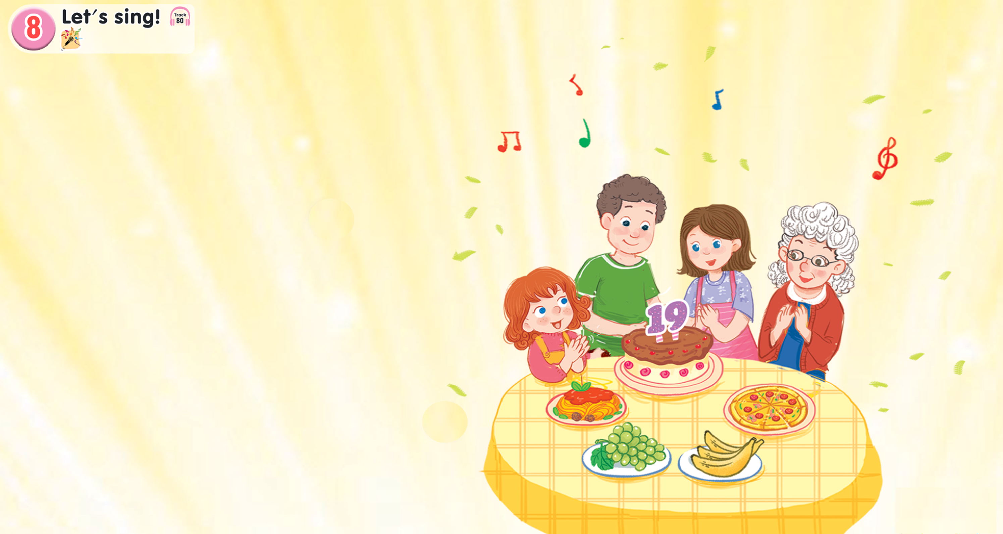
Look and say.

Slide 21


Watch a video song.

Slide 22
8. Let’s sing.
That’s my brother.
That’s my brother.
That’s my brother.
That’s my brother.
How old is he?
How old is he?
How old is he?
How old is he?
He’s nineteen.
He’s nineteen.
He’s nineteen.
He’s nineteen.
My grandmother is here.
My grandmother is here.
My grandmother is here.
My grandmother is here.
My sister is here.
My sister is here.
My sister is here.
My sister is here.
We are all here.
We are all here.
We are all here.
We are all here.
At his birthday party.
At his birthday party.
At his birthday party.
At his birthday party.

Slide 23
Work in groups
That’s my brother.
That’s my brother.
That’s my brother.
That’s my brother.
How old is he?
How old is he?
How old is he?
How old is he?
He’s nineteen.
He’s nineteen.
He’s nineteen.
He’s nineteen.
My grandmother is here.
My grandmother is here.
My grandmother is here.
My grandmother is here.
My sister is here.
My sister is here.
My sister is here.
My sister is here.
We are all here.
We are all here.
We are all here.
We are all here.
At his birthday party.
At his birthday party.
At his birthday party.
At his birthday party.

Slide 24
Fun corner and wrap-up.

Slide 25




FIND THE ODD ONE OUT

Slide 26


Find the odd one out
fifteen
sister
A
B
seventeen
nineteen
C
D

Slide 27

Find the odd one out
A
fifteen
B
nineteen
C
father
D
twenty

Slide 28


A
father
Find the odd one out
B
mother
C
sister
D
sixteen

Slide 29

Find the odd one out
seventeen
cake
banana
yogurt
A
B
C
D

Slide 30

Find the odd one out
A
grandmother
B
monkey
C
zebra
D
zebu

Slide 31



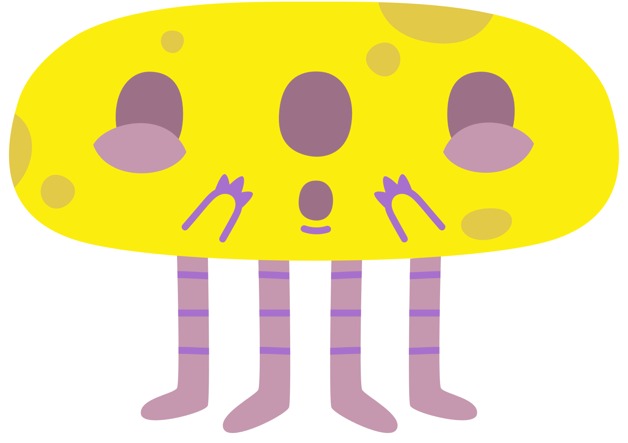





DID YOU FIND THEM ALL?
THANK YOU!

Slide 32
Website: hoclieu.vn
Fanpage: https://www.facebook.com/tienganhglobalsuccess.vn/

