Slide 1


Slide 2


Slide 3


Our sports day
9
Lesson 3 - Period 5

Slide 4
TABLE OF CONTENTS
01
02
03
04
Review
Listen and repeat.
Listen and circle.
Let’s chant.

Slide 5
01
Review

Slide 6
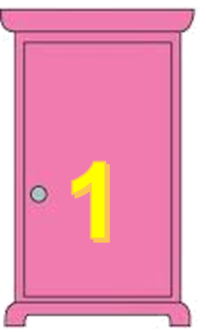
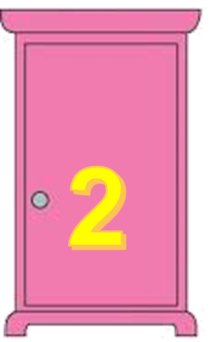
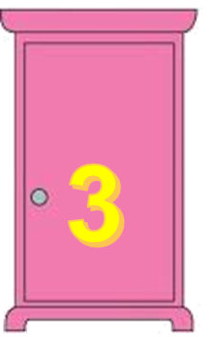
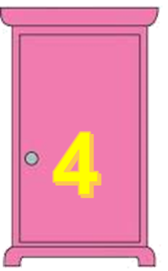

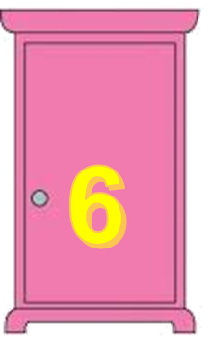
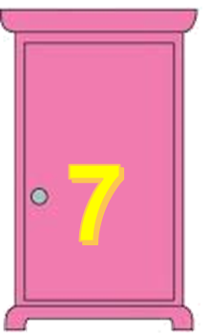
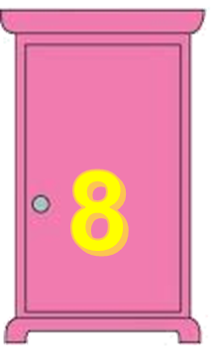

TEAM 1
TEAM 2

Slide 7
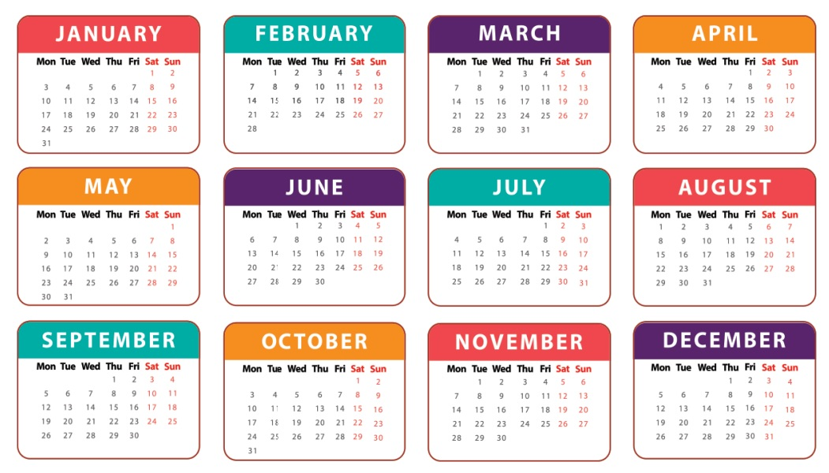
When’s your sports day?
It’s in June.

Slide 8
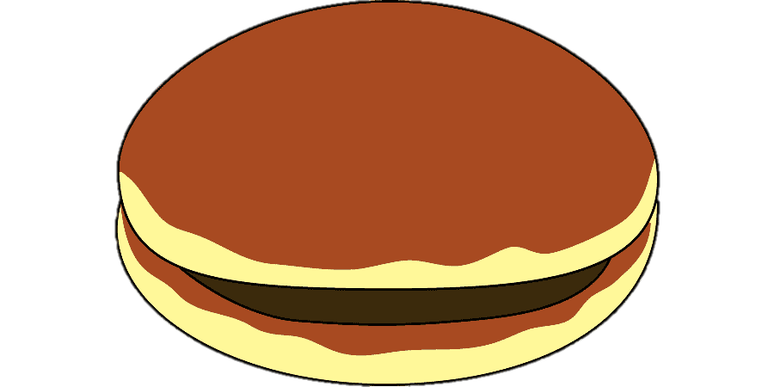
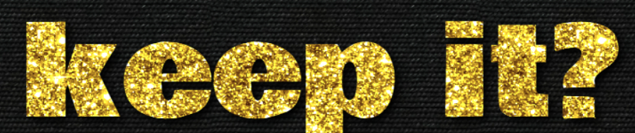
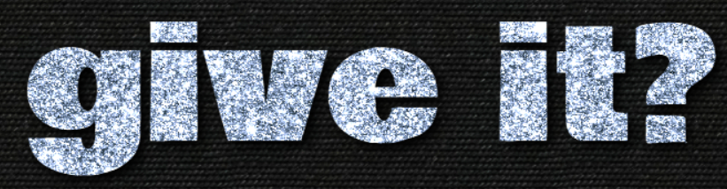
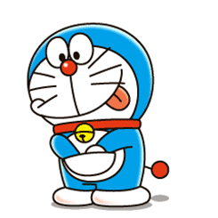
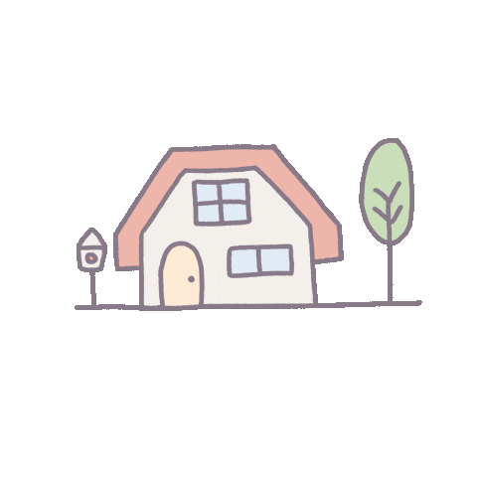
4 points
or

Slide 9
Is your sports day in February?
Yes, it is.

Slide 10
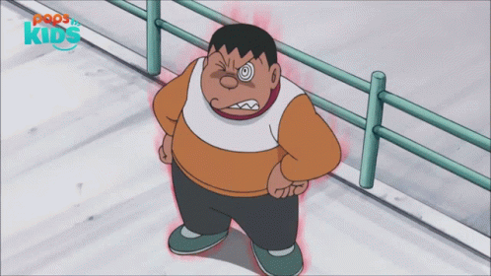

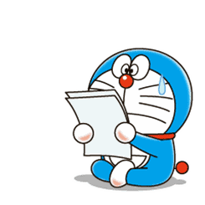
1 points
or

Slide 11
Is your sports day in July?
No, it isn’t.

Slide 12
3 points
or

Slide 13
When’s your sports day?
It’s in December.

Slide 14
2 points
or

Slide 15
When’s your birthday?
It’s in April.

Slide 16
2 points
or

Slide 17
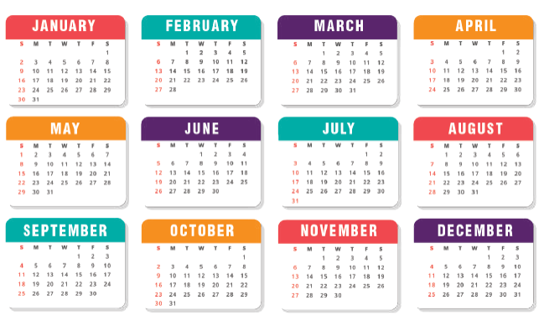
Is your sports day in October?
Yes, it is.

Slide 18
3 points
or

Slide 19
When’s your birthday?
It’s in May.

Slide 20
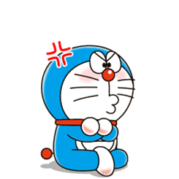
0 points
or

Slide 21
Is your sports day in January?
No, it isn’t.

Slide 22
6 points
or

Slide 23
02
Listen and repeat.

Slide 24
letter y
/i/
/aɪ/
February
July

Slide 25

1
Listen and repeat.
y February
Our sports day is in February.
y July
My birthday is in July.

Slide 26
03
Listen and circle.

Slide 27
2
Listen and circle.
1. Is your sports day in ___?
a. July b. February c. January
2. I like ___.
a. July b. January c. cycling

Slide 28
04
Let’s chant.

Slide 29


3
Let’s chant.
When’s your sports day?
In January, February or May?
In January, in January.
It’s in January.
When’s your sports day?
In May, June or July?
In July, in July.
It’s in July.

Slide 30
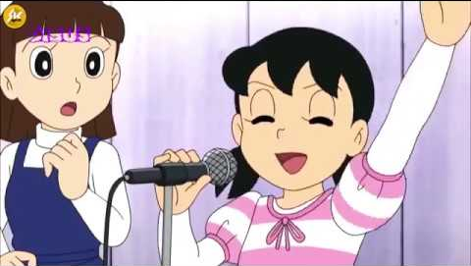
Chant like Shizuka does!

Slide 31
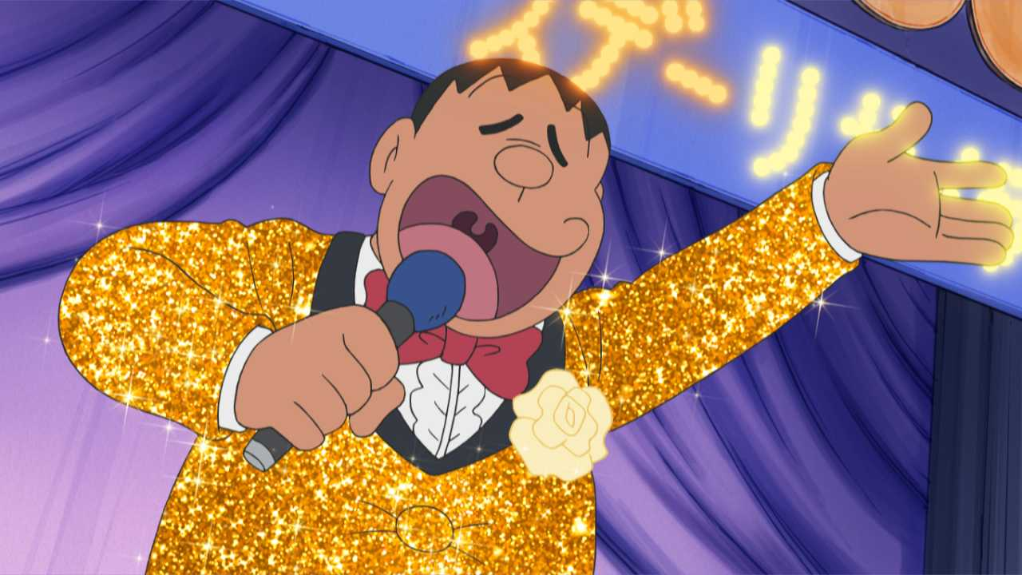
Chant like Jaian does!

Slide 32
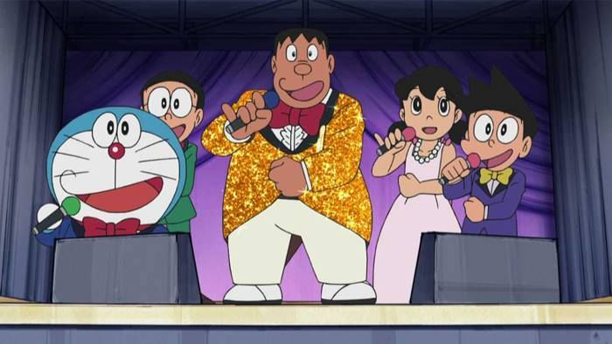
Let’s chant together!

