Slide 2


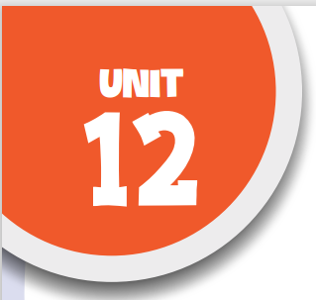

Our Tet holiday
Lesson 3 - Period 5

Slide 3
Table of contents
1
2
3
Warm-up
Activity 1
Activity 2
4
5
Activity 3
Fun corner
Listen and repeat.
Listen and underline one more stressed word. Then repeat.
Let’s chant.

Slide 4
1
Warm-up
Guessing game

Slide 5
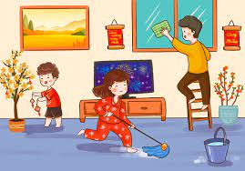
decorate the house
SHOW

Slide 6
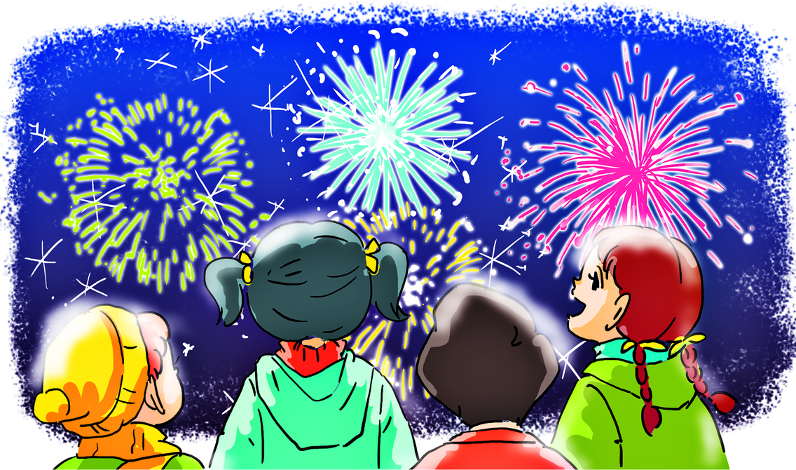
watch fireworks
SHOW

Slide 7

buy flowers
SHOW

Slide 8
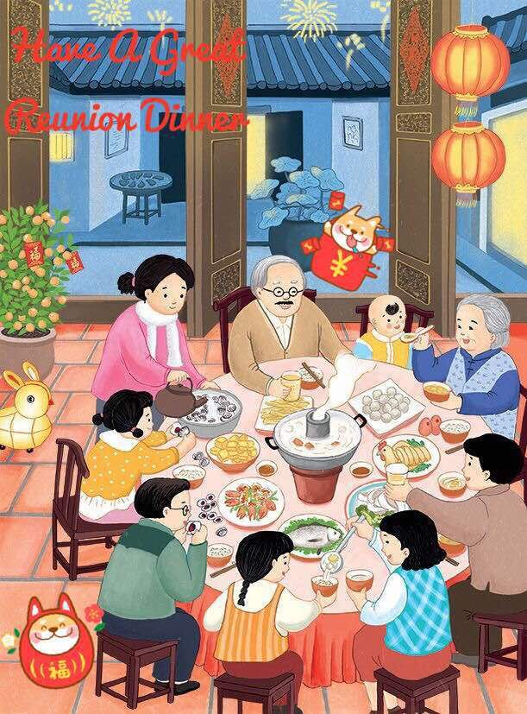
have a party
SHOW

Slide 9
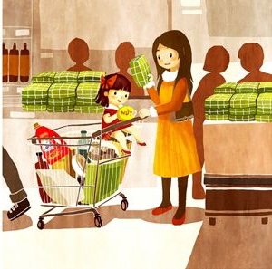
do the shopping
SHOW

Slide 10
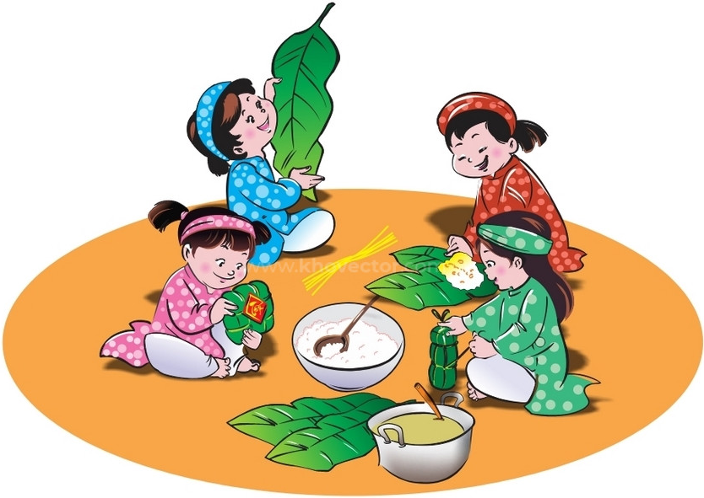
make banh chung
SHOW

Slide 11

SENTENCE STRESS
CONTENT words
STRUCTURE words
words carrying the meaning:
main verbs – nouns –
adjectives - adverbs
words for correct grammar:
pronouns- prepositions – conjunctions- auxiliary verbs
important words
NOT important words
STRESSED
NOT STRESSED

Slide 12
We ‘ll watch fireworks show.
’watch
’fireworks ’show.
Verb
Noun
Noun
STRESSED

Slide 13
He ‘ll clean the house.
’house.
’clean
Verb
Noun
STRESSED

Slide 14
2
Activity 1
Listen and repeat.

Slide 15
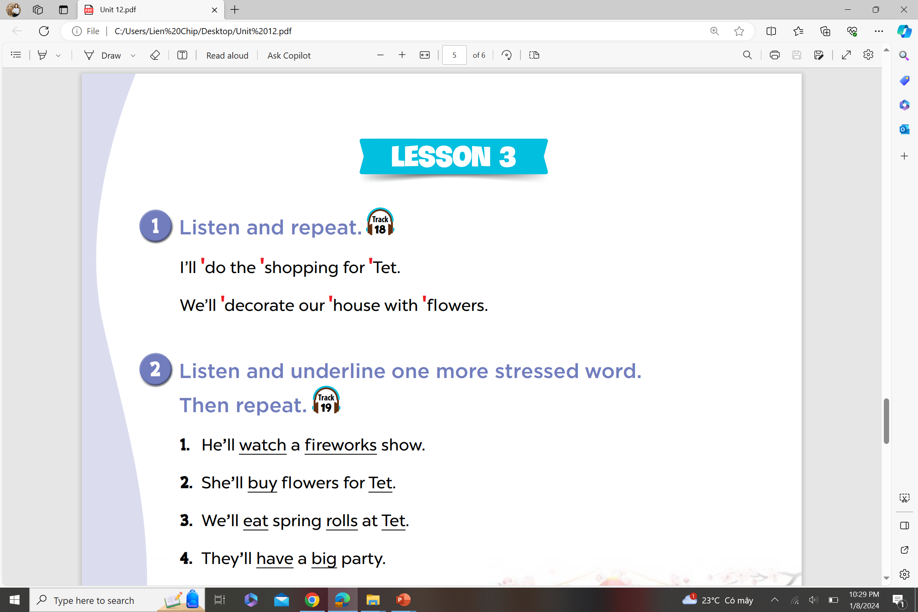

Verb
Noun
Noun

Slide 16
Verb
Noun
Noun

Slide 17
Activity 2
3
Listen and underline one more stressed word. Then repeat.

Slide 18
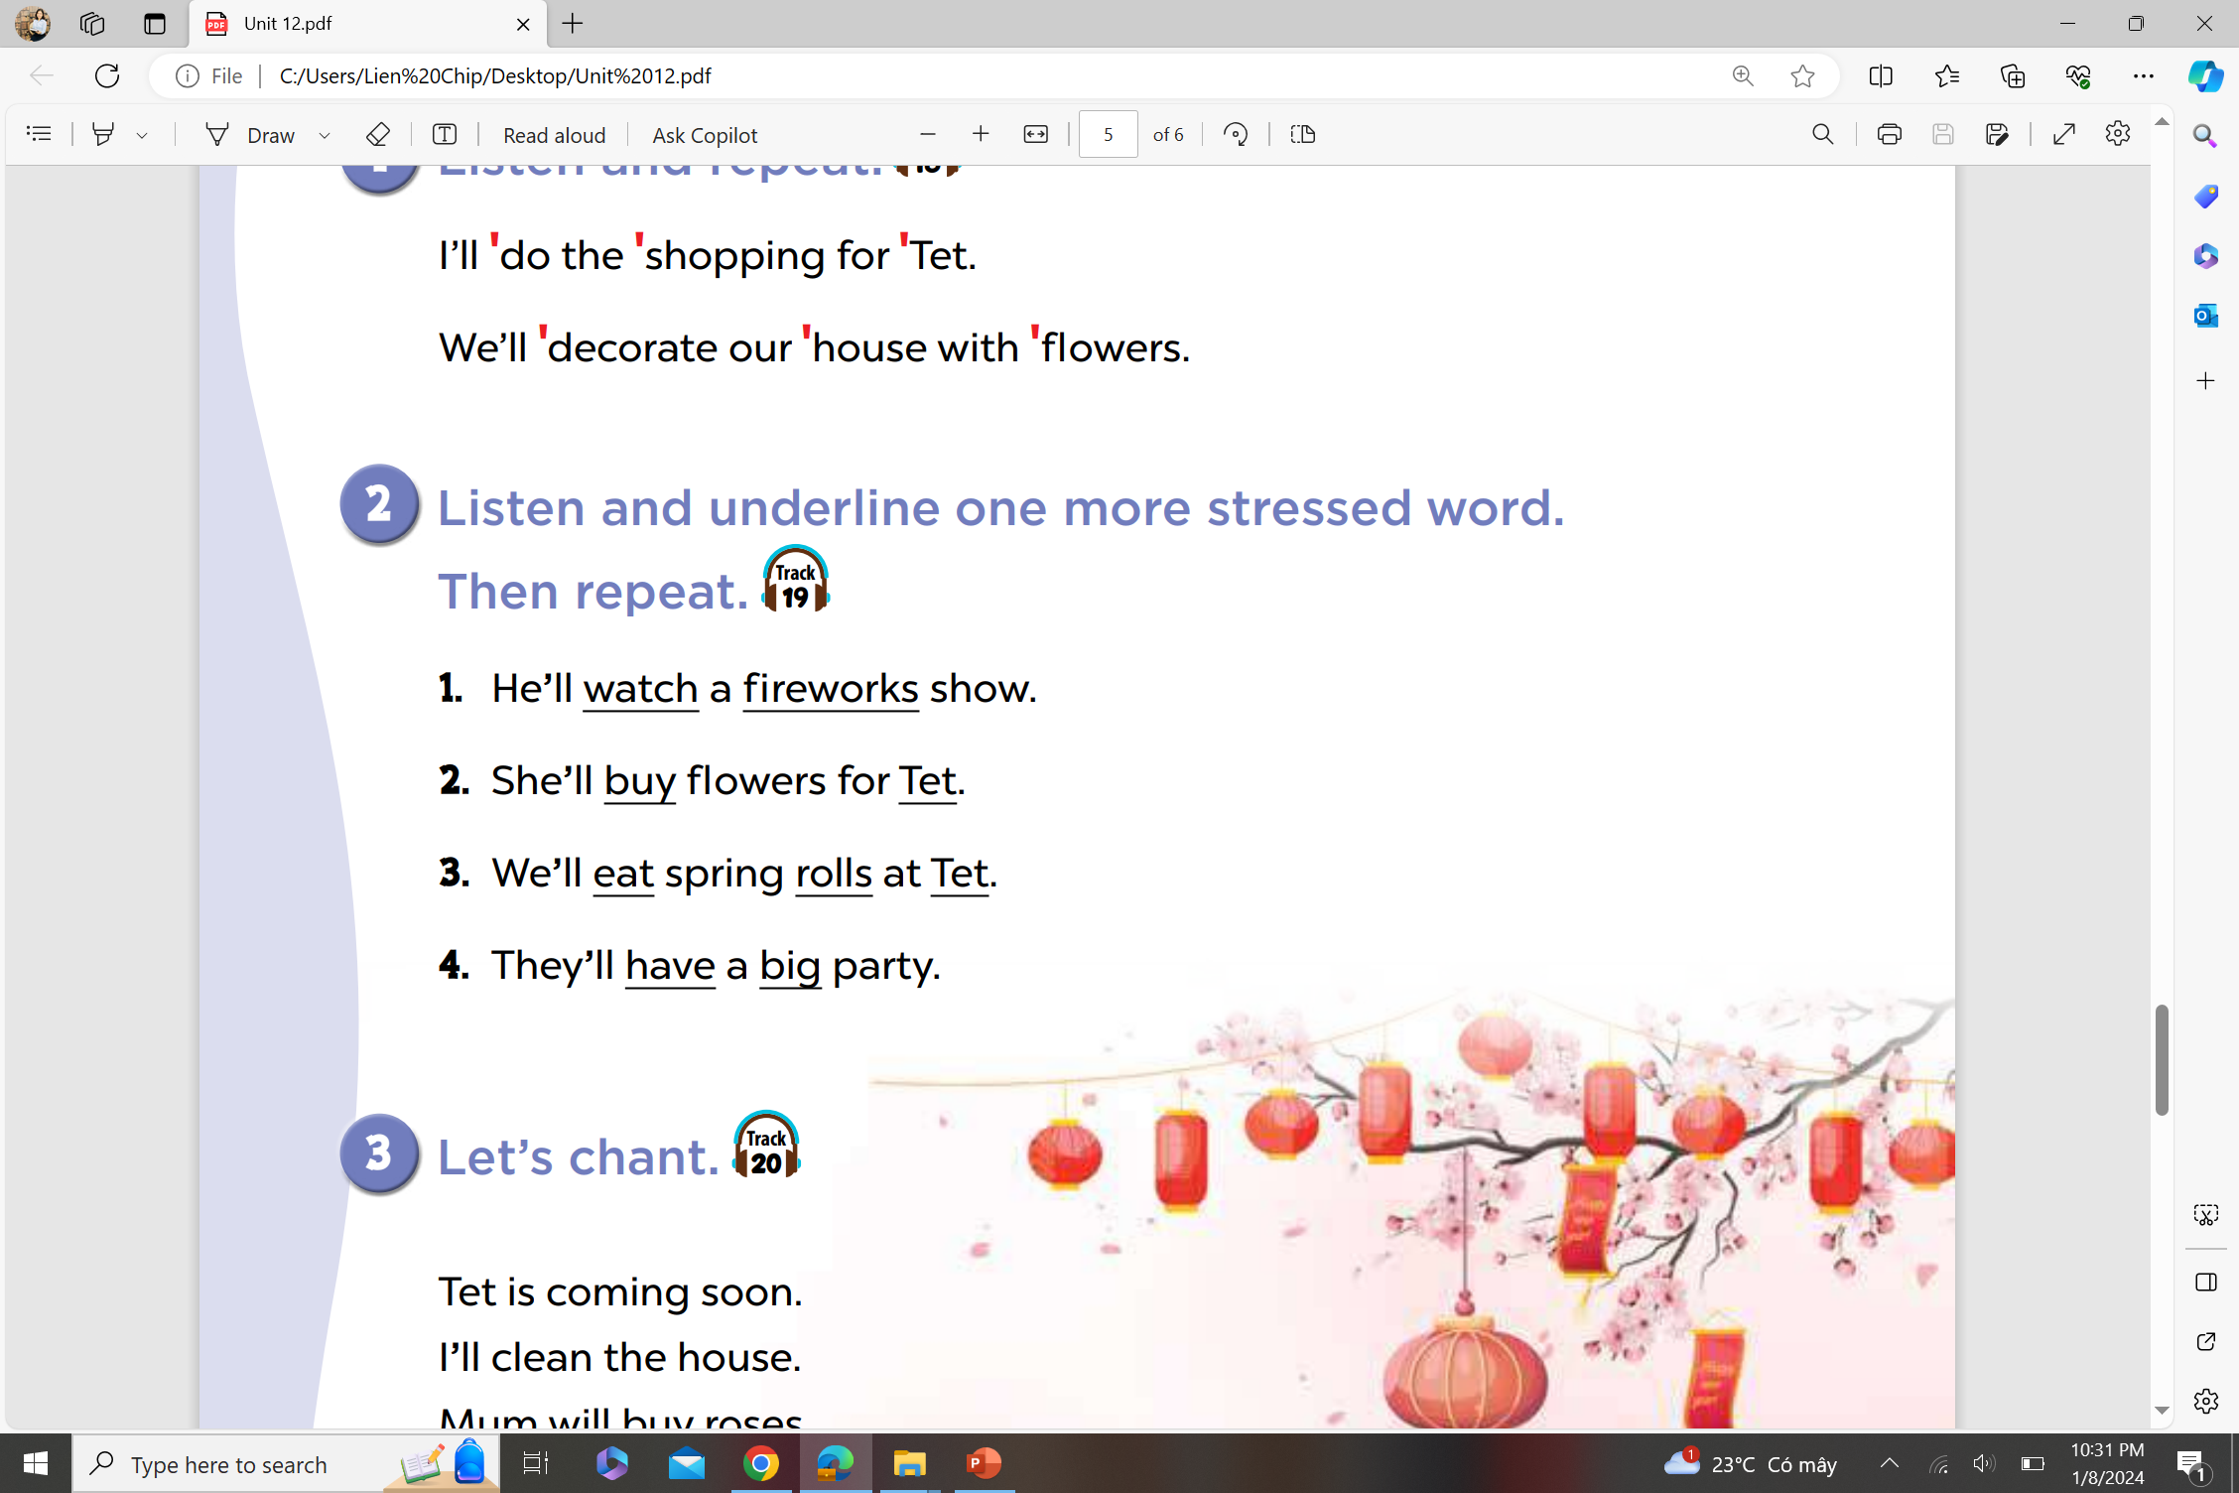
Verb
Noun
Noun

Slide 19
Verb
Noun
Noun

Slide 20
Verb
Noun
Noun
Noun

Slide 21
Verb
Adjective
Noun

Slide 22
4
Activity 3
Let’s chant.

Slide 23
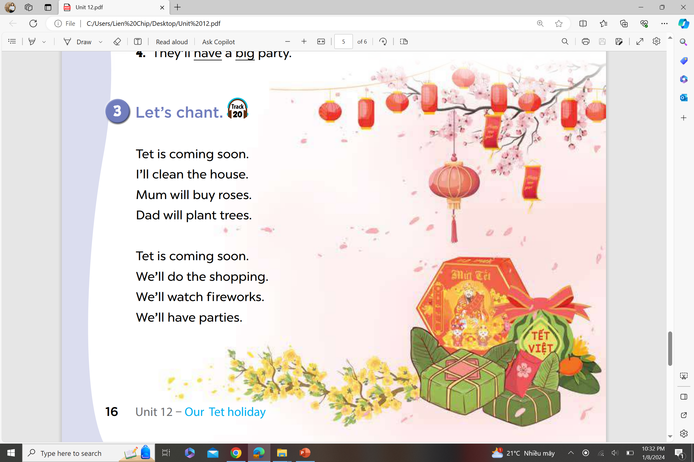

Slide 24
5
Fun corner
Read the sentences and find out
the stressed words.

Slide 25
















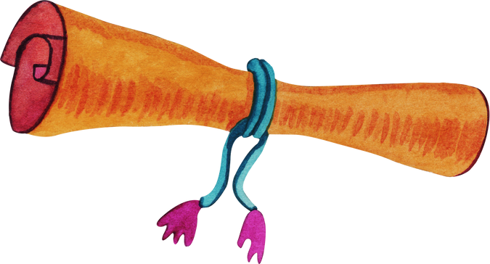


Notes:
Click vào mỗi ngôi nhà để ông Táo di chuyển đến các ngôi nhà thu thập báo cáo
Mỗi ngôi nhà sẽ liên kết tới trang câu hỏi tương ứng

Slide 26

I’ll eat some food.
A. eat - food
B. I’ll - eat
C. some - food

Slide 27
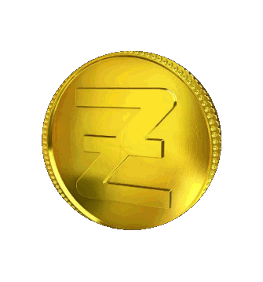
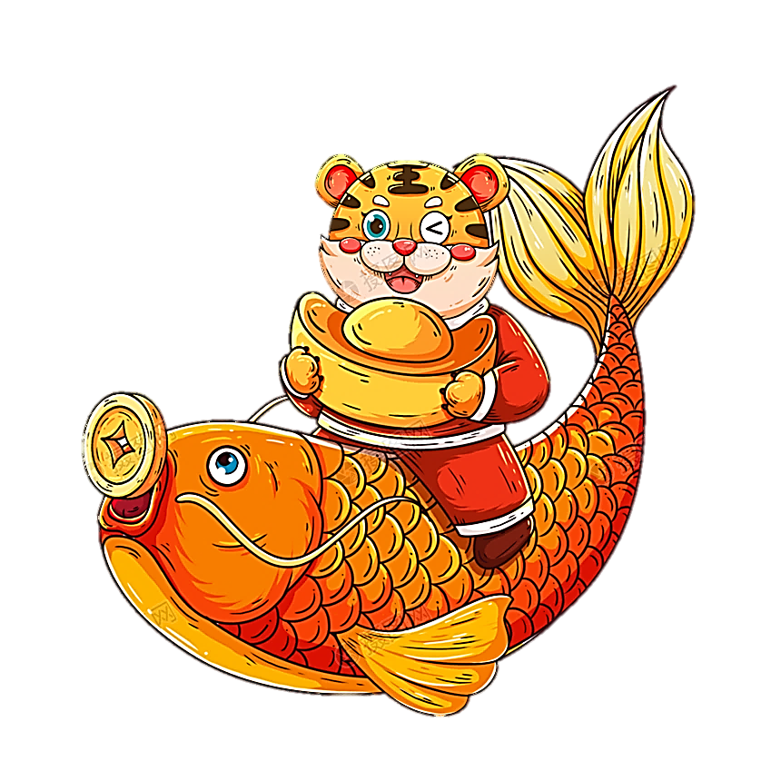
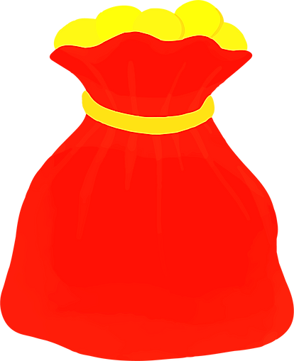

Slide 28
We’ll go to a fireworks show.
A. We’ll - go - fireworks
B. go – fireworks - show
C. a - show

Slide 29

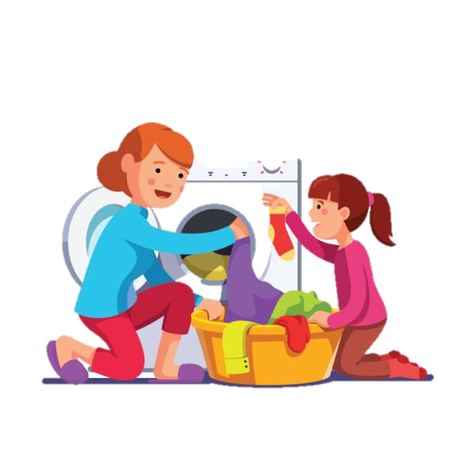

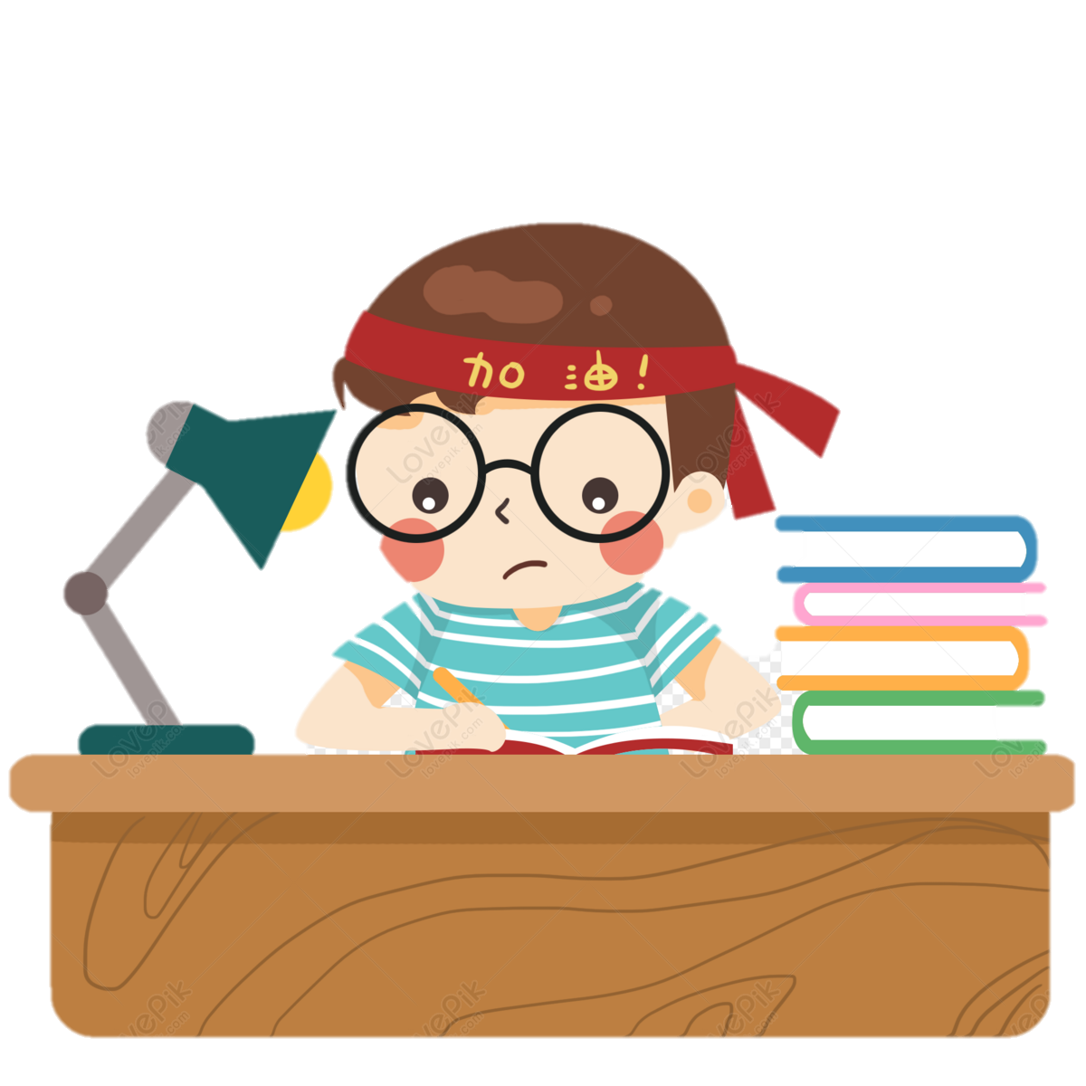
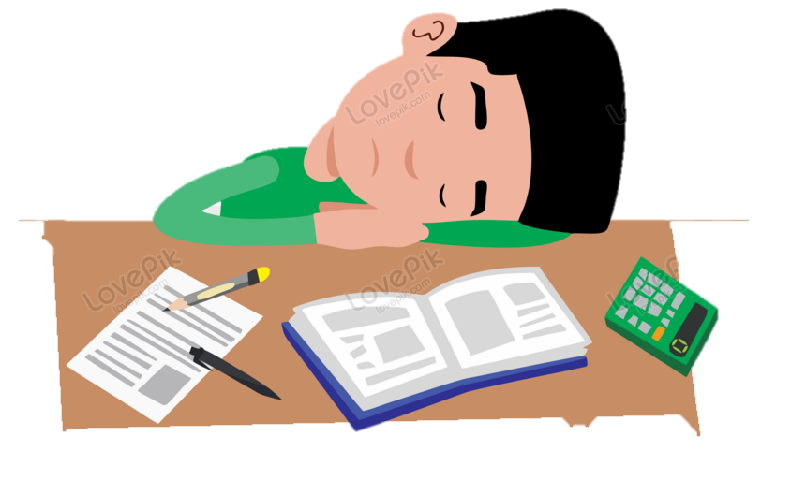

1
2
3
Notes:
Chọn số và click vào số để nhận số điểm tương ứng với câu hỏi đã trả lời.

Slide 30
She’ll go to a flower festival.
A. go – a - festival
B. She’ll – go - flower
C. go – flower - festival

Slide 32
They’ll wear new clothes on Tet.
A. wear – new - Tet
B. wear – new – clothes - Tet
C. wear – clothes

Slide 33






Slide 34
He’ll decorate his house for Tet.
A. his – house - Tet
B. decorate – his - for
C. decorate - house - Tet

Slide 36
I’ll do the shopping for Tet.
A. do – shopping - Tet
B. do – for - Tet
C. the – shopping - Tet

Slide 37
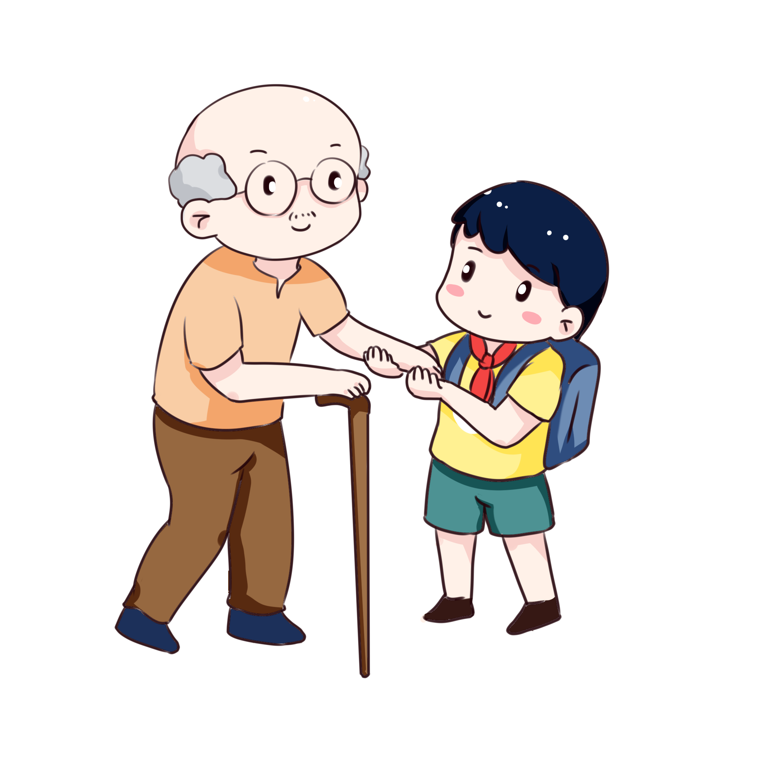
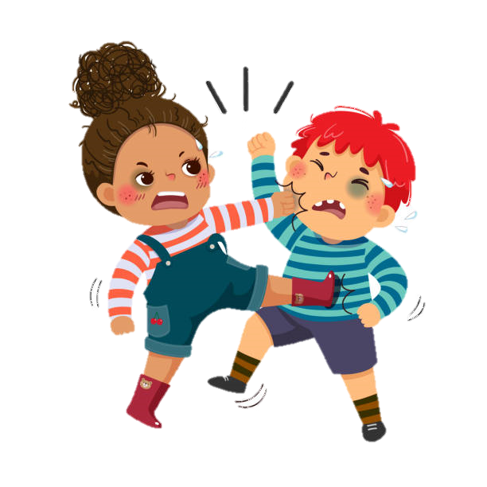

1
2
3
Notes:
Chọn số và click vào số để nhận số điểm tương ứng với câu hỏi đã trả lời.

Slide 38
Website: hoclieu.vn
Fanpage: https://www.facebook.com/tienganhglobalsuccess.vn/

