Slide 1






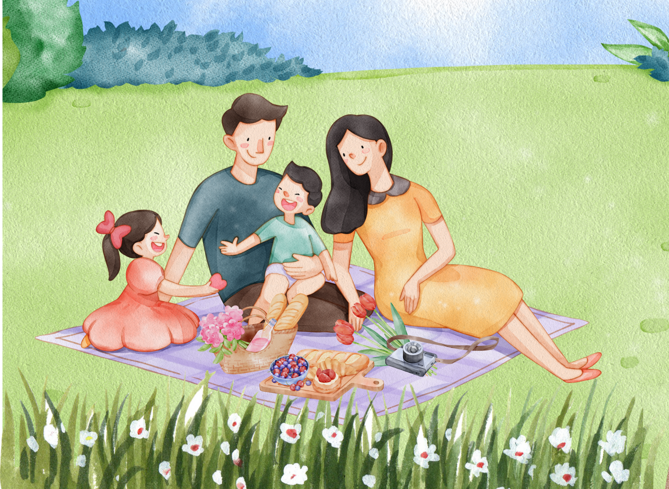
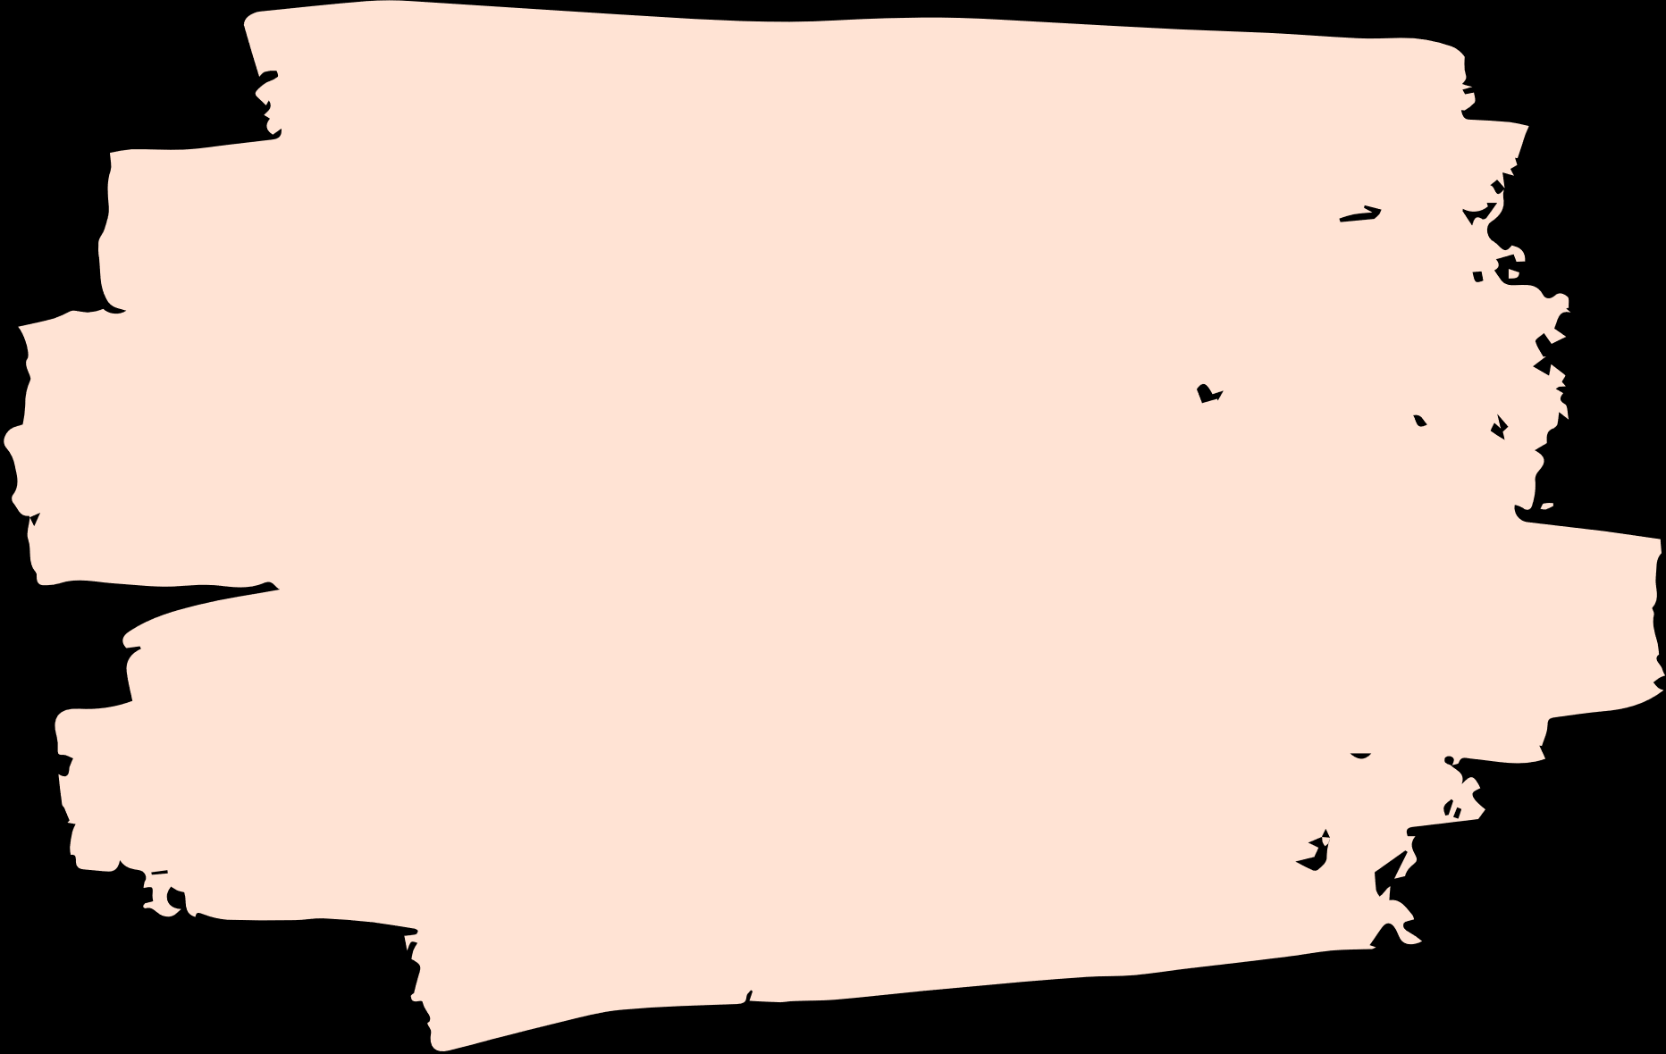
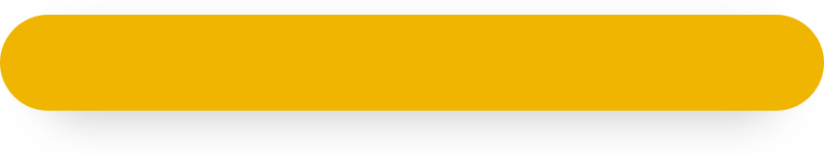
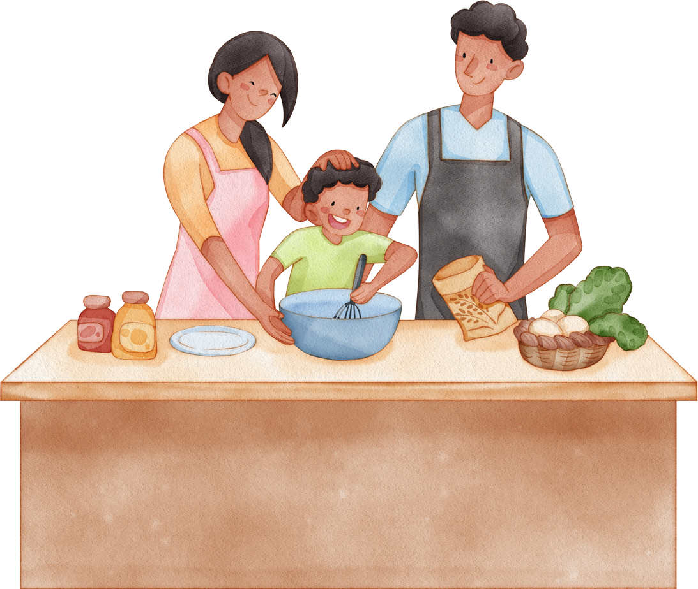
Unit 15
My family’s
weekend
Lesson 2 – Period 2

Slide 2
Warm-up
Lesson 1 – Period 1

Slide 3
LADYBUG
WRITTING
START

Slide 4
cook meals
c
l
m
a
k
e
o
s
o
CHECK

Slide 5
watch films
s
l
t
m
a
c
i
w
h
f
CHECK

Slide 6
play tennis
a
t
l
e
p
s
i
y
n
n
CHECK

Slide 7
do yoga
o
g
d
y
a
o
CHECK

Slide 8
Well done!

Slide 9
Review
Lesson 1 – Period 1

Slide 10
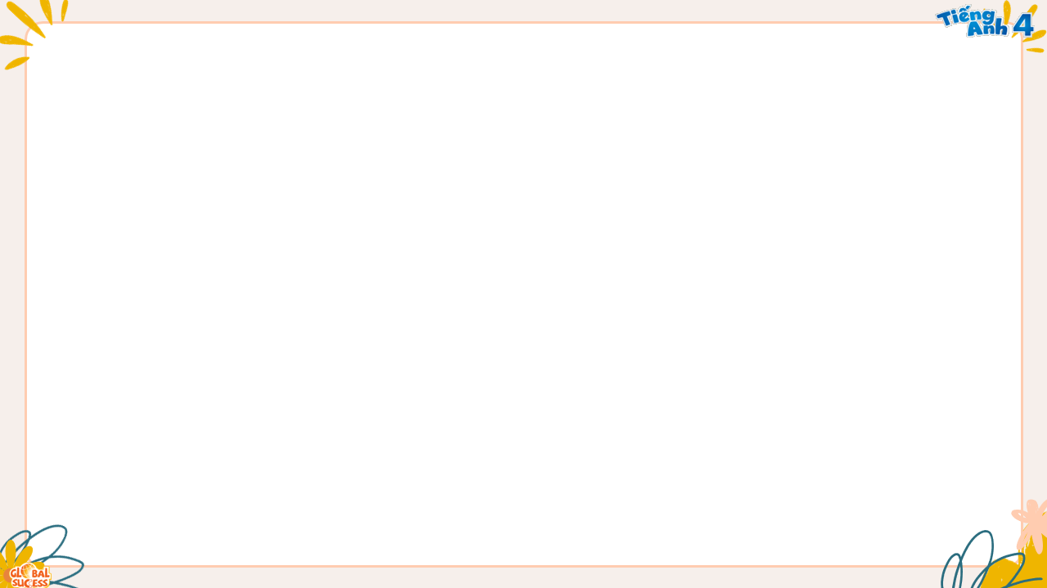
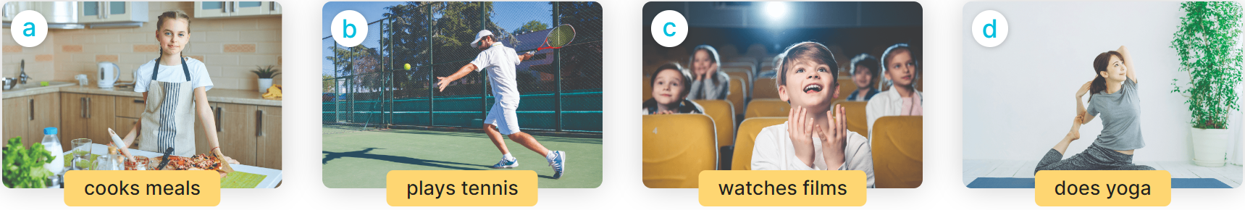

What does she/he do on Sundays?
She/ He ___________.
MsPham
0936082789

Slide 11
Practice
Lesson 1 – Period 1

Slide 12

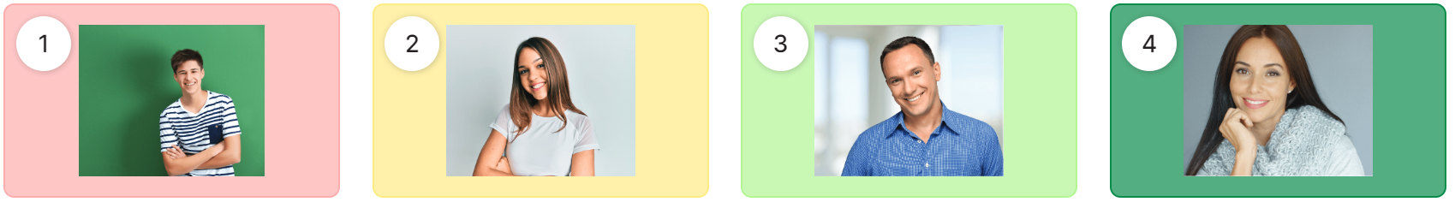
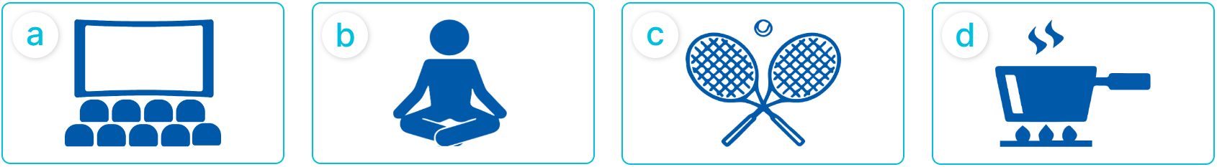
4
Listen and match.

Slide 13
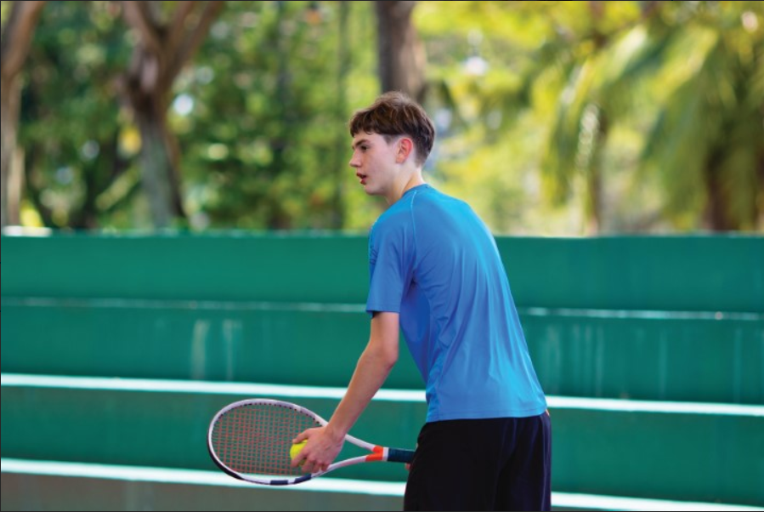
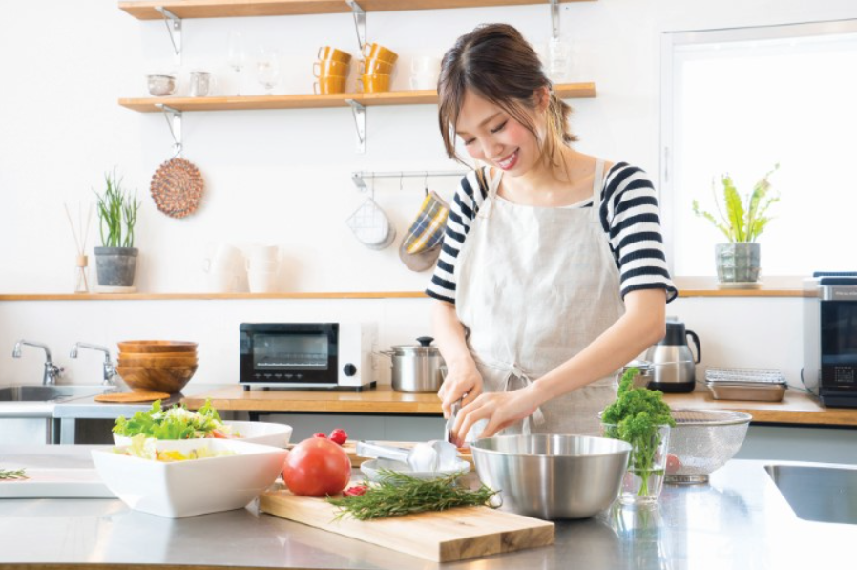
5
Look, complete and read.
A: Where does your brother go on Sundays
B: He goes to the ___________.
A: What does he ________ there.
B: He goes play ___________.
MsPham
0936082789
sports centre
1
do
tennis
A: Where is your mother on Sundays?
B: She’s at ____________.
A: ________ does she do?
B: She _____________________.
home
2
What
cooks meal

Slide 14
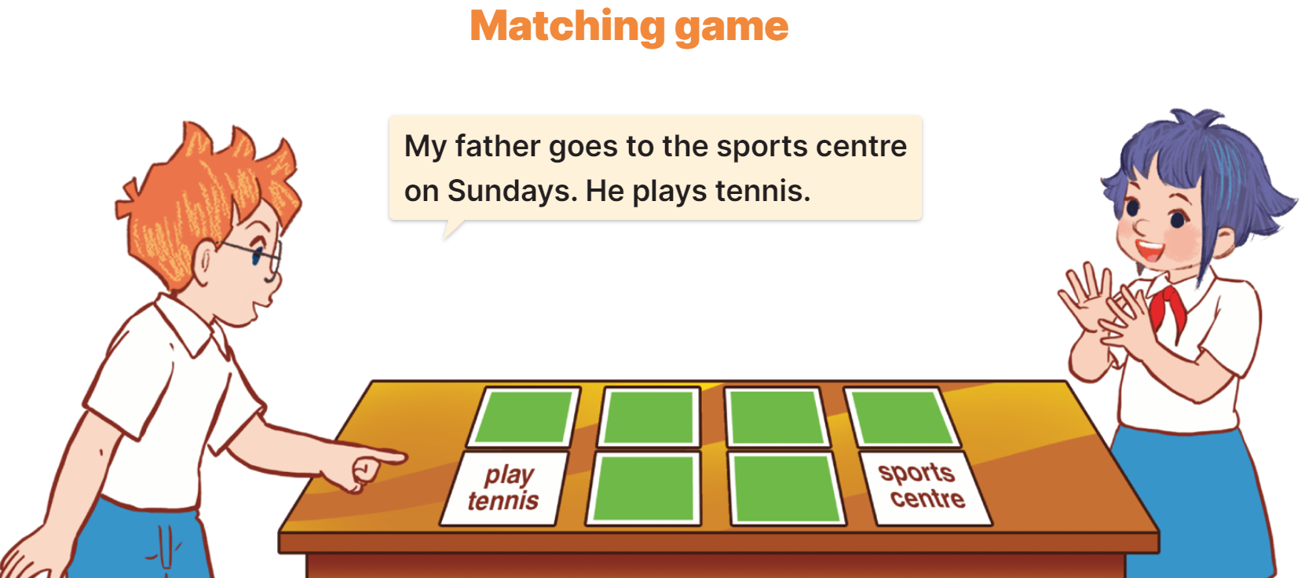
6
Let’s play.
Examples
1
2
3
4
5
6
7
8

Slide 15
Thank you!
Lesson 1 – Period 1

