Slide 1






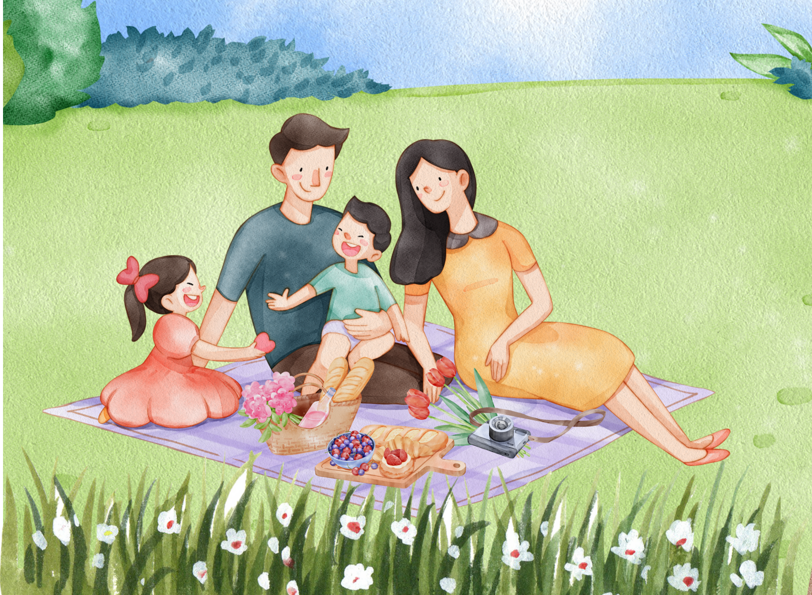

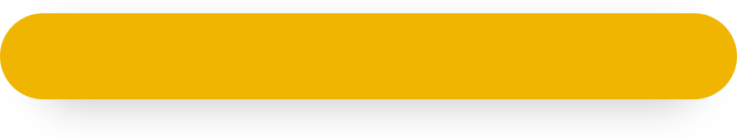
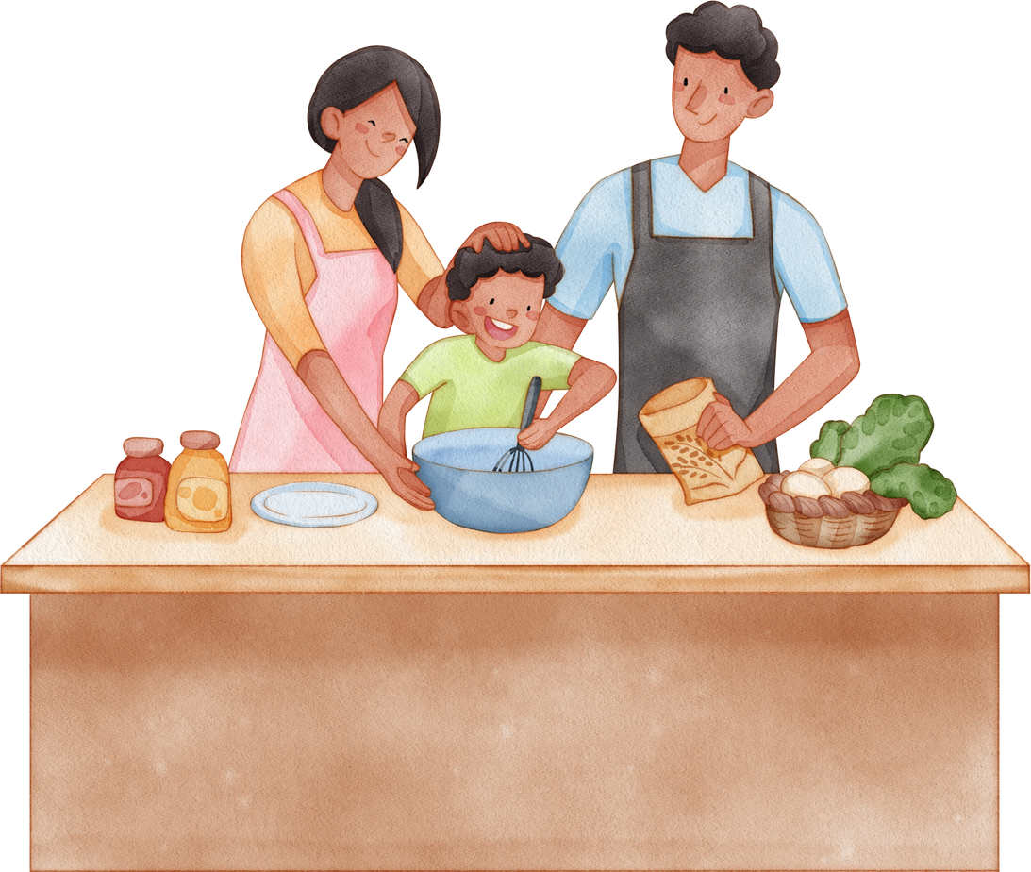
Unit 15
My family’s
weekend
Lesson 3 – Period 2

Slide 2
Warm-up
Lesson 1 – Period 1

Slide 3

What
3
on Saturdays?
does
she
do
Notes:
Animation: Scrambled text disappears after 3 seconds

Slide 4
WHAT’S THE ANSWER?
What does she do on Saturdays?

Slide 5
on
does
4
Where
Sundays?
go
he
Notes:
Animation: Scrambled text disappears after 3 seconds

Slide 6
WHAT’S THE ANSWER?
Where does he go on Sundays?

Slide 7


Level 3

Slide 8
5
tennis
on Sundays.
plays
He
Notes:
Animation: Scrambled text moves then disappears

Slide 9
WHAT’S THE ANSWER?
He plays tennis on Sundays.

Slide 10
goes
6
My mother
the
to
on Sundays
cinema
Notes:
Animation: Scrambled text moves then disappears

Slide 11
WHAT’S THE ANSWER?
My mother goes to the cinema on Sundays.

Slide 12
Level 4

Slide 13
7
He washes the dishes on Saturdays.
Notes:
Animation: Text moves across the screen horizontally

Slide 14
WHAT’S THE ANSWER?
He washes the dishes on Saturdays.

Slide 15
8
She cleans the house on Sundays.
Notes:
Animation: Text moves across the screen vertically

Slide 16
WHAT’S THE ANSWER?
She cleans the house on Sundays.

Slide 17
GREAT JOB!

Slide 18
Practice
Lesson 1 – Period 1

Slide 19
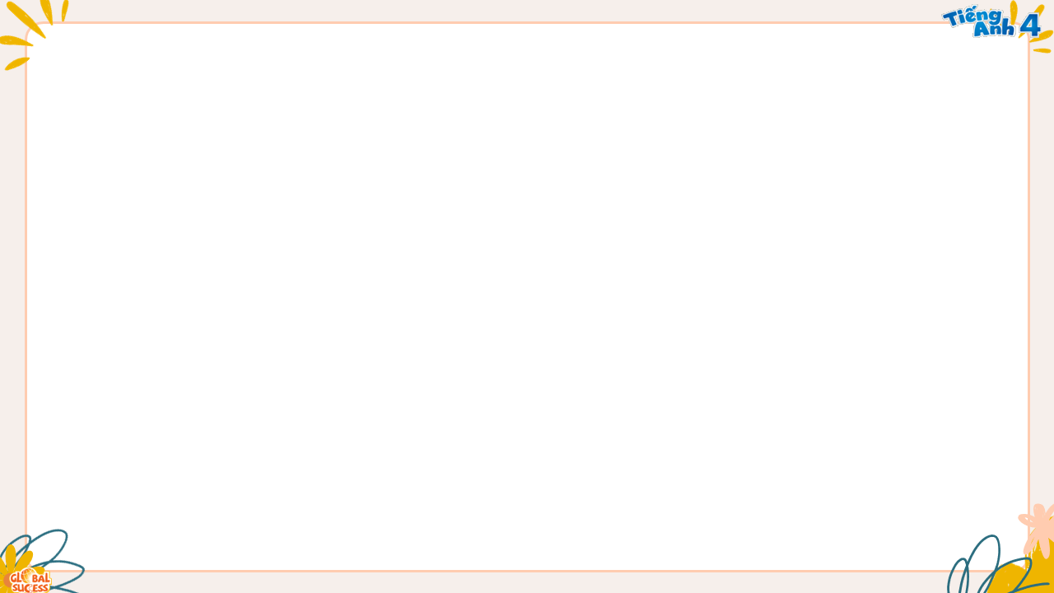

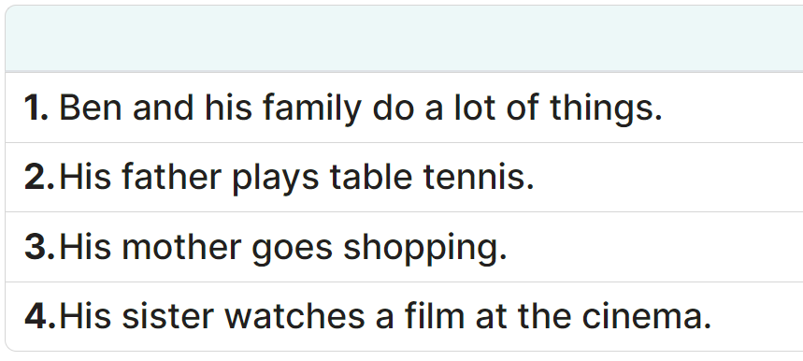
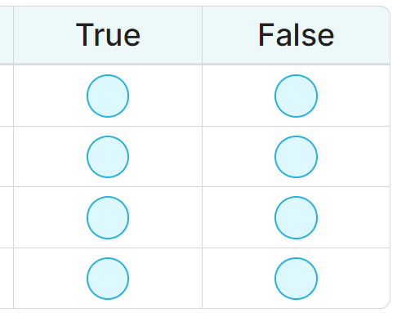
4
Listen and tick True or False.
Today is Sunday. Ben and his family do a lot of things on Sundays. His father goes to the sports centre. He plays tennis. His mother goes to the shopping centre. His sister goes to the cinema. Ben stays at home. He watches TV. In the evening, they have a nice meal together.
MsPham
0936082789
✓
✓
✓
✓

Slide 20
5
Let’s write.
Mai and her family do a lot of things at the weekend. On Saturdays, her father _______. Her mother _______. Her brother _______. Mai _______. On Sundays, her family _______ together.
MsPham
0936082789
MsPham
0936082789

Slide 21
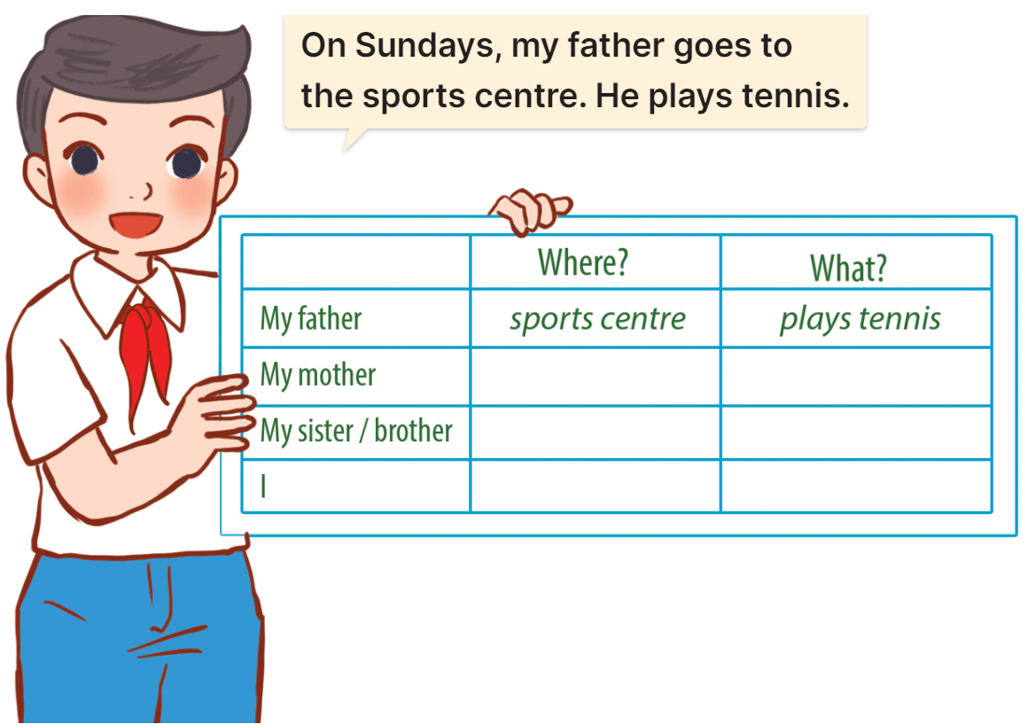
6
Project.

Slide 22
Thank you!
Lesson 1 – Period 1

