Slide 1








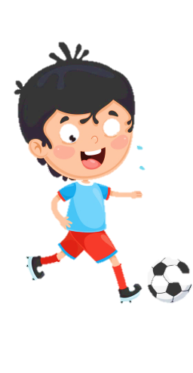



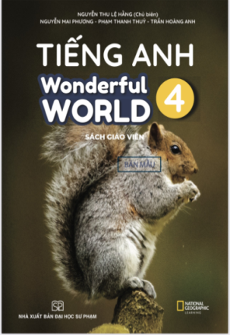







Notes:
Để nguyên trang bìa như này, chỉ thay đổi tên bài trong quá trình làm. Logo của sách Wonderful World

Slide 2





Unit 8: Technology
Lesson 2 – Period 1

Slide 3


Warm up
Matching Game

Slide 4


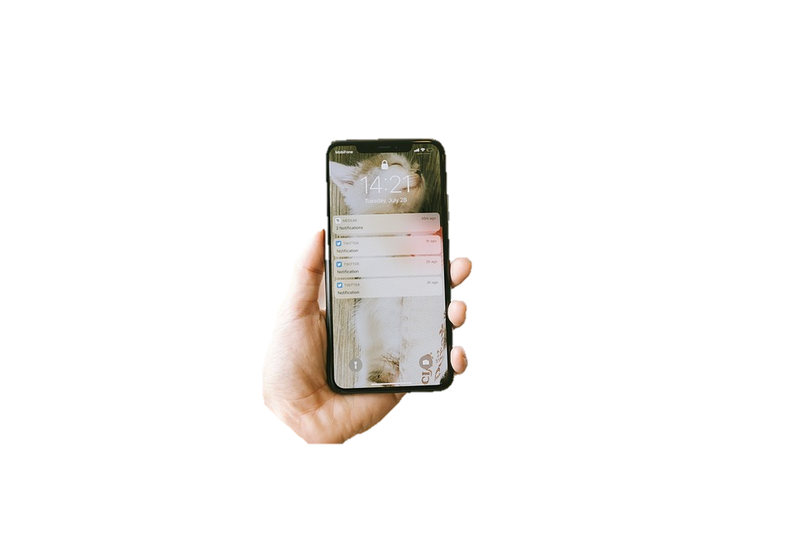


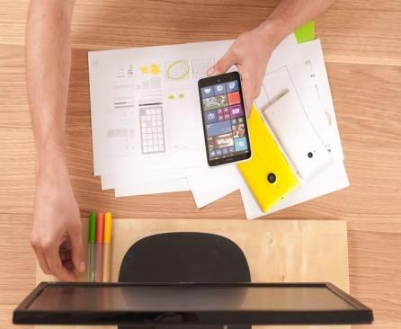
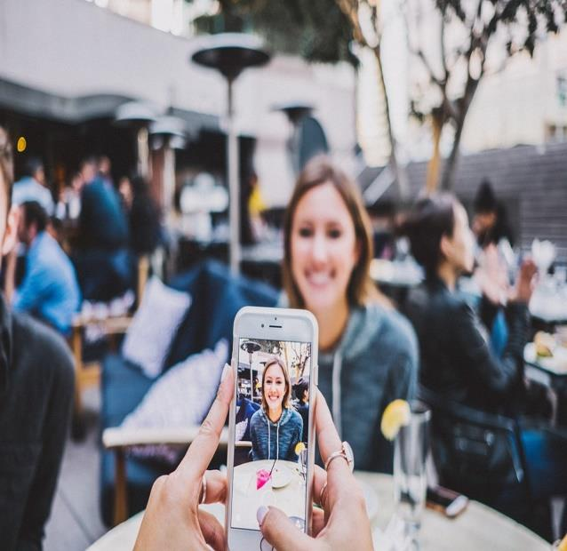
Smart
phone
make videos
write emails
robot

Slide 5

Presentation
1
Listen and point. Repeat.

Slide 6

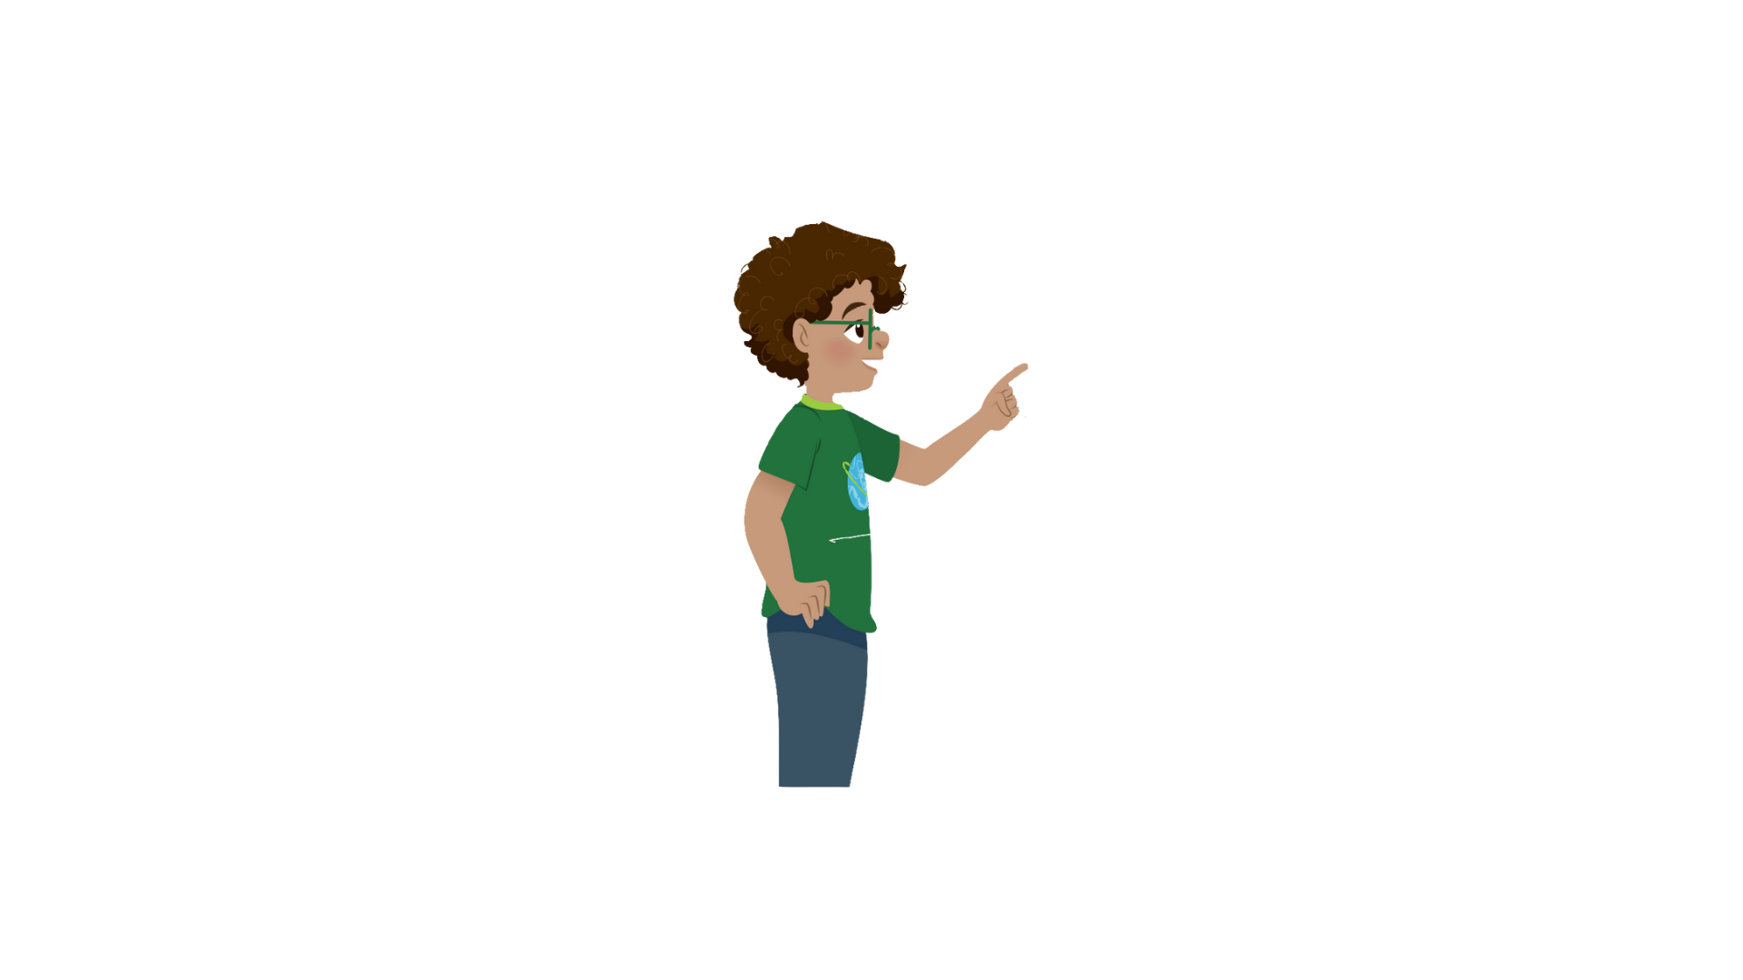


1
Listen and point. Repeat.
Surf the Internet

Slide 7


Use the tablet

Slide 8

Work in pairs

Slide 9
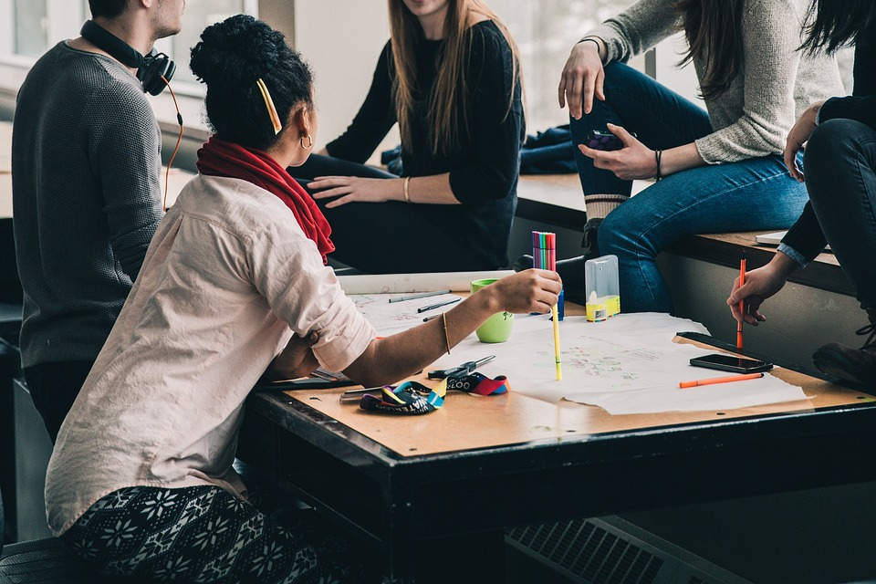
Work in groups

Slide 10


1
Listen and point. Repeat.
Surf the Internet
Use the tablet
Work in pairs
Work in groups

Slide 11






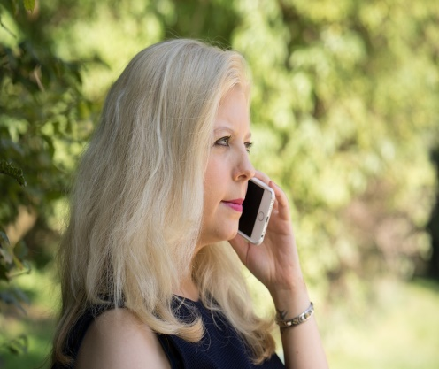

SLAP THE BOARD GAME

Slide 12

Practice
2
Listen and read. Tick

Slide 13



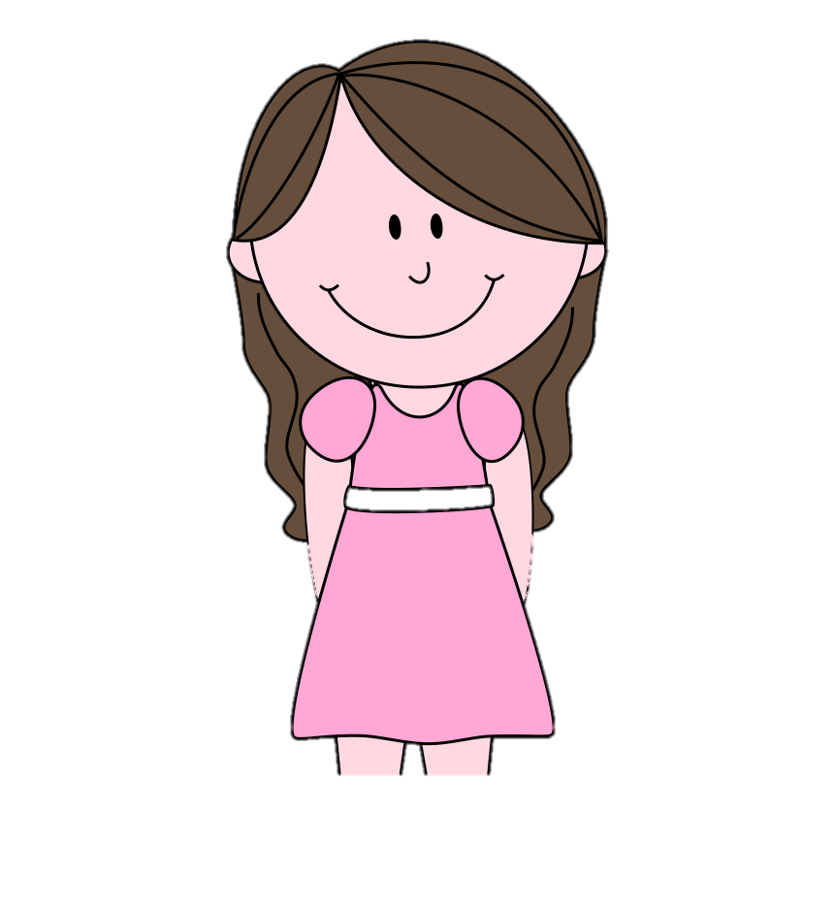
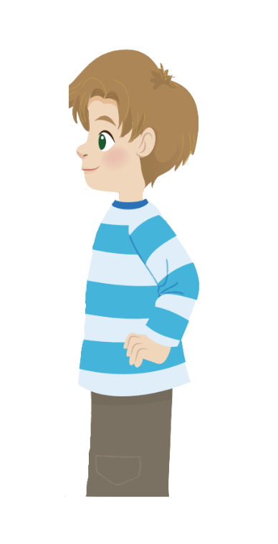
2
Listen and read.Tick.
No, you can’t. But you can open your book and look at the word list.
Robert
Teacher
Yes, teacher.
Now, let’s work in pairs and answer question 1 to 5.
I can see some new words. Teacher, can we use the tablet?

Slide 14
2
Listen and repeat.Tick.
Now, let’s work in pairs and answer question 1 to 5.
Teacher
Robert
I can see some new words. Teacher, can we use the tablet?
The teacher wants her students to work in
✓
pairs.
groups.

Slide 15

2
Listen and repeat.Tick.
2. Students can use
their tablets
their books.
✓
Teacher
Robert
No, you can’t. But you can open your book and look at the word list.
Yes, teacher.

Slide 16
Practice
3
Look and say.

Slide 17








1
2
3
4
Next
Notes:
Chia hs lớp thành 2 nhóm Mèo và Thỏ, Hs chọn số và trả lời câu hỏi
Nếu trả lời sai, nhóm sẽ nhảy xuống 1 bậc

Slide 18



1. Students _____ work in pairs in class.
A. never
B. always
C. sometimes
D. often
Back

Slide 19

Reorder the words to make correct sentence
2. She/ uses/ the/ sometimes/ tablets.
2. She sometimes uses the tablets.
Back

Slide 20
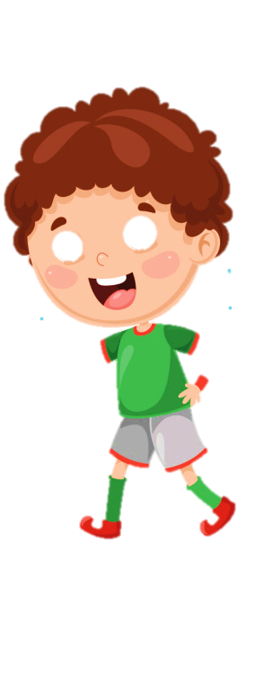


3. They always work ____________.
A. in groups
B. individually
C. in pairs
D. group
Back

Slide 21



4. She sometimes surfs the Internet.
1. | 2 | 3 | 4
Picture 4
Back

Slide 22

Production

Slide 23



Notes:
Hs vẽ 1 đồ CN yêu thích và nói về mục đích sử dụng CN.

Slide 24

Assessment

Slide 25






Look and read. Put tick (✓) or cross (✗) in the box.
1. We work in pairs.
2. She sometimes uses the tablet.
3. My mother always make phone calls.
Notes:
HOẠT ĐỘNG TƯƠNG TÁC

Slide 26

6 Wrap up

Slide 27
REMEMBER
VOCABULARY:
Surf the Internet
Work in pairs
Work in groups
Use the tablet
STRUCTURE:
I/We/ They sometimes/always + V
He/She sometimes/always + Vs/es

