Slide 1





















Unit 11
My day
Lesson 3 – Task 7,8,9

Slide 2











1 Warm up
What letter is missing?

Slide 3



r_ce
i
a
u
1
2
3

Slide 4

_elly
d
j
v
1
2
3

Slide 5
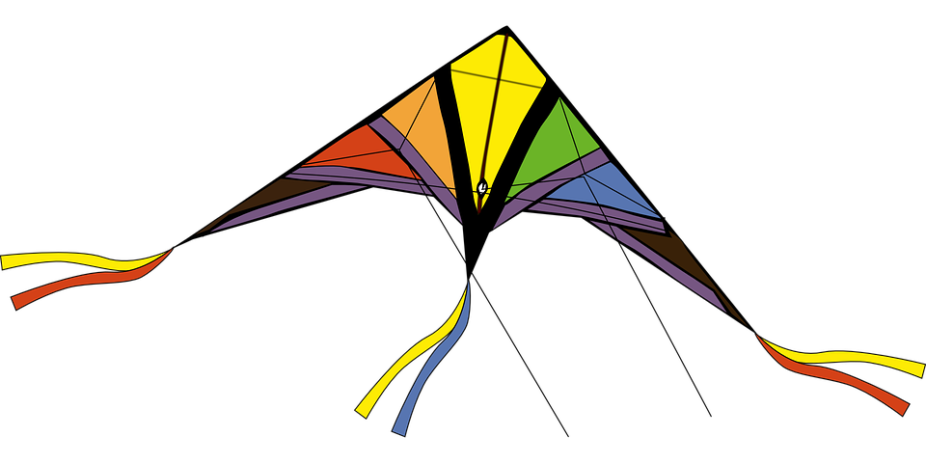
k_te
a
o
i
1
2
3

Slide 6
_ellow
k
y
s
1
2
3

Slide 7

_o-yo
y
r
v
1
2
3

Slide 8
2 Presentation

Slide 9
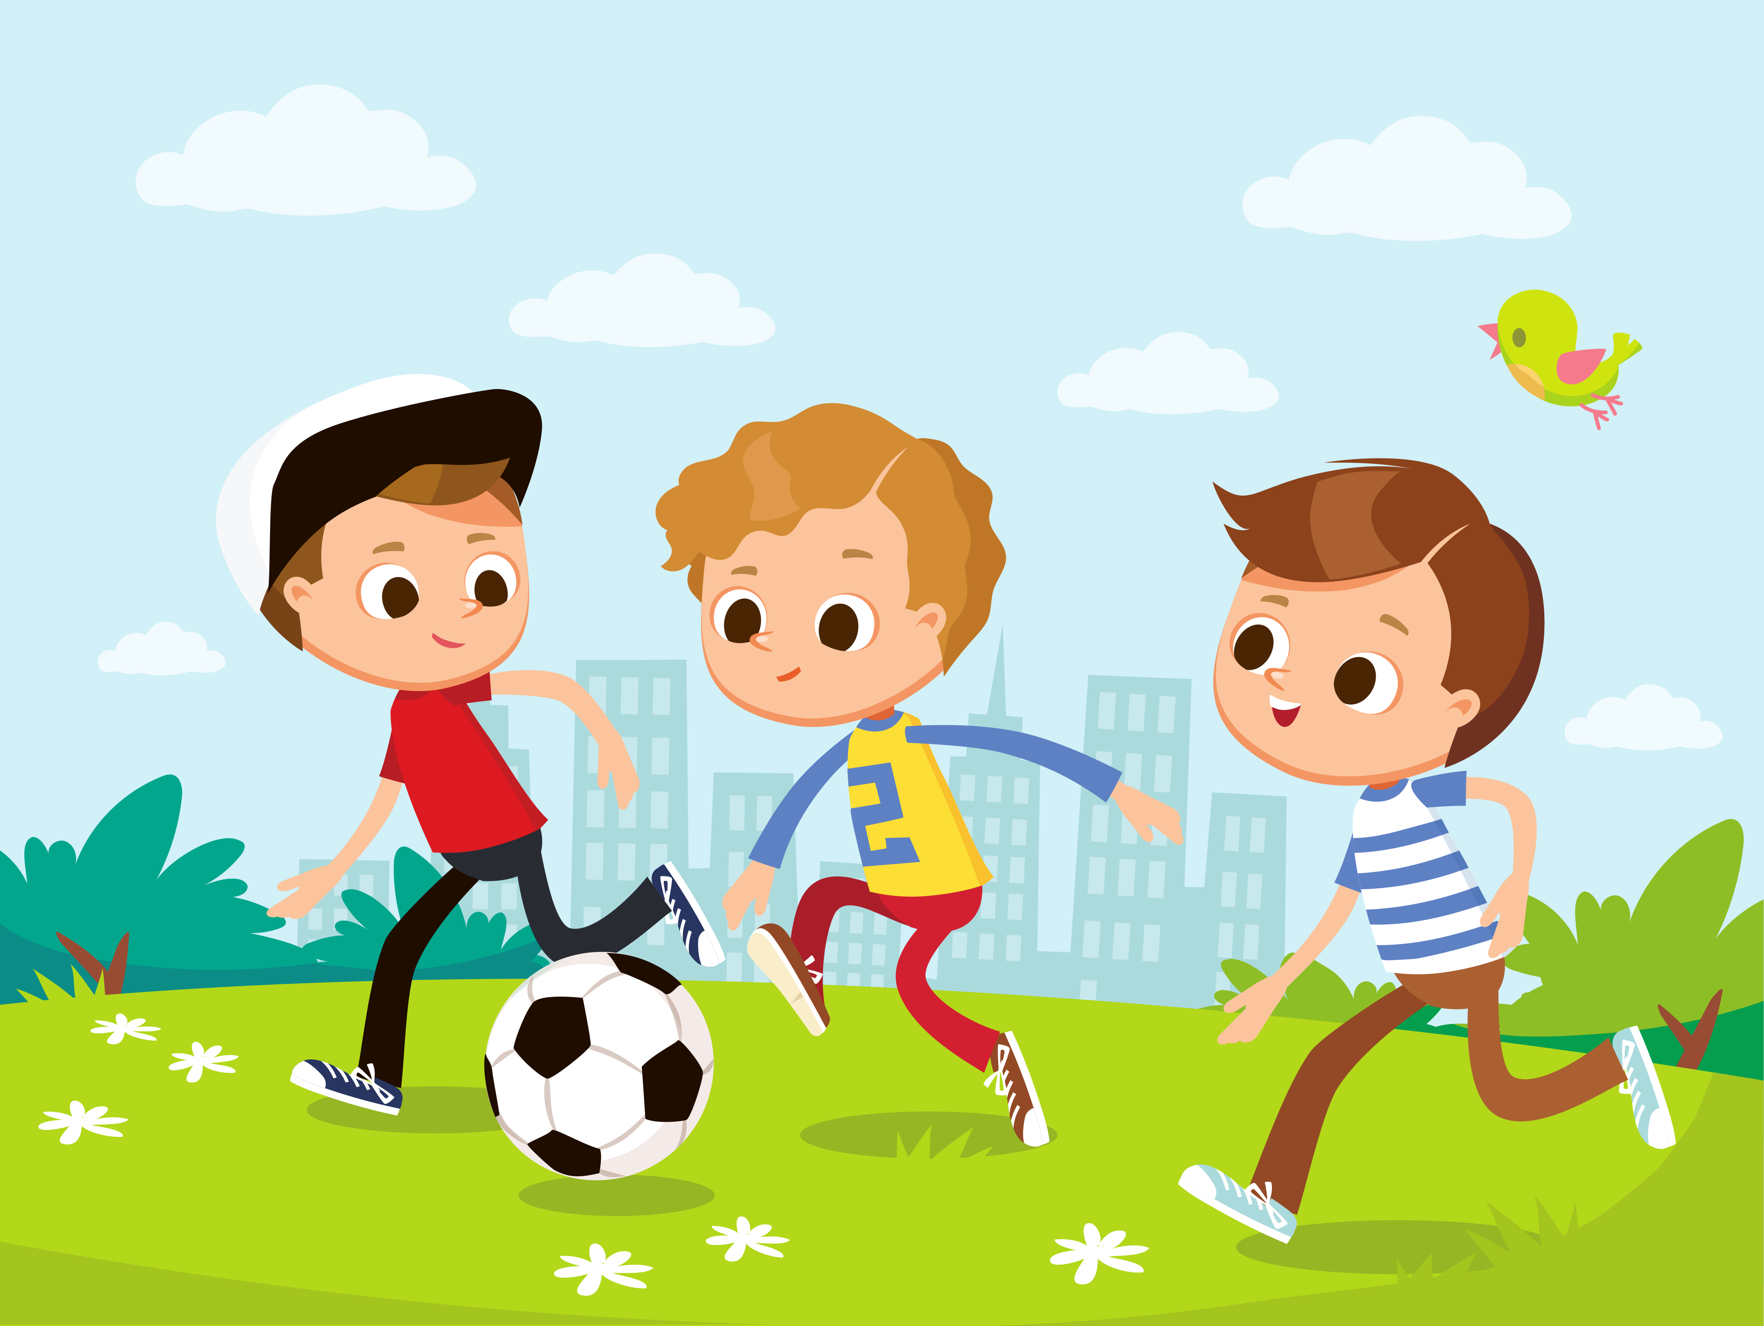



Friday

Slide 10
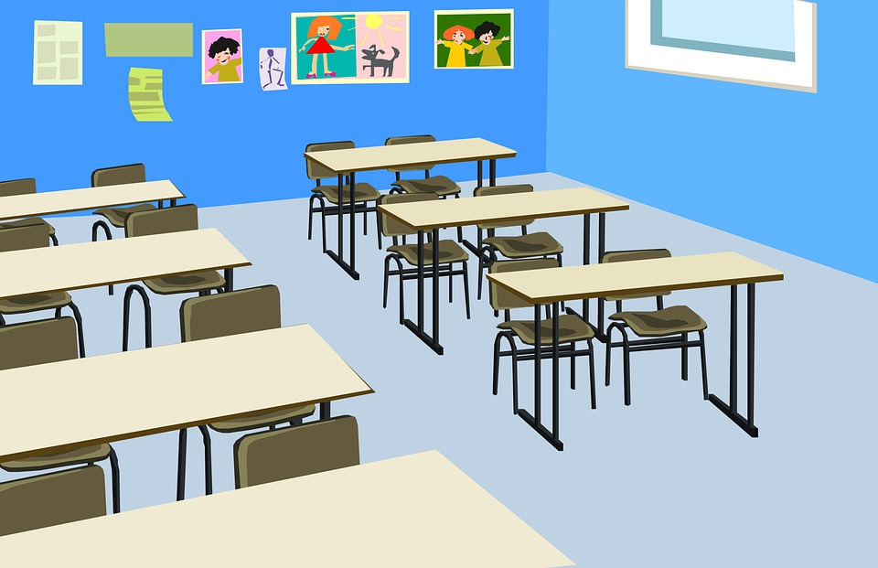

https://www.youtube.com/watch?v=Hb8COxAtl14&list=PLD6B222E02447DC07&index=25

Slide 11
yes

Slide 12
https://www.youtube.com/watch?v=_Fi9E6Yw-qg&list=PLD6B222E02447DC07&index=42

Slide 13

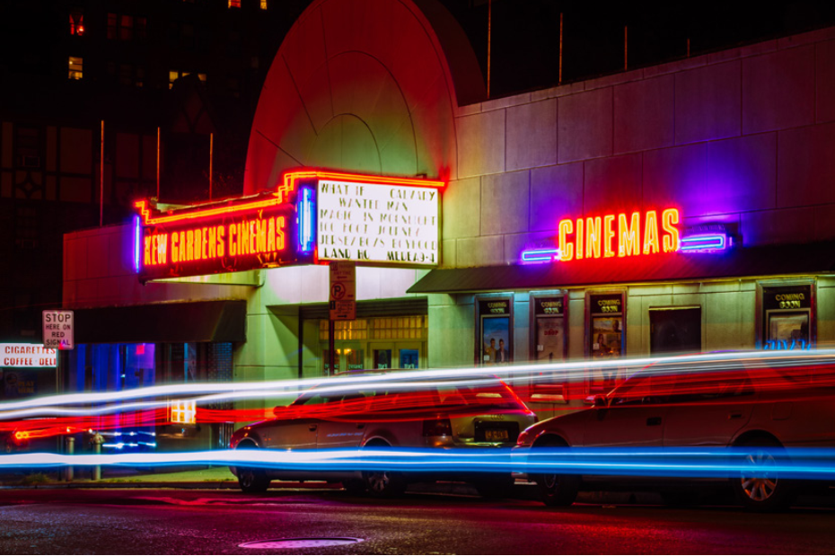
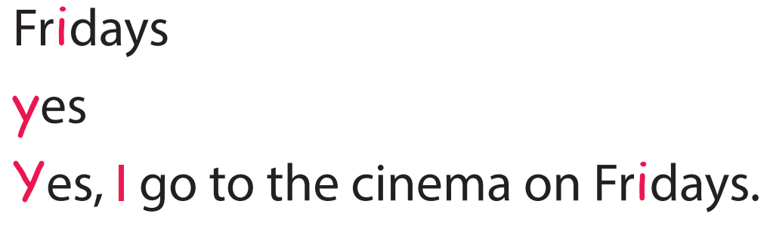
Task 7 Listen and repeat.

Slide 14
3 Practice

Slide 15

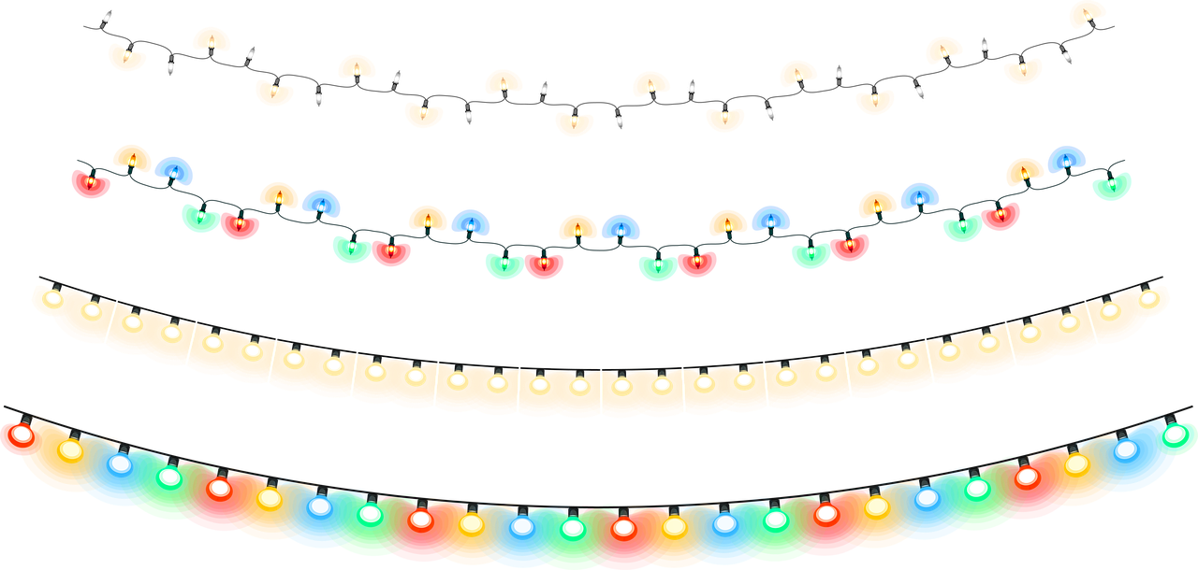
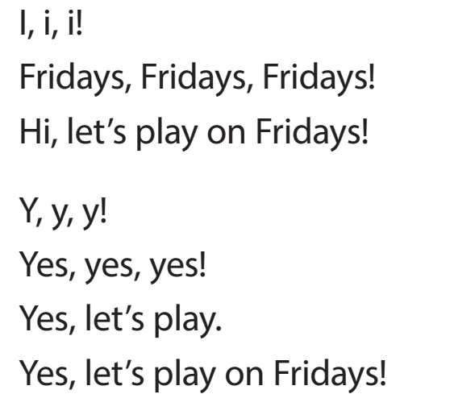

Task 8 Listen and chant.

Slide 16
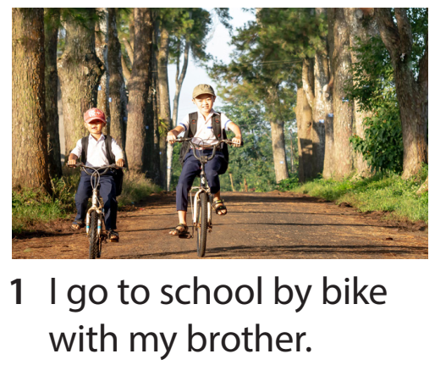
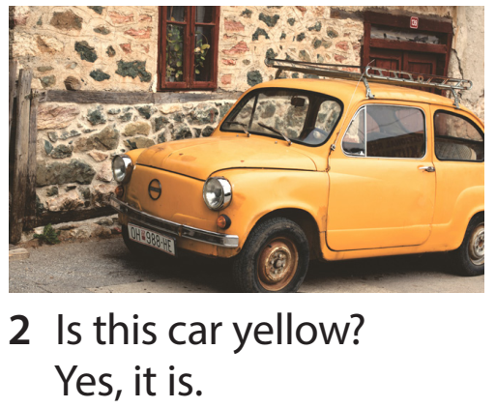
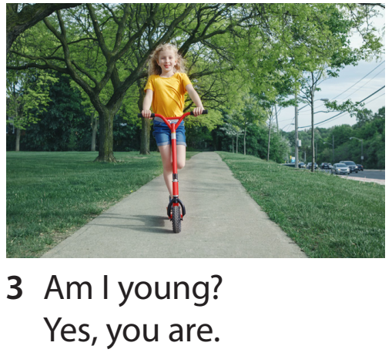
Task 9 Say it.

Slide 17
4 Production

Slide 18

Find and write!
i
y
bike | yes
… | …

Slide 19
5 Assessment

Slide 20

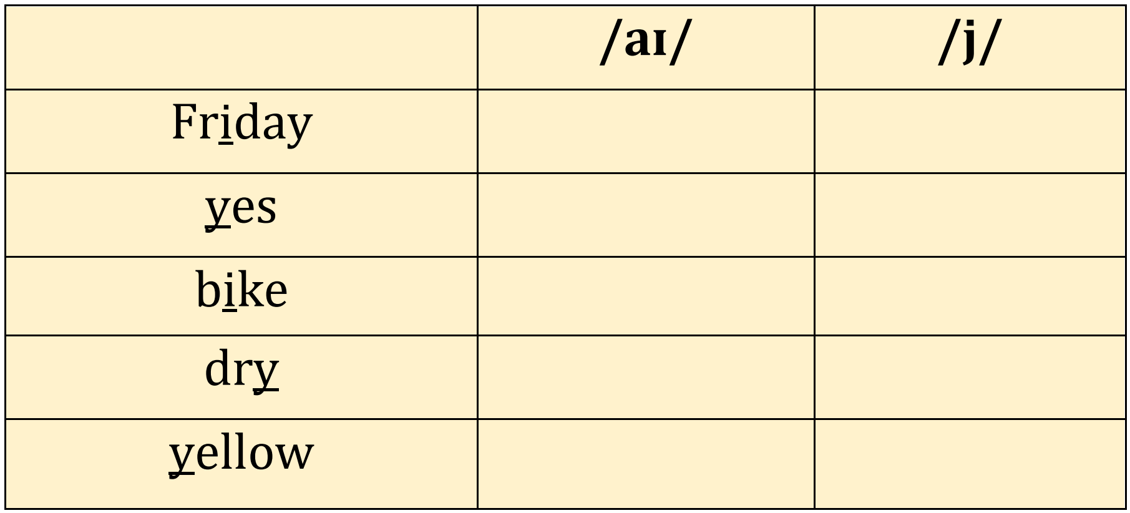
Listen and tick
✓
i
y
✓
✓
✓
✓
✓

Slide 21




Thank you & goodbye!

