Slide 1
Welcome to our class
Teacher: Phạm Công Thành

Slide 2
KIM’S GAME
FUNNY ACTIVE
LISTEN TO MUSIC
MAKE A CAKE TALL
KIND PLAY FOOTBALL
NICE

Slide 3
TIME’S UP!
TIME LIMITED:
1 minute
START TIMER
60
50
10
40
20
30

Slide 4
KIM’S GAME
FUNNY ACTIVE
LISTEN TO MUSIC
MAKE A CAKE TALL
KIND PLAY FOOTBALL
NICE

Slide 5

F R I E N D S
U N I T 3
Lesson 6: Skills 2

Slide 6

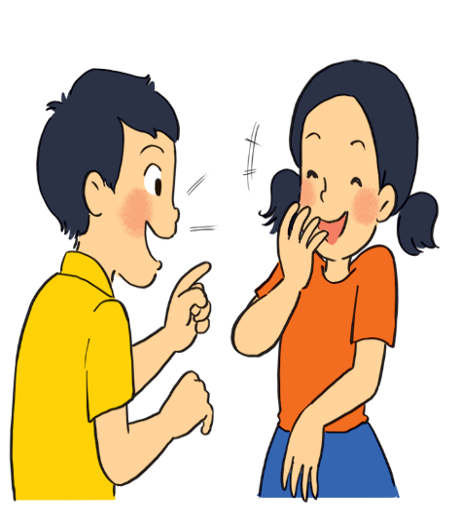
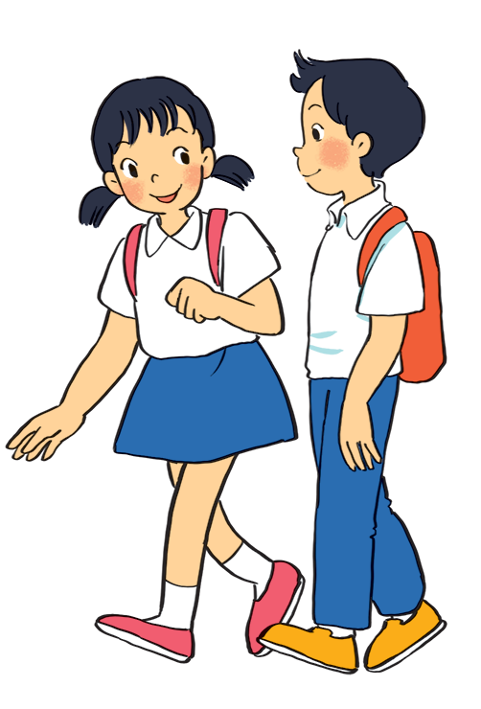
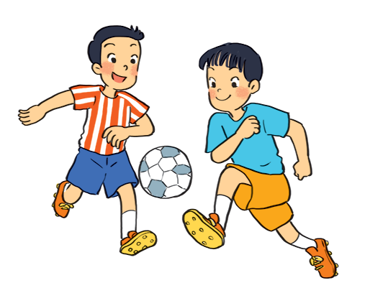
What are the students doing in each picture?
GUESSING
a
They are talking
They are walking
c
b
They are playing football

Slide 7
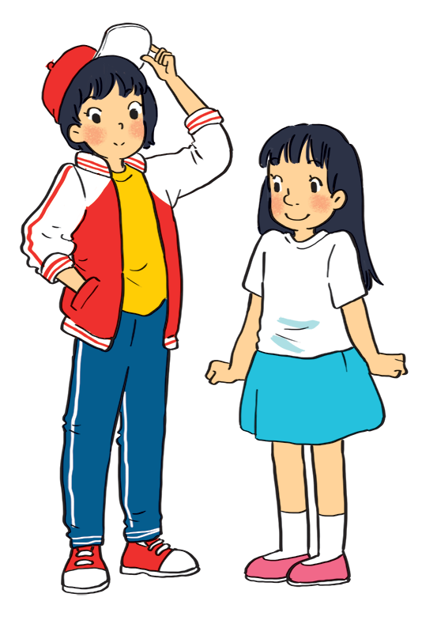
TALKING ABOUT
MINH
MI

Slide 8
TRUE/ FALSE PREDICTION
Lan is tall and slim. _____
Lan is not friendly.______
Chi is short with short hair.____
Chi is a hard -working student.____

Slide 9


Listen to Mi and Minh talking about their best friends. Look at the picture below and say which one is Lan and which one is Chi.
Lan
Chi
Lan is the girl wearing a red and white jacket and a red cap.
Chi is the girl wearing a white T-shirt and a blue skirt.

Slide 10

Listen to the talk again. Fill each blank with a word / number you hear.
1.
Mi and Lan are studying in class
6A.
.
Lan has short hair and a small .
2.
black
mouth
Lan is active and .
3.
friendly
Chi’s hair is long and black, and her nose is
4.
big.
.
5.
Chi is
kind
to Minh.

Slide 11
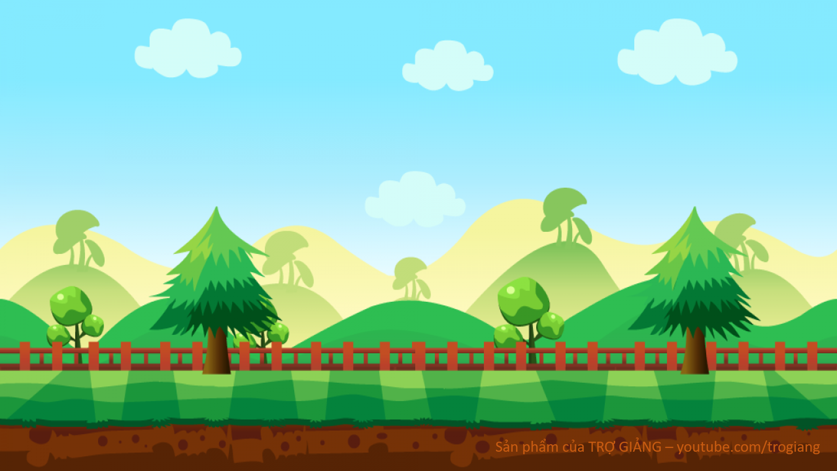
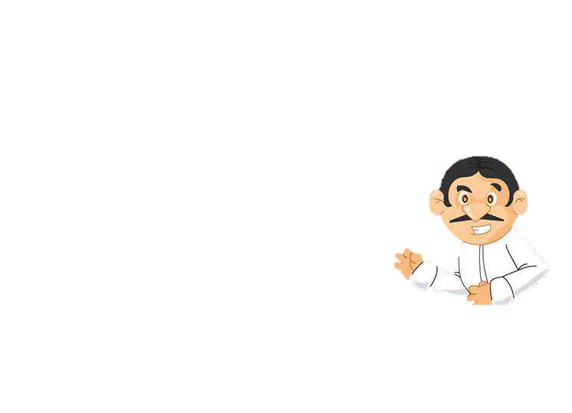

1. Mi and Lan are studying in class_______
6A

Slide 12
2.Lan has short______ hair and a small_______
black
mouth

Slide 13
3.Lan is active and___________
friendly

Slide 14
4.Chi’s hair is long and black, and her nose is__________
big

Slide 15
5.Chi is___________to Minh
kind

Slide 16
Listen to the talk again. Fill each blank with a word / number you hear.
1.
Mi and Lan are studying in class
6A.
.
Lan has short hair and a small .
2.
black
mouth
Lan is active and .
3.
friendly
Chi’s hair is long and black, and her nose is
4.
big.
.
5.
Chi is
kind
to Minh.

Slide 17
AUDIO SCRIPT
Mi: My best friend is Lan. She studies with me in class 6A. She’s tall and slim. She has short black hair and a small mouth. She’s very active and friendly. She likes playing sports and has many friends. Look, she’s playing football over there!
Minh: Chi is my best friend. We’re in class 6B. She’s short with long black hair and a big nose. I like her because she’s kind to me. She helps me with my English. She’s also hard-working. She always does her homework before class. Look, she’s going to the library.

Slide 18
Brainstorming
Appearances
Characters
-kind
-friendly
-helpful
-active…
-tall
-short
-slim
-long hair
-short hair
-black/ blond..

Slide 19

II. Writing
Work in pairs. Ask and answer about your best friend. Use these notes to help you.
1. What’s his / her name?
His name’s Huy / My best friend is Huy.
2. What does he / she look like?
He has tall and has short black hair.
3. What’s he / she like?
He is active and funny.
4. Why do you like him / her?
I like him because we often do our homework together, and he helps me a lot

Slide 20

Write a diary entry of about 50 words about your best friend. Use the answers to the questions in 4.
Dear Diary,
My bst friend is
I like
because

Slide 21
* Model writing
My best friend is Lan. She studies with me in class 6A. She’s tall and slim. She has short black hair and a small mouth. She’s very active and friendly. She likes playing sports and has many friends. I hope that in the future we’ll be best friends.

Slide 22
SUMMARY
UNIT 3- SKILLS 2
MY FRIENDS
Listening skill
Writing skill
appearance
character
Kind, active, friendly…
tall, short, slim…
short hair, long hair, small mouth…

Slide 23
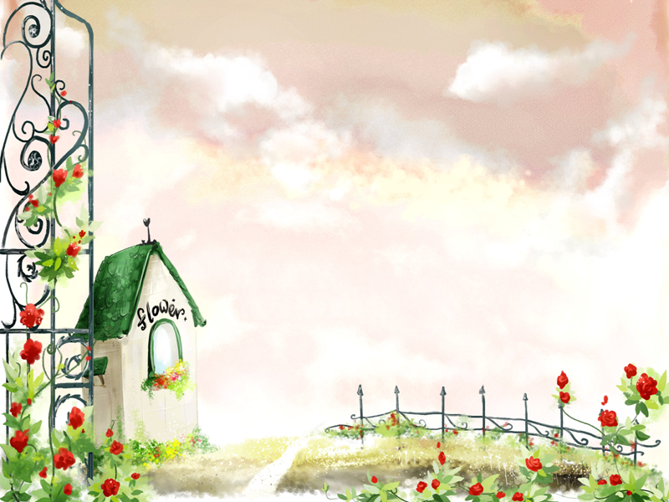
HOMEWORK
Rewrite your writing into your notebooks.
- Prepare: Looking back & project

