Slide 1





Warmly welcome all the teachers and students attend!
Teacher: Phạm Công Thành
Kien Thiet secondary school

Slide 2

WARM-UP
What community atctivities did you do last summer?

Slide 3



Perod 21st
Unit
3
COMMUNITY SERVICE
LESSON 6: SKILLS 2
Listening
  Tom and Linda’s community activities last summer.
Writing
  Write an email about your school activities last summer.

Slide 4

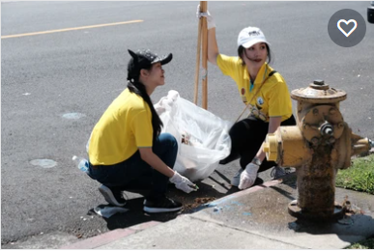
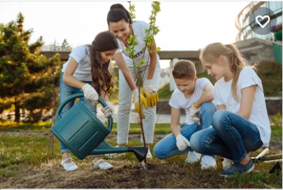
PRE-LISTENING
1
What community activities are the children doing in the pictures?
a
b
c
reading books to the elderly
picking up litter
planting trees

Slide 5
WHILE-LISTENING
2
Listen to Tom and Linda talking about their community activities last summer. Circle the correct answers.
1. Linda and her friends taught ______.
A. English and literature
B. maths and history
C. English and maths
2. Linda and her friends ______ the elderly.
A. talked to
B. cooked for
C. read books to
3. Tom and his friends picked up ______.
A. books and paper
B. bottles and books
C. paper and bottles
4. Tom and his friends ______.
A. grew some trees
B. tutored maths
C. cleaned schools

Slide 6
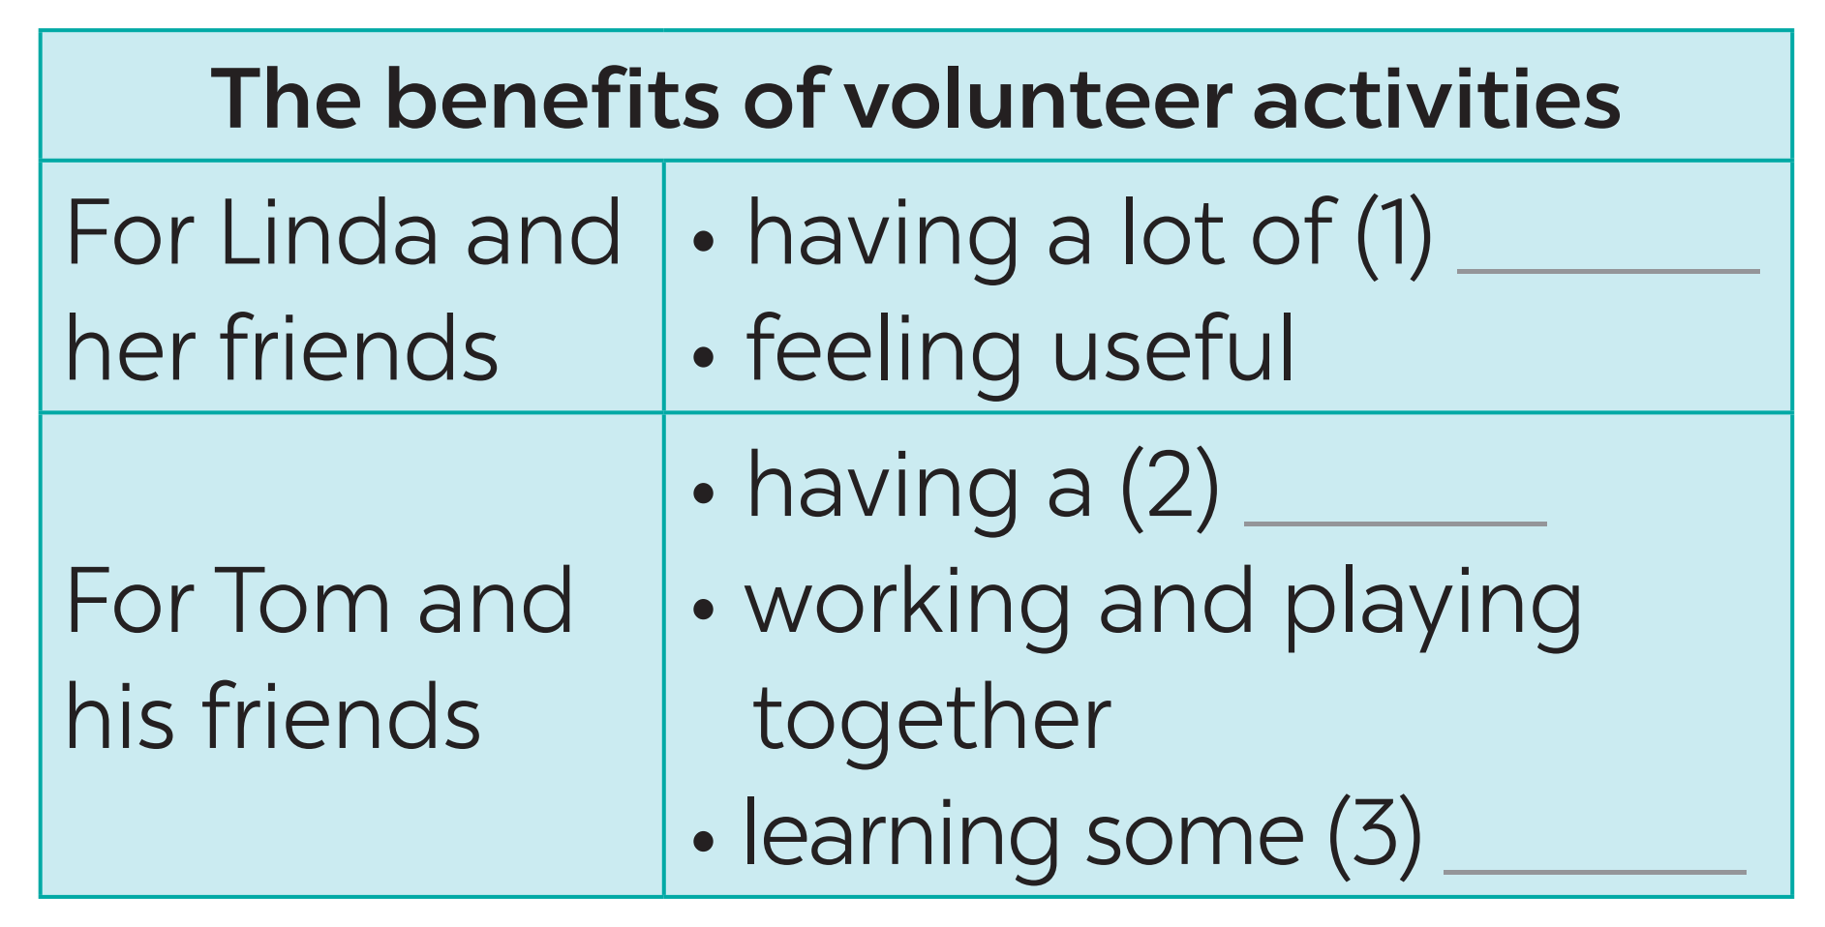
Linda: Glad to hear it, Tom.
Tom: Yes. It was a really good time. We worked and played together, and we learnt some skills, too.
WHILE-LISTENING
Tom: Awesome! Was it difficult?
Linda: Yes. But we had a lot of fun.
3
Listen again and fill in each blank with no more than two words.
Linda: Glad to hear it, Tom.
Tom: Yes. It was a really good time. We worked and played together, and we learnt some skills, too.
fun
good time
skills

Slide 7
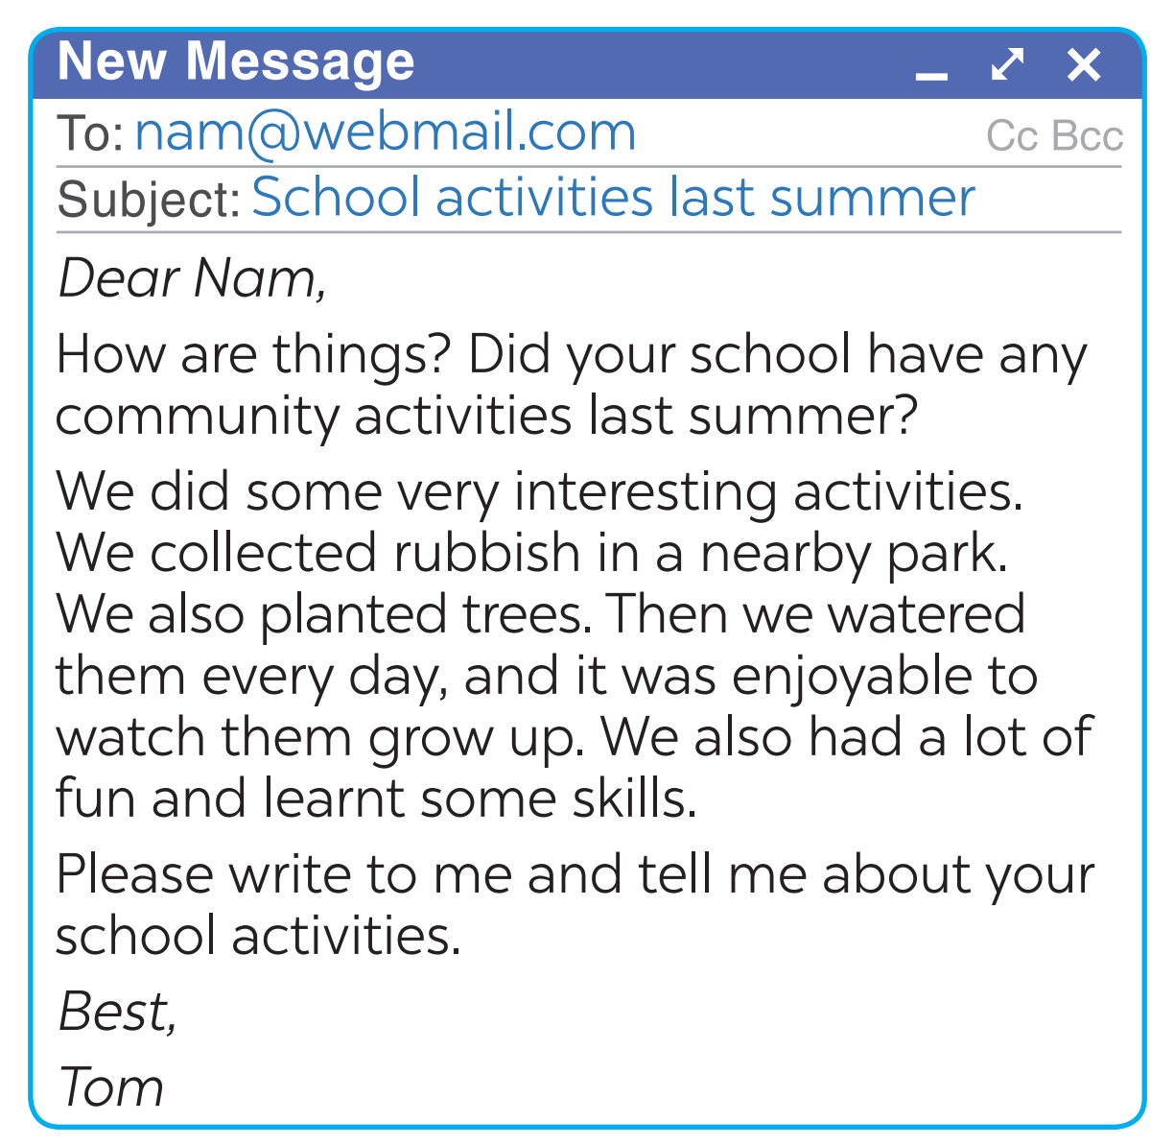
PRE-WRITING
4
Read Tom’s email to Nam about his school activities last summer.
Who is writing to whom?
What is the subject of the email?
How did Tom start his email?
How did Tom end his email?
What is the purpose of the first paragraph of the email?

Slide 8
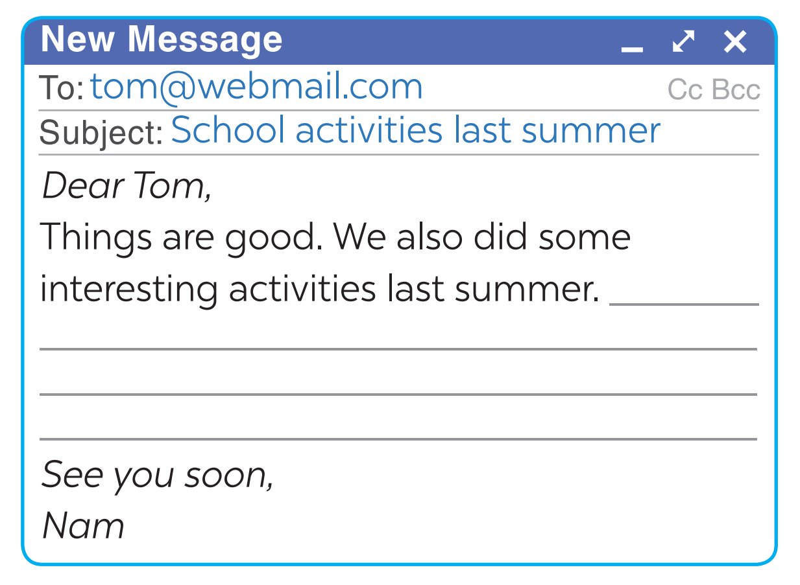
WHILE-WRITING
5
You are Nam. Now write an email of about 70 words to Tom about your school activities last summer. Start your email as shown below.
What community activities did Nam do last summer?
What benefit brings to?

Slide 9
WHILE-WRITING
5
You are Nam. Now write an email of about 70 words to Tom about your school activities last summer. Start your email as shown below.
* Suggested writing:
Dear Tom,
Things are good. We also did some interesting activities last summer.
We did some very interesting activities. First, we donated food and warm clothes to children in mountainous areas. So we can help children have a better life. Second, we planted vegetables, trees and flowers in school garden. Therefore, we may make our school greener and cleaner. We also had a lot of fun and learnt some skills. we really loved our last summer
Please write to me and tell me about your school activities.
See you soon,
Best,
Nam

Slide 10

CONSOLIDATION
1
WRAP-UP
In this lesson, we have learnt to:
listen for specific information about some community activities and their benefits;
write an email about community activities one did last summer.

Slide 11
CONSOLIDATION
2
HOMEWORK
Rewrite the email on your notebook.
Prepare for the next lesson: Looking back & Project

Slide 12

Website: sachmem.vn
Fanpage: facebook.com/sachmem.vn/

Slide 13
LESSON 6: SKILLS 2
WARM-UP
Chatting & Homework checking
Task 1: What community activities are the children doing in the pictures?
Task 2: Circle the correct answers.
Task 3: Listen again and fill in each blank with no more than two words.
LISTENING
Task 4: Read Tom’s email to Nam about his school activities last summer.
Task 5: Write an email of about 70 words to Tom about your school activities last summer.
WRITING
POST-LISTENING
& WRITING
Task 6:Correting the email and retell the community activities which Linda and Tom did last summer.

Slide 14
LESSON 6: SKILLS 2
WARM-UP
Chatting & Homework checking
Task 1: What community activities are the children doing in the pictures?
Task 2: Circle the correct answers.
Task 3: Listen again and fill in each blank with no more than two words.
LISTENING
Task 4: Read Tom’s email to Nam about his school activities last summer.
Task 5: Write an email of about 70 words to Tom about your school activities last summer.
WRITING
POST-LISTENING
& WRITING
Task 6:Correting the email and retell the community activities which Linda and Tom did last summer.
Wrap-up
Homework
CONSOLIDATION

