Slide 1
Teacher: Dao Quang Tuyen

Slide 2
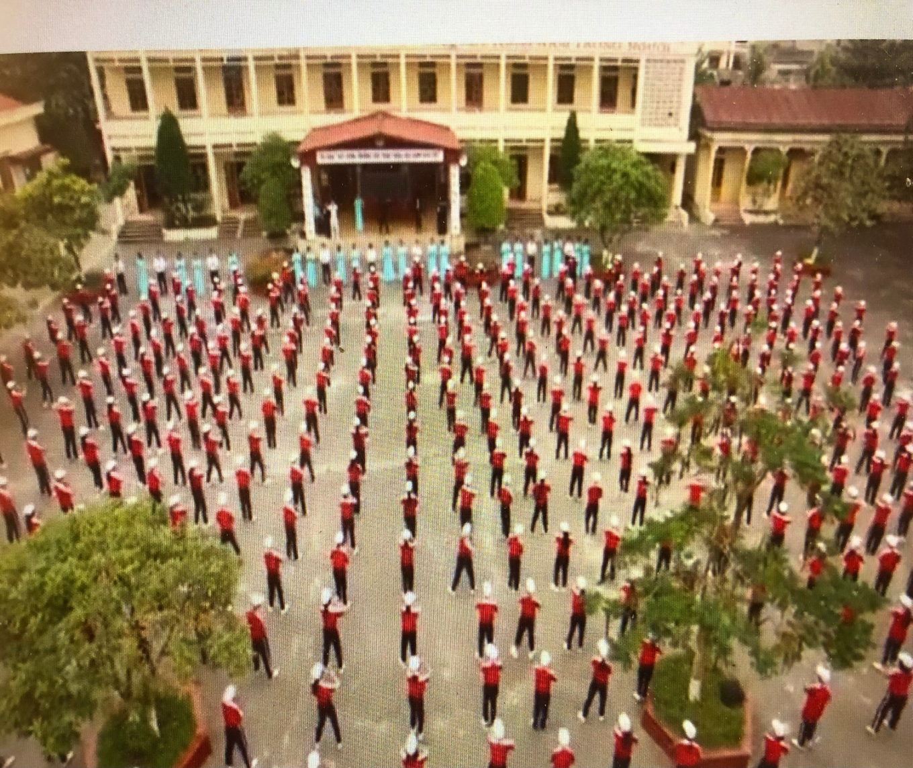
Warm up: Chatting
Do you like your new school? Why or why not?
What’s the name of your school?
Is your school big or small?
How many students and teachers are there?

Slide 3


UNIT 1: MY NEW SCHOOL
LESSON 5:
I. Reading

Slide 4
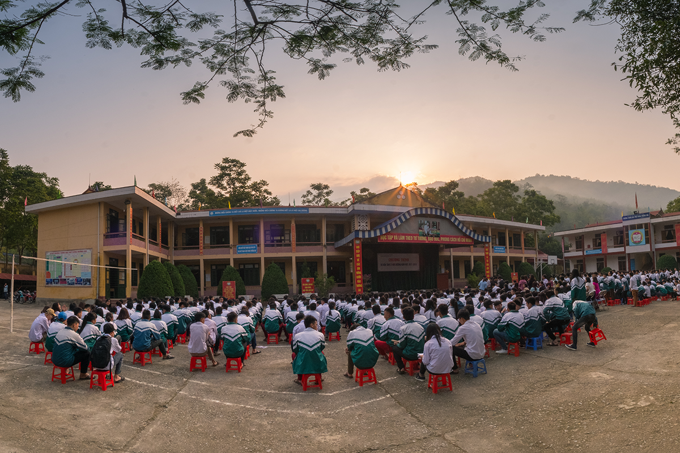
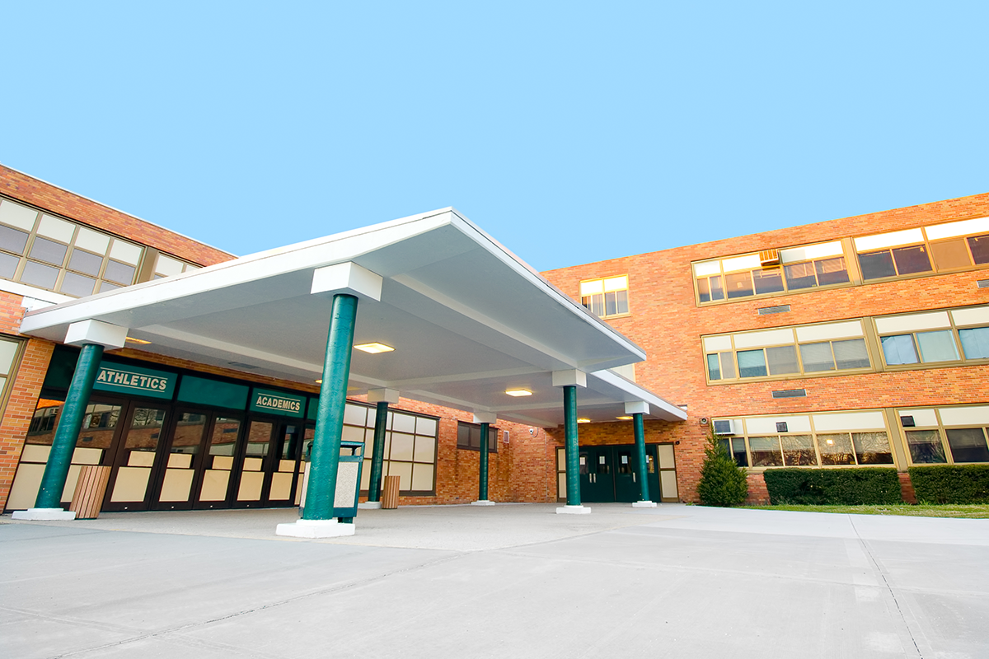

READING
1. What can you see in these pictures?
2. Are these schools in the same place?
3. Which school do you think is in Viet Nam?

Slide 5
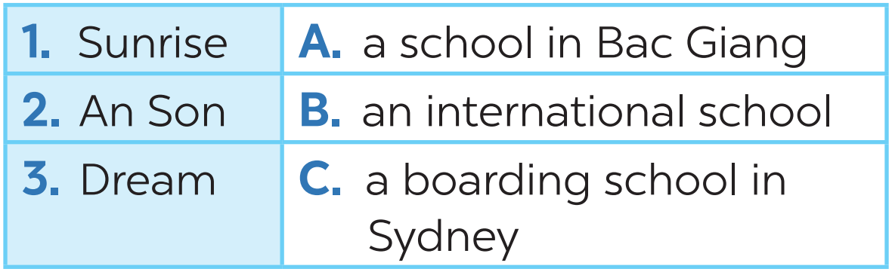
READING
1
Look at the picture and quickly read the passages. Match 1-3 with A-C.

Slide 6
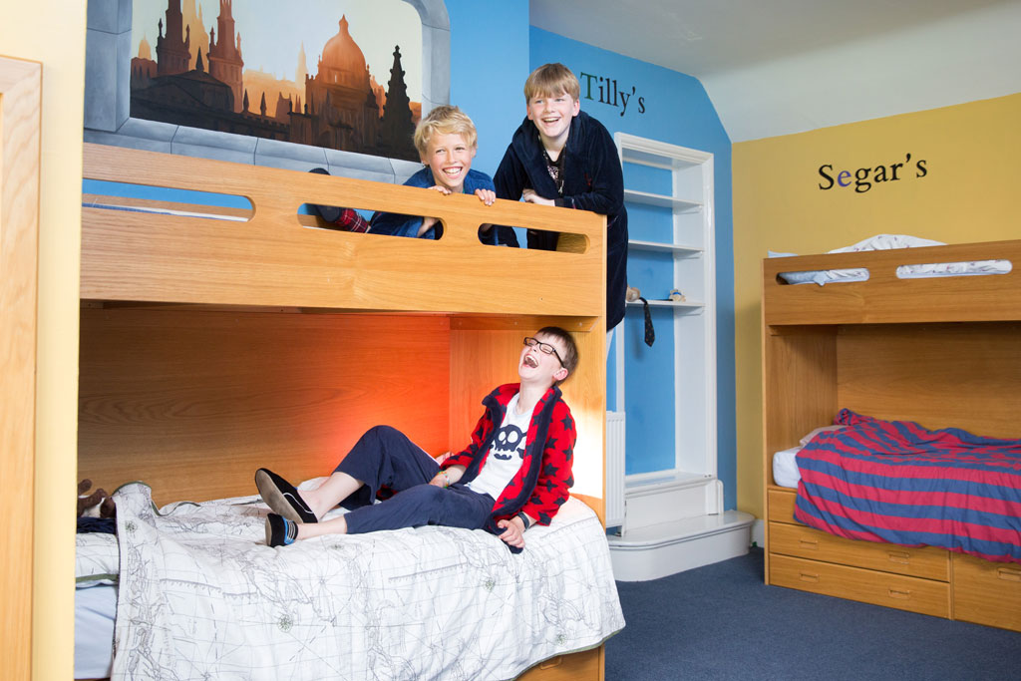

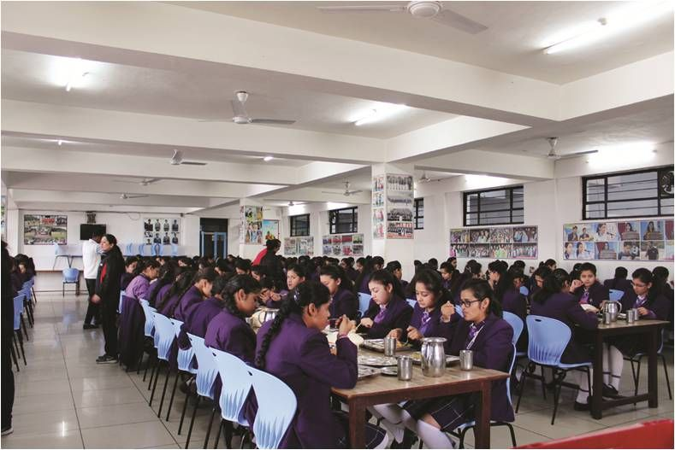
READING
boarding school (n)
A school where students live and study
/ˈbɔːdɪŋ ˌskuːl/
trường nội trú

Slide 7
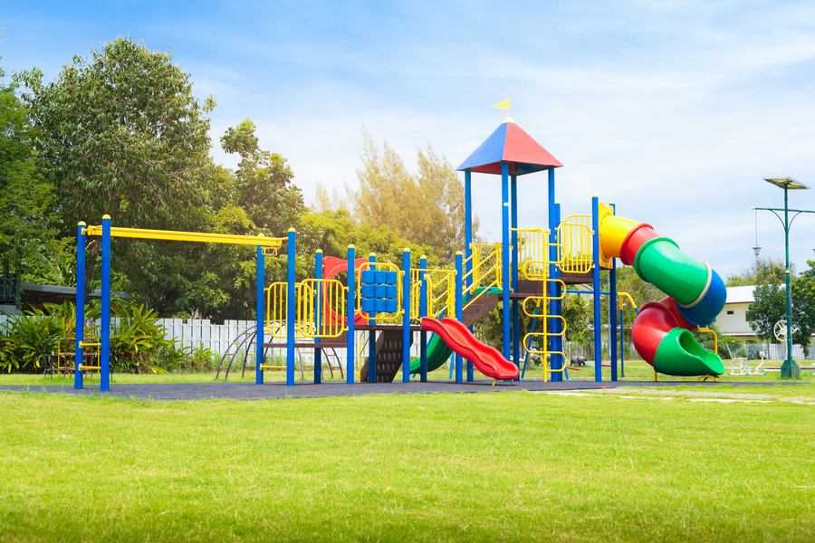
READING
playground (n)
/ˈpleɪɡraʊnd/
sân chơi

Slide 8

READING
international (adj)
/ˌɪntəˈnæʃənəl/
(mang tính)
quốc tế

Slide 9
* Checking words:
What and Where
playground
boarding school
international

Slide 10
READING
New words | Pronunciation | Meaning
1. boarding school (n) | /ˈbɔːdɪŋ ˌskuːl/ | trường nội trú
2. playground (n) | /ˈpleɪɡraʊnd/ | sân chơi
3. international (adj) | /ˌɪntəˈnæʃənəl/ | (mang tính) quốc tế

Slide 11
READING
2
Read the passages again and complete the sentences.
1. Students live and study in a ________ school. They only go home at weekends.
2. Sunrise is a school in _______.
3. There are ______________________ around An Son School.
4. ____________ has an art club.
5. At Dream School, students learn English with _______________________.
boarding
Sydney
mountains and green fields
Dream School
English-speaking teachers

Slide 12

Game : Lucky star
Answer the questions.

Slide 13

Lucky star !
7
4
3
2
8
1
6
5

Slide 14
1. Which school is a boarding school?
Sunrise.

Slide 15
2. Where is An Son School?
It is in Bac Giang.

Slide 16

Lucky Number
Lucky Number

Slide 17
Lucky Number
Lucky Number

Slide 18
Lucky Number
Lucky Number

Slide 19
Lucky Number
Lucky Number

Slide 20
3. Is there a school garden in An Son School?
Yes. There is.

Slide 21
4. What do Dream School students do in the afternoon?
They join many interesting clubs.

Slide 22
II. Speaking

Slide 23

Which school in 1 would you like to go to? Why or Why not? Complete the table.
Name of school | Reasons you like it | Reason you don’t like it
Sunrise An Son -Dream
Then discuss your choice with a friend.
Example:
A: Which school would you like to go to?
B: I’d like to go to Sunrise School.
A: Why?
B: Because students study and live there. .

Slide 24
Name of school | Reasons you like it | Reasons you don't like it
Sunrise | It is a boarding school | Not have school garden
An Son | It has school garden. It has mountains and green fields. | It's small
Dream | It is modern and it has many interesting clubs | - It is expensive

Slide 25



HOMEWORK
- Learn the new words by heart.
- Read the passages again.
-- Prepare for the next lesson:
+

Slide 26

Goodbye
Thank you for your attention!!!

