Slide 1
Tran Tat Van Primary school
Teacher: Phạm Thị Bích Liên

Slide 2
UNIT 2: THANK YOU
Section A4,5,6,7

Slide 3
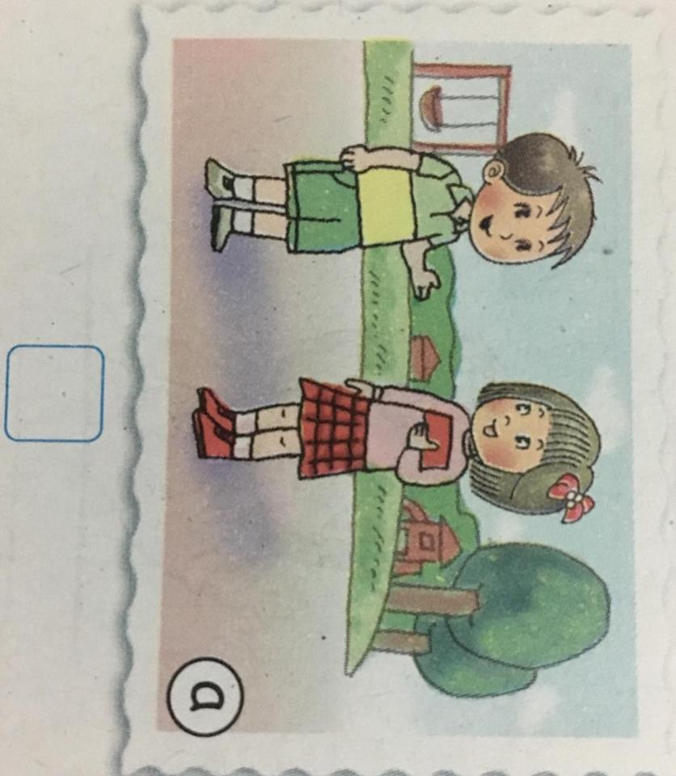
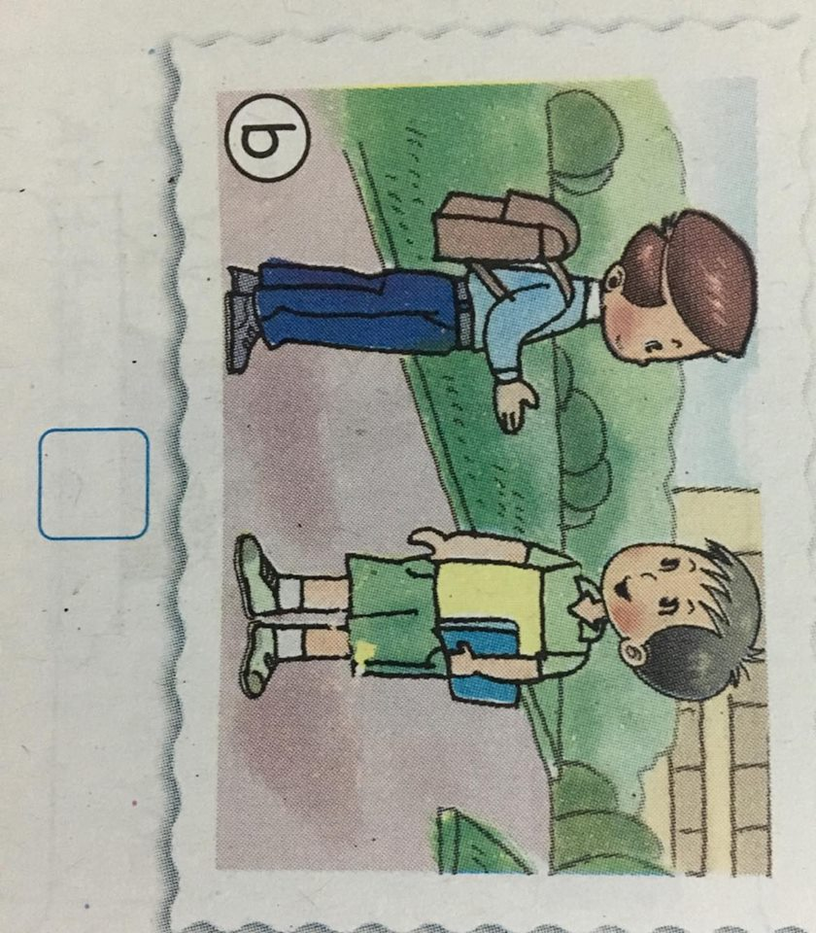
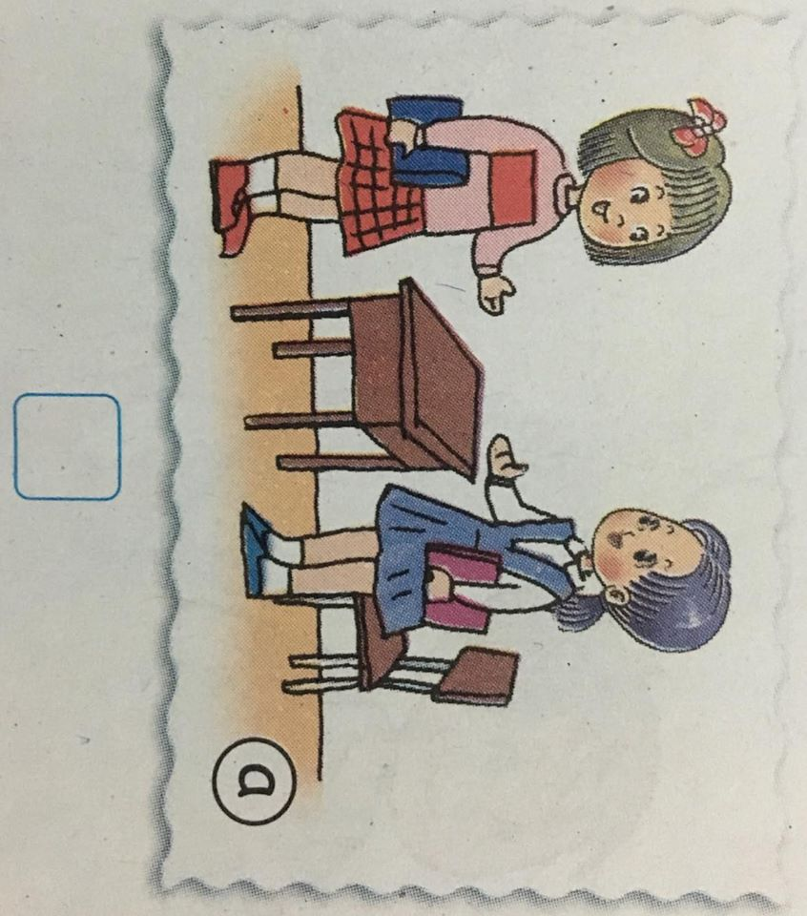
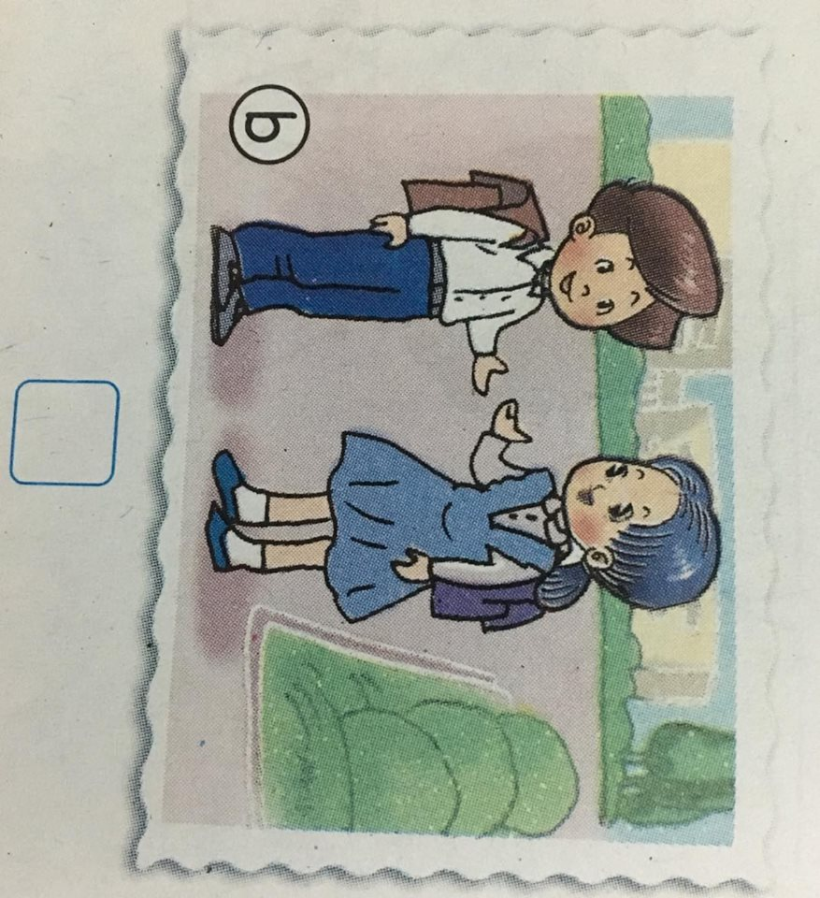
4. Listen and check
1.
X
2.

Slide 4
5. Say it right
see LiLi see
Meet Alan read
6. Let’s write
A: How……………………………. ?
B: I’m……………., ………….. You.

