Slide 1
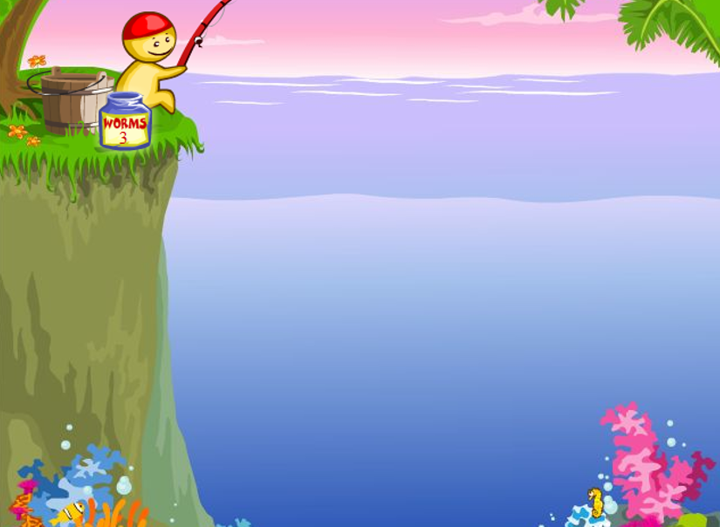
GAME
CATCH FISH

Slide 2
NEXT
Notes:
Invite sts to choose the questions by saying the colour.
Click “NEXT” to move to the next part.

Slide 3
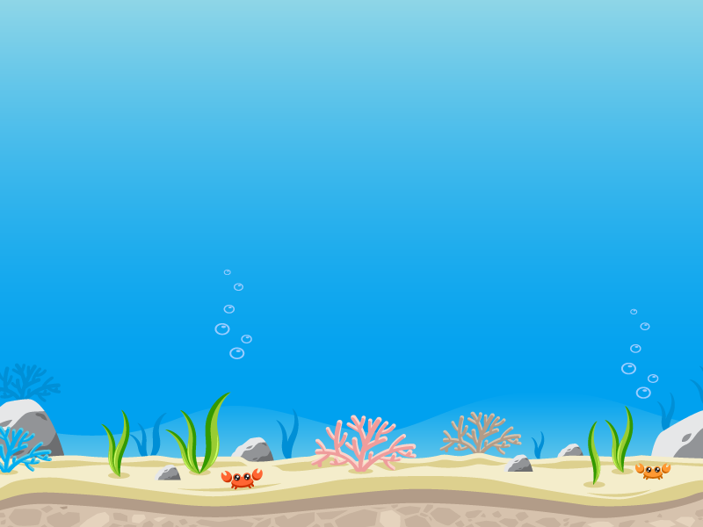
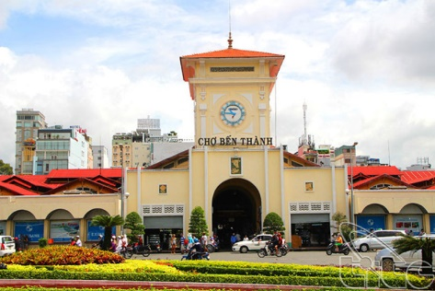
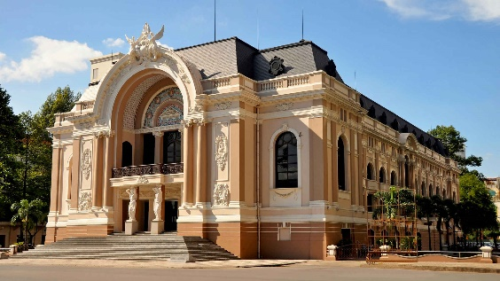
Which place would you like to visits? or ?
BACK
Notes:
Click mouse / Enter to show the answer.
Click “BACK” to back to the main slide of the game.

Slide 4
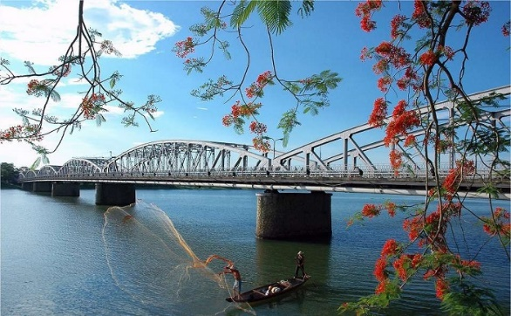
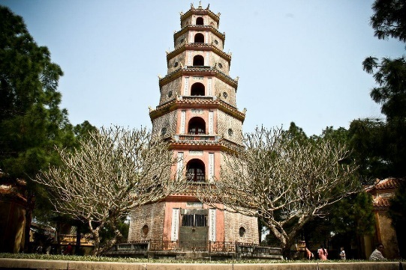
Which place would you like to visit
or ?
BACK
Notes:
Click mouse / Enter to show the answer.
Click “BACK” to back to the main slide of the game.

Slide 5
We have English on ……………….
Monday
BACK
Notes:
Click mouse / Enter to show the answer.
Click “BACK” to back to the main slide of the game.

Slide 6
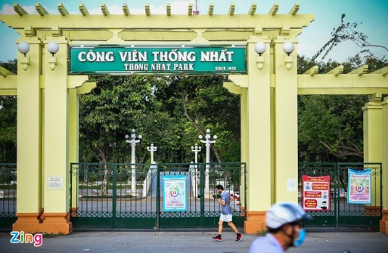
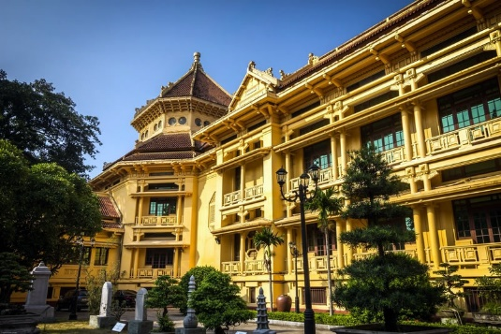
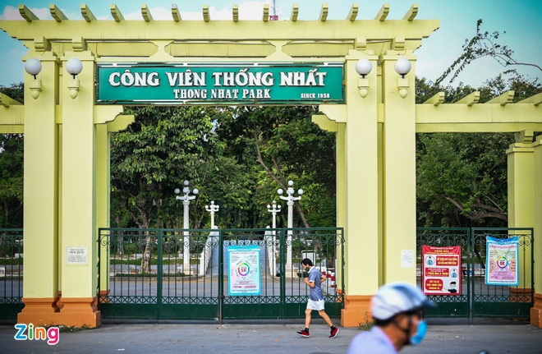
Which place would you like to visit or ?
BACK
Notes:
Click mouse / Enter to show the answer.
Click “BACK” to back to the main slide of the game.

Slide 7
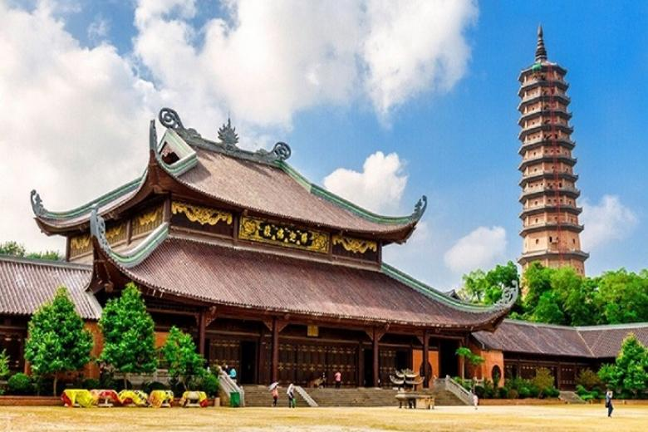
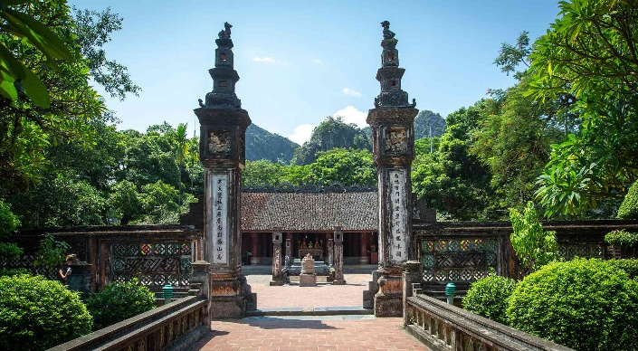
Which place would you like to visit or ?
BACK
Notes:
Click mouse / Enter to show the answer.
Click “BACK” to back to the main slide of the game.

Slide 8
What day is it?
It’s Tuesday.
BACK
Notes:
Click mouse / Enter to show the answer.
Click “BACK” to back to the main slide of the game.

Slide 9
When do you have English?
I have it on Wednesday.
BACK
Notes:
Click mouse / Enter to show the answer.
Click “BACK” to back to the main slide of the game.

Slide 10
What day is it today?
It’s ………………..
BACK
Notes:
Click mouse / Enter to show the answer. (sts answer by themselves, depend on the real day).
Click “BACK” to back to the main slide of the game.

Slide 11
What will the weather be like tomorrow?
BACK
Notes:
Click mouse / Enter to show the answer.
Click “BACK” to back to the main slide of the game.

