Slide 1

Good morning!

Slide 2

Unit 7: Pollution
PERIOD 60:
SKILLS 2

Slide 3
VOCABULARY
algal (n) tảo
bloom (v,n) nở hoa
discharge (n,v) phóng điện
Power plant (n) nhà máy nhiệt điện
Power station (n) trạm phát điện

Slide 4
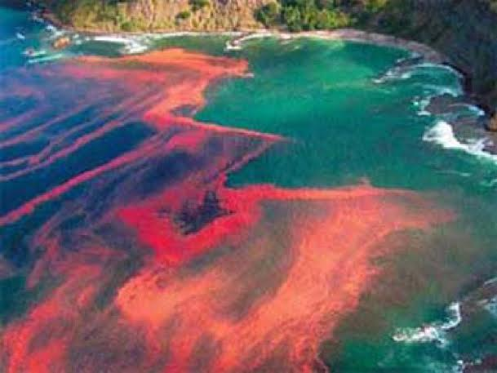
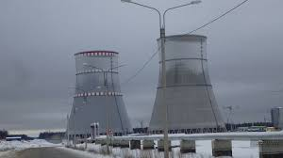

LISTENING
Describe what you see in the pictures and talk about the
relationship between them.
Listen and check your answers.
The first picture shows an algal bloom in coastal seawater.
- The second picture shows the cooling towers from a power station.
They are both related to thermal pollution.

Slide 5
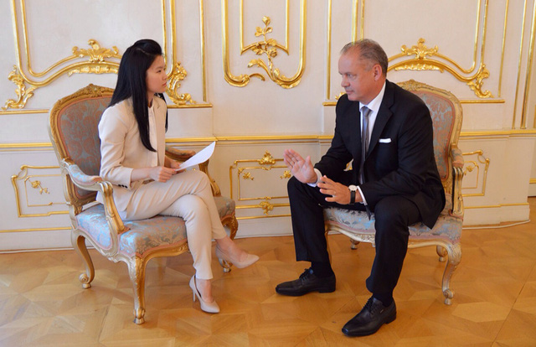
2. Listen to part of a conversation on TV between a
reporter and an environmentalist about thermal pollution.
Complete the diagram. Use no more than three words for
each blank.

Slide 6
Thermal pollution:
- Definition:
(1)…………or (2)………..
SOLUTIONS
Building cooling towers to (10)………….. the water.
Causes
- Power plants using water to (3)
………….. equipment.
- Discharge of cold water into (4)…………….
Effects
- (5)……….. ….decreasing oxygen
- Less oxygen harming (6) …………………..
- (7)………… algal blooms being another effect
- Can change (8)……….. of the water and (9)………… fish.
cool
warm rivers
Warm water
hotter
fish populations
cooler
Harmful
color
poison
cool down

Slide 7
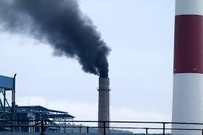
WRITING
3. Work in pairs. Discuss the causes and effects of one type of pollution in your area. Make notes in the diagram.

Slide 8
………………………. pollution
Definition: ………………………
EFFECTS
………………………
CAUSES
………………………

Slide 9
Air pollution
Definition: Air pollution occurs when the air contains gases, dust, fumes or outdour in harmful amounts.
Causes: industrial waste, exhaust from cars and plane…
Effects: causing diseases, death to human, damage to other living organisms such as animals and food crops, or the natural or built environment.

Slide 10
4. Imagine that you two are writing an article for the local newspaper about a type of pollution in your area. One of you writes about the causes and the other writes about the effects of the pollution type you have just discussed in 3.
5. Read each other’s work and put them together
to make a complete article.

Slide 11
Suggested article
Air Pollution
Air pollution is now a serious problem for those living my area. Air pollution may be any industrial waste, gases , dust, fume or odour in harmful amounts which are harmful for man, vegetation, animals or buildings.
Air pollution can have some different causes. The major source of air pollution is industrial waste from factories. The second is exhaust from cars, motor vehicles and planes...Agricultural activities as crop spraying with pesticides and herbicides are another one.
Air Pollution can have dramatic effects. It causes various dangerous diseases, death to human, damage to other living organisms such as animals and food crops, or the natural or built environment. The buildings look dirty.
So, what should we do to reduce air pollution?

Slide 12
HOMEWORK
Learn by heart vocab.
Rewrite the article and do exercises E1,2 ( PAGE 10-
workbook).
Prepare part : LOOKING BACK & PROJECT

Slide 13

Thanks for your attendance!
Goodbye. See you again

