Slide 2
Thursday,April 6th 2023
Unit 10:Our houses in the future
Lesson 6:Skills 2 p.45

Slide 3
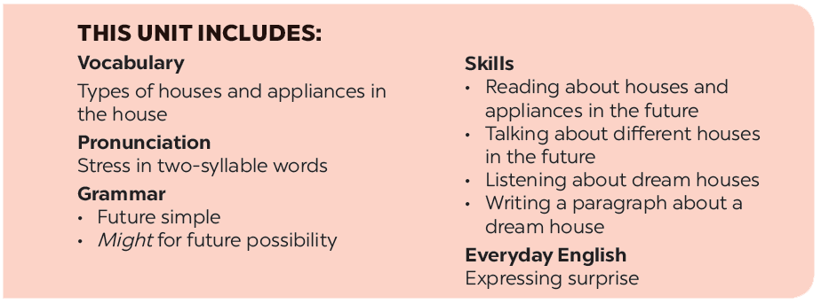

Slide 4
Listening
Listen again and answer the questions about their dream houses.
Listen to Nick and Linda talking about their dream houses. Which house would each prefer? Write their names under the correct pictures.
Writing
Work in pairs. Discuss your dream house, and fill the table.
Listen to the conversation again. What is important to Linda? What is important to Nick? Tick () the columns.
Use the information in 4 to write a paragraph of about 50 words about your dream house.

Slide 5
Listening

Slide 6
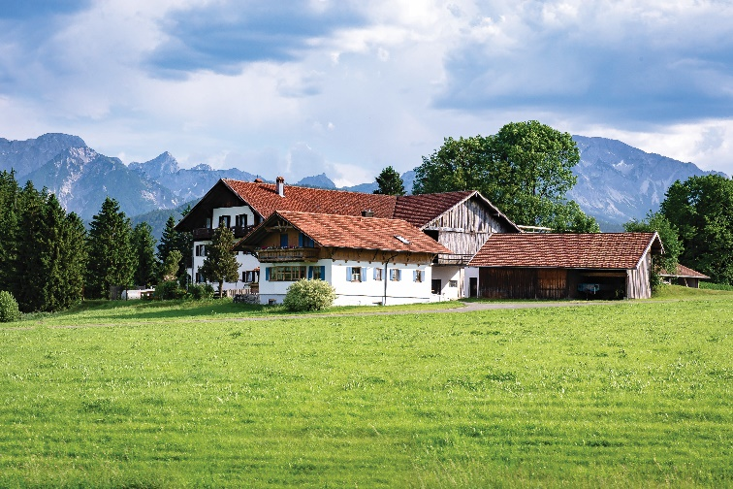
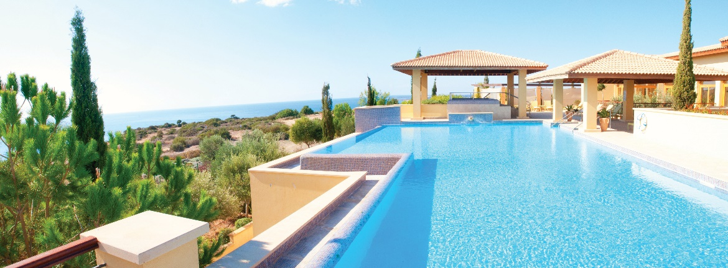
Listen to Nick and Linda talking about their dream houses. Which house would each prefer? Write their names under the correct pictures.
a
b
Nick: a flat in the city
c
Linda: a villa by the sea, with a swimming pool and a garden)
Audio script

Slide 7
AUDIO SCRIPT
Nick: Can you tell me about your dream house, Linda?
Linda: Well, it's a big villa by the sea. It has a view of the sea. It has a swimming pool and a garden.
Nick: My dream house is different.
Linda: Really? What's it like?
Nick: It's a beautiful flat in the city. It has a park view in front and a city view at the back.
Linda: Oh, sounds great!
Nick: It has a super smart TV. I can watch films from other planets.
Linda: That sounds great, too. But I think it'll be...

Slide 8
Listen to the conversation again. What is important to Linda? What is important to Nick? Tick () the columns.
 | Linda | Nick
1. park view
2. city view
3. sea view
4. swimming pool
5. garden





Audio script

Slide 9
AUDIO SCRIPT
Nick: Can you tell me about your dream house, Linda?
Linda: Well, it's a big villa by the sea. It has a view of the sea. It has a swimming pool and a garden.
Nick: My dream house is different.
Linda: Really? What's it like?
Nick: It's a beautiful flat in the city. It has a park view in front and a city view at the back.
Linda: Oh, sounds great!
Nick: It has a super smart TV. I can watch films from other planets.
Linda: That sounds great, too. But I think it'll be...

Slide 10
Listen again and answer the questions about their dream houses.
1.
What type of house does Linda have?
She has a big villa.
2.
Where is her house?
Her house / It is by the sea.
3.
What is around her house?
There’s a swimming pool and a garden around her house.
4.
What type of house does Nick have?
He has a flat.
5.
Where is it?
It’s in the city.
Audio script

Slide 11
AUDIO SCRIPT
Nick: Can you tell me about your dream house, Linda?
Linda: Well, it's a big villa by the sea. It has a view of the sea. It has a swimming pool and a garden.
Nick: My dream house is different.
Linda: Really? What's it like?
Nick: It's a beautiful flat in the city. It has a park view in front and a city view at the back.
Linda: Oh, sounds great!
Nick: It has a super smart TV. I can watch films from other planets.
Linda: That sounds great, too. But I think it'll be...

Slide 12
Writing

Slide 13
Work in pairs. Discuss your dream house, and fill the table.
Example:
A: What type of dream house is it?
B: It’s a palace.
A: Where is it?
B: It’s in the mountains
....
Types of house: | palace
Location: | in the mountains
Number of rooms: | _______________________
Appliances in the house: | _______________________

Slide 14
Use the information in 4 to write a paragraph of about 50 words about your dream house.
Example:
My dream house is a big palace. It is in the mountains. ___________________
________________________________ ________________________________ ________________________________

Slide 15
Use the information in 4 to write a paragraph of about 50 words about your dream house.
Sample paragraph
My dream house is a big palace. It is in the mountains. It is surrounded by lots of trees. It has sevenrooms: three bedrooms, two bathrooms, one kitchen and one living room. There is a large swimming pool in front of it. I have some robots in the palace. They help me to clean the floor, cook meals, water flowers...
I am happy to live in my palace.

Slide 16
* Home Assignments
- Make sentences using the vocabulary
- Do EX part E in unit 10 in WB.

