Slide 1

UNIT 1: LOCAL ENVIRONMENT
Lesson 5: Skills 1

Slide 2

      UNIT 1: LOCAL ENVIRONMENT
      LESSON 5: SKILLS 1
I. Vocabulary:
authenticity (n):
tính xác thực
layer (n) :
lớp ( lá )
preserve (v) :
bảo vệ, bảo tồn
treat ( v) :
xử lí (chất thải…)
income (n) :
thu nhập

Slide 3
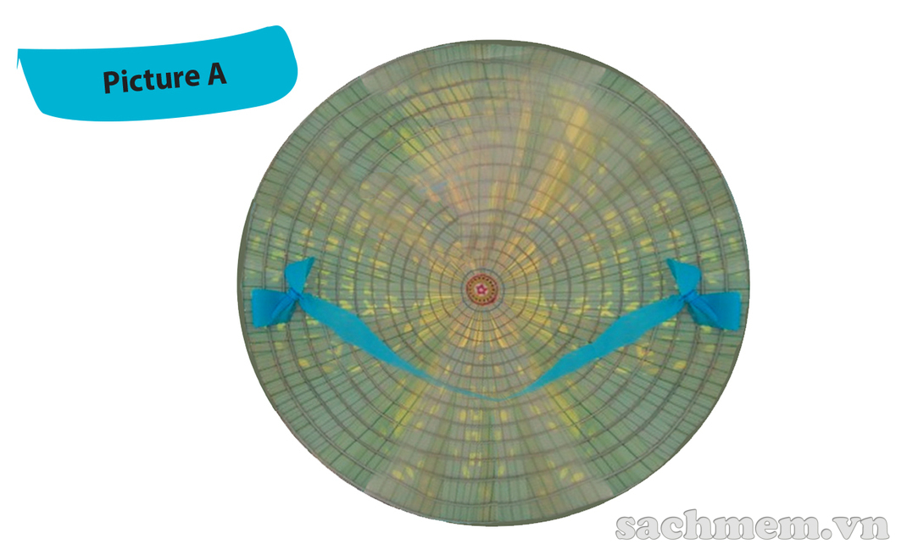
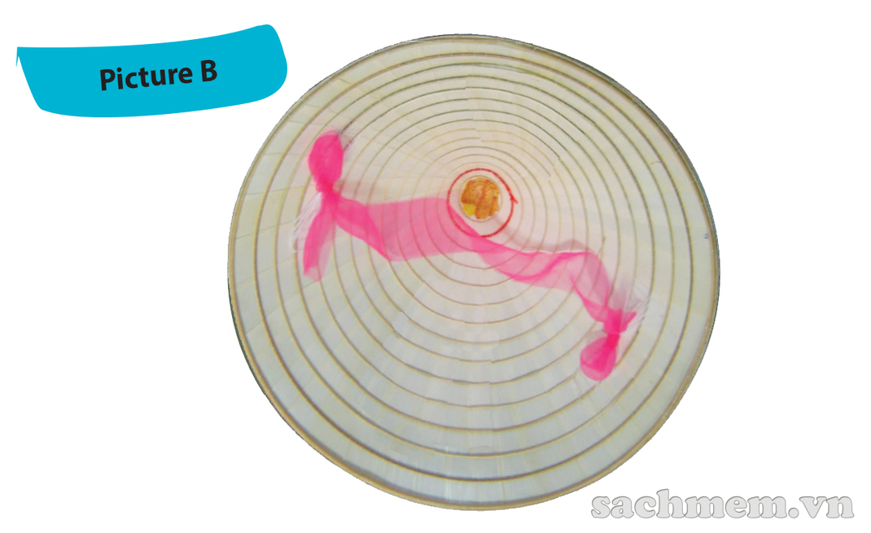
1. Work in pairs. One look at Picture A and other look at picture B. Ask each other question to find out the similarities and differences between your pictures
- Similarities: conical hat, string
Differences
Picture B: white, no decoration, pink string, look heavier
Picture A: light green, pictures between layers, blue string, look lighter

Slide 4

2. Mi visited Tay Ho village in Hue last month. She has decided to present what she knows about this place to the class. Read what she has prepared and match the titles with the paragraphs
Paragraph A:
1. Present status of the craft
Paragraph B:
2. Location and history of conical hat making village
Picture A: light green, pictures between layers, blue string, look lighter
Picture B: white, no decoration, pink string, look heavier
Paragraph C:
3. How the conical hat is made

Slide 5

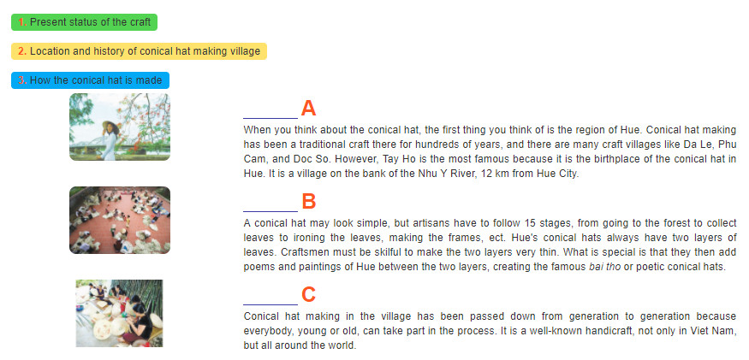
2. Mi visited Tay Ho village in Hue last month. She has decided to present what she knows about this place to the class. Read what she has prepared and match the titles with the paragraphs
1. Present status of the craft
2. Location and history of conical hat making village
3. How the conical hat is made
2
3
1

Slide 6
3. Read the text again and answer the questions
Why is Tay Ho the most well-known conical hat making village?
2. How far is it from Tay Ho to Hue City?
3. What is the first stage of conical hat making?
4. What is special about the hat layers?
5. What is special about the bai tho conical hat?
6. Who can make conical hats?
Because it is the birthplace of the conical hat in Hue.
It’s 12 km from Hue City.
It’s going to the forest to collect leaves.
They’re very thin.
It has poems and paintings of Hue between the two layers.
Everybody can, young or old.

Slide 7
SPEAKING
4. Read the following ideas. Are they about benefits of traditinal crafts (B) or challenges that artisans may face (C). Write B or C
B
1. providing employment
2. losing authenticity
3. providing additional income
4. relying too much on tourism
5. treating waste and pollution
6. preserving cultural heritage
C
B
C
C
B
Can you add some more benefits and challenges

Slide 8
Can you add some more benefits and challenges that artisans may face?
Other benefits: | Other challenges:
Creating national/regional pride helping develop tourism helping improve local infrastructure and services, Creating cohesion between craft families and communities | limited designs, natural resources running out, competition from other countries

Slide 9
5. Imagine that your group is responsible for promoting traditional crafts in your area. Propose an action plan to deal with the challenges
Our group want to propose an action plan for promoting conical hat, a well-know traditional crafts of our country.
The first part of the plan, we want to provide young people, especially students like us, with knowledge about this product. Young people should know about conical hat’s history, symbolization, the making process, ect… so they understand why we need to promoting it and keep it alive even in the current modern life. After that, we should organize some fairs or festival for conical hat and even other traditional crafts to increase the sale of these products. Last but not least, we can produce conical hats for different purposes instead of only for wearing. In this days and age, conical hats are no longer a conventional accessory for the majority of our population. However, we can create more unique and artistic conical hats for decorating home or dance and music performance. It can also be a way to increase the sale of this product.
We hope our plan can help to promote conical hats in the future. Thanks for listening!

Slide 10
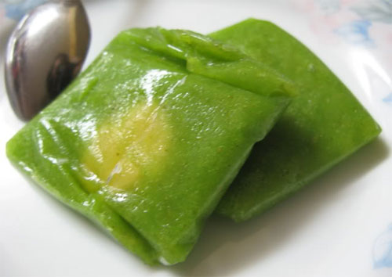
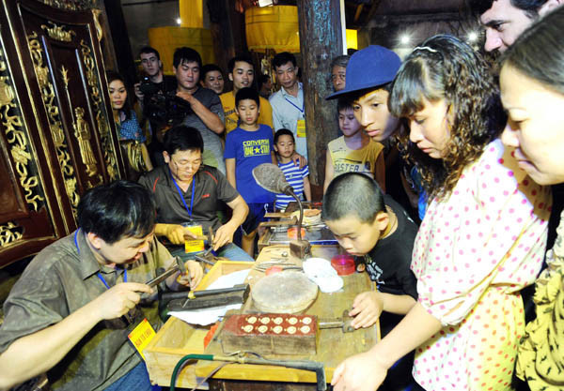
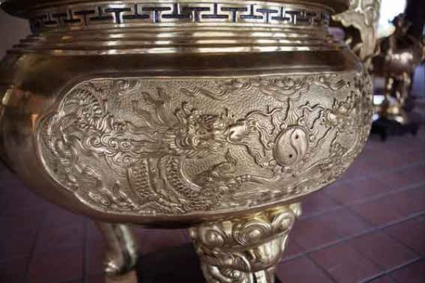
Activity 5. Imagine that your group is responsible for promoting traditional crafts in your area. Propose an action plan to deal with the challenges.
Square Sticky Rice Cake: Tranh Khuc village, Hanoi
Silver carving in Hang Bac street, Hanoi
Ngu Xa Bronze casting Ba Dinh District, Hanoi

Slide 11
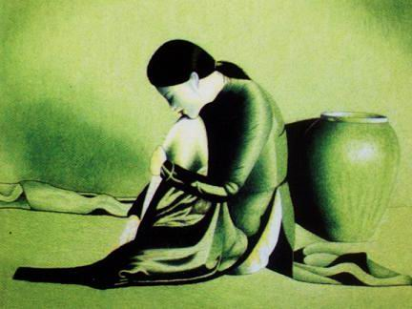
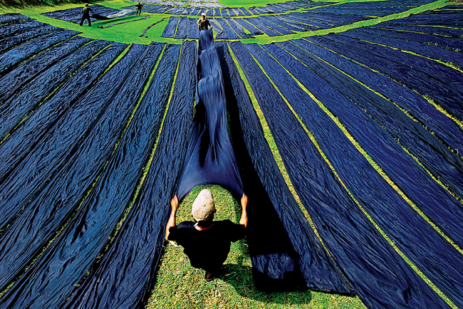
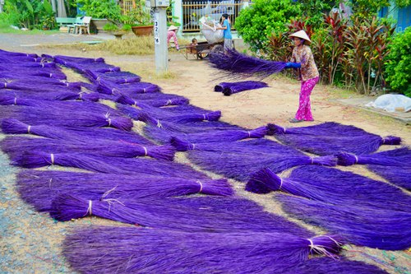
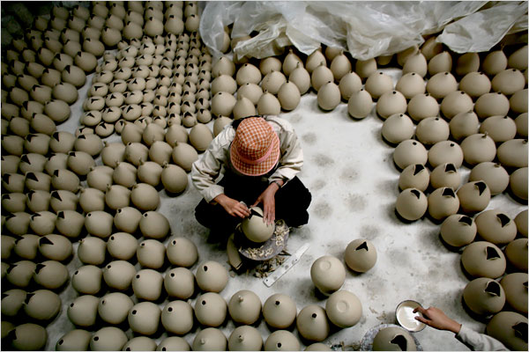
Embroidery: Quat Dong village, Ha Tay province
Silk: Van Phuc village, Ha Tay province
Sedge Mats : Dinh Yen village, Dong Thap province
Ceramics: Bat Trang village, Hai Dung province

Slide 12
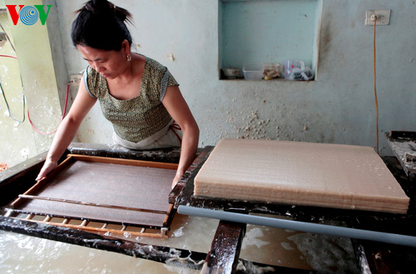
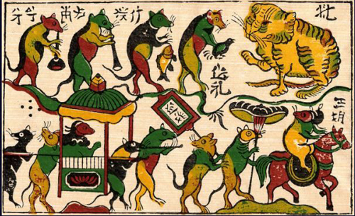
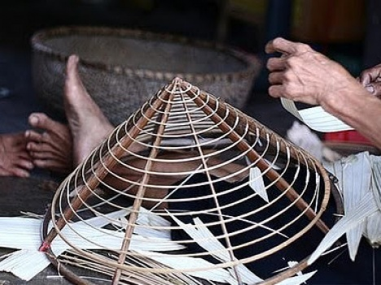
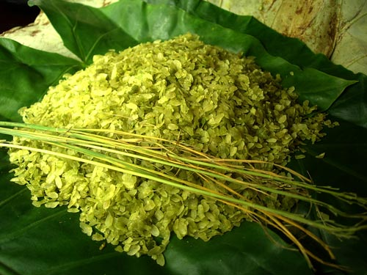
Poonah-Paper: Yen Thai village, Quang Binh province
Folklore Painting: Dong Ho painting, Bac Ninh province
Conical Hats: Chuong village, Ha Tay province
Green Young Sticky Rice: Vong village, Bac Ninh province

Slide 13

HOME ASSIGNMENTS
- Make sentences using the vocabulary
-Do D 1,2,3 (WB)

