Slide 2
Friday,February 18th 2022
Unit 9: Cities of the world
Lesson 1: Getting started p.26-27

Slide 4
Listen and read.
Match the cities with their landmarks.
Write the names of the cities in the correct place.
What city is it?
Read the conversation again and match the cities with the adjectives describing them.

Slide 5
Listen and read.
What nice photos!
Notes:
Thiếu tên bài đọc.

Slide 6
What nice photos!
Mai: Tom, are these photos from your vacations?
Tom: Yes, they are. This is Sydney, a city in Australia.
Mai: What’s it like?
Tom: It’s exciting with a lot of beaches.
Mai: What a beautiful place!
Tom: Yes, its beaches are very clean.
Mai: Wonderful. Oh, this is London. Isn’t it raining?
What bad weather!
Tom: Yes, it rains all the time. Can you see Big Ben?
Mai: Yeah ... on the River Thames. It’s a landmark of London.
Tom: It is. And this is Times Square in New York, crowded but interesting.
Mai: You’re lucky to visit many places.
Tom: I am. What about your vacations?
Mai: Here are some photos of mine. This is ...

Slide 7
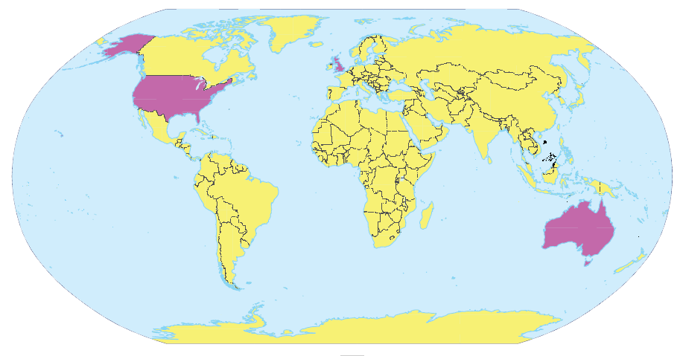
Write the names of the cities in the correct place.
1.
New York
2.
London
Sydney
London
New York
3.
Sydney

Slide 8
Read the conversation again and match the cities with the adjectives describing them.
a. rainy
1. Sydney
?
b. crowded
2. London
c. exciting
?
d. beautiful
3. New York
?
e. interesting

Slide 9
SUGGEST
What nice photos!
Mai: Tom, are these photos from your vacations?
Tom: Yes, they are. This is Sydney, a city in Australia.
Mai: What’s it like?
Tom: It’s exciting with a lot of beaches.
Mai: What a beautiful place!
Tom: Yes, its beaches are very clean.
Mai: Wonderful. Oh, this is London. Isn’t it raining? What bad weather!
Tom: Yes, it rains all the time. Can you see Big Ben?
Mai: Yeah... on the River Thames. It’s a landmark of London.
Tom: It is. And this is Times Square in New York, crowded but interesting.
Mai: You’re lucky to visit many places.
Tom: I am. What about your vacations?
Mai: Here are some photos of mine. This is…

Slide 10
SUGGEST
What nice photos!
Mai: Tom, are these photos from your vacations?
Tom: Yes, they are. This is Sydney, a city in Australia.
Mai: What’s it like?
Tom: It’s exciting with a lot of beaches.
Mai: What a beautiful place!
Tom: Yes, its beaches are very clean.
Mai: Wonderful. Oh, this is London. Isn’t it raining? What bad weather!
Tom: Yes, it rains all the time. Can you see Big Ben?
Mai: Yeah... on the River Thames. It’s a landmark of London.
Tom: It is. And this is Times Square in New York, crowded but interesting.
Mai: You’re lucky to visit many places.
Tom: I am. What about your vacations?
Mai: Here are some photos of mine. This is…

Slide 11
SUGGEST
What nice photos!
Mai: Tom, are these photos from your vacations?
Tom: Yes, they are. This is Sydney, a city in Australia.
Mai: What’s it like?
Tom: It’s exciting with a lot of beaches.
Mai: What a beautiful place!
Tom: Yes, its beaches are very clean.
Mai: Wonderful. Oh, this is London. Isn’t it raining? What bad weather!
Tom: Yes, it rains all the time. Can you see Big Ben?
Mai: Yeah... on the River Thames. It’s a landmark of London.
Tom: It is. And this is Times Square in New York, crowded but interesting.
Mai: You’re lucky to visit many places.
Tom: I am. What about your vacations?
Mai: Here are some photos of mine. This is…

Slide 12
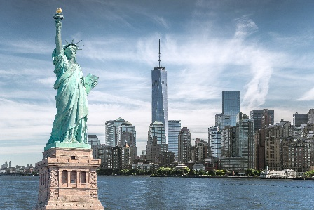
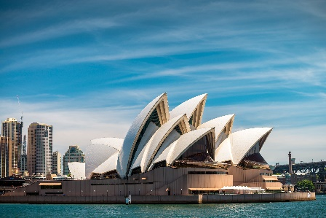
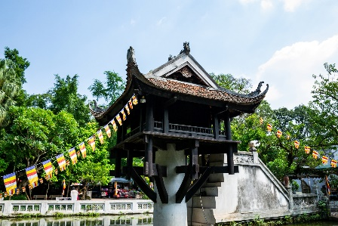
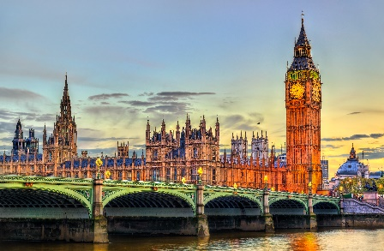
Match the cities with their landmarks.
a
1. Ha Noi
b
2. London
c
3. New York
d
4. Sydney

Slide 13
What city is it?
Example:
A: What’s it like?
B: It has beautiful beaches.
C: Is it in Australia?
B: Yes, it is.
A: It’s Sydney.
B: Right.

Slide 14
Home Assignments
Make sentences using the vocabulary.
Do EX in part A in unit 9 in WB.

