Slide 1



Slide 2

Monday,January 3rd 2022
UNIT 9:
ENGLISH IN THE WORLD
Lesson 2: A closer look 1 p.34-335

Slide 3
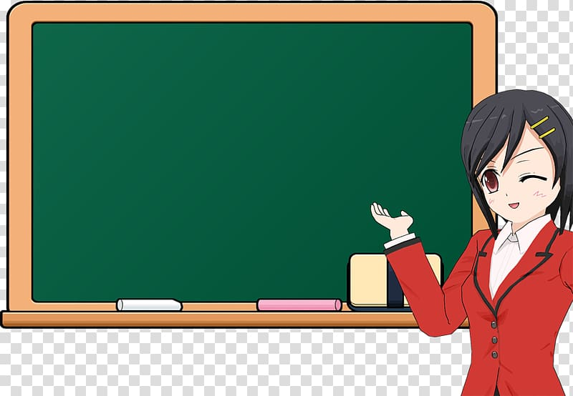

* Key words:
- bilingual (adj):
thông thạo hai thứ tiếng
He is bilingual in English and Vietnamese.
be bilingual in the language
- fluent (adj):
lưu loát
She is fluent in speaking English.
be fluent in the language
- rusty (adj):
bị mai một
My English is a bit rusty.
be a bit rusty
- pick up (v):
học lõm
I picked up a little Chinese on my holiday.
pick up a language
- get by (v):
có thể giao tiếp căn bản
He can get by in English.
get by in a language

Slide 4

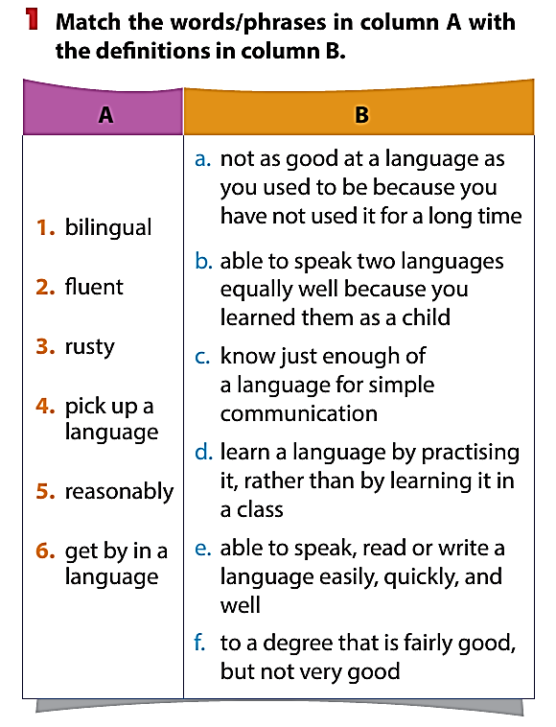
b
e
a
d
f
c

Slide 5
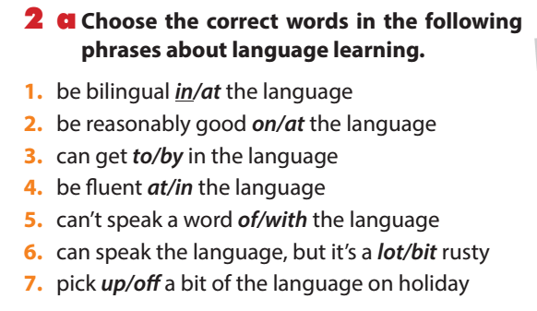

Slide 6
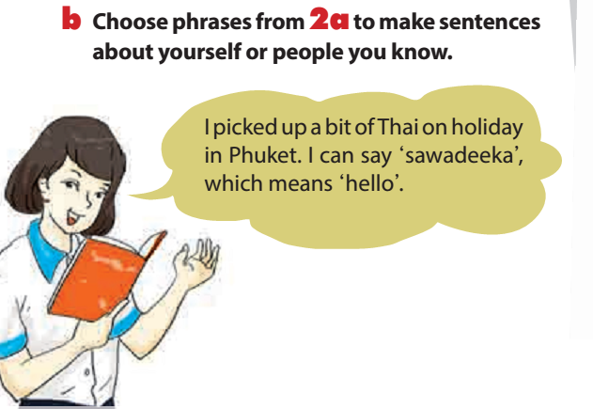

Slide 7


Kyo York is bilingual in English and Vietnamese.

Slide 8
I can speak French but it’s a bit rusty because I haven’t used it for a long time.

Slide 9
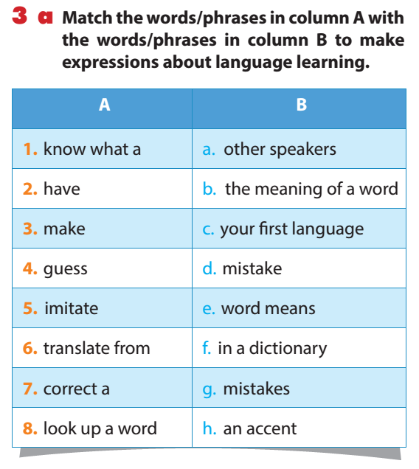
1. know what a
a. other speakers
2. have
b. the meaning of a word
3. make
c. your first language
4. guess
d. mistake
5. imitate
e. word means
6. translate from
f. in a dictionary
7. correct a
g. mistakes
8. look up a word
h. an accent

Slide 10

1. know what a word means
biết một từ có nghĩa gì
2. have an accent
có chất giọng
3. make mistakes
mắc lỗi
4. guess the meaning of a word
đoán nghĩa của 1 từ
5. imitate other speakers
bắt chước nói theo người khác
6. translate from your first language
dịch từ tiếng mẹ đẻ
7. correct a mistake
sửa lỗi
8. look up a word in a dictionary
tra từ trong từ điển

Slide 11
guess
know
have
make
translate
correct
imitate
look up
If you don’t (1) ________ what a word means, try to (2) ________ the meaning, or (3) ________ the word in your dictionary. All foreign speakers (4) ________ an accent, but that doesn’t matter. To make your pronunciation better, listen to English speakers and try to (5) ________ them. Don’t worry if you (6) ________ mistakes or don’t try to (7) ________ a mistake – that’s normal! It’s often useful to (8) ________ words from one language to the other, but it’s best when you can start to think in the new language.

Slide 12
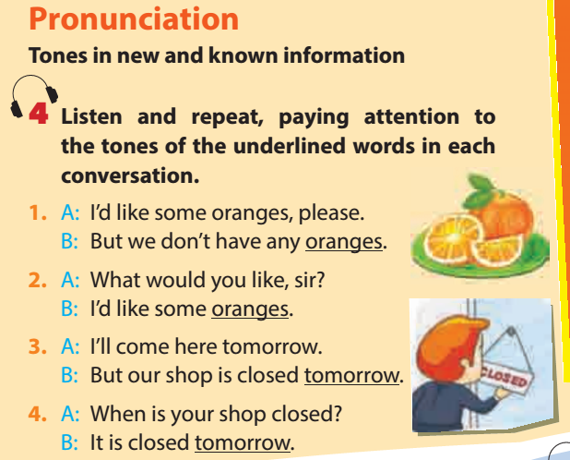









Slide 13
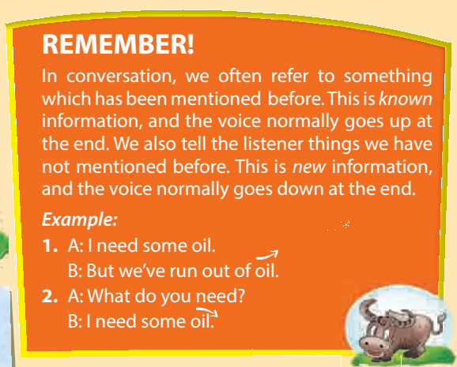

Slide 14
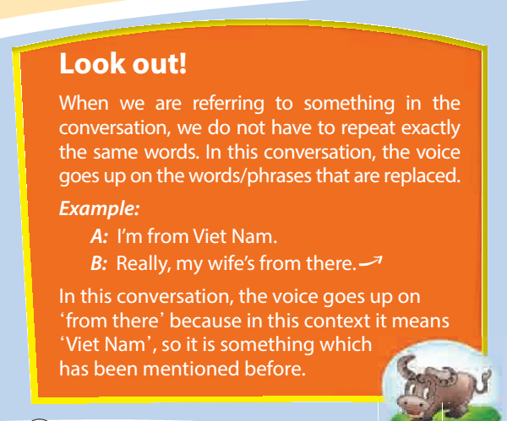

Slide 15
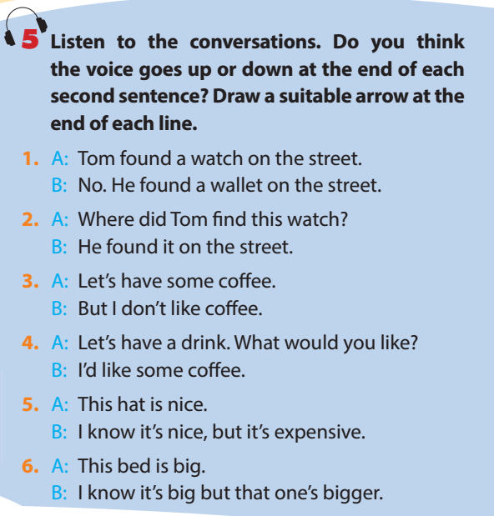

Slide 16
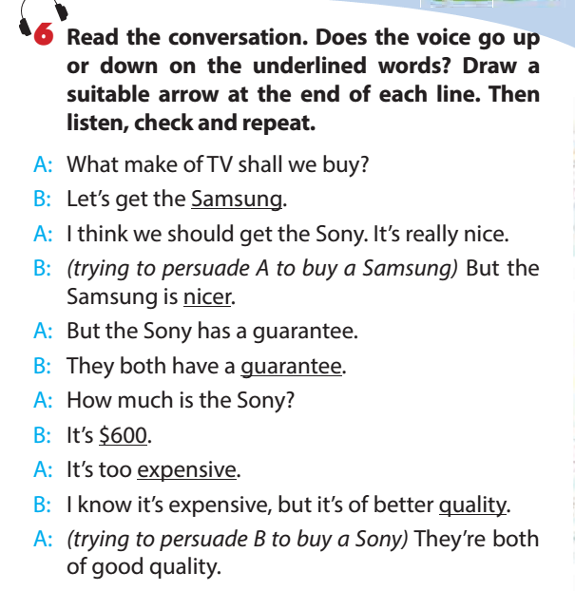


Slide 17


Home Assignments
- Make sentences using the new words and phrases
- Practice Pronunciation
-Do Ex B1,2 p.42 in MLH’s WB.

