Slide 2
LET’S PLAY
Notes:
Play a game: Break the bricks.
There is a hidden picture under the bricks.
Students play in groups and answer the questions, with each correct answer, students can break one bricks and then guess what is the hidden picture about.
The goup who has the correct answer is the winner.

Slide 3
1
2
BREAK THE BRICKS
3
4

Slide 4
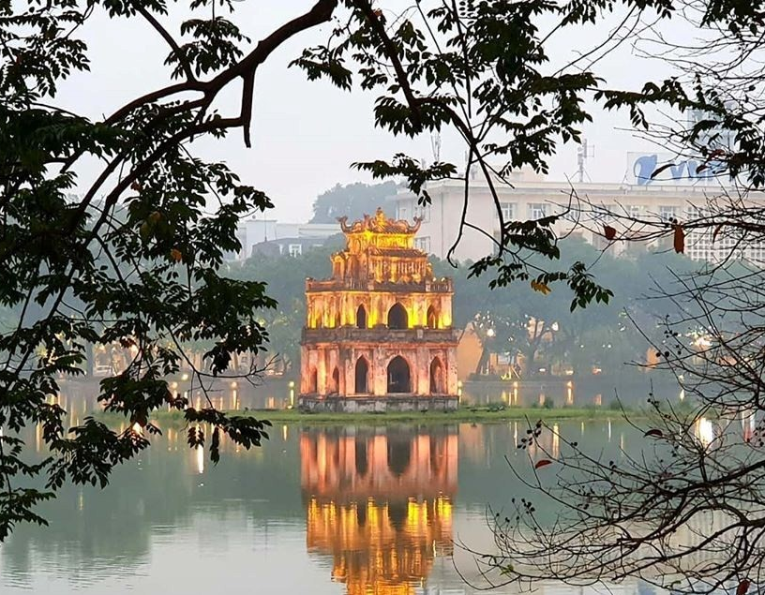
1
3
Hà Nội
Phở
North
2
4
Bún chả
four
Notes:
Click chuột để các ô gạch lần lượt rơi xuống.
Bấm vào biểu tượng chìa khóa để show đáp án.

Slide 5
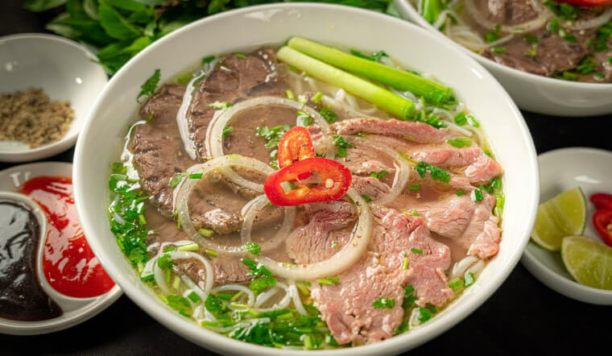
What dish is it?
1
P
H
Ở

Slide 6
The South and the _____ of Việt Nam.
2
N
O
R
T
H

Slide 7
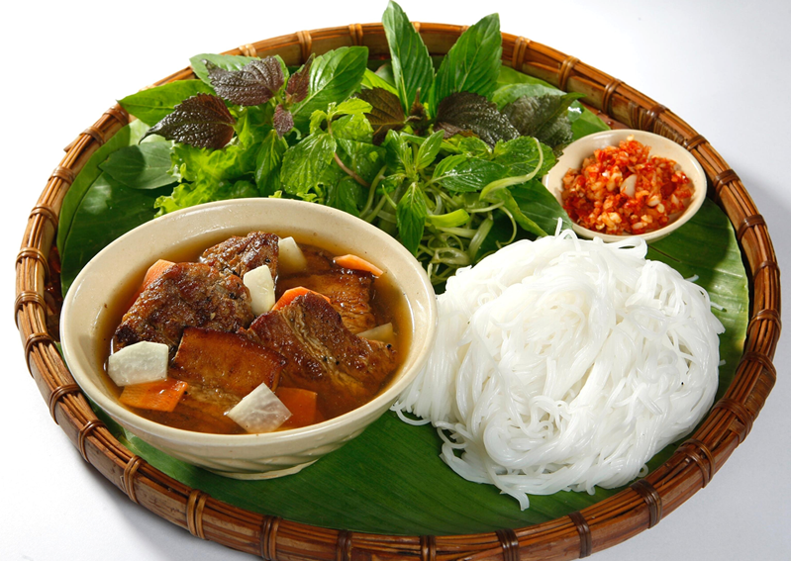
What dish is it?
3
B
Ú
N
C
H
Ả

Slide 8
How many seasons are there in the North of Việt Nam?
4
F
O
U
R

Slide 9
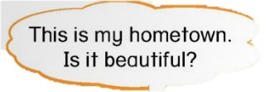
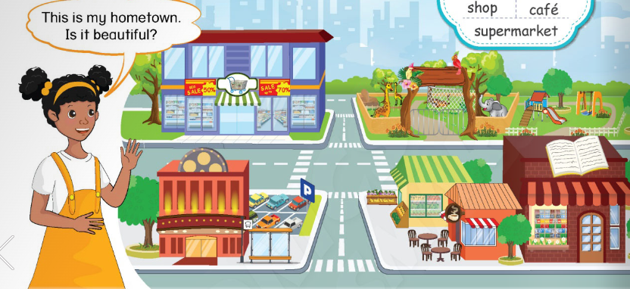
UNIT 5 – Places and Directions
Learn more

Slide 10
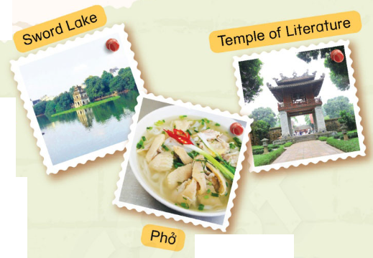
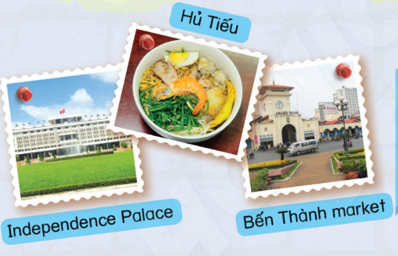
1
Listen and read.
Notes:
Ask students to look at the pictures and ask them What is the picture about? Where is it located?/ Where can we eat these food?
- Ask students if they visited Hà Nội or Hồ Chí Minh City. Where did they visit and what did they eat in Hà Nội/Hồ Chí Minh?
Teach the new words: Sword Lake, Temple of Literature, Phở, Hủ tiếu, Independence Palace, Bến Thành market.
Play the audio for students to listen and repeat new words.

Slide 11
1
Listen and read.
Ha Noi
Notes:
Ask students to look at the pictures and ask them What is the picture about? Where is it located?/ Where can we eat these food?
- Ask students if they visited Hà Nội or Hồ Chí Minh City. Where did they visit and what did they eat in Hà Nội/Hồ Chí Minh?
Teach the new words: Sword Lake, Temple of Literature, Phở, Hủ tiếu, Independence Palace, Bến Thành market.
Play the audio for students to listen and repeat new words.

Slide 12
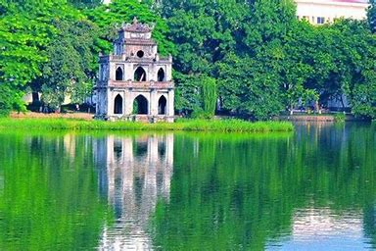
Sword lake

Slide 13
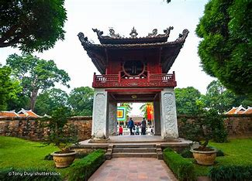
Temple of Literature

Slide 14
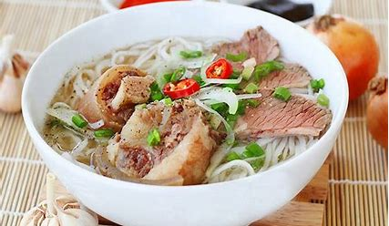
Pho

Slide 15
1
Listen and read.
Ho Chi Minh City
Notes:
Ask students to look at the pictures and ask them What is the picture about? Where is it located?/ Where can we eat these food?
- Ask students if they visited Hà Nội or Hồ Chí Minh City. Where did they visit and what did they eat in Hà Nội/Hồ Chí Minh?
Teach the new words: Sword Lake, Temple of Literature, Phở, Hủ tiếu, Independence Palace, Bến Thành market.
Play the audio for students to listen and repeat new words.

Slide 16
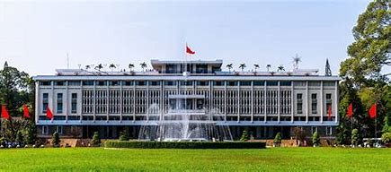
Independence Palace

Slide 17
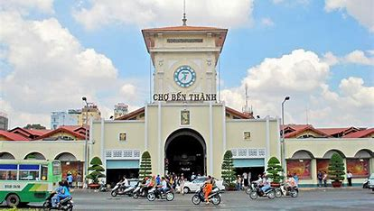
Ben Thanh Market

Slide 18
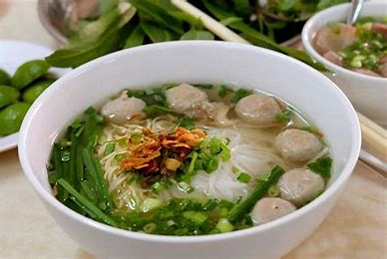
Hu Tieu

Slide 19
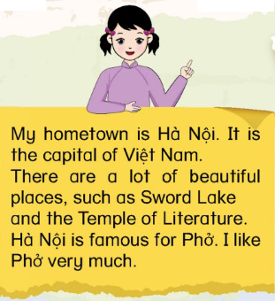
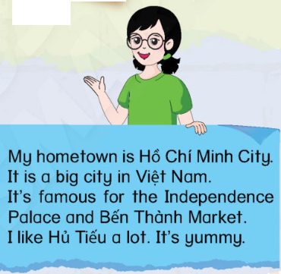
1
Listen and read.
Notes:
Tell students that they are going to read about Hà Linh’s and Emma’s hometowns.
Play the audio for students to listen the two girls talk about their hometowns.
Ask stude nts to listen and repeat each sentences.
Give time for students to read the two paragraphs.
Students work in pairs: one student points, one student reads.

Slide 20
1
Listen and read.
Answer the questions
1. Where is Hà Linh’s hometown?
2. Where is Emma’s hometown?
3. Is Sword Lake in Hà Nội?
4. What is Hồ Chí Minh City famous for?
5. Does Hà Linh like phở?
6. What does Emma like to eat in her hometown?
Notes:
Ask students to read the text and answer the questions.

Slide 21
1
Listen and read.
Answer the questions
Where is Hà Linh’s hometown?
Where is Emma’s hometown?
3. Is Sword Lake in Hà Nội?
4. What is Hồ Chí Minh City famous for?
5. Does Hà Linh like phở?
6. What does Emma like to eat in her hometown?
Hà Linh’s hometown is Hà Nội.
Emma’s hometown is Hồ Chí Minh City.
Yes, it is.
It’s famous for Independence Palace and Bến Thành market.
Yes, she is.
She likes Hủ Tiếu.
Notes:
Correct students’ answers and give feedback.

Slide 22
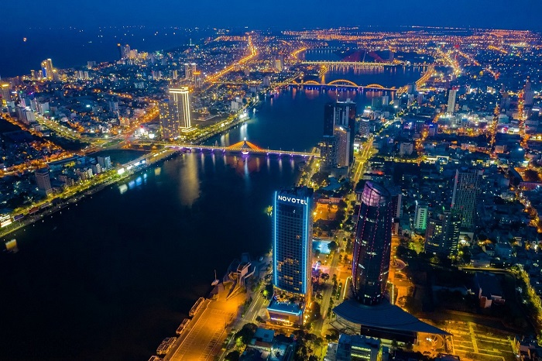
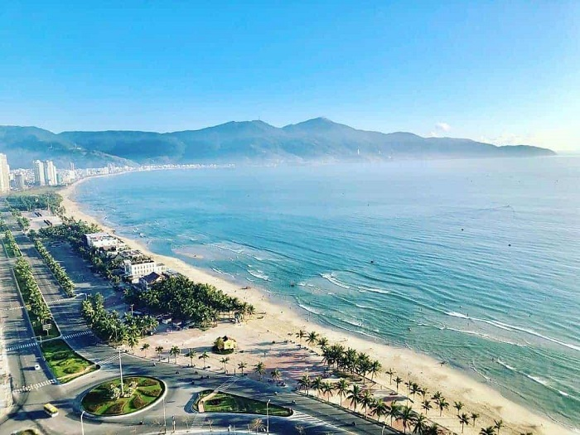
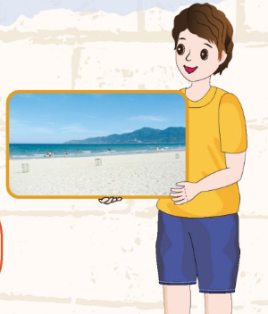
2
Talk about your hometown.
Đà Nẵng
Mỹ Khê Beach
Notes:
Ask students to look at the picture that Tom is holding.
Ask students what the picture is about? If they know where is it?
Introduce Tom’s hometown – Đà Nẵng and Mỹ Khê beach to the students.
Ask students share something they know about Đà Nẵng and Mỹ Khê beach.

Slide 23
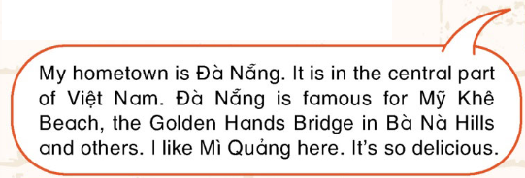
2
Talk about your hometown.
Notes:
Focus the students on Tom’s bubbles, read what Tom introduce about his hometown and answer the questions:
What is the name of Tom’s hometown?
What is Tom’s hometown famous for?
What do Tom like to eat in his hometown?

Slide 24
2
Talk about your hometown.
1. What is the name of Tom’s hometown?
2. What is Tom’s hometown famous for?
3. What does Tom like to eat in his hometown?
Notes:
Focus the students on Tom’s bubbles, read what Tom introduce about his hometown and answer the questions:
What is the name of Tom’s hometown?
What is Tom’s hometown famous for?
What do Tom like to eat in his hometown?

Slide 25
2
Talk about your hometown.
What is the name of Tom’s hometown?
What is Tom’s hometown famous for?
What do Tom like to eat in his hometown?
Tom’s hometown is Đà Nẵng.
Đà Nẵng is famous for Mỹ Khê Beach, the Golden Hand Bridge in Bà Nà Hills and others.
Tom likes Mì Quảng.
Notes:
Focus the students on Tom’s bubbles, read what Tom introduce about his hometown and answer the questions:
What is the name of Tom’s hometown?
What is Tom’s hometown famous for?
What do Tom like to eat in his hometown?

Slide 26
2
Talk about your hometown.
What is the name of your hometown?
What is it famous for?
+ Places
+ Foods and drinks
Notes:
Tell the students that they are going to share about their hometown, using the suggested questions.
What is the name of your hometown?
What is it famous for?
+ Places
+ Foods and drinks
Give students time to do the task.
Ask students to work in groups of 3 and talk about their hometown.
Invite some students to share about their hometown in front of class.
Give feedback.
Focus students on the Fact, look and read it aloud. Ask students name some big and beautiful cities in Vietnam.

Slide 27
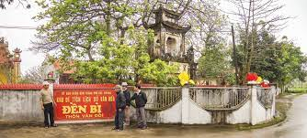
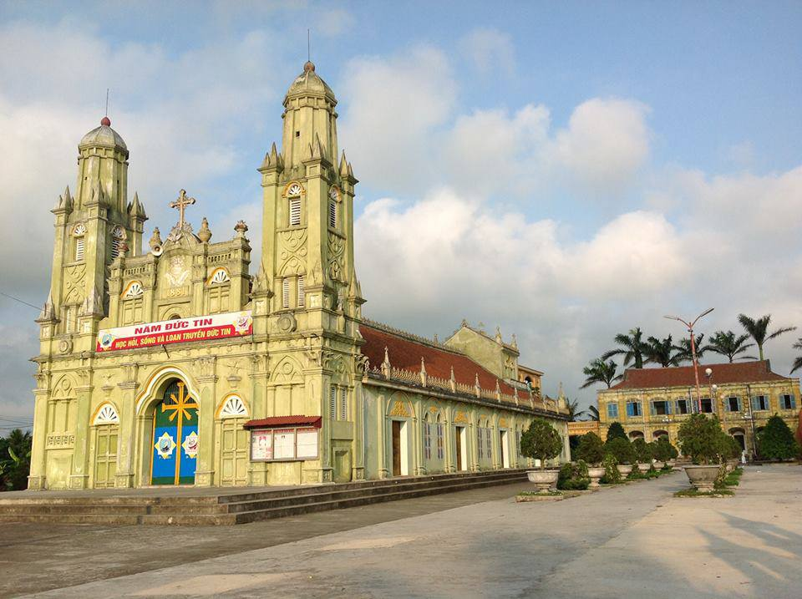
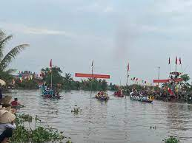
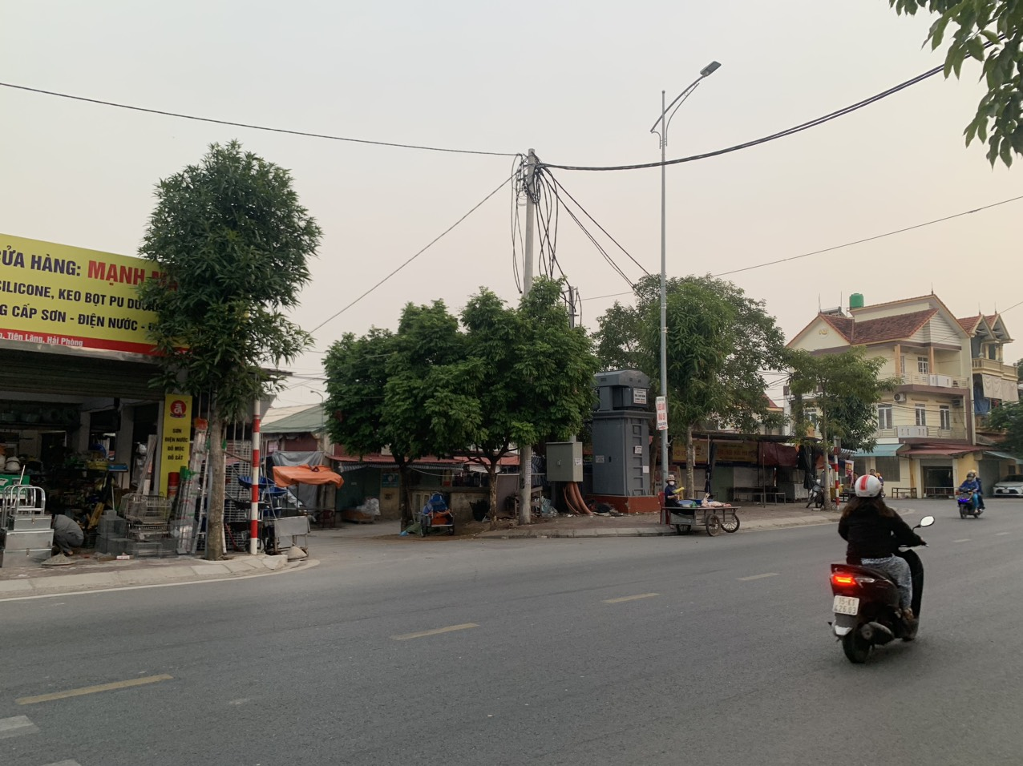
2
Talk about your hometown.
What is the name of your hometown?
What is it famous for?
+ Places
+ Foods and drinks
Notes:
Tell the students that they are going to share about their hometown, using the suggested questions.
What is the name of your hometown?
What is it famous for?
+ Places
+ Foods and drinks
Give students time to do the task.
Ask students to work in groups of 3 and talk about their hometown.
Invite some students to share about their hometown in front of class.
Give feedback.
Focus students on the Fact, look and read it aloud. Ask students name some big and beautiful cities in Vietnam.

Slide 28
My hometown is Doan Lap
Doan Lap is famous for Bi Temple, Dong Xuyen Church, Boat race festival and Dam Market.
Notes:
Tell the students that they are going to share about their hometown, using the suggested questions.
What is the name of your hometown?
What is it famous for?
+ Places
+ Foods and drinks
Give students time to do the task.
Ask students to work in groups of 3 and talk about their hometown.
Invite some students to share about their hometown in front of class.
Give feedback.
Focus students on the Fact, look and read it aloud. Ask students name some big and beautiful cities in Vietnam.

Slide 29
VALUE
Hà Nội, Đà Nẵng and Hồ Chí Minh City are big and beautiful cities in Việt Nam.
Notes:
Focus students on the Fact, look and read it aloud. Ask students name some big and beautiful cities in Vietnam.

Slide 30
… Day … Month …. Date … Year
Unit 5: Place and Directions
Learn more
Vocabulary
Sword Lake, Temple of Literature, Phở, Hủ tiếu, Independence Palace, Bến Thành market
Notes:
Review all the words they have learned by using flashcards.
Count the stars.
Give compliments.

Slide 31
WRAP UP
Notes:
Review all the words they have learned by using flashcards.

Slide 32
CÔNG TY CỔ PHẦN PHÁT TRIỂN GIÁO DỤC
VIỆT NAM VPBOX
Hà Nội
Tầng 2, Nhà A, Nhà Khách La Thành, số 226 Vạn Phúc, P.Liễu Giai,
Quận Ba Đình, Hà Nội.
ĐT: (024) 3 3793 2405
phonics.hanoi@vpbox.edu.vn
Thành Phố Hồ Chí Minh
Số 270A, Lý Thường Kiệt, P.14, Quận 10.
ĐT: (028) 3 820 5934
phonics.hcm@vpbox.edu.vn
www.vpbox.edu.vn
https://phonics-smart.edu.vn

