Slide 1
Things we can do
5
LESSON 2 P1,2,3

Slide 2
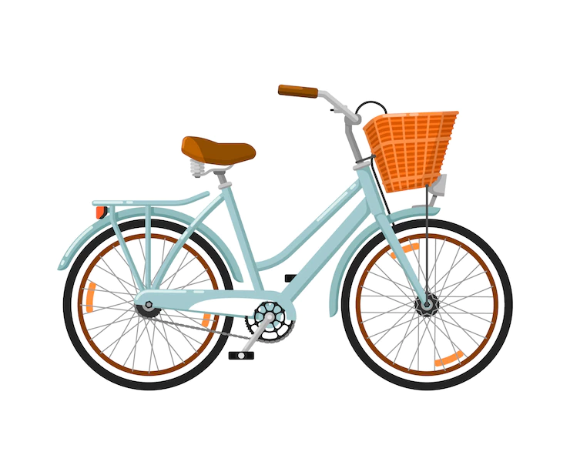
What can you do ?
I can ride a bike.

Slide 3
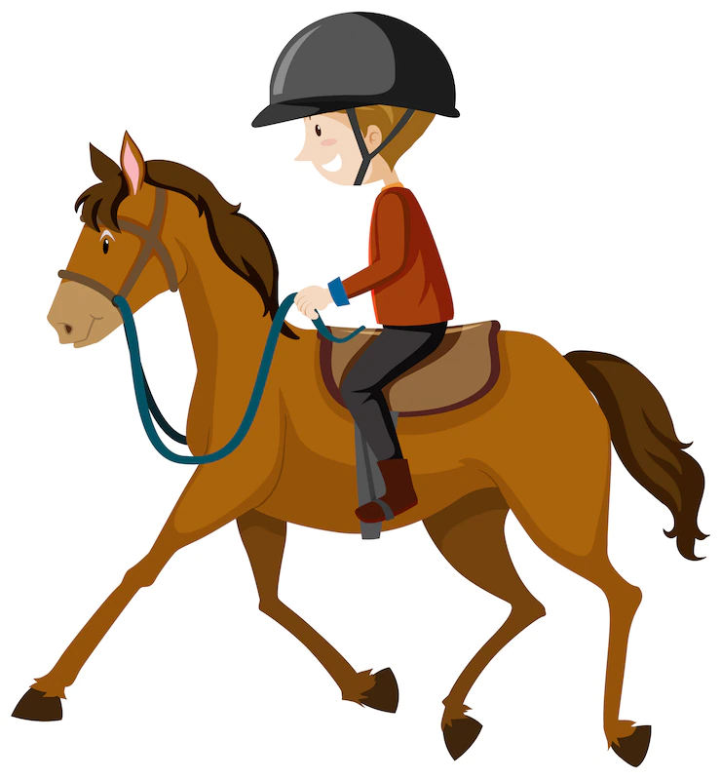
What can you do ?
I can ride a horse.

Slide 4
What can you do ?
I can fly a kite.

Slide 5
What can you do ?
I can play the piano.

Slide 6
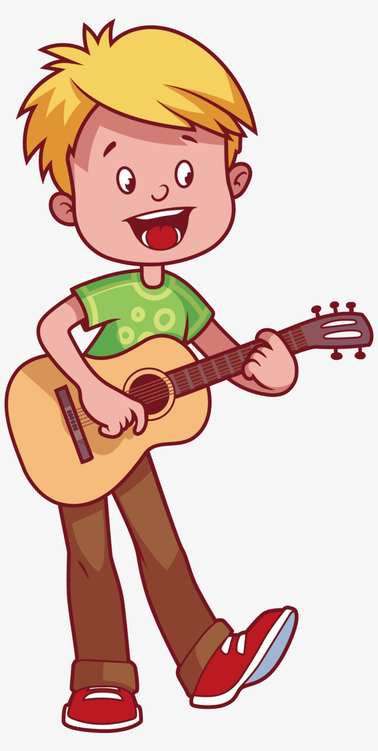
What can you do ?
I can play the guitar.

Slide 7
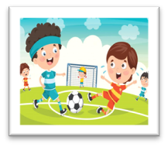
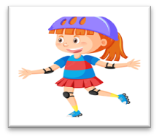
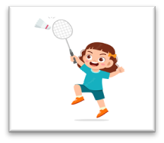
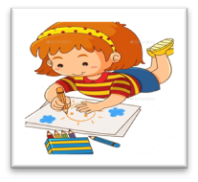
Play football
Cook
Swim
Roller skate
Play badminton
Draw
Notes:
Click the card to show the words/picture. Click again to turn it face down.

Slide 8
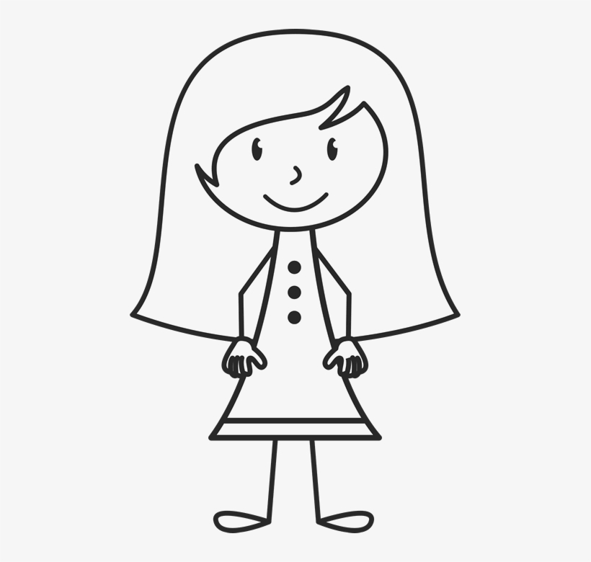
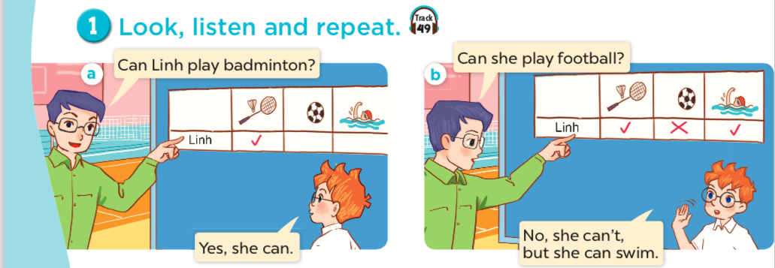
Who is Linh?
What can Linh do?
What can't Linh do?
a girl

Slide 9
Can Mary cook?
she
Yes, she can.

Slide 10
Can she swim?
No, she can't, but she can cook.

Slide 11
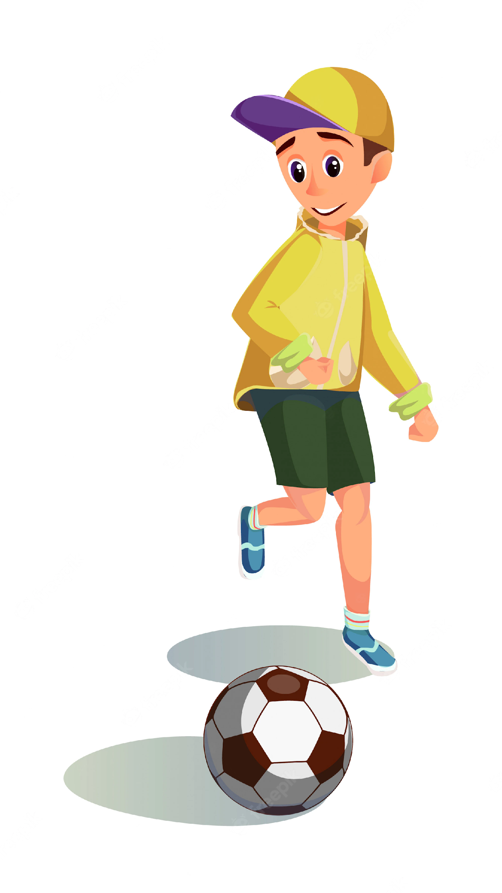
Can Ben play football?
he
Yes, he can.

Slide 12
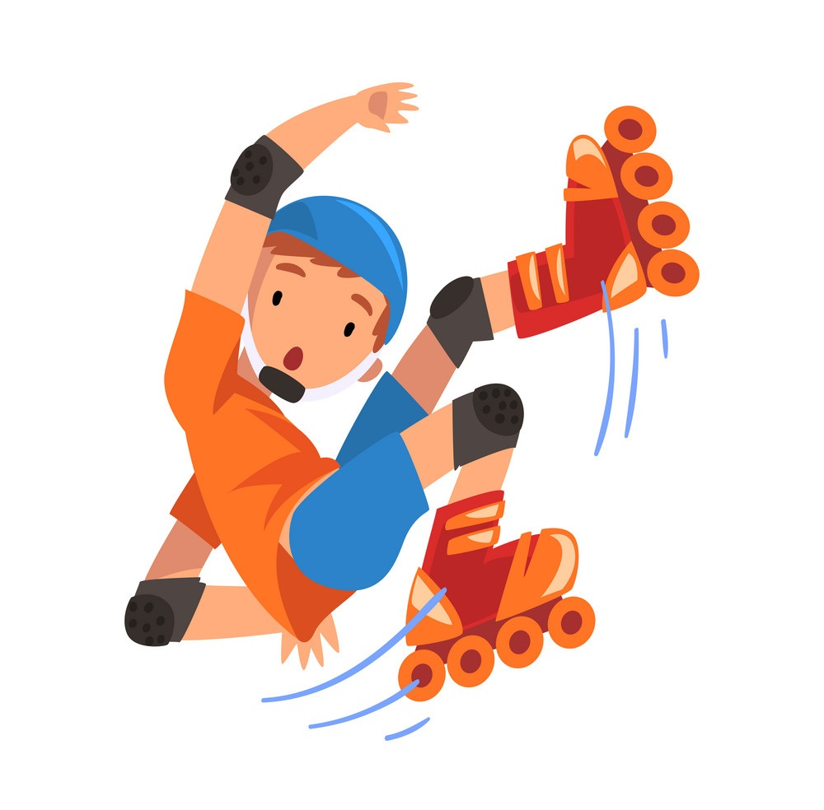
Can he roller skate?
No, he can't,
but he can play football.

Slide 13
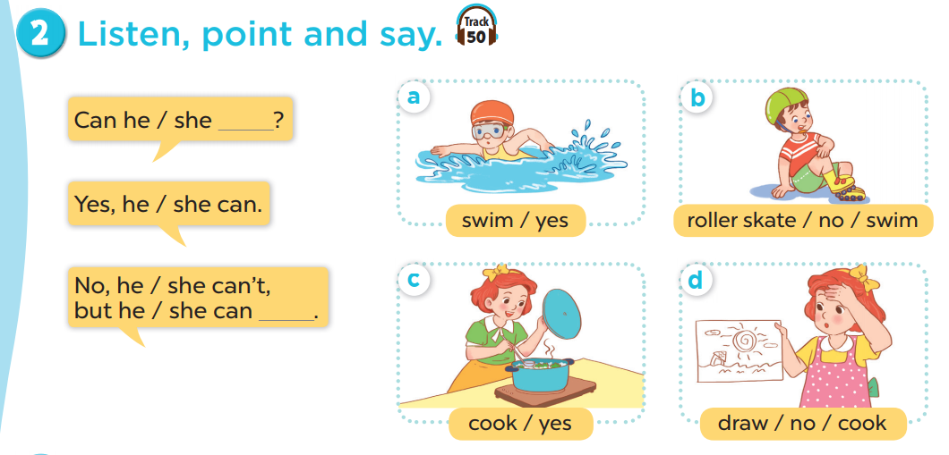
Work in pairs. Practise.
Listen, point and say.

Slide 14
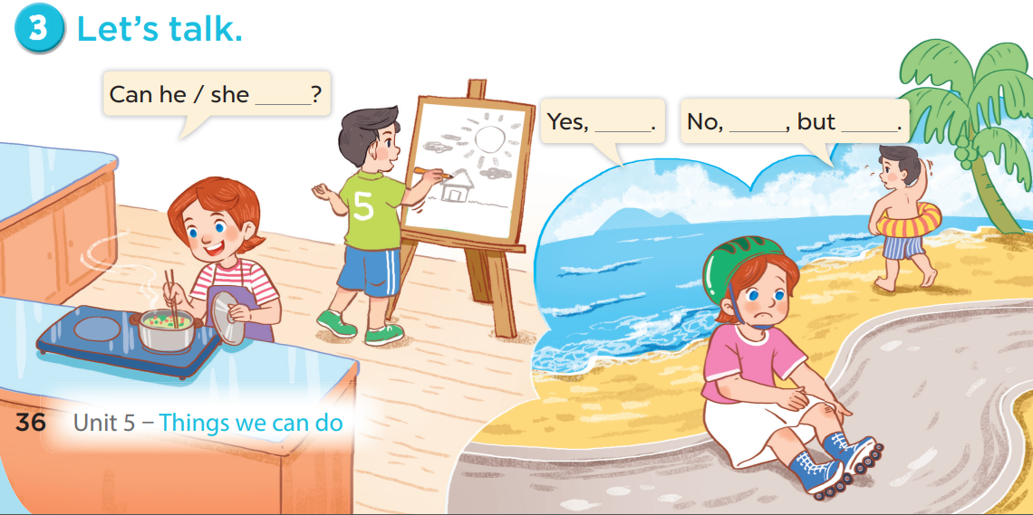

Slide 15
Games

Slide 16
Notes:
CLICK THE CLOUD – GO TO PART 4

Slide 17
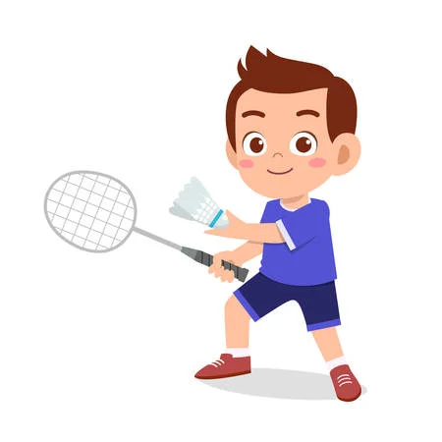
Can he _______________?
play badminton
____, he can.
Yes
Notes:
CLICK PINK AMONG US – GO TO THE POINTS

Slide 18
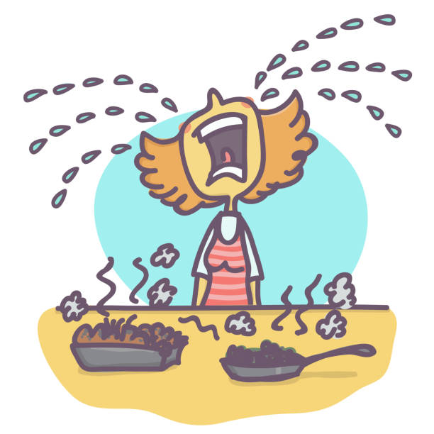
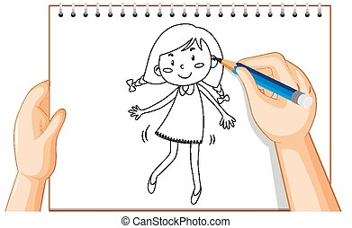
Can she cook?
No
____, she can't,
but she can _____.
draw
Notes:
CLICK PINK AMONG US – GO TO THE POINTS

Slide 19
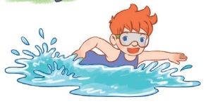
Can he ________?
swim
Yes, he _____.
can
Notes:
CLICK PINK AMONG US – GO TO THE POINTS

Slide 20
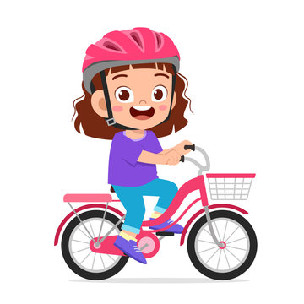
Can she ____________?
ride a bike
Yes, ________.
she can
Notes:
CLICK PINK AMONG US – GO TO THE POINTS

Slide 21
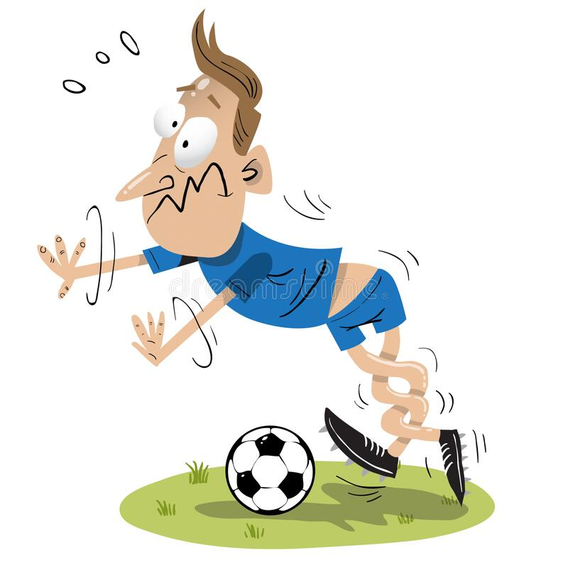
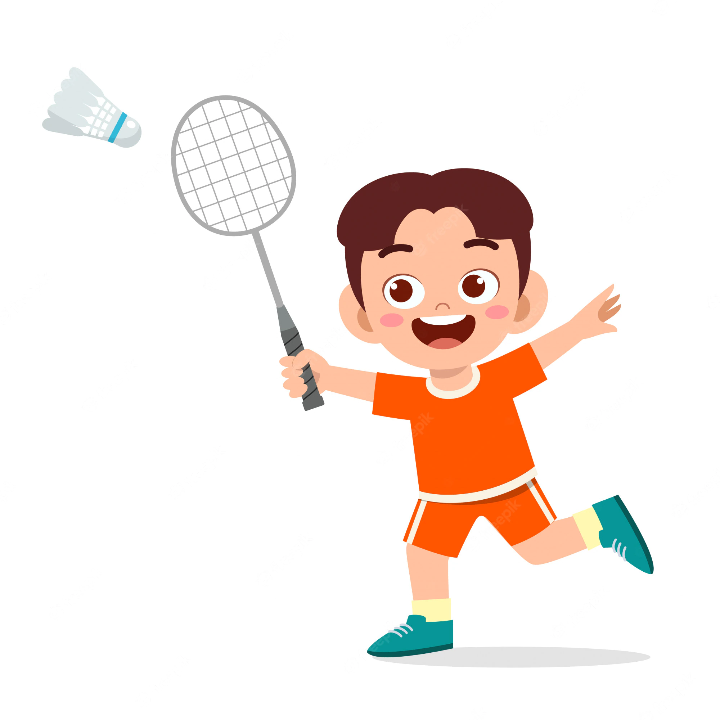
Can he play football ?
No
____, he can't,
but he can ______________.
play badminton
Notes:
CLICK PINK AMONG US – GO TO THE POINTS

Slide 22
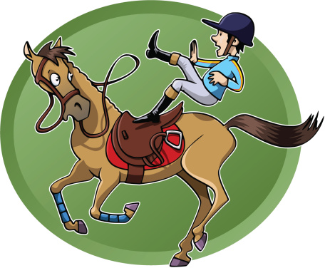
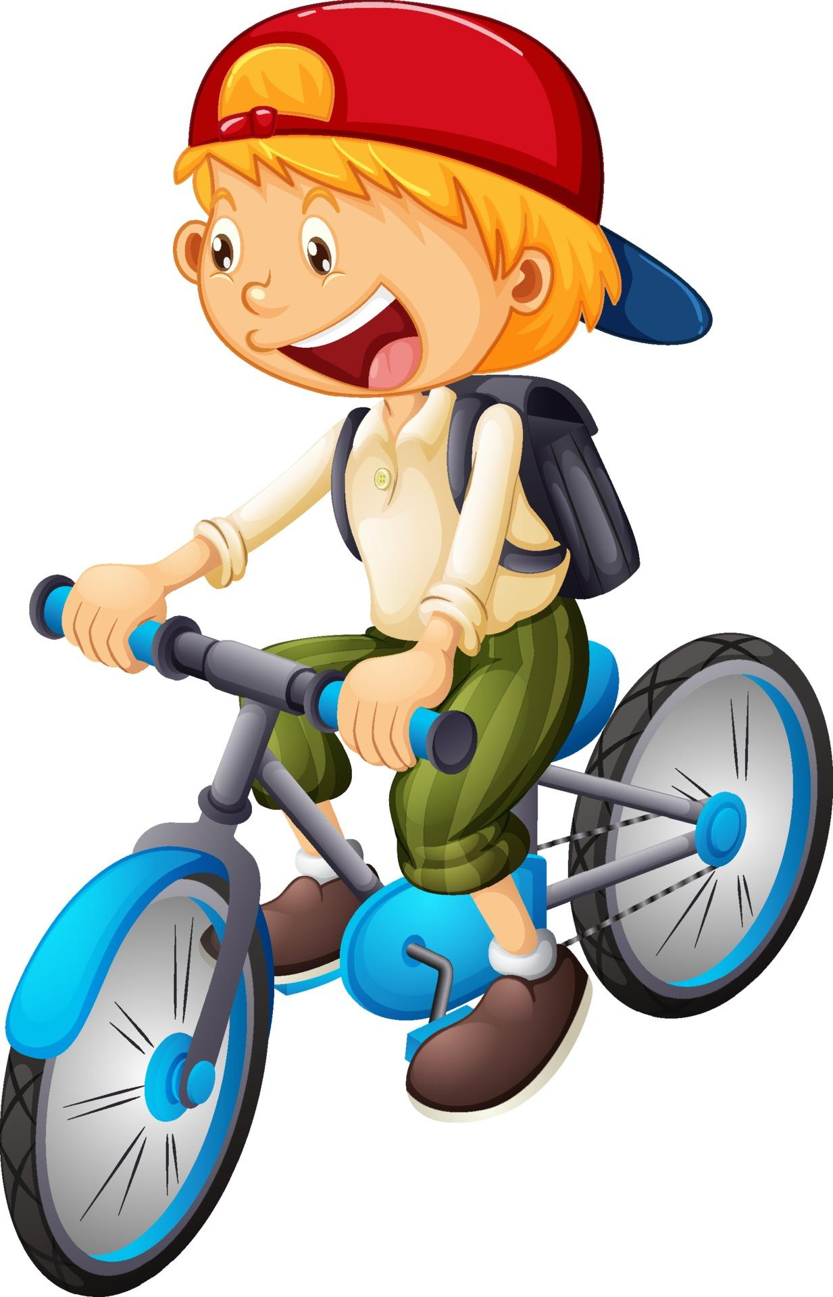
Can he ride a horse ?
can't
No, he ______,
but he _____ ride a bike.
can
Notes:
CLICK PINK AMONG US – GO TO THE POINTS

Slide 23
Can _____ play the piano?
she
Yes, _______.
she can
Notes:
CLICK PINK AMONG US – GO TO THE POINTS

Slide 24
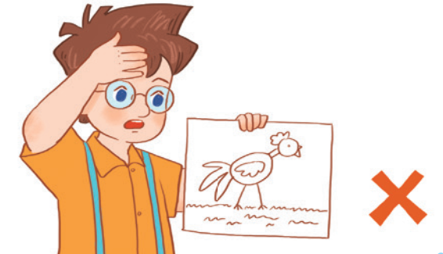
Can he ________?
draw
____, he _____.
No
can't
Notes:
CLICK PINK AMONG US – GO TO THE POINTS

