Slide 2
Period 3

Slide 3
Contents
1. Warm-up and review
2. Find, circle and match.
3. Quiz time
4. Look and match.
5. Fun corner and wrap-up

Slide 4
1.Warm-up and review

Slide 5
Warm-up
Who is
FASTER?!!!
Notes:
Divide the class into 2 big groups. Each group has a leader to check their group’s work.
Teacher sticks the flashcards and writes numbers 1-6 on the board.
Teacher says a number, each member from 2 groups says the word.

Slide 6
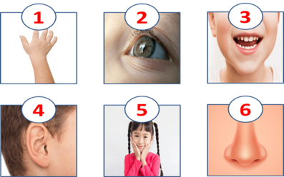

Slide 7
WORD
GAME
Notes:
- Teacher uses flashcards to review vocabulary from Unit 1 to Unit 5.
- Then asks pupils to look at the given letter, rearrange them to find the correct word.
- Teacher gives points or candies to the fastest pupil with the correct answer.

Slide 8
Question
1
N
B
E
Hint: This is a name.

Slide 9
Question
1
B
E
N

Slide 10
Question
2
A
F
C
E
Hint: This is a part of your body.

Slide 11
Question
2
F
A
C
E

Slide 12
Question
3
E
T
H
G
I
Hint: This is a number.

Slide 13
Question
3
E
I
G
H
T

Slide 14
Question
4
W
I
S
M
G
N
M
I
Hint: This is a hobby.

Slide 15
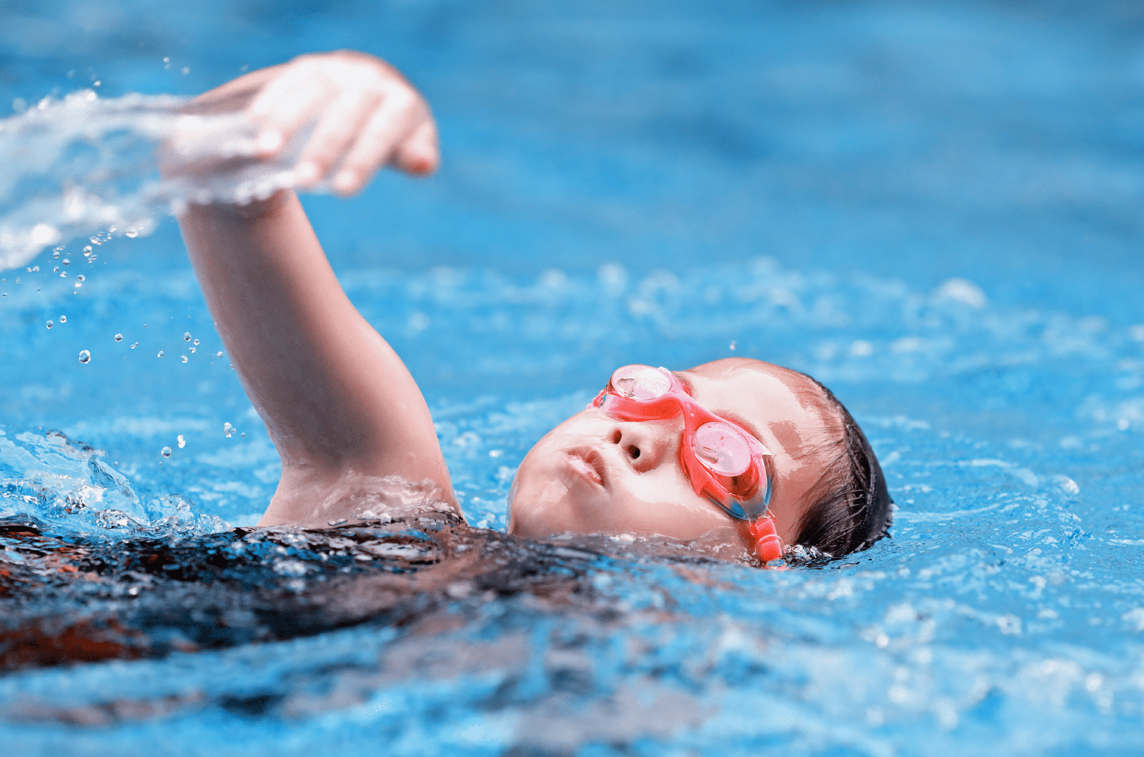
Question
4
S
W
I
M
M
I
N
G

Slide 16
2. Find, circle
and match

Slide 17
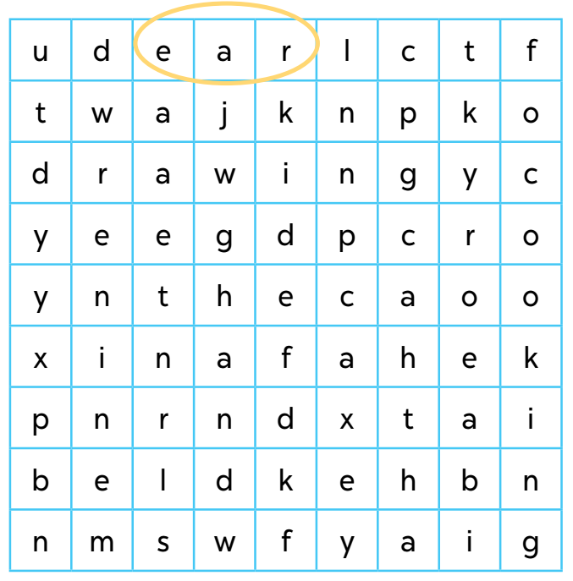
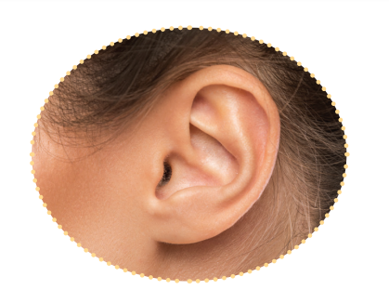

Slide 24
2. Quiz time

Slide 25
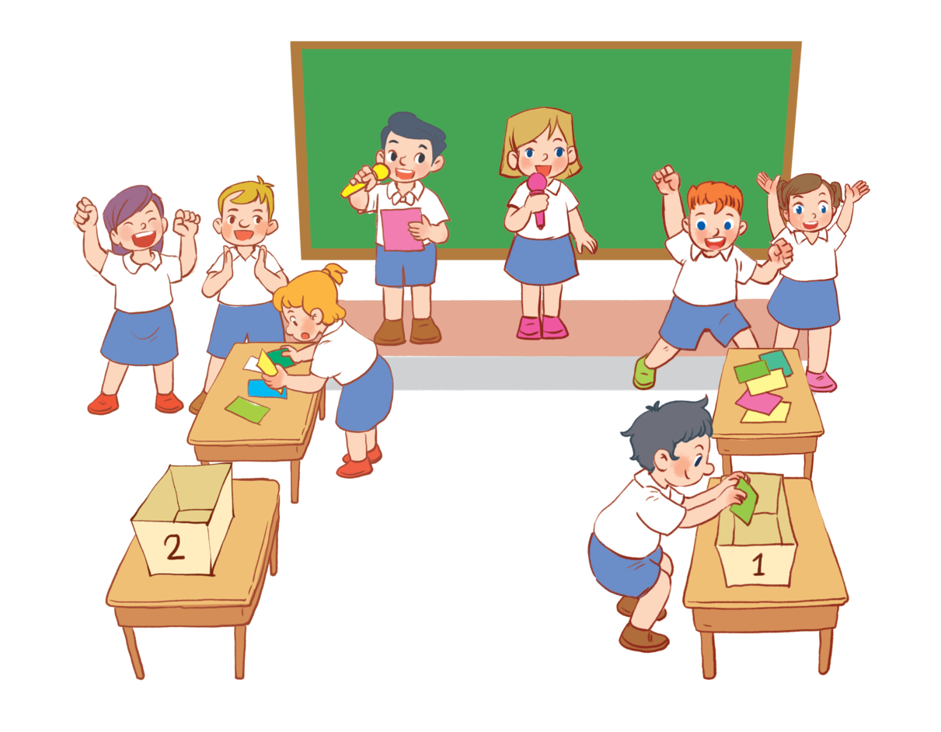

Slide 26
3. Look and match.

Slide 27
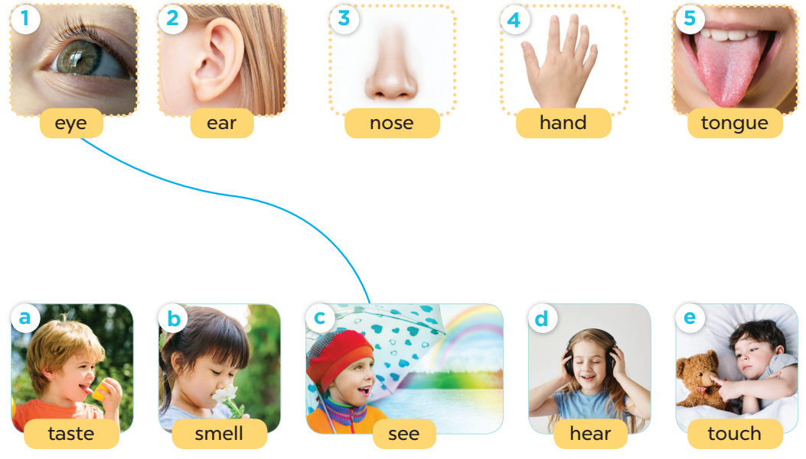

Slide 28
5. Fun corner and wrap-up

Slide 29
Game time!
Notes:
Vocabulary review.

Slide 30
We can use THIS BODY PART to smell.
a nose
Notes:
A nose

Slide 31
2. It’s between Number six and eight.
seven
Notes:
Number 7

Slide 32
3. We say it to greet people.
Hello/ Hi!
Notes:
Hello/ Hi!

Slide 33
4. We can use this to listen to music.
an ear
Notes:
dancing

Slide 34
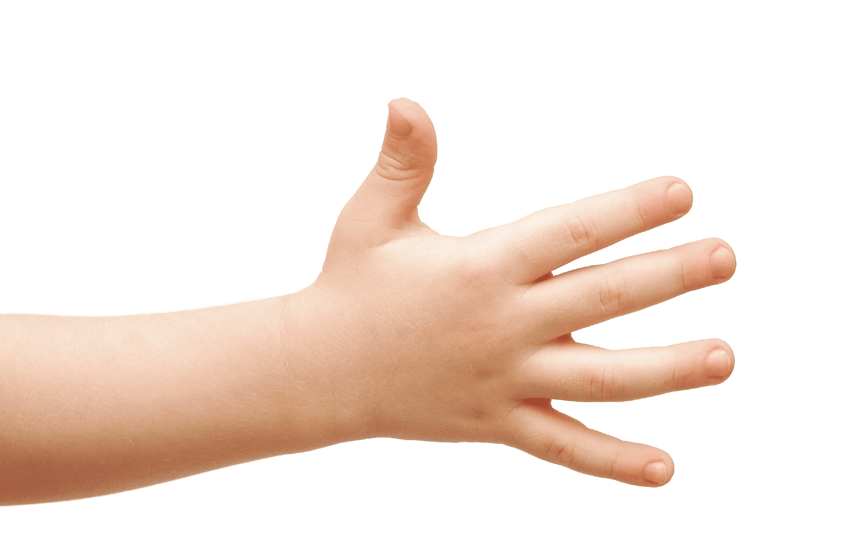
5. We use it to touch things.
a hand
Notes:
A hand

Slide 35
Website:sachmem.vn
Fanpage: www.facebook.com/sachmem.vn

